Slide 1

This PowerPoint has been designed for use with the workbook:
GM3 BIVARIATE DATA
Workbooks, resources and PowerPoints are available at BertramEducation.com

Slide 2


Statistics is the science of collecting, analysing, interpreting, and presenting data. Understanding data allows us to make predictions, test ideas, and draw conclusions about real-world situations.
In this unit you will focus on bivariate data analysis (relationships between two variables) and time series analysis (patterns over time).
Workbook
page
1

Slide 3

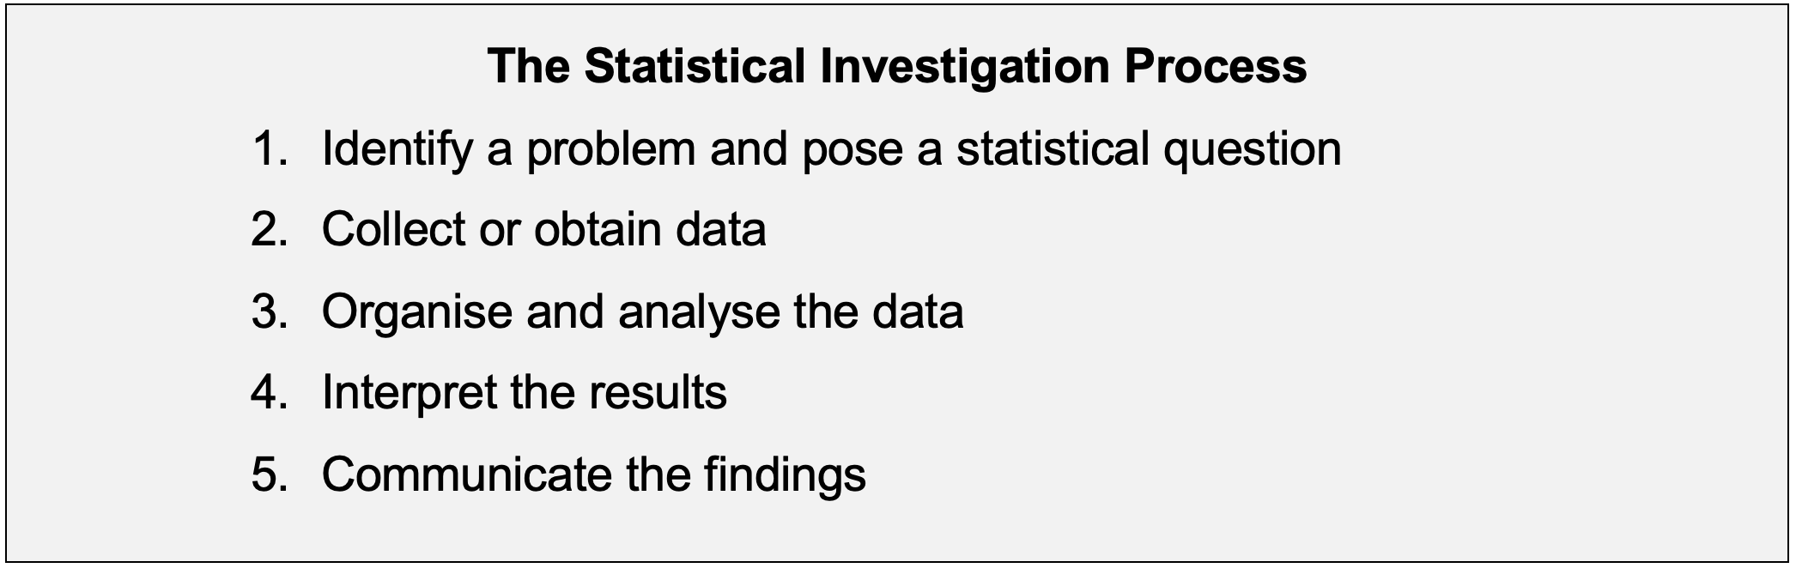
THE STATISTICAL INVESTIGATION PROCESS
Workbook
page
1

Slide 4

EXAMPLE INVESTIGATION
This example investigation shows you the ‘big picture’ of what the investigation process looks like in action.
Scenario: A school canteen wants to know if increasing advertising for fruit smoothies will lead to more sales. They ask a group of TCE general maths students to help them investigate.
Workbook
page
2

Slide 5
EXAMPLE INVESTIGATION
Step 1: Identify the problem and pose a statistical question
“Does the number of advertising posters affect smoothie sales?”
Step 2: Collect or obtain data
Students record the number of posters displayed and the number of fruit smoothies sold over the course of 10 weeks. They vary how many posters are displayed each week.
Workbook
page
2

Slide 6
EXAMPLE INVESTIGATION
Step 3: Organise and analyse the data
Data is collected in a two-way frequency table and then plotted as a scatterplot. They use the data to create a range of graphs showing the results.
Students use their statistics skills to find a linear relationship between the number of posters and the number of sales. They calculated the correlation coefficient to quantify the strength of the relationship.
Workbook
page
2

Slide 7
EXAMPLE INVESTIGATION
Step 4: Interpret the results
Students analyse the data to look for patterns, associations and causation.
They posed questions like: what happens to smoothie sales as the number of posters increase? Could things other than the number of posters be affecting sales?
A strong positive relationship was identified - more posters generally lead to more smoothies sold.
Workbook
page
2

Slide 8
EXAMPLE INVESTIGATION
Step 5: Communicate the findings
The students prepared a report of their findings and advised the canteen that increasing advertising may increase sales.
You will complete multiple investigations throughout this course.
Workbook
page
2

Slide 9
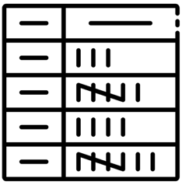
TWO-WAY FREQUENCY TABLES
A two-way frequency table is used to organise data about two variables at the same time.
They show how often combinations of the two variables occur.
Two-way frequency tables are useful for:
  Organising raw data for analysis
  Comparing categories across variables
  Calculating percentages to identify patterns and associations
Workbook
page
3

Slide 10


TWO-WAY FREQUENCY TABLES
Worked example.
The school board wants to know how engaged TCE students are in sport.
They survey 50 TCE students from their school and ask them the following questions:
Do you play a sport? (Yes / No)
Are you in Year 11 or Year 12?
Workbook
page
3

Slide 11
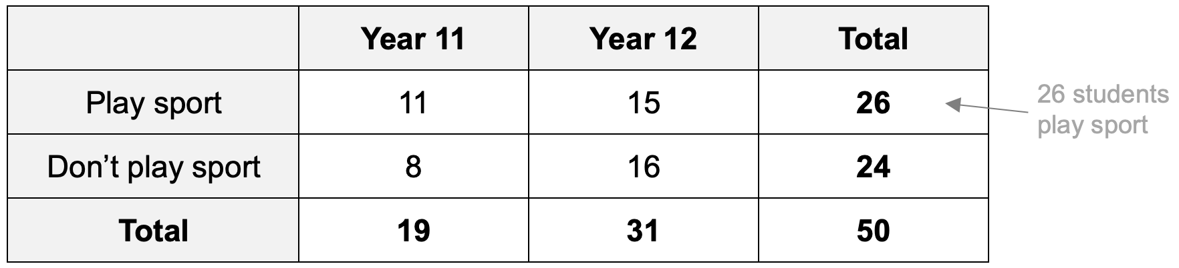
TWO-WAY FREQUENCY TABLES
Worked example (continued).
From the survey they create a two-way frequency table.
The rows (horizontal →) represent whether or not students play a sport.
The columns (vertical ↓) represent the year level of the students.
Workbook
page
3

Slide 12
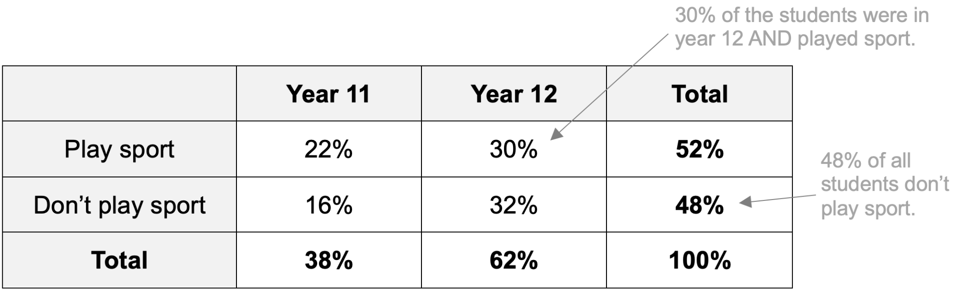
TWO-WAY FREQUENCY TABLES
Worked example (continued).
Percentages can be used in two-way frequency tables.
From analysing the overall percentages, we can see that:
Overall, 52% of the TCE students play sport
More year 12 students (62%) play sport than year 11 students (38%)
Year 12 students are over-represented in the sample (62% of respondents)
Workbook
page
3

Slide 13
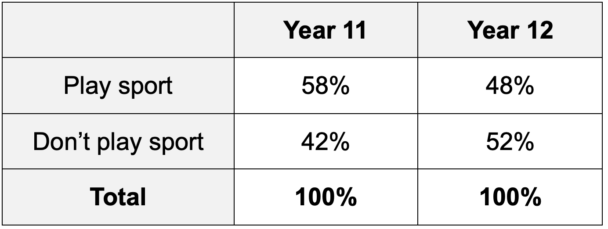
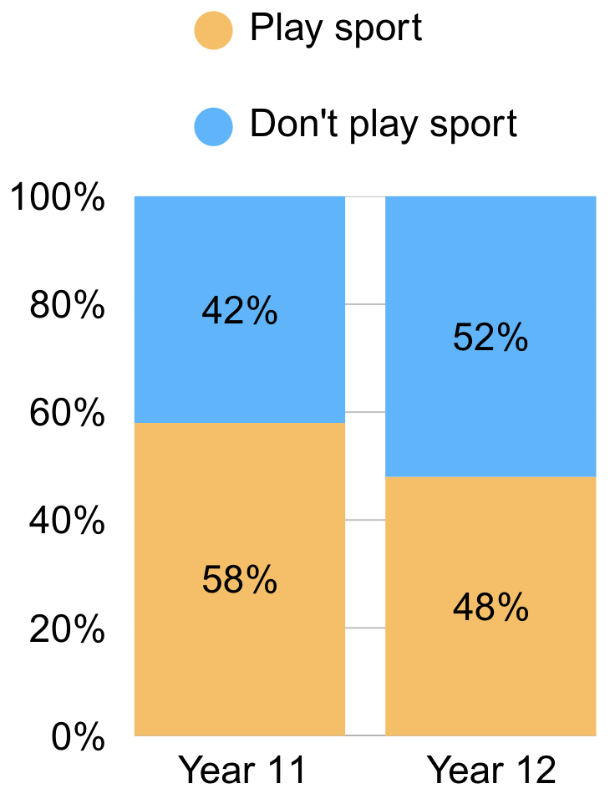
TWO-WAY FREQUENCY TABLES
Worked example (continued).
We could also use percentages to divide the data by year level.
From analysing the year level specific percentages, we can see:
Among Year 11 students, most play sport (58%) but many do not.
Among Year 12 students the group is more evenly split
Suggests that Year 11’s are more likely to play sport than Year 12 students
Workbook
page
4

Slide 14


TWO-WAY FREQUENCY TABLES
With your teacher 1.
A community group wants to know how people prefer to spend their weekends. They ask community members whether they prefer outdoor activities (like hiking or mountain biking) or indoor activities (like movies or gaming). The responses are grouped by age: ‘Under 20’ and ‘20 & Over’
Workbook
page
4

Slide 15
TWO-WAY FREQUENCY TABLES
With your teacher 1.
Complete the two-way frequency below by adding the totals to the first table, then converting to percentages in the second table.
 | Under 20 | 20 & over | Total |  |  | Under 20 | 20 & over | Total
Outdoor | 15 | 22 |  |  | Outdoor | % | % | %
Indoor | 18 | 45 |  |  | Indoor | % | % | %
Total |  |  |  |  | Total | % | % | %
Workbook
page
4

Slide 16

TWO-WAY FREQUENCY TABLES
With your teacher 2.
A survey was conducted with people about their preferred mode of transport to school or work. They could choose between public transport or private car.
The responses are also grouped by gender: Male, female, and other.
Workbook
page
5

Slide 17
TWO-WAY FREQUENCY TABLES
With your teacher 2.
Complete the table below.
 | Male | Female | Other | TOTAL
Public | 5 | 10 | 2
Private | 10 | 25 | 3
TOTAL
Workbook
page
5

Slide 18
TWO-WAY FREQUENCY TABLES
With your teacher 2.
Turn the previous table into percentages out of the total (55)
 | Male | Female | Other | TOTAL
Public | % | % | % | %
Private | % | % | % | %
TOTAL | % | % | % | %
Workbook
page
5

Slide 19
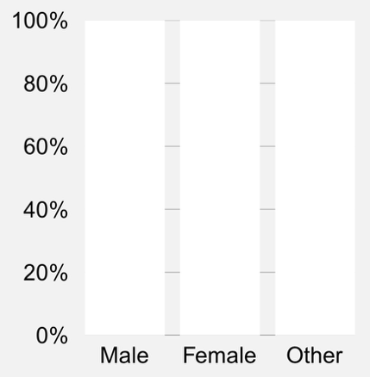
TWO-WAY FREQUENCY TABLES
With your teacher 2.
Turn the original table into percentages per gender, then into a segmented column chart.
 | Male | Female | Other
Public | % | % | %
Private | % | % | %
TOTAL | % | % | %
Workbook
page
Write two observations about your findings from this data.
5

Slide 20

TWO-WAY FREQUENCY TABLES
Try it yourself.
Complete the ‘try it yourself’ questions on page 6 and 7 of your workbook.
Workbook
page
6

Slide 21
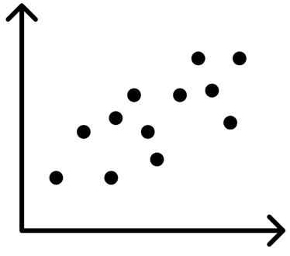
SCATTER PLOTS
A scatter plot is a graph that shows the relationship
between two numerical variables.
Each point on the graph represents one observation, with one variable on the x-axis (horizontal) and the other on the y-axis (vertical).
Scatter plots allow us to:
See if there is a pattern or trend between two variables (AKA association)
Identify the strength of a relationship
Detect unusual values (outliers)
Decide whether one variable may help predict the other
Visualise the data to see if a relationship exists
Workbook
page
8

Slide 22
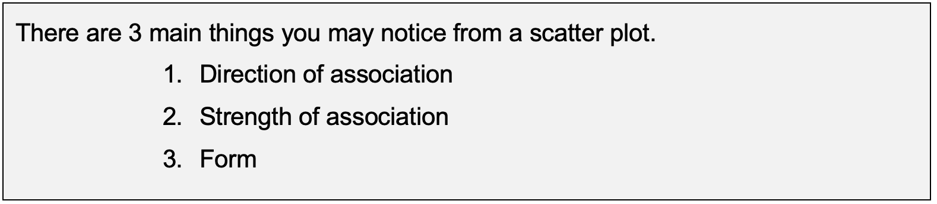
SCATTER PLOTS
An association in statistics is when two variables are
related in some way.
It doesn’t mean one causes the other — just that as one changes, the other tends to change in a particular pattern.
Workbook
page
8

Slide 23
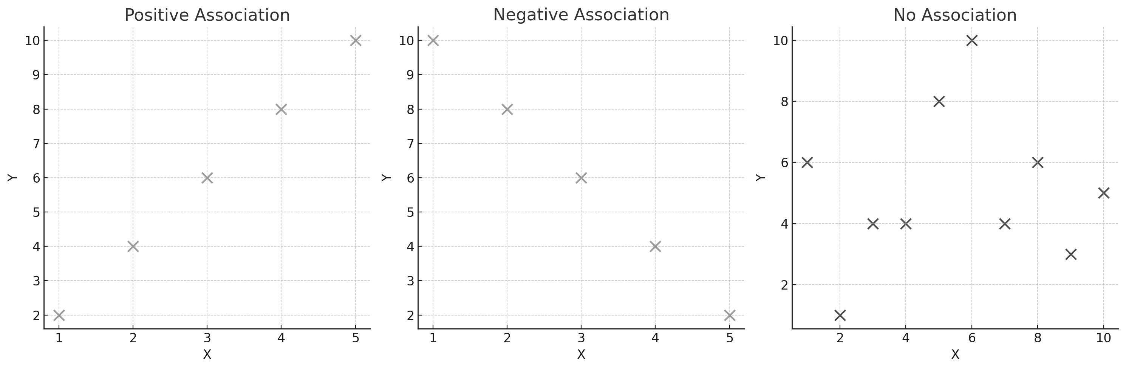
SCATTER PLOTS
1. Direction of association
Positive association: As one variable increases, the other increases
Negative association: As one variable increases, the other decreases
No association: The points are scattered randomly with no clear trend.
Workbook
page
8

Slide 24
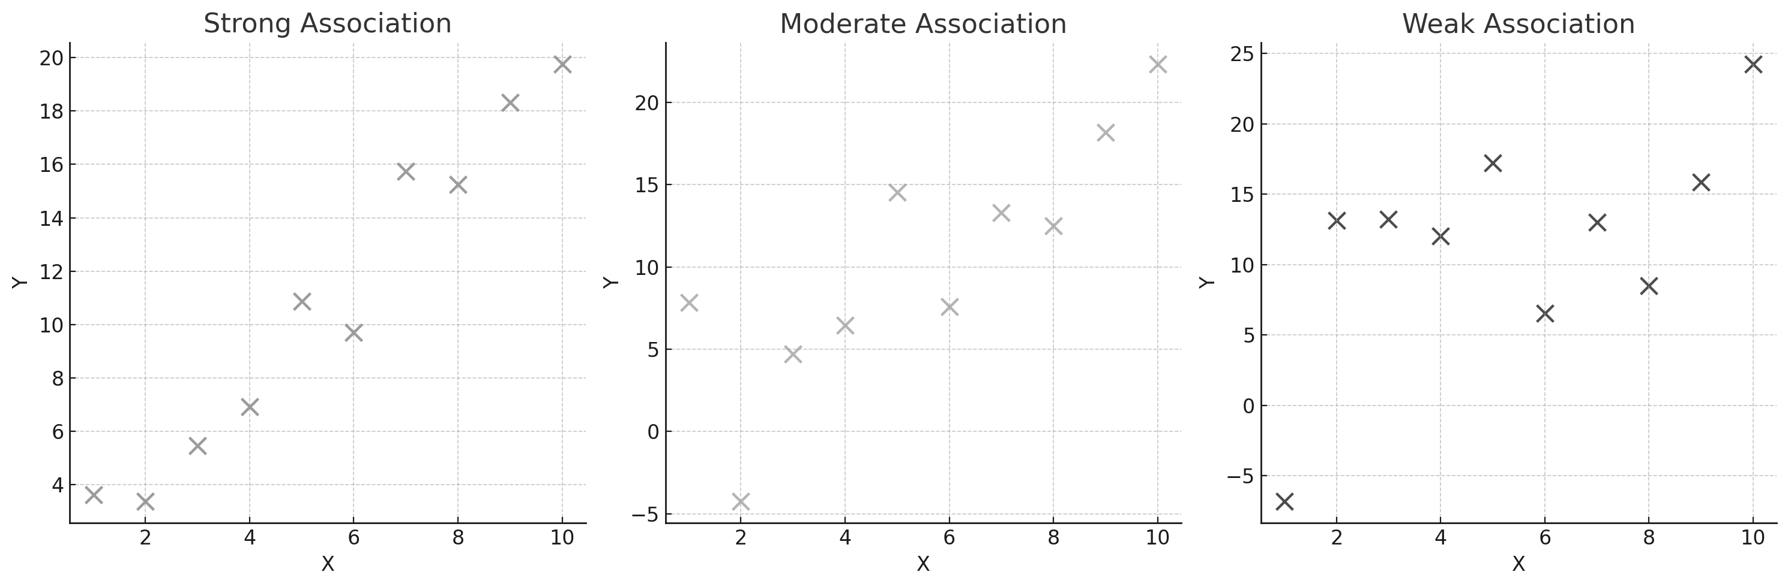
SCATTER PLOTS
2. Strength of association
Strong: Points lie close to an imaginary trend line.
Moderate: Points are spread out but still show some trend.
Weak: No visible trend.
Workbook
page
9

Slide 25
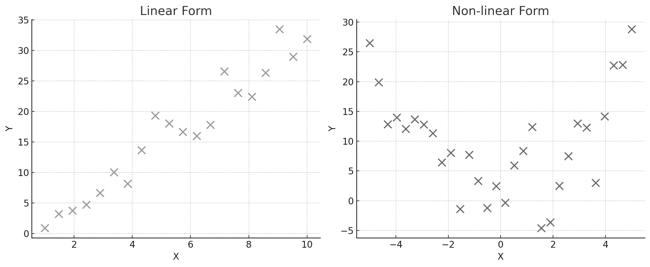
SCATTER PLOTS
3. Form
Linear: Data follows an approximate straight-line pattern.
Non-linear: Data curves (e.g., quadratic or exponential shapes).
Workbook
page
9

Slide 26
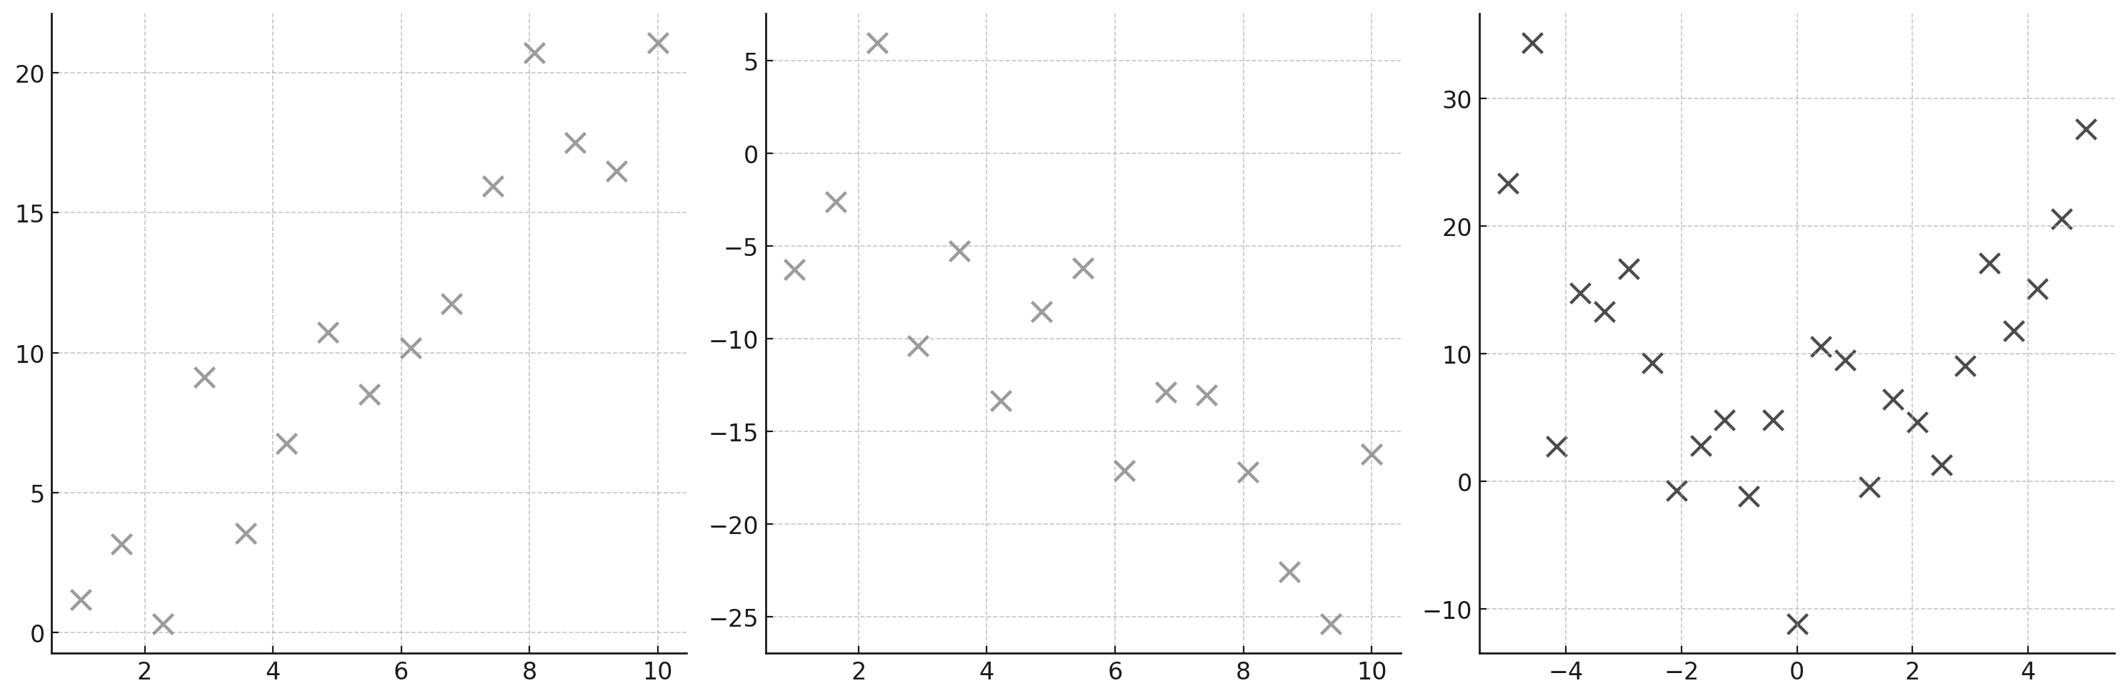
SCATTER PLOTS
With your teacher.
Determine the direction of association, strength of association and form of the following scatter plots.
Workbook
page
9

Slide 27
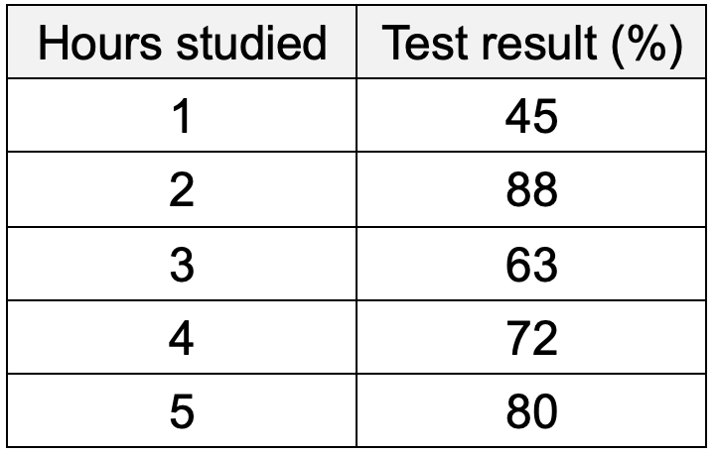
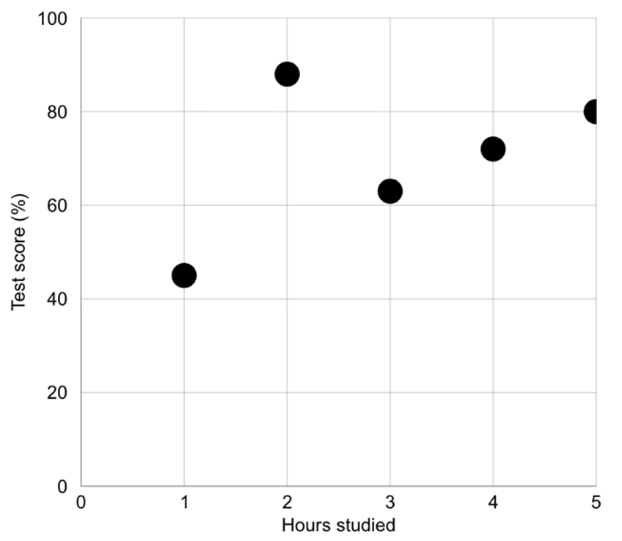
SCATTER PLOTS
Worked example.
Ms Bertram wants to determine if students who study for longer than their peers have higher test scores. She asks students to time themselves studying for a test, then records this data with their test results in a table. She uses the table to plot the results on a scatter plot.
She makes the following observations from the scatterplot:
There is a strong positive linear association.
There is one obvious outlier.
More study time is generally linked with higher test scores.
Workbook
page
10

Slide 28
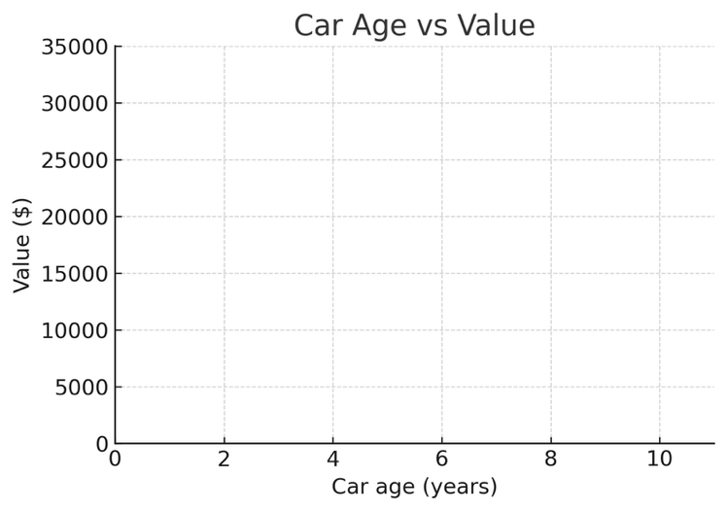
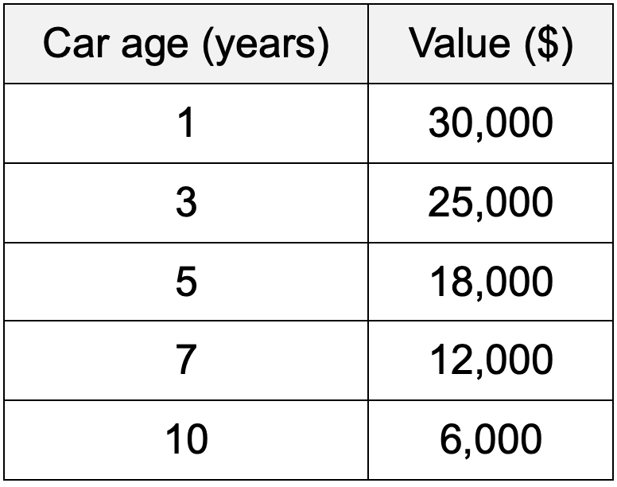
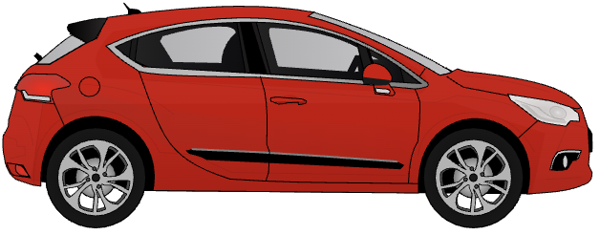
SCATTER PLOTS
With your teacher 1.
Alex’s Awesome Automobiles buys and sells used cars. Alex suspects there is an association between the age of the cars and their value.
He records the age and value of 5 car sales over the course of 2 weeks.
Use the data to prepare a scatter plot, then comment on the direction of association, strength of association, and form.
Workbook
page
10

Slide 29
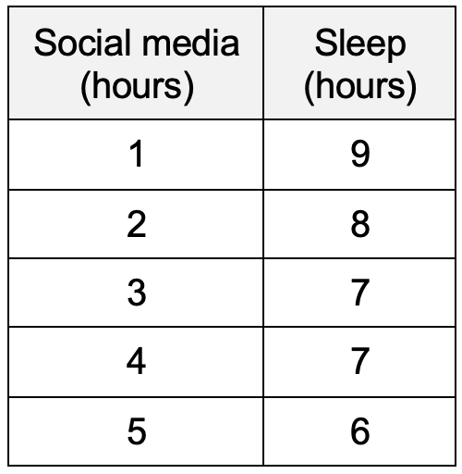

SCATTER PLOTS
With your teacher 2.
A group of students recorded the number of hours they spent on social media each day and the number of hours they slept that night. They are curious if the time on social media impacts how much sleep they get.
Workbook
page
11

Slide 30
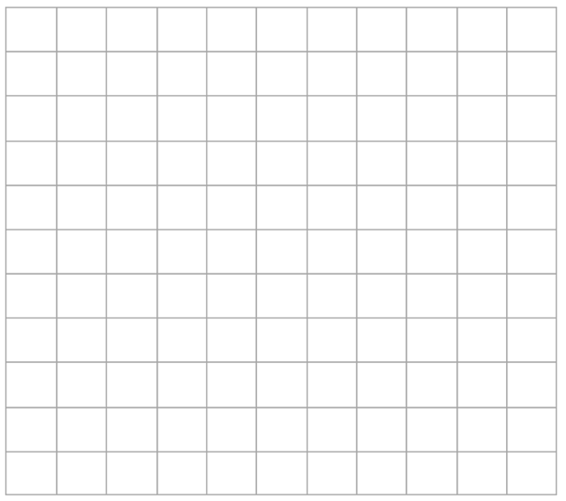
SCATTER PLOTS
With your teacher 2.
A group of students recorded the number of hours they spent on social media each day and the number of hours they slept that night. They are curious if the time on social media impacts how much sleep they get.
Your tasks:
Determine which column is the independent variable (X axis) and
which is the dependent variable (Y axis).
Prepare a scatterplot from scratch using the graph paper.
Describe the association
Write a few sentences interpreting the results in the context of the data.
Workbook
page
11

Slide 31
SCATTER PLOTS
Try it yourself.
Complete the ‘try it yourself’ questions on page 12, 13 and 14 of your workbook.
Workbook
page
12

Slide 32

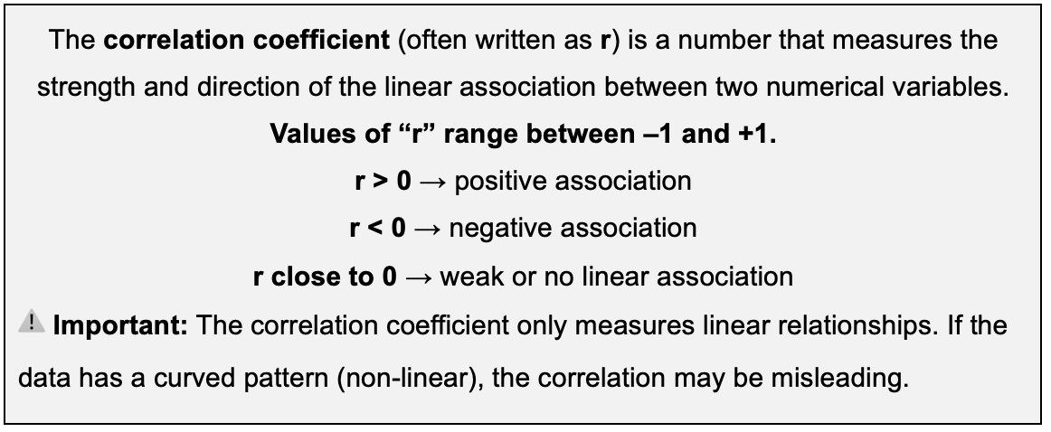
THE CORRELATION COEFFICIENT
Previously, we described the strength of the relationship
between two variables using the terms
Positive, negative, strong, moderate, weak.
Now we are going to quantify the strength of the relationship (give it a numerical value) using a measure called the correlation coefficient.
Workbook
page
15

Slide 33
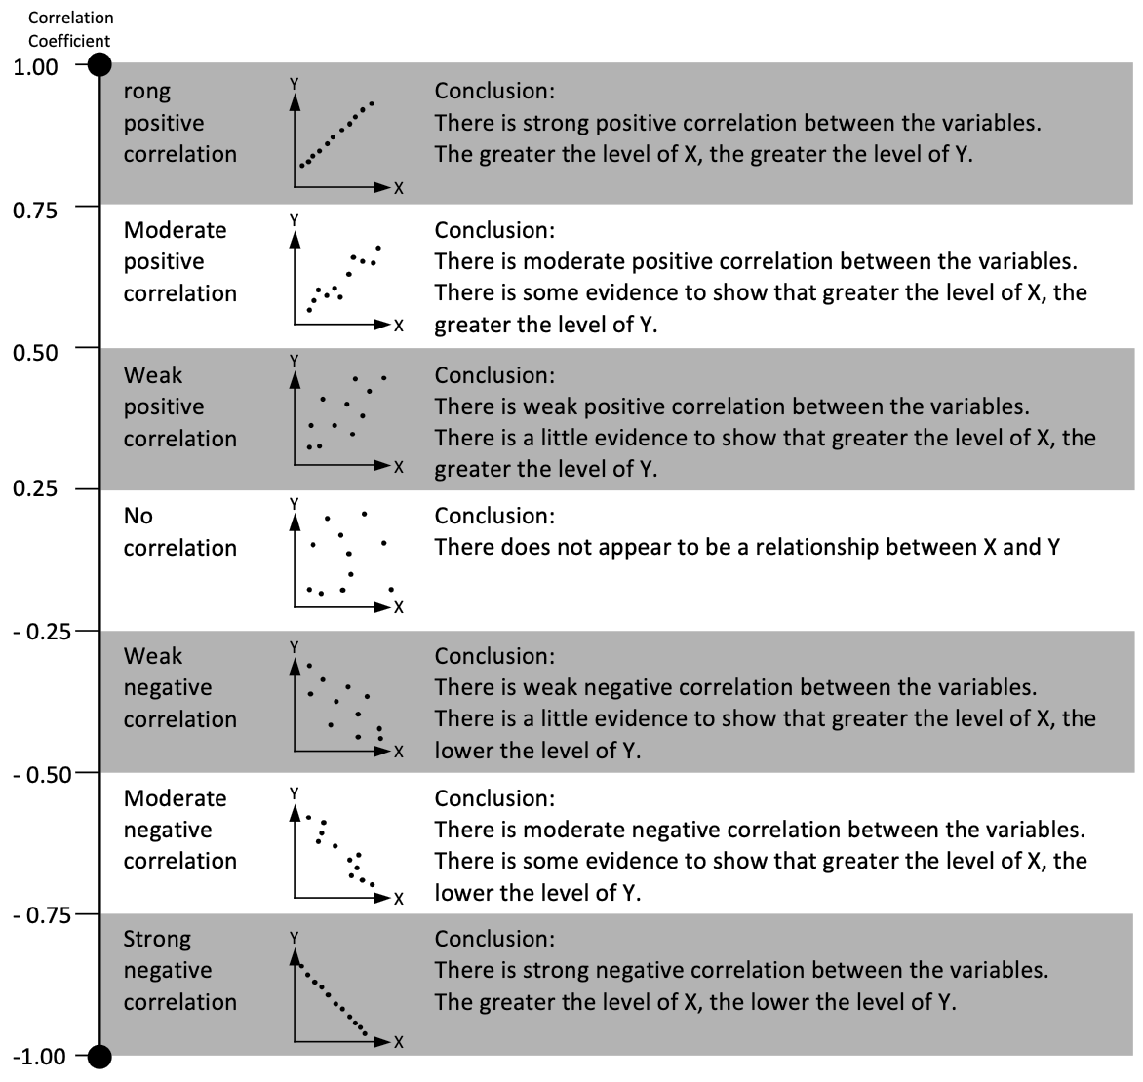
THE CORRELATION COEFFICIENT
Workbook
page
15

Slide 34
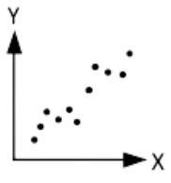
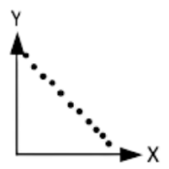
THE CORRELATION COEFFICIENT
With your teacher.
For each of the below, write two sentences interpreting the correlation coefficient.
r = - 0.89
r = + 0.4
Workbook
page
15

Slide 35
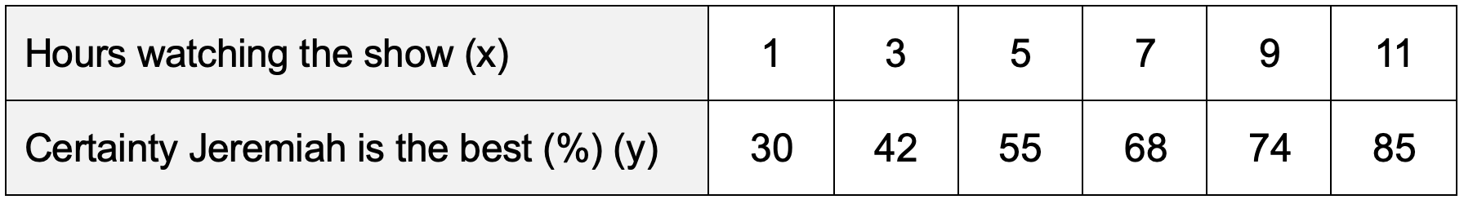

THE CORRELATION COEFFICIENT
Worked example.
Lily wants to know if there is a relationship between the number of hours spent watching the TV series, The Summer I Turned Pretty, and how certain people are that Jeremiah is the best fit for Belly.
She surveys 6 of her friends and records the following data:
Workbook
page
16

Slide 36
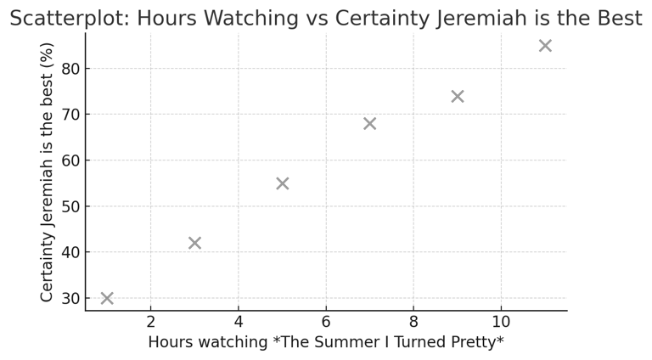
THE CORRELATION COEFFICIENT
Worked example (continued).
Lily creates a scatterplot of Hours watching (x-axis) against Certainty Jeremiah is the best (%) (y-axis).
Using the CAS calculator,
Lily finds that the correlation coefficient is:
r = 0.97
Lily concludes that there is a strong positive correlation between hours spent watching the show and certainty that Jeremiah is the best fit for Belly.
The longer people watch the show, the more likely they are to prefer Jerimiah.
Workbook
page
16
*Disclaimer – this question was written before season 3 came out.

Slide 37
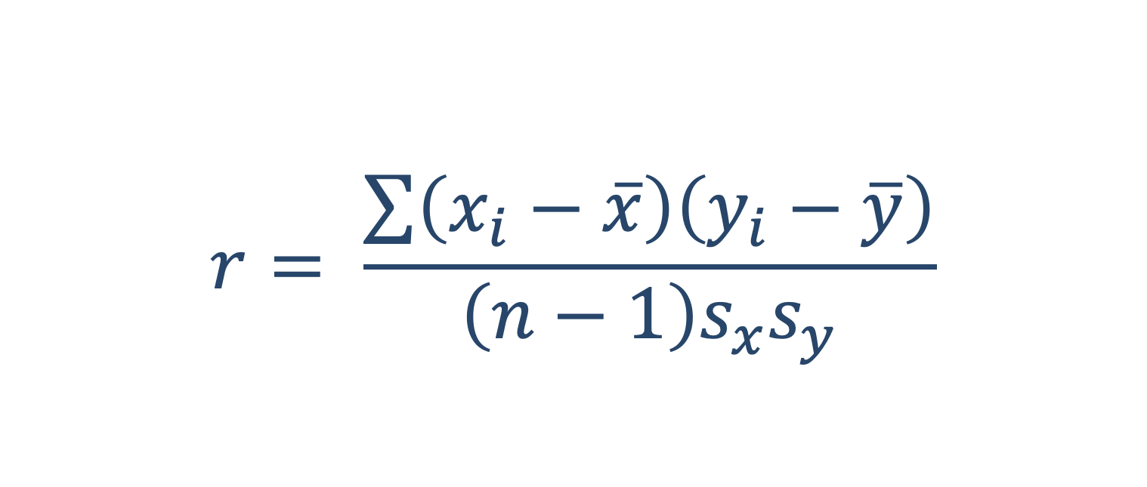
THE CORRELATION COEFFICIENT
The correlation coefficient can be calculated by hand using
Pearson’s correlation formula.
The formula uses averages and standard deviations of both variables.
$$r= \frac{\sum{\left(x_{i}−\overline{x}\right)\left(y_{i}−\overline{y}\right)}}{\left(n−1\right)s_{x}s_{y}}$$
In practice, almost everyone uses technology to calculate r.
Workbook
page
17

Slide 38

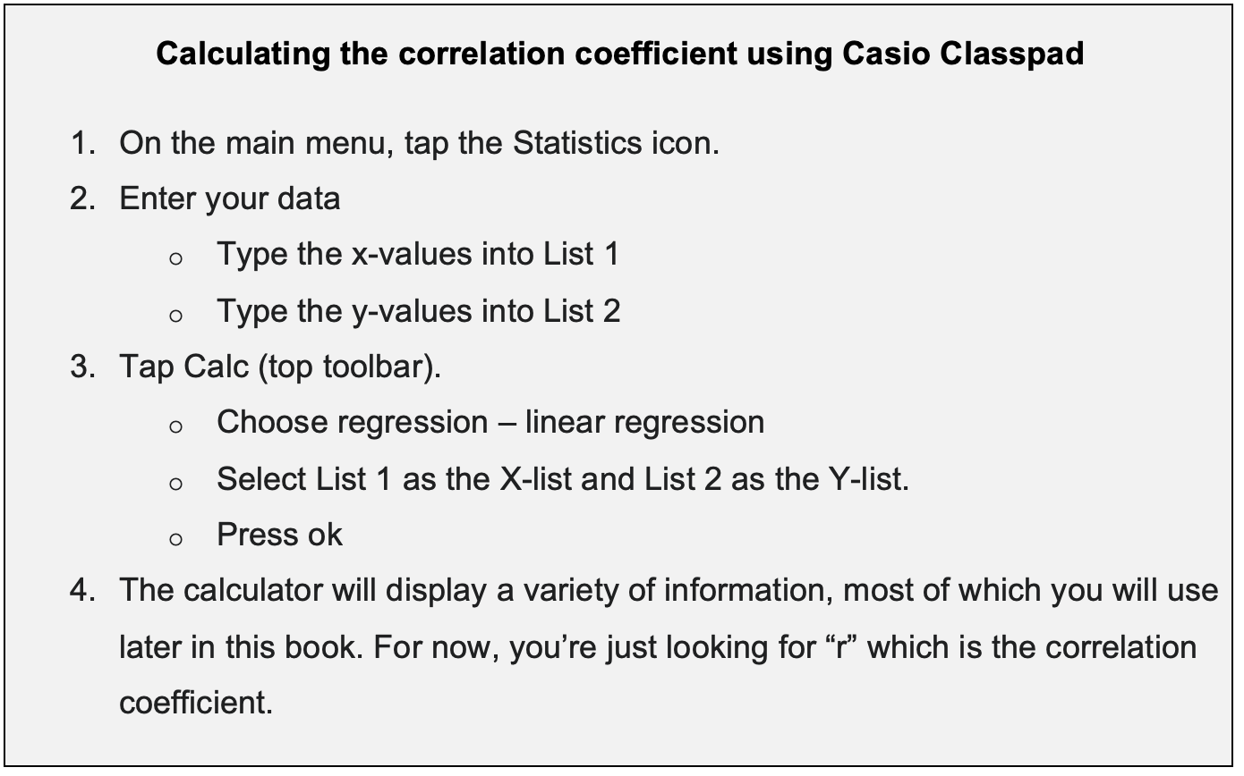
THE CORRELATION COEFFICIENT
Workbook
page
17

Slide 39
THE CORRELATION COEFFICIENT
Worked example.
Lily cannot believe that her friends can’t instantly see that Jerimiah is the best choice for Belly. She selects 15 new people who have never seen the show and asks them to rank Jerimiah out of 10 after each episode for the first season (7 episodes). She averages their scores and presents the following data.
On her CAS calculator, she enters the episode number into list 1, and the average rank in list 2. She then calculates the correlation coefficient as r = 0.44
She interprets that there is a weak positive correlation between the episode number and peoples’ opinion of Jerimiah. There is a little evidence to show that the more episodes they watch, the more they like Jerimiah for Belly.
Workbook
page
17

Slide 40
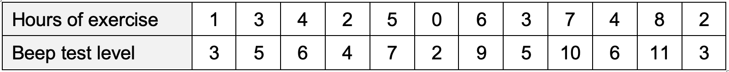
THE CORRELATION COEFFICIENT
With your teacher.
The fitness beep test results of 12 students are shown in the following table together with the number of hours they exercised in the week leading up to the test.
Plot the data on the scatterplot.
What type of correlation do you think is involved?
Use your calculator to find the correlation coefficient.
Write a conclusion based on your correlation coefficient.
Workbook
page
18

Slide 41
THE CORRELATION COEFFICIENT
With your teacher.
Write a suitable conclusion based on the correlation coefficient.
A psychologist studies the relationship between hours of sleep per night and student concentration scores on a memory test. She finds a correlation coefficient of 0.62.
Workbook
page
18

Slide 42
THE CORRELATION COEFFICIENT
With your teacher.
Write a suitable conclusion based on the correlation coefficient.
A sports scientist investigates the relationship between the number of hours spent at soccer training per week and players’ fitness test results. He finds a correlation coefficient of 0.81.
Workbook
page
18

Slide 43
THE CORRELATION COEFFICIENT
Try it yourself.
Complete the ‘try it yourself’ questions on page 19 of your workbook.
Workbook
page
19

Slide 44
ASSOCIATION VS CAUSATION
Association means that two variables are related in some way.
When one changes, the other tends to change too.
Causation means that one variable directly causes the other to change.
Two variables being associated
does NOT mean that one causes the other.
ASSOCIATION ≠ CAUSATION
Workbook
page
20

Slide 45
ASSOCIATION VS CAUSATION
There are several possible reasons why two variables may appear related without a cause-and-effect link.
Coincidence
  Sometimes data lines up by chance.
  Example: Global temperatures and the number of pirates in the world both decreased over the past 200 years - it doesn’t mean pirates control the climate!
Confounding
  A third variable could explain the relationship.
  Example: Ice cream sales and drowning deaths are positively associated. The confounding variable is temperature - in summer, both ice cream sales and swimming increase.
Reverse causation
  Sometimes we assume the wrong direction.
  Example: Towns with more firefighters also have more fire damage. It’s not that firefighters cause more fires – towns with larger number of fires employ more firefighters.
Workbook
page
20

Slide 46
ASSOCIATION VS CAUSATION
Worked example.
A researcher studies children and finds that those with larger shoe sizes tend to have better reading ability. Is this a causal relationship?
No – the larger shoe sizes are not causing an improvement in reading. There is a confounding variable: age. The older children got, the better their reading skills were, and the bigger their feet got too.
Older children generally have bigger feet and better reading skills.
Workbook
page
20

