Slide 1

This PowerPoint has been designed for use with the workbook:
GM2 ALGEBRA
Workbooks, resources and PowerPoints are available at BertramEducation.com

Slide 2

Workbook
page
17
Matrices definitions.
A matrix is a rectangular array of numbers arranged in rows and columns.
Matrices provide a structured and efficient way to represent numerical data, allowing for clear organisation and straightforward manipulation.
Each value within a matrix, just like every cell in a spreadsheet, is called an element.

Slide 3
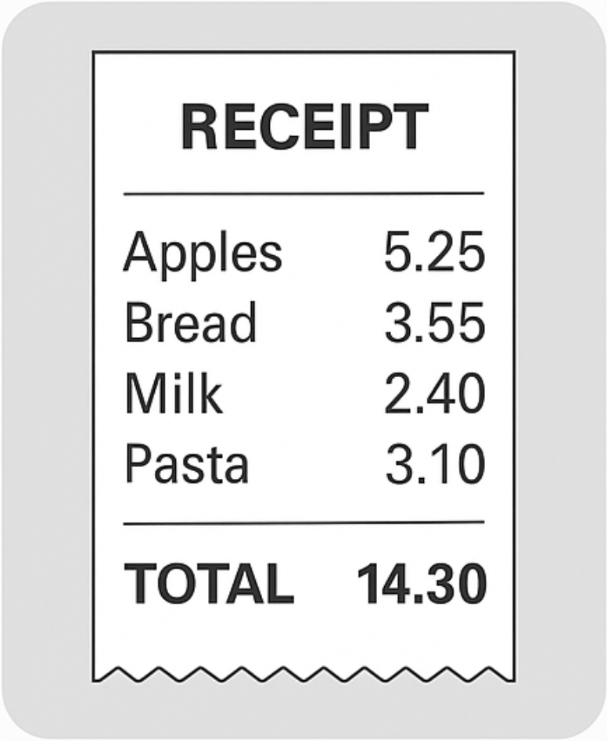
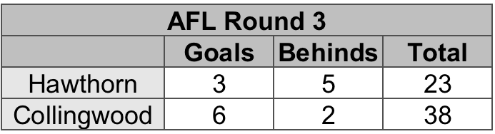
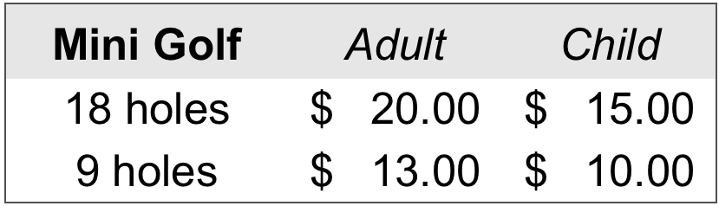
Workbook
page
MATRICES DEFINITIONS
17
Examples of matrices

Slide 4
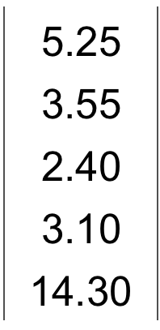
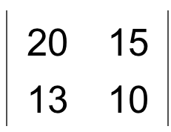
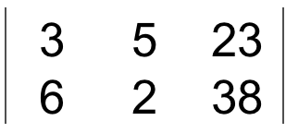
Workbook
page
MATRICES DEFINITIONS
17
Matrices are written inside square or curved brackets.
You can label the axis to provide more information, or if you know what each element means you can leave the labels off.
The previous real life matrices examples could be represented by:

Slide 5
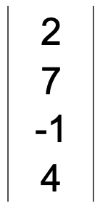
Workbook
page
MATRICES DEFINITIONS
17
Order of a matrix
The order (or size) of a matrix describes its size — how many rows and columns it has.
write the number of rows first,
followed by the number of columns.
A matrix with 2 rows and 3 columns has order 2 × 3
A matrix with 4 rows and 1 column has order 4 × 1

Slide 6

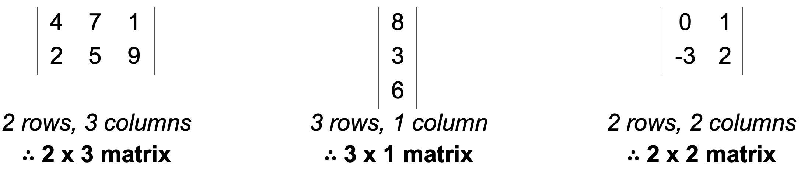
Workbook
page
MATRICES DEFINITIONS
18
Worked examples.
Give the order of each of the following matrices.

Slide 7

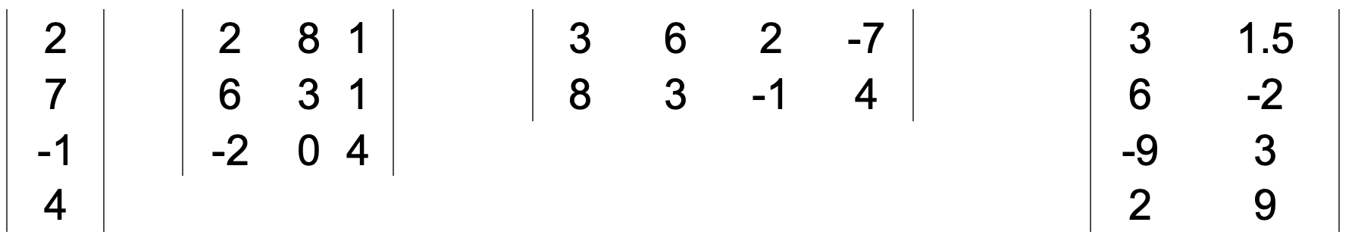
Workbook
page
MATRICES DEFINITIONS
18
With your teacher.
1. Give the size of each of the following matrices.
a.
b.
c.
d.

Slide 8
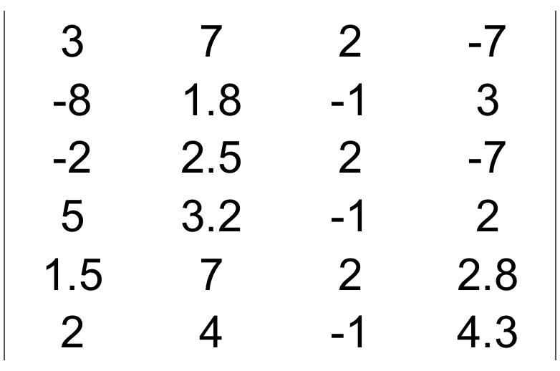
Workbook
page
MATRICES DEFINITIONS
18
With your teacher.
2. For the matrix on the right, answer the following:
a. What is the size of the matrix?
b. What element is in row 2, column 4?
c. What is the location of the element 2.5?
d. What element is in column 3, row 5?

Slide 9

Workbook
page
MATRICES DEFINITIONS
18
With your teacher.
3. A fitness centre offers five different classes:
yoga, pilates, spin, zumba, and boxing.
There are two gym instructors (Anthony and Benedict) who take these classes.
Anthony teaches 4 yoga classes, 2 Pilates classes, 8 spin classes, 3 Zumba classes, and 10 boxing classes.
Benedict teaches 7 yoga classes, 2 Pilates classes, 5 spin classes, 1 Zumba class and 6 boxing classes.

Slide 10
Workbook
page
MATRICES DEFINITIONS
18
With your teacher.
Anthony teaches 4 yoga classes, 2 Pilates classes, 8 spin classes, 3 Zumba classes, and 10 boxing classes.
Benedict teaches 7 yoga classes, 2 Pilates classes, 5 spin classes, 1 Zumba class and 6 boxing classes.
a. Represent this data in a 2 x 5 matrix
? |  | ? |  | ?
? |  | ? |  | ?

Slide 11
Workbook
page
MATRICES DEFINITIONS
18
With your teacher.
Anthony teaches 4 yoga classes, 2 Pilates classes, 8 spin classes, 3 Zumba classes, and 10 boxing classes.
Benedict teaches 7 yoga classes, 2 Pilates classes, 5 spin classes, 1 Zumba class and 6 boxing classes.
b. Rewrite this data as a 5 x 2 matrix
? | ?
? | ?
? | ?
? | ?
? | ?

Slide 12

Workbook
page
MATRICES DEFINITIONS
19
Try it yourself.
Complete the ‘try it yourself’ questions on page 19 and 20 of your workbook.

Slide 13
Workbook
page
ADDING AND SUBTRACTING MATRICES
21
You can only add or subtract matrices if they have the same order (same number of rows and columns).
To add or subtract, perform the operation on the elements with matching positions.

Slide 14
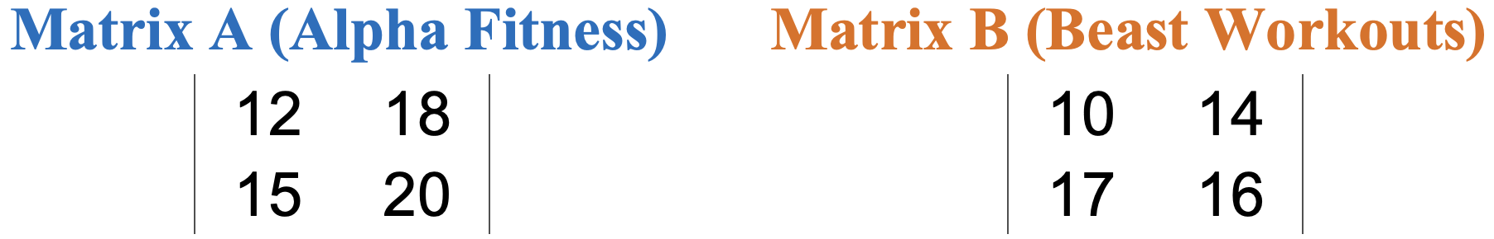
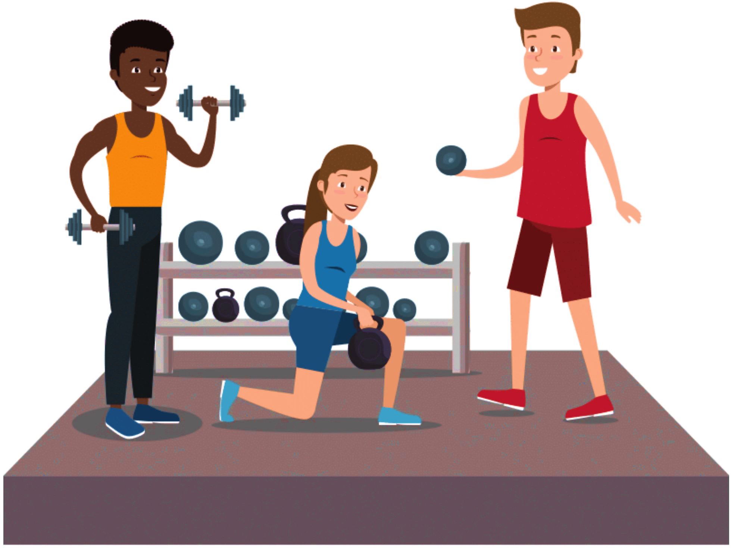
Workbook
page
ADDING AND SUBTRACTING MATRICES
21
Worked example.
A fitness centre tracks how many people attend two different gyms; Alpha Fitness (gym A) and Beast Workouts (gym B), over two days.
The number of attendees is recorded in matrices where;
rows represent days (Monday and Tuesday)
columns are morning and afternoon sessions

Slide 15
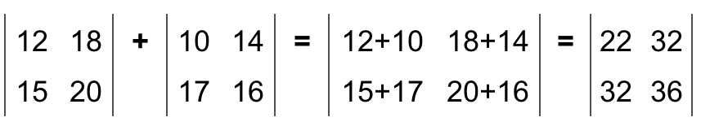
Workbook
page
ADDING AND SUBTRACTING MATRICES
21
Worked example (continued).
We can add the matrices (Matrix A + Matrix B) to find the total number of people attending both gyms each day, at each session.
This results in matrix C, which tells us things such as 22 people attended in the Monday morning session across both gyms, and that 36 people came in for the Tuesday afternoon session.

Slide 16
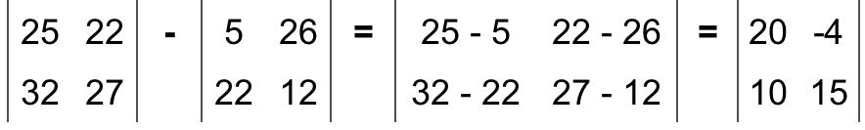
Workbook
page
ADDING AND SUBTRACTING MATRICES
21
Worked example (continued).
The same method is used for subtracting matrices.

Slide 17
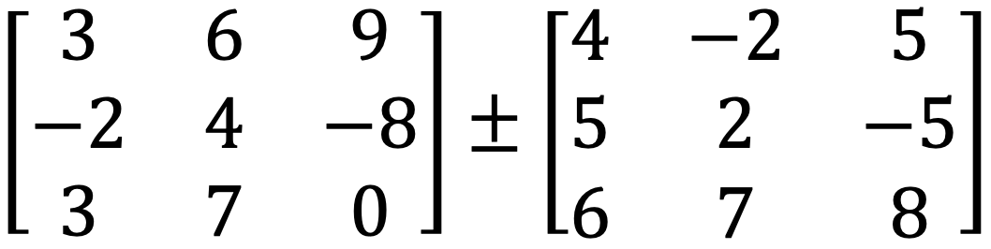
Workbook
page
ADDING AND SUBTRACTING MATRICES
21
With your teacher.
Add the pair of matrices, then subtract them

Slide 18
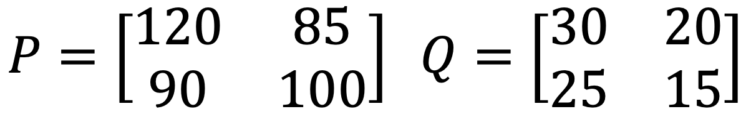

Workbook
page
ADDING AND SUBTRACTING MATRICES
22
With your teacher.
1. Matrix P shows the number of items in two warehouses, where the rows represent the type of produce (apples and oranges) and the columns represent which shed they are in (shed A and shed B).
Matrix Q shows what is being delivered today.
Calculate P + Q to find the updated stock levels.
? | ?
? | ?

Slide 19
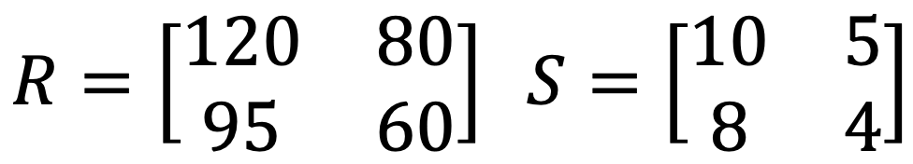

Workbook
page
ADDING AND SUBTRACTING MATRICES
22
With your teacher.
2. Matrix R shows the number of adult and student tickets sold for two concerts, where the rows represent each concert (Harry Styles and Justin Bieber), and the columns represent the type of ticket (adult and student). Matrix S shows the number of refunds processed.
Calculate R – S to determine the final number of tickets sold of each type at each concert.
? | ?
? | ?

Slide 20
Workbook
page
ADDING AND SUBTRACTING MATRICES
23
Try it yourself.
Complete the ‘try it yourself’ questions on page 23 and 24 of your workbook.

Slide 21
Workbook
page
SCALAR MULTIPLICATION
25
Scalar multiplication
A scalar is a single number.
Scalar multiplication means multiplying every element of a matrix by that number.

Slide 22
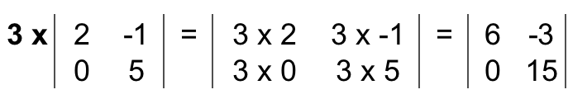
Workbook
page
SCALAR MULTIPLICATION
25
Worked example.
Multiply a matrix by 3

Slide 23
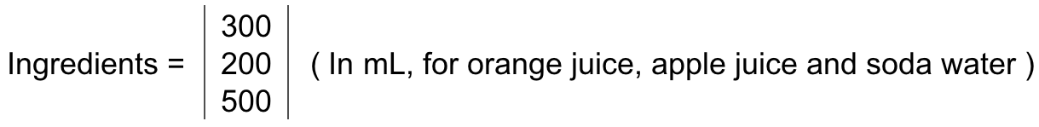
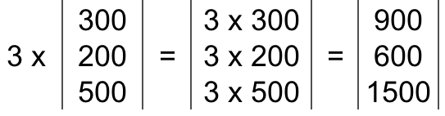

Workbook
page
SCALAR MULTIPLICATION
25
Real world example.
A recipe for fruit punch makes 1 litre and requires the following ingredients:
If you want to make 3 litres of each drink, you multiply the matrix by 3:
This tells you to use 900 mL of orange juice, 600 mL of apple juice, and 1.5 L of soda water.

Slide 24
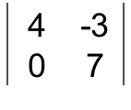
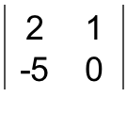
Workbook
page
SCALAR MULTIPLICATION
25
With your teacher.
1. Multiply by 2:
? | ?
? | ?
=
2. Multiply by - 3
? | ?
? | ?
=

Slide 25
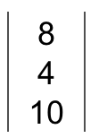
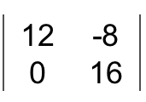

Workbook
page
SCALAR MULTIPLICATION
25
With your teacher.
3. Multiply by ½:
?
?
?
=
4. Multiply by - $\frac{1}{4}$:
? | ?
? | ?
=

Slide 26
Workbook
page
SCALAR MULTIPLICATION
26
Try it yourself.
Complete the ‘try it yourself’ questions on page 26 of your workbook.

Slide 27
Workbook
page
MATRIX MULTIPLICATION
27
You can only multiply two matrices when the number of columns in the first matrix is equal to the number of rows in the second matrix.
Inside numbers = possibility to multiply
(2 x 3) x (3 x 4) = yes, able to multiply
(2 x 3) x (2 x 3) = no, not able to multiply

Slide 28
Workbook
page
MATRIX MULTIPLICATION
27
The result is a new matrix whose dimensions are the rows of the first and the columns of the second.
Outside numbers – order of resulting matrix
(2 x 3) x (3 x 4) = Result will be a (2 x 4) matrix
(2 x 3) x (2 x 3) = not possible to multiply
When multiplying matrices the inside terms determine whether it is possible. The outside terms decide the order of the new matrix.
E.g. (2 x 3) x (3 x 1) = (2 x 1)

Slide 29
Workbook
page
MATRIX MULTIPLICATION
27
With your teacher.
For each of the following pairs of matrices,
- Write the order of both matrices
- Determine if they can be multiplied
- If it is possible to multiply, state the order of the new matrix

Slide 30
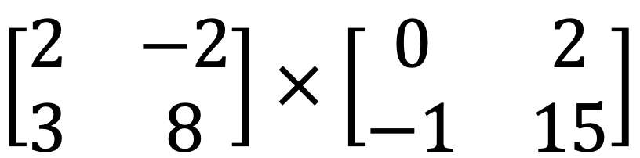
Workbook
page
MATRIX MULTIPLICATION
27
With your teacher.
For each of the following pairs of matrices,
- Write the order of both matrices
- Determine if they can be multiplied
- If it is possible to multiply, state the order of the new matrix
a.

Slide 31
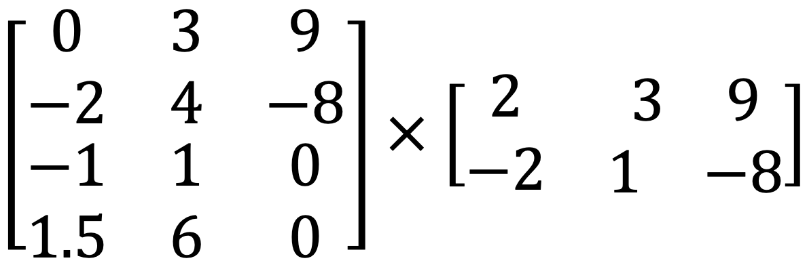
Workbook
page
MATRIX MULTIPLICATION
27
With your teacher.
For each of the following pairs of matrices,
- Write the order of both matrices
- Determine if they can be multiplied
- If it is possible to multiply, state the order of the new matrix
b.

Slide 32
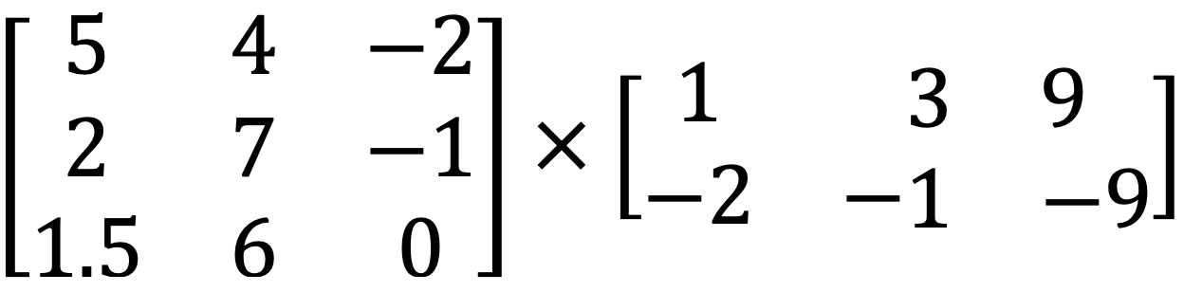
Workbook
page
MATRIX MULTIPLICATION
27
With your teacher.
For each of the following pairs of matrices,
- Write the order of both matrices
- Determine if they can be multiplied
- If it is possible to multiply, state the order of the new matrix
c.

Slide 33
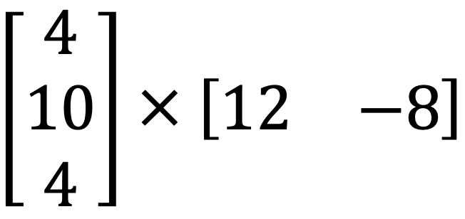
Workbook
page
MATRIX MULTIPLICATION
27
With your teacher.
For each of the following pairs of matrices,
- Write the order of both matrices
- Determine if they can be multiplied
- If it is possible to multiply, state the order of the new matrix
d.

Slide 34
Workbook
page
MATRIX MULTIPLICATION
28
STEPS TO MULTIPLYING MATRICES
Step 1: Check the multiplication is possible
Step 2: Set up the answer matrix
Step 3: Multiply each column in matrix A by each row in matrix B
Step 4: Simplify

Slide 35
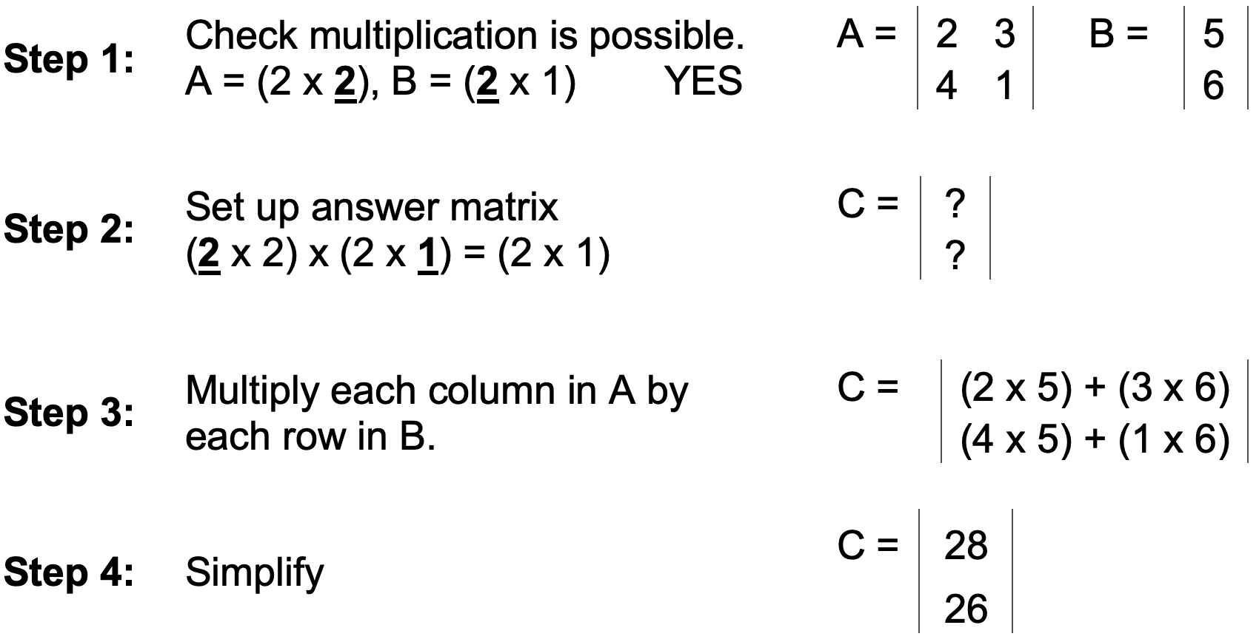
Workbook
page
MATRIX MULTIPLICATION
28
Worked example (1).

Slide 36
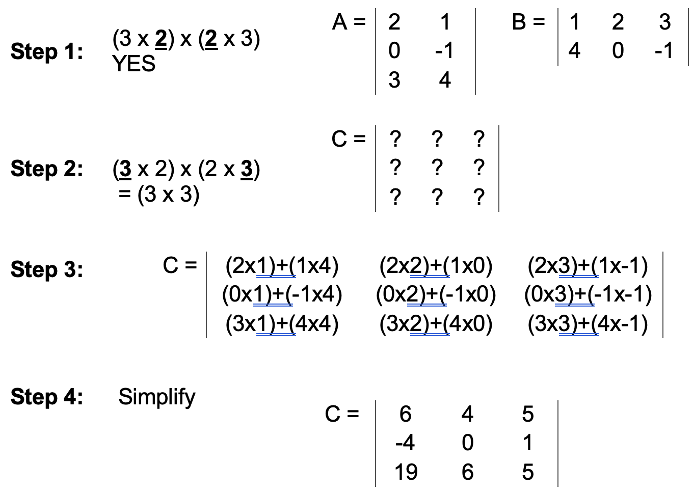
Workbook
page
MATRIX MULTIPLICATION
28
Worked example (2).

Slide 37
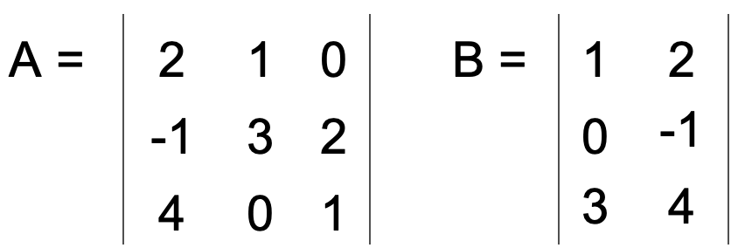

Workbook
page
MATRIX MULTIPLICATION
29
With your teacher.
Work through each of the 4 steps to multiply matrix A and Matrix B
Step 1: Check multiplication is possible.
A = ( x ), B = ( x )

Slide 38
Workbook
page
MATRIX MULTIPLICATION
29
With your teacher (continued).
Step 2: Set up answer matrix
( x ) x ( x ) = ( x )
C = | ? | ?
 | ? | ?
 | ? | ?

Slide 39
Workbook
page
MATRIX MULTIPLICATION
29
With your teacher (continued).
Step 3: Multiply each column in matrix A by each row in matrix B
( x )+( x )+( x ) | ( x )+( x )+( x )
( x )+( x )+( x ) | ( x )+( x )+( x )
( x )+( x )+( x ) | ( x )+( x )+( x )
C =

Slide 40
Workbook
page
MATRIX MULTIPLICATION
29
With your teacher (continued).
Step 4: Simplify
C = | ? | ?
 | ? | ?
 | ? | ?

Slide 41
Workbook
page
MATRIX MULTIPLICATION
29
Try it yourself.
Complete the ‘try it yourself’ questions from page 29 to 33 of your workbook.

Slide 42
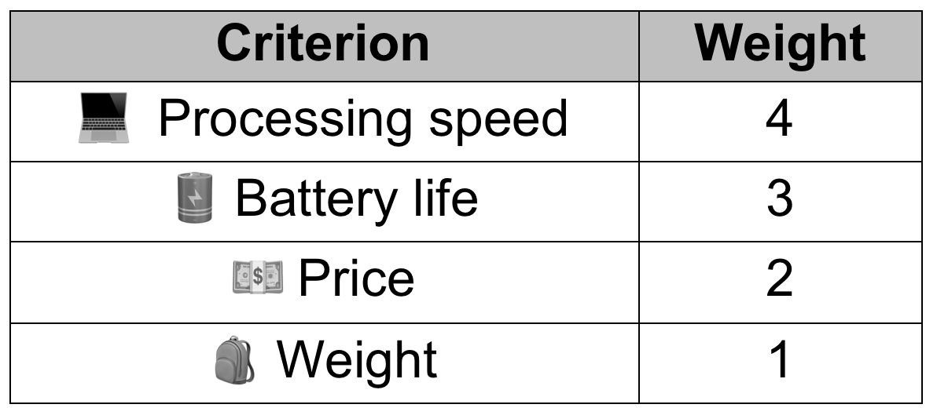

Workbook
page
THE DECISION MATRIX
34
Worked example.
Jaxon is buying a new laptop for school and work. He is trying to decide between four models based on the criteria of: processing speed, battery life, price, and weight. He knows some things are more important than others, so he assigns weights to each of the criterion, as below.

Slide 43
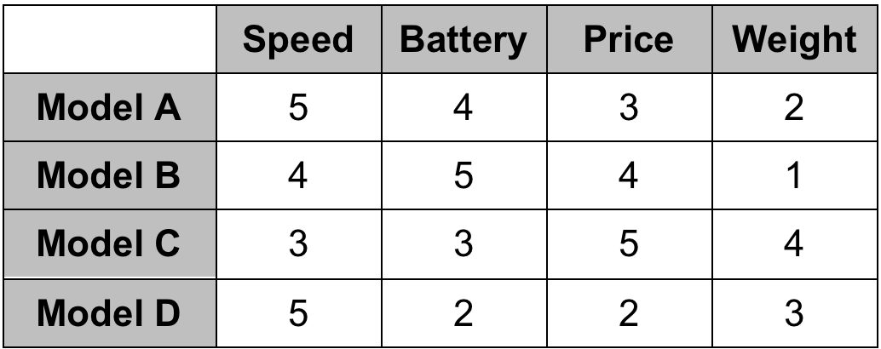
Workbook
page
THE DECISION MATRIX
34
Worked example (continued).
Jaxon rates each laptop on a scale of 1 to 5 for each category.

Slide 44
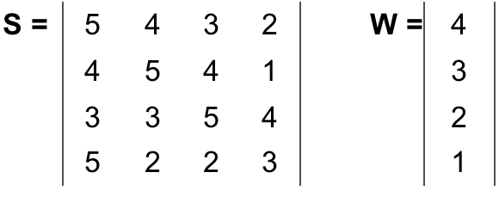
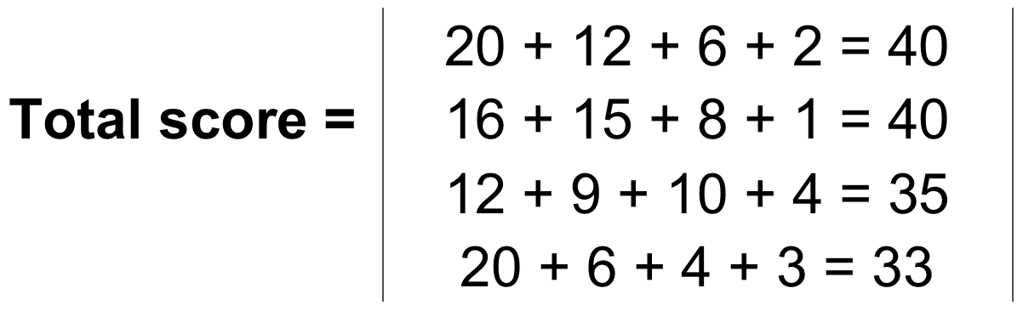
Workbook
page
THE DECISION MATRIX
34
Worked example (continued).
From these two tables he creates a score matrix (S) and a weight matrix (W). Then he multiplies the two matrices together to get the total scores per laptop.
Therefore: Model A and B tied with a score of 40. Model C was the next best option with a score of 35, and model D scored the worst with 33.

Slide 45
Workbook
page
THE DECISION MATRIX
35
Try it yourself.
Complete the ‘try it yourself’ questions from page 35 and 36 of your workbook.

Slide 46
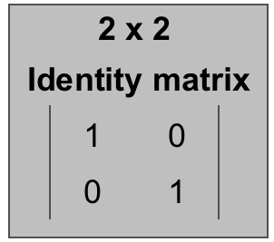
Workbook
page
THE IDENTITY MATRIX
37
All the numbers on the main diagonal are 1s
All the other numbers are 0s

Slide 47
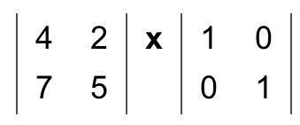
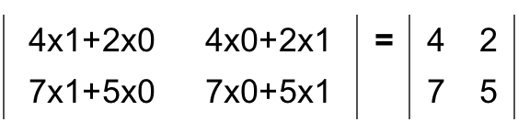
Workbook
page
THE IDENTITY MATRIX
37
Worked example.

Slide 48
Workbook
page
THE IDENTITY MATRIX
37
With your teacher.
What would a 3x3 identity matrix would look like? How about a 4x4?

Slide 49
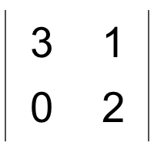
Workbook
page
THE IDENTITY MATRIX
37
With your teacher.
Multiply the following matrix by a 2x2 identity matrix

Slide 50
Workbook
page
THE IDENTITY MATRIX
37
With your teacher.
What happens if you multiply an identity matrix by itself?

Slide 51
Workbook
page
THE IDENTITY MATRIX
38
Try it yourself.
Complete the ‘try it yourself’ questions from page 38 of your workbook.

Slide 52

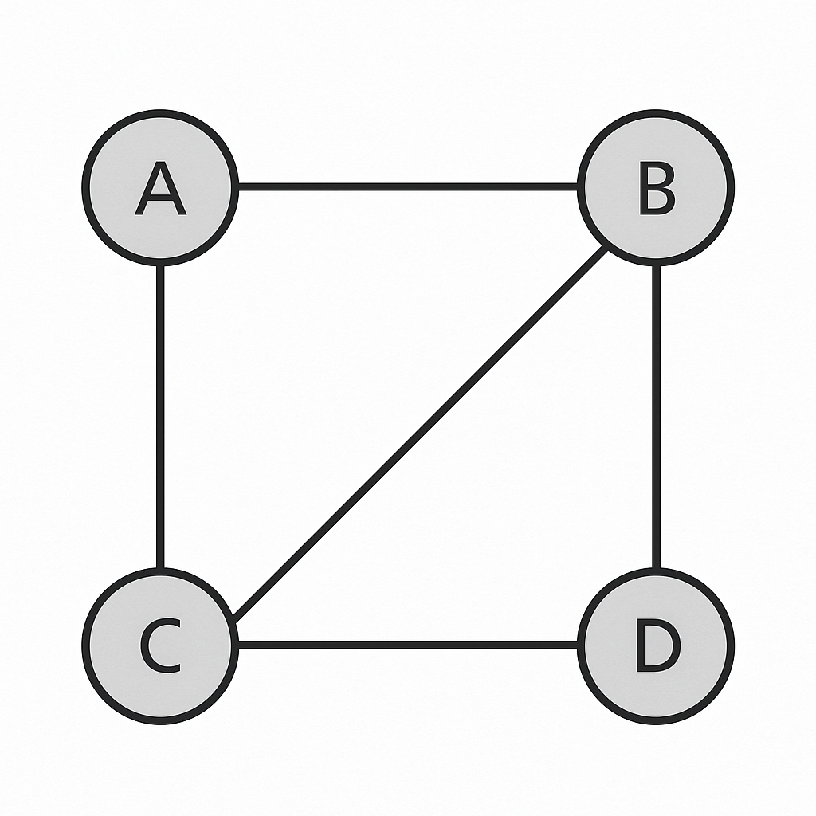
Workbook
page
NETWORKS AND THE ADJACENCY MATRIX
39
A network is a diagram made up of nodes (or vertices) and edges (or lines) that connect them.
A graph can be used to represent a network.
For this example:
The circles containing the letters are the nodes/vertices. The lines that join the letters are the edges.

Slide 53
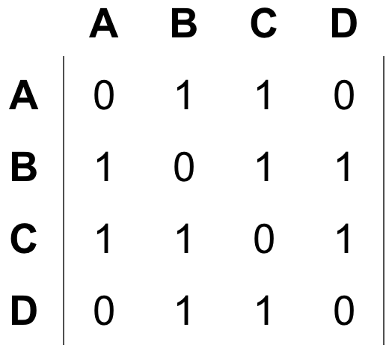
Workbook
page
NETWORKS AND THE ADJACENCY MATRIX
39
An adjacency matrix is a way of representing a network using a matrix. It shows which nodes are connected — and how many direct links there are between them.

Slide 54
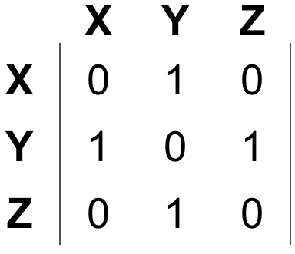
Workbook
page
NETWORKS AND THE ADJACENCY MATRIX
39
With your teacher.
1. Draw a graph to represent this adjacency matrix:

Slide 55
Workbook
page
NETWORKS AND THE ADJACENCY MATRIX
39
With your teacher.
2. Write an adjacency matrix for this network:
Town A is connected to Town B and Town C
Town B is connected to A, C, and D
Town C is connected to A and B
Town D is connected to B

Slide 56
Workbook
page
NETWORKS AND THE ADJACENCY MATRIX
40
With your teacher.
3. Draw a graph to represent the following friendship network:
Anthony, Benedict and Colin are all friends
Benedict is also friends with Daphne and Eloise
Colin is also friends with Eloise but doesn’t acknowledge Daphne

Slide 57
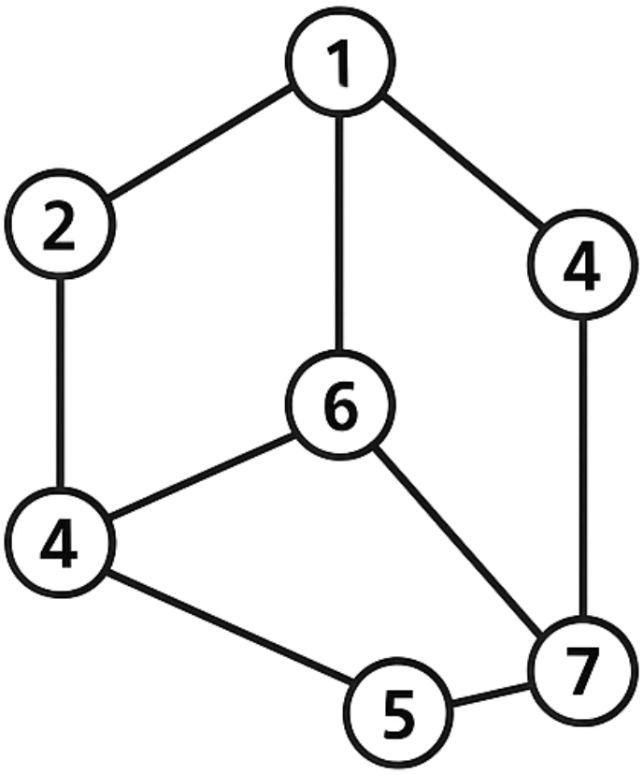
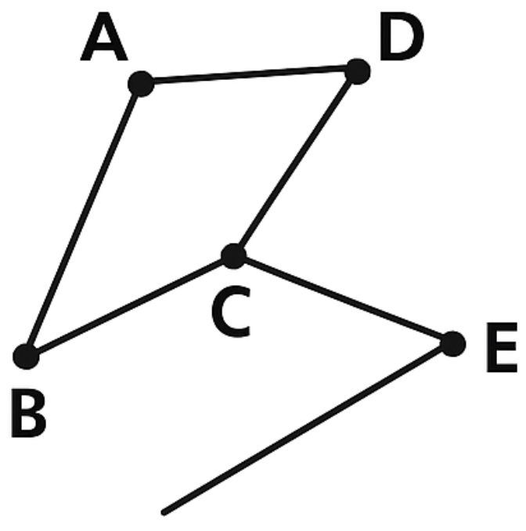
Workbook
page
NETWORKS AND THE ADJACENCY MATRIX
40
With your teacher.
4. Write an adjacency matrix for each of the following network diagrams.

Slide 58
Workbook
page
NETWORKS AND THE ADJACENCY MATRIX
40
With your teacher.
5. Explain how an adjacency matrix could be useful in planning road construction or analysing social media connections.

Slide 59
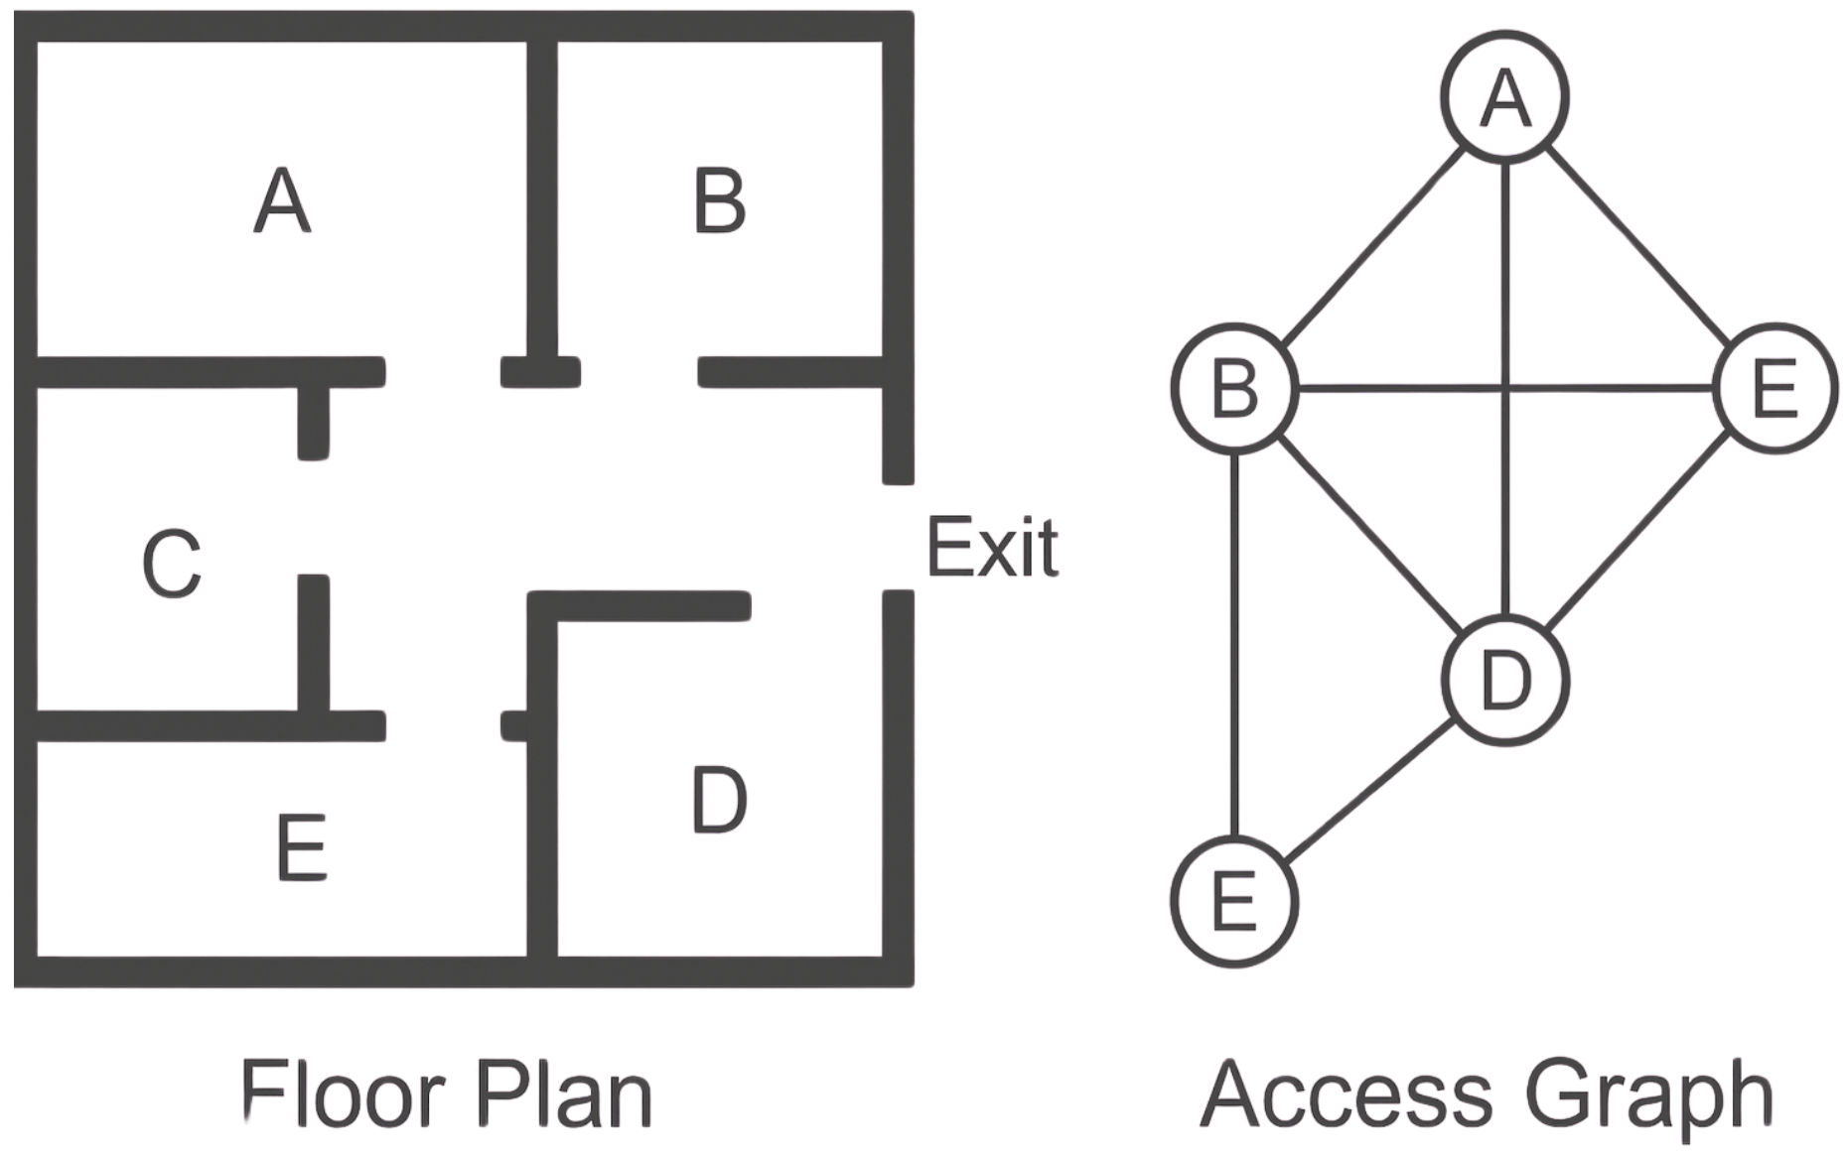
Workbook
page
ACCESS GRAPHS
41
With your teacher.
An access graph (also known as a reachability graph) shows which nodes can be reached from other nodes. Unlike an adjacency matrix, which shows only direct connections, an access graph tells us whether a path exists — even through other nodes

Slide 60
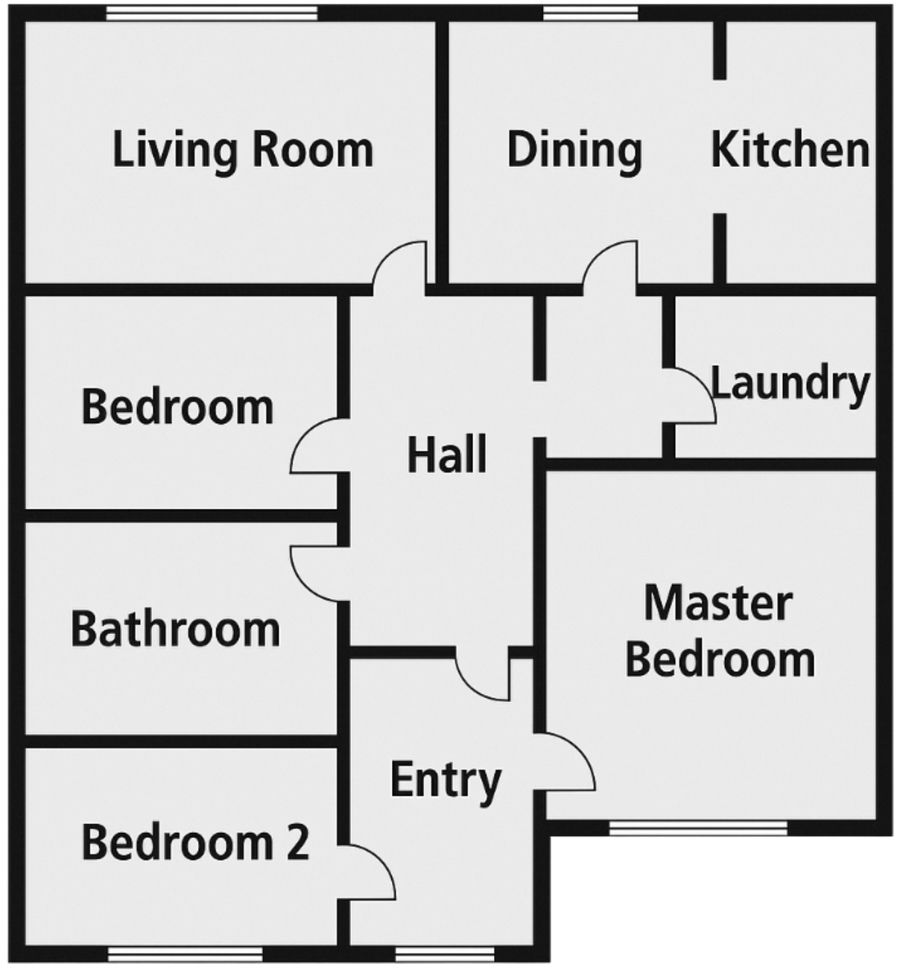
Workbook
page
ACCESS GRAPHS
41
With your teacher.
Draw an access graph to represent the below house plan, then turn it into an adjacency matrix.

Slide 61
Workbook
page
THE IDENTITY MATRIX
42
Try it yourself.
Complete the ‘try it yourself’ questions from page 42 to 44 of your workbook.

