Slide 1

This PowerPoint has been designed for use with the workbook:
GM2 MEASUREMENT
Workbooks, resources and PowerPoints are available at BertramEducation.com

Slide 2

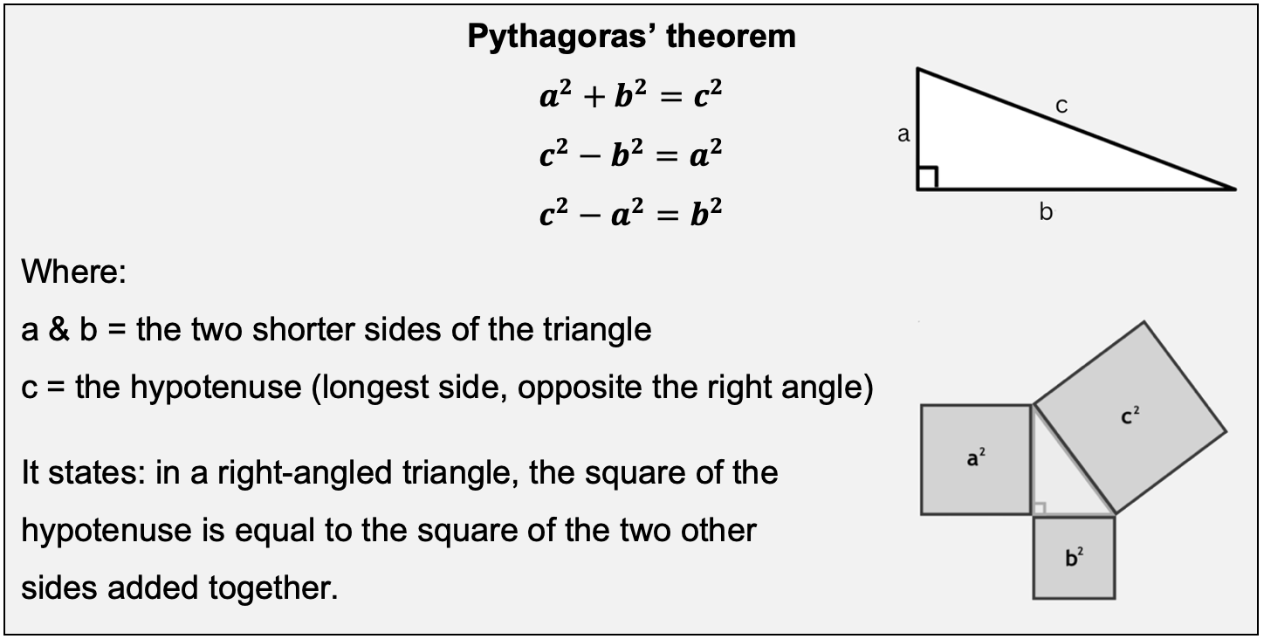
Workbook
page
37

Slide 3

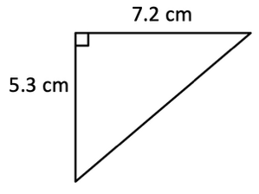
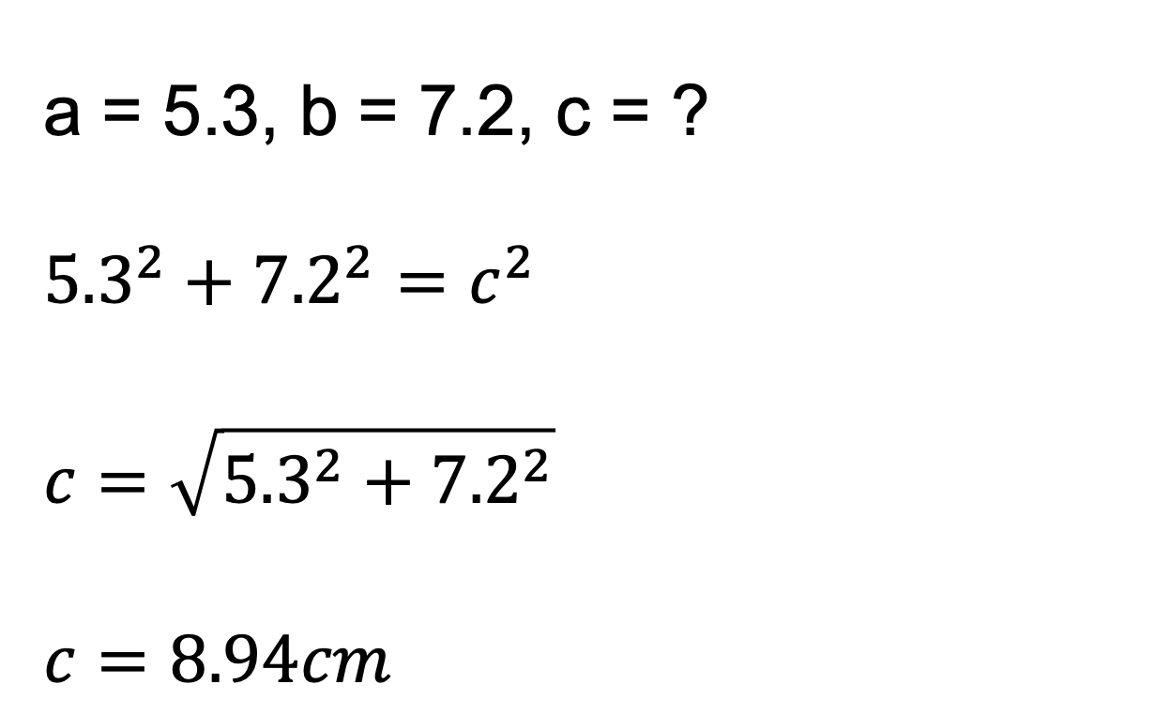
Workbook
page
PYTHAGORAS THEOREM
38
Worked examples.
Find the missing length in these right-angled triangles.
a = 5.3, b = 7.2, c = ?
$${5.3}^{2}+{7.2}^{2}=c^{2}$$
$$c=\sqrt{{5.3}^{2}+{7.2}^{2}}$$
$c=8.94cm$

Slide 4
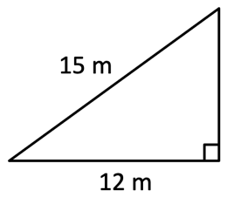

Workbook
page
PYTHAGORAS THEOREM
38
Worked examples.
Find the missing length in these right-angled triangles.
c = 15m, b = 12m, a = ?
$${15}^{2}−{12}^{2}=a^{2}$$
$$a=\sqrt{{15}^{2}−{12}^{2}}$$
$a=9m$

Slide 5

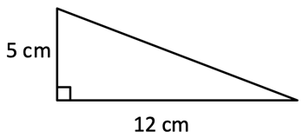
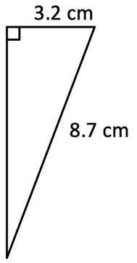
Workbook
page
PYTHAGORAS THEOREM
38
With your teacher.
Find the missing length in these right-angled triangles.

Slide 6
Workbook
page
PYTHAGORAS THEOREM
38
With your teacher.
a. A triangle has sides of 3cm, 4cm, and 5cm.
Prove whether it is right-angled.

Slide 7
Workbook
page
PYTHAGORAS THEOREM
38
With your teacher.
b. A ladder is leaning up against a wall. The bottom of the ladder is 2m away from the wall. The top of the ladder meets the wall at a point 5m off the ground. How long is the ladder?

Slide 8
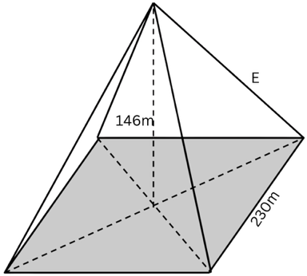
Workbook
page
PYTHAGORAS THEOREM
39
With your teacher.
The great pyramid of Khufu, in Egypt, was the world’s tallest man-made structure for nearly 4,000 years. Standing at 146 metres tall, it has a square base with each side 230 metres long. The four corners of the pyramid face exactly North, South, East and West.
Find the length of the sloping edge (E).

Slide 9

Workbook
page
PYTHAGORAS THEOREM
40
Try it yourself.
Complete the ‘try it yourself’ questions on page 40 of your workbook.

Slide 10
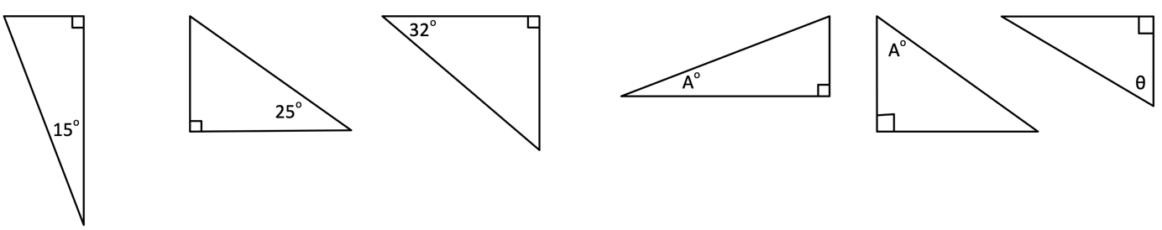
Workbook
page
TRIGONOMETRIC RATIOS
41
With your teacher.
Label the hypotenuse (H), opposite (O), and adjacent (A) sides

Slide 11
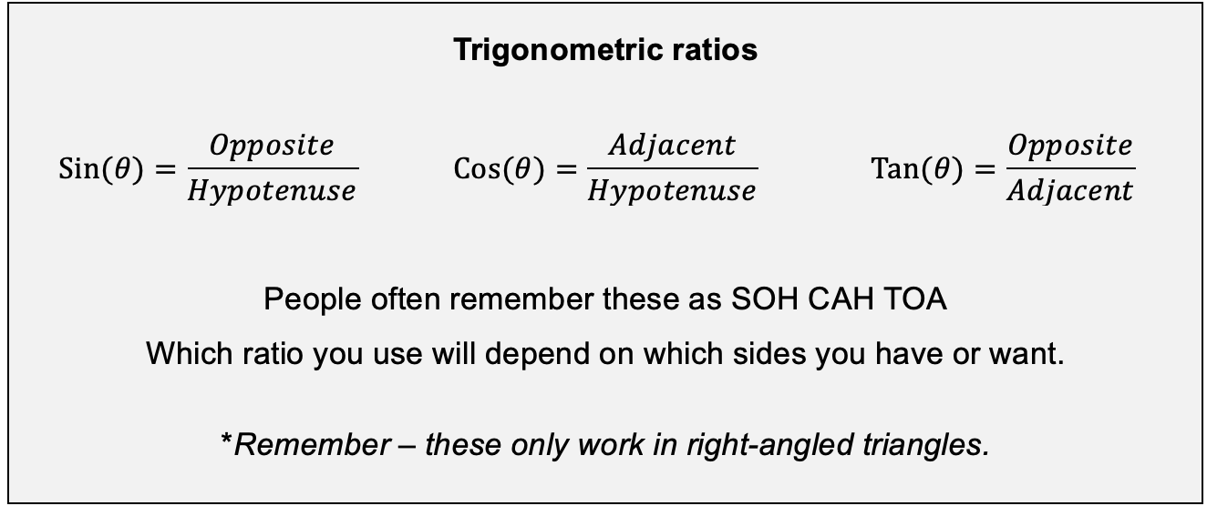
Workbook
page
TRIGONOMETRIC RATIOS
41

Slide 12
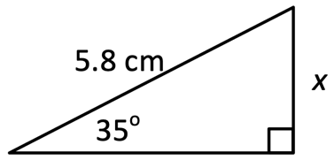
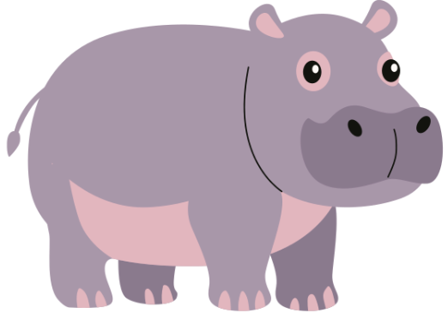
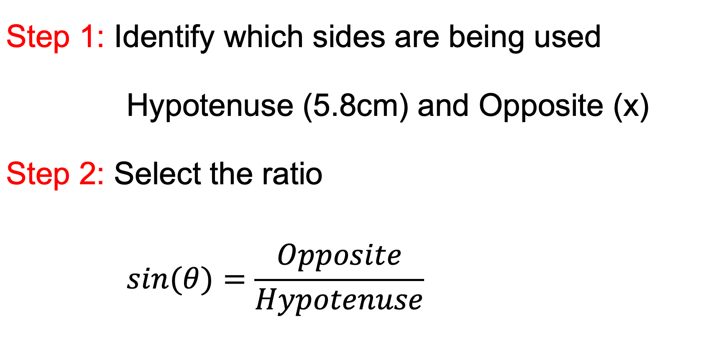
Workbook
page
TRIGONOMETRIC RATIOS
42
Finding a missing side.
Worked example.
Find the missing side (x) of the triangle.
Step 1: Identify which sides are being used
 | Hypotenuse (5.8cm) and Opposite (x)
Step 2: Select the ratio
 | $$\sin{(θ)}=\frac{Opposite}{Hypotenuse}$$

Slide 13
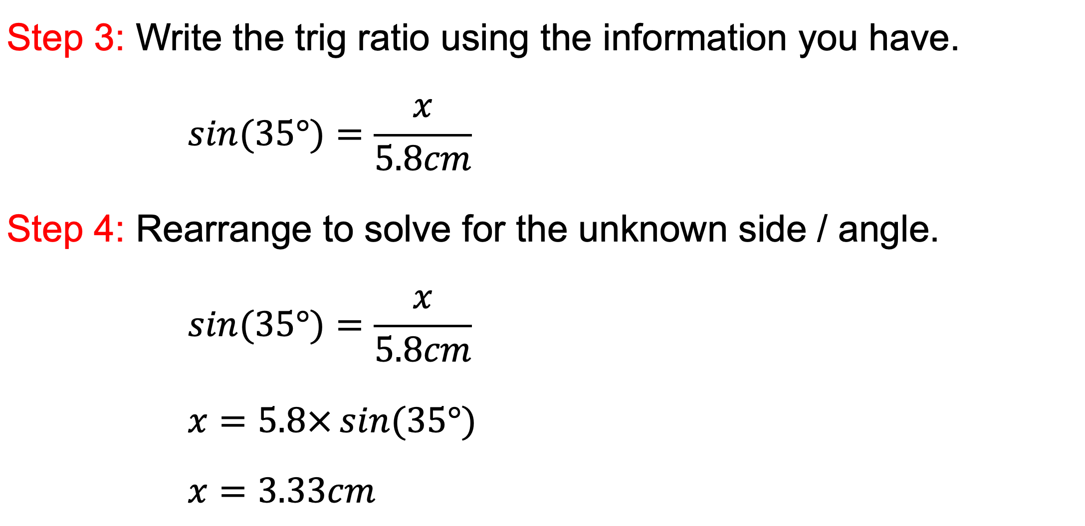
Workbook
page
TRIGONOMETRIC RATIOS
42
Finding a missing side.
Worked examples.
Find the missing side (x) of the triangle.
Step 3: Write the trig ratio using the information you have.
 | $$\sin{(35°)}=\frac{x}{5.8cm}$$
Step 4: Rearrange to solve for the unknown side / angle.
 | $$\sin{(35°)}=\frac{x}{5.8cm}$$
 | $$x=5.8×\sin{(35°)}$$
 | $$x=3.33cm$$

Slide 14
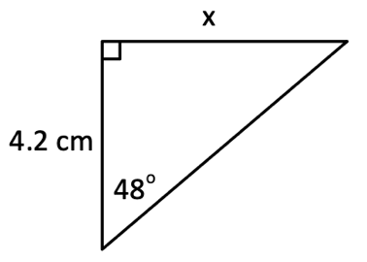
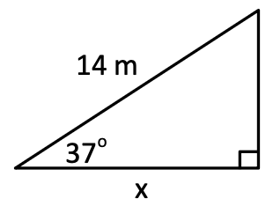
Workbook
page
TRIGONOMETRIC RATIOS
42
Finding a missing side.
With your teacher.
1. Find the missing side of the following triangles. (solve for numerator)

Slide 15
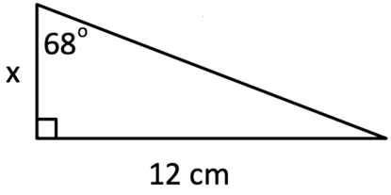
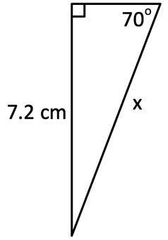
Workbook
page
TRIGONOMETRIC RATIOS
42
Finding a missing side.
With your teacher.
2. Find the missing side of the following triangles. (solve for denominator)

Slide 16
Workbook
page
TRIGONOMETRIC RATIOS
43
Finding a missing side.
Try it yourself.
Complete the ‘try it yourself’ questions on page 43 of your workbook.

Slide 17
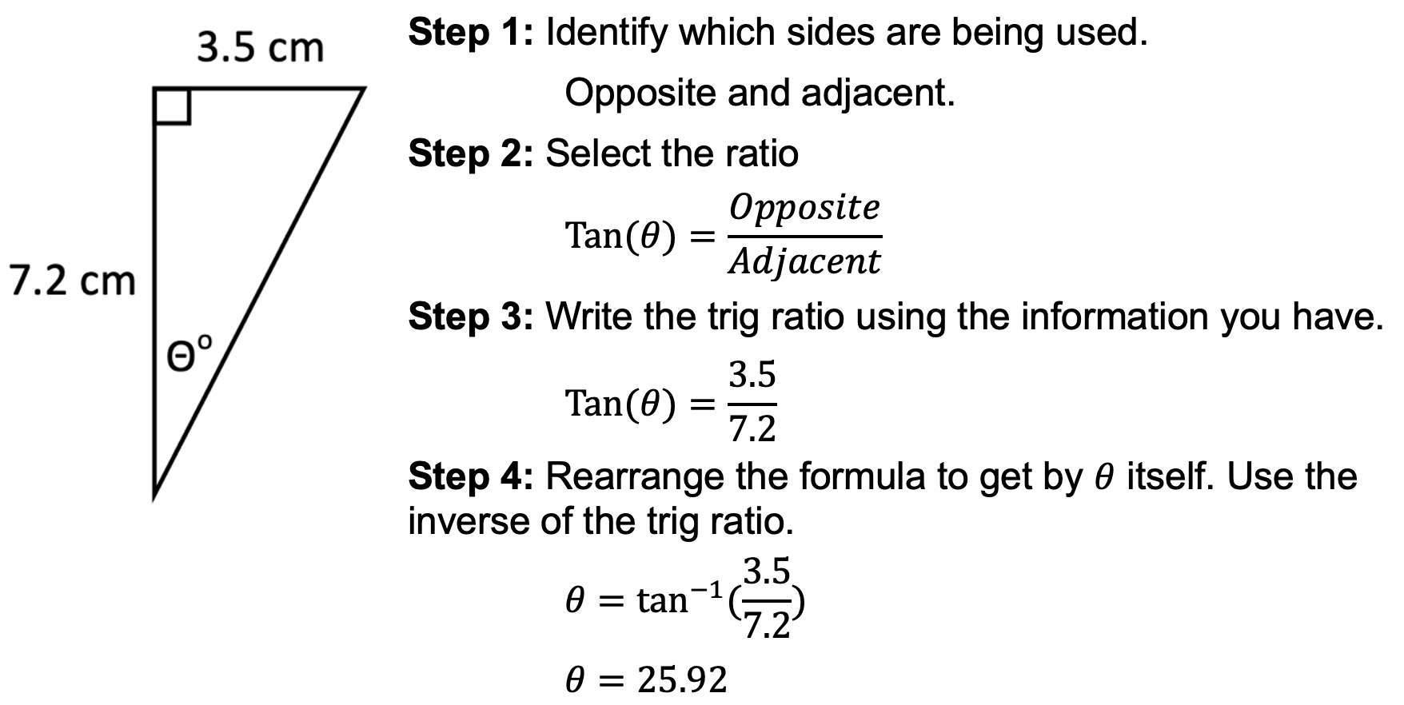
Workbook
page
TRIGONOMETRIC RATIOS
44
Finding a missing angle.
Worked example 1. Finding an unknown angle by rearranging SOH CAH TOA

Slide 18
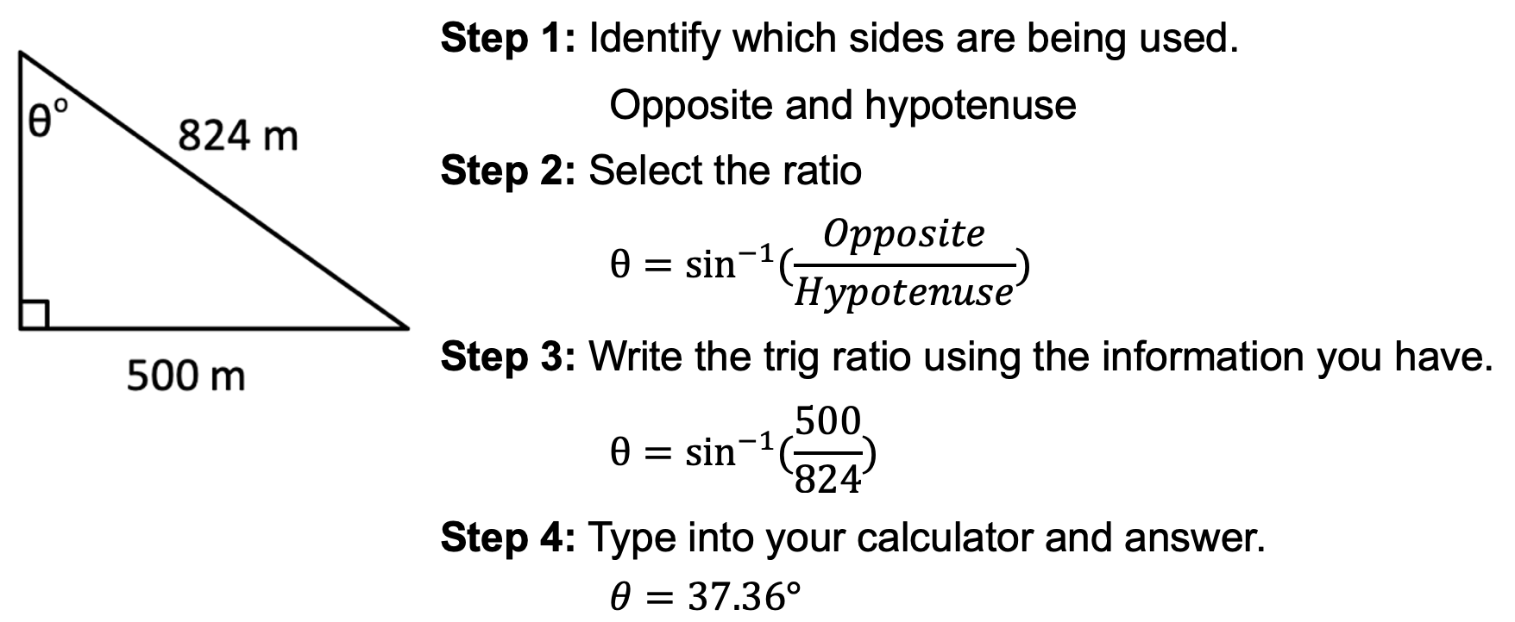
Workbook
page
TRIGONOMETRIC RATIOS
44
Finding a missing angle.
Worked example 2. Finding unknown angle using shortcut formula.

Slide 19
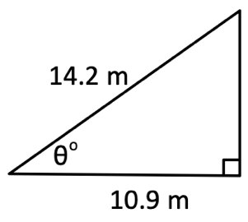
Workbook
page
TRIGONOMETRIC RATIOS
45
Finding a missing angle.
With your teacher.
1. Find the missing angle in each triangle.

Slide 20
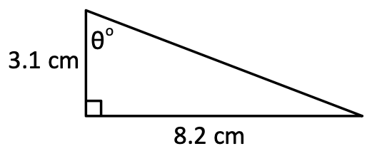
Workbook
page
TRIGONOMETRIC RATIOS
45
Finding a missing angle.
With your teacher.
1. Find the missing angle in each triangle.

Slide 21
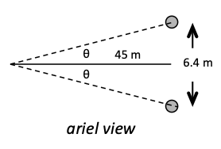
Workbook
page
TRIGONOMETRIC RATIOS
45
Finding a missing angle.
With your teacher.
2. Jack Gunston is lining up for a shot for a goal. If he makes it, Hawthorn win the AFL grand final. He is 45m out from goal line, the goal posts are 6.4 metres apart. By what angle of error (X) can he stray and still score a goal?

Slide 22
Workbook
page
TRIGONOMETRIC RATIOS
45
Finding a missing angle.
With your teacher.
3. A tree is 12 m tall. From a point 20 m away from the base of the tree, a student is lying on the ground and looks up to the top of the tree.
  a. Draw a diagram to represent the situation
  b. Find the angle of elevation from the student to the top of the tree.

Slide 23
Workbook
page
TRIGONOMETRIC RATIOS
46
Finding a missing angle.
Try it yourself.
Complete the ‘try it yourself’ questions on page 46 of your workbook.

Slide 24
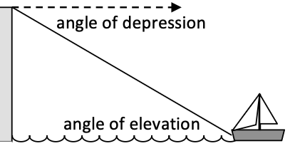
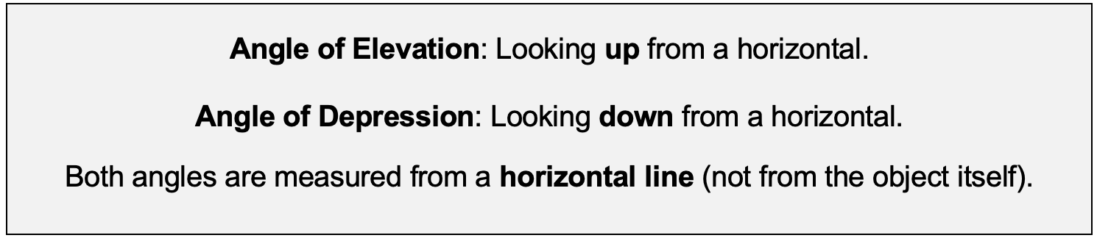
Workbook
page
ELEVATION AND DEPRESSION
47

Slide 25
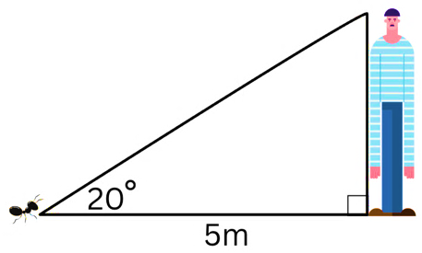
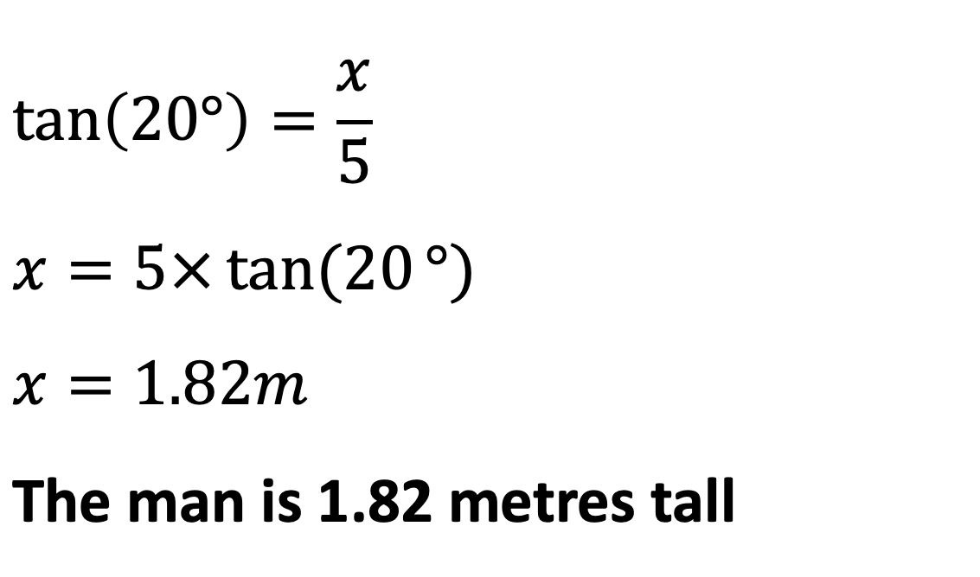
Workbook
page
ELEVATION AND DEPRESSION
47
Worked examples.
1. An ant on the ground is looking up at the tallest man he has ever seen. The ant is 5 metres away from the man and is looking up at an angle of 20º. How tall is the man?
$$\tan\left(20°\right)=\frac{x}{5}$$ $$x=5×\tan{(20}°)$$ $$x=1.82m$$ The man is 1.82 metres tall

Slide 26
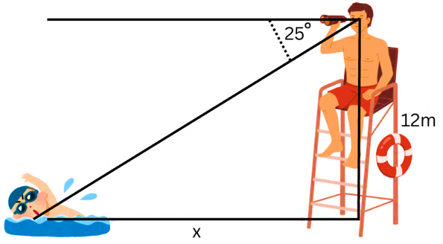

Workbook
page
ELEVATION AND DEPRESSION
47
Worked examples.
2. A lifeguard is sitting at the top of a lookout tower that is 12 m high. He spots a swimmer in the water at an angle of depression of 25°. How far is the swimmer from the base of the tower?
90° – 25° = 65°
$$\tan\left(65°\right)=\frac{x}{12}$$
$$x=12×\tan{(65}°)$$
$$x=25.73m$$
The swimmer is 25.73 metres from the base of the tower.

Slide 27
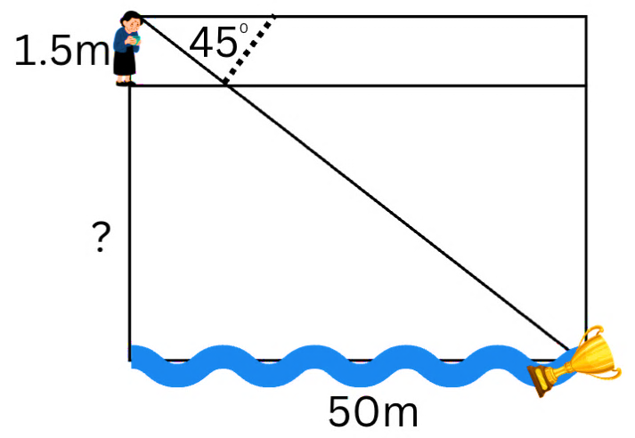
Workbook
page
ELEVATION AND DEPRESSION
48
With your teacher.
1. Elizabeth Blackburn dropped her Nobel Prize trophy off a cliff near her childhood home in Launceston.
Elizabeth contemplates jumping
in after it but is not sure how high
the cliff is. The trophy is currently
floating 50m away from the base of
the cliff, and Elizabeth is looking down
at it at an angle of depression of 45º.
If Elizabeth is 1.5 metres tall, how tall is the cliff?

Slide 28
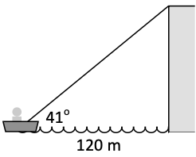
Workbook
page
ELEVATION AND DEPRESSION
48
With your teacher.
2. A small boat 120m out to sea notes that the angle of elevation to of the top of a cliff is 41º. Find the height of the cliff.

Slide 29
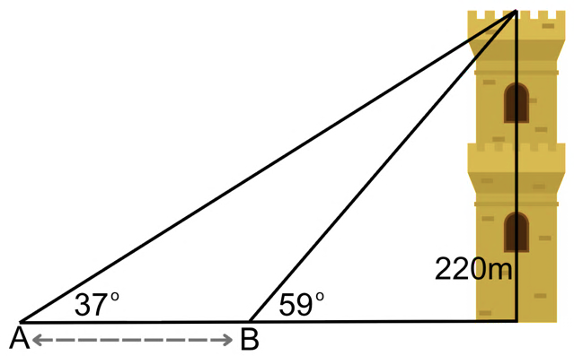
Workbook
page
ELEVATION AND DEPRESSION
49
Worked examples.
A woman standing at position A finds that the angle of elevation to the top of a 220m high tower is 37º. Upon walking to position B, which is closer to the tower, she finds that the angle has become 59º.
Find the distance that the woman walked between making the observations.

Slide 30
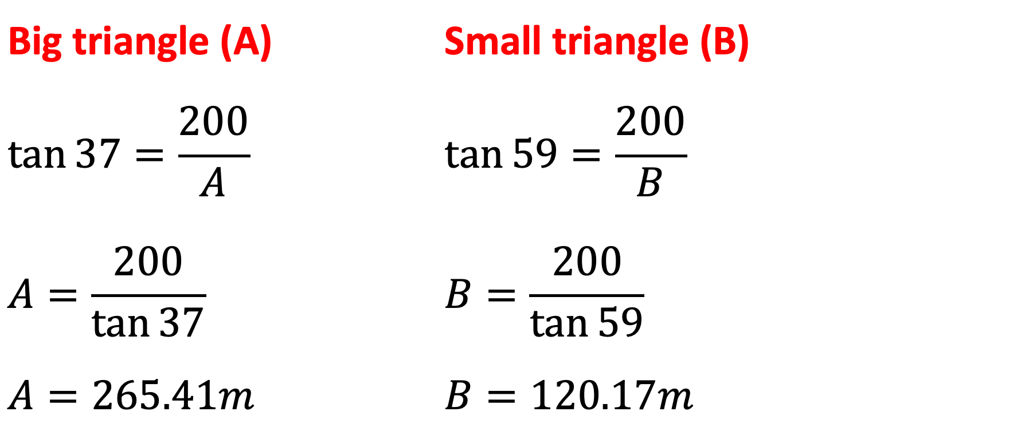
Workbook
page
ELEVATION AND DEPRESSION
49
Worked examples.
Big triangle (A) | Small triangle (B)
$$\tan{37}=\frac{200}{A}$$ | $$\tan{59}=\frac{200}{B}$$
$$A=\frac{200}{\tan{37}}$$ | $$B=\frac{200}{\tan{59}}$$
$$A=265.41m$$ | $$B=120.17m$$
Distance between = 265.41 – 120.17 = 145.24
The woman walked 145.24 metres between observations.

Slide 31
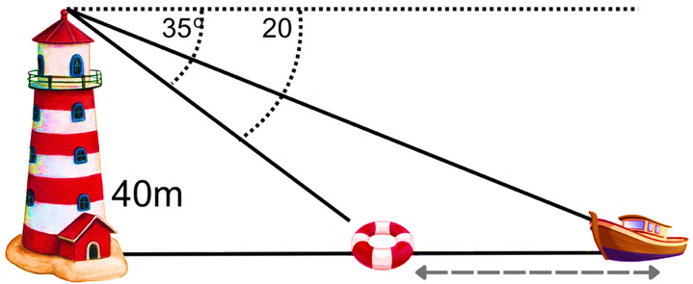
Workbook
page
ELEVATION AND DEPRESSION
49
With your teacher.
From the top of a lighthouse, 40m high, a lookout sees a small boat and a buoy in the same straight line out to sea. The angle of depression to the buoy is 35°. The angle of depression to the boat is 20°.
Find how far apart the boat and the buoy are.

Slide 32
Workbook
page
ELEVATION AND DEPRESSION
50
Try it yourself.
Complete the ‘try it yourself’ questions on page 50 of your workbook.

Slide 33
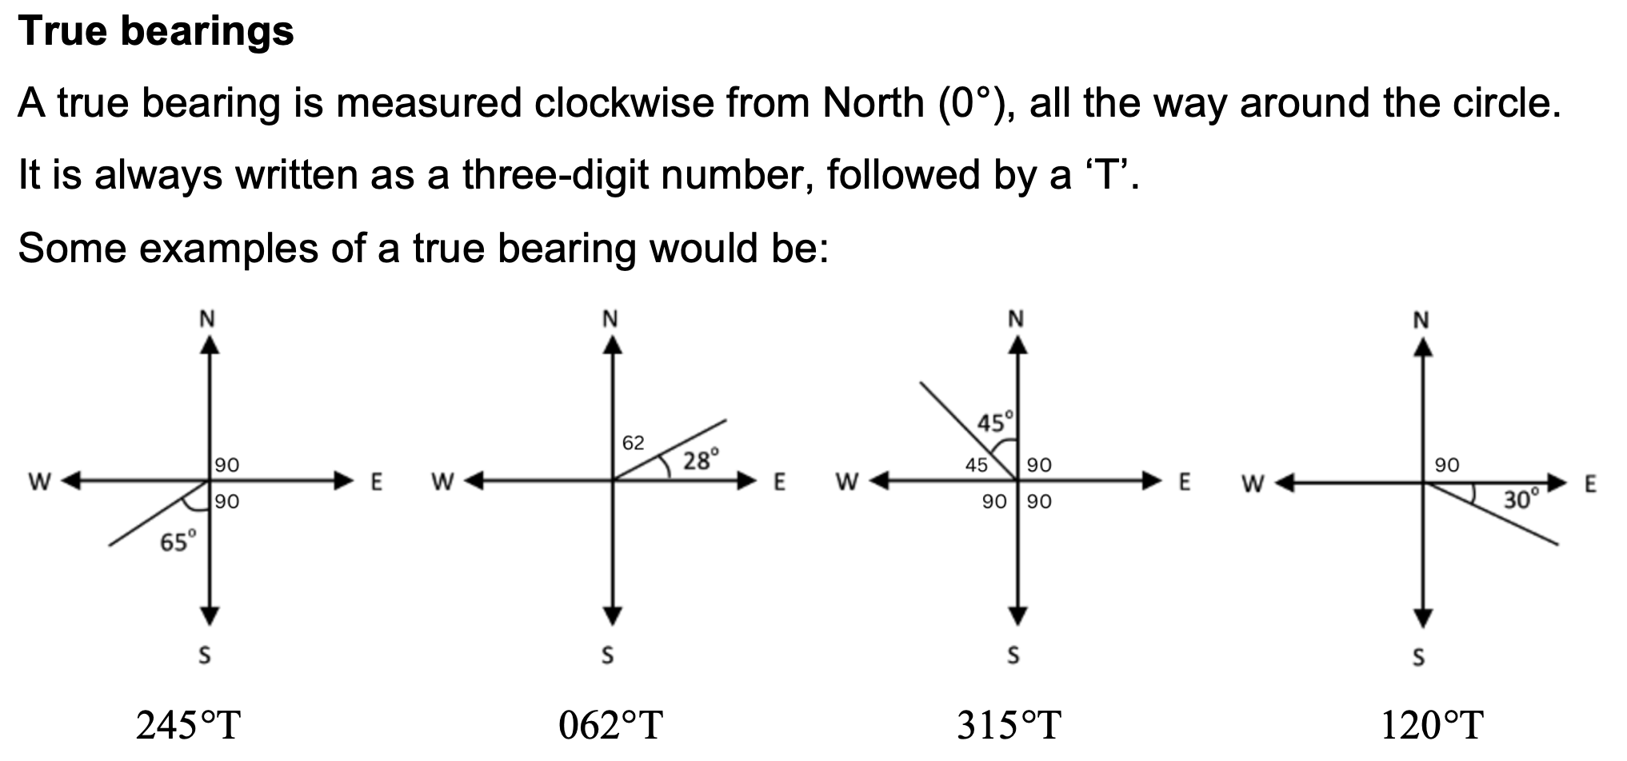
Workbook
page
BEARINGS
51

Slide 34
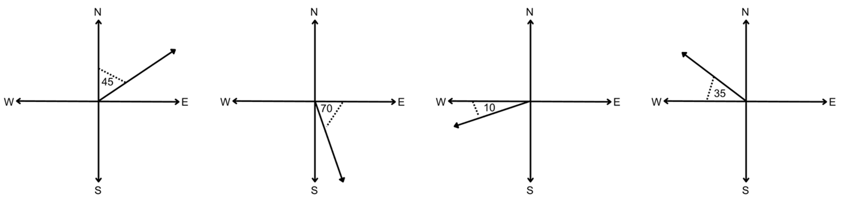
Workbook
page
BEARINGS
51
With your teacher.
1. Write the true bearings for the following diagrams.

Slide 35
Workbook
page
BEARINGS
51
With your teacher.
2. A boat leaves the harbour and sails on a true bearing of 090° for 5 km.
It then changes course and sails on a true bearing of 180° for 12 km.
Draw a sketch of the boat’s journey and use Pythagoras’ theorem to find how far the boat is from the harbour.

Slide 36
Workbook
page
BEARINGS
52
Reduced bearings.
Reduced bearings describe a direction by measuring the smallest angle from either North or South.
Reduced bearings start with N or S (N for North, S for South), then the angle (must be less than 90º) and then which side it is closest to (East or West).

Slide 37
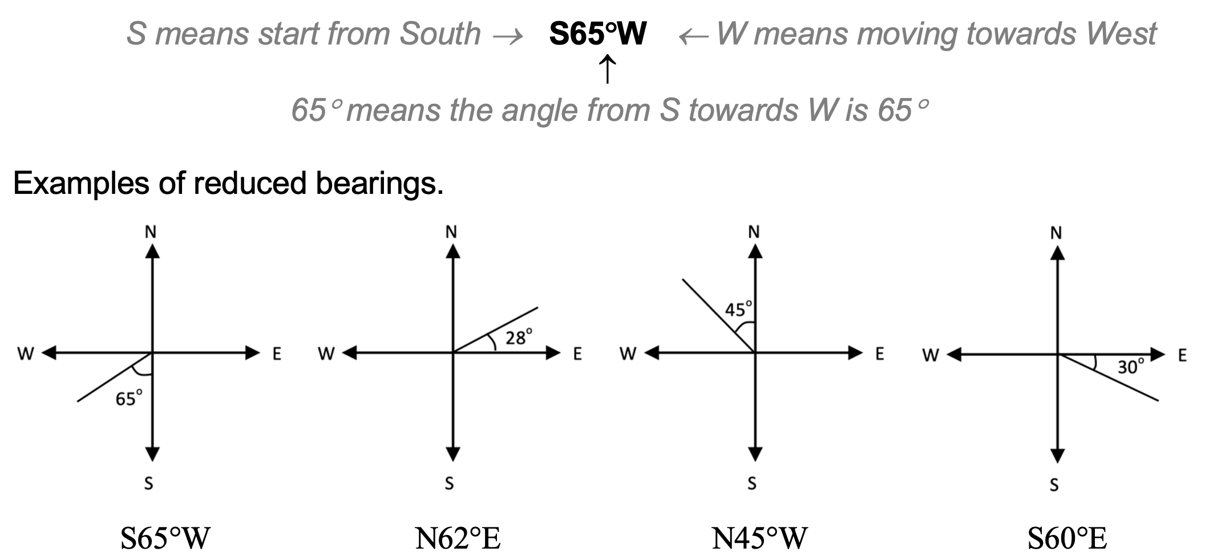
Workbook
page
BEARINGS
52

Slide 38
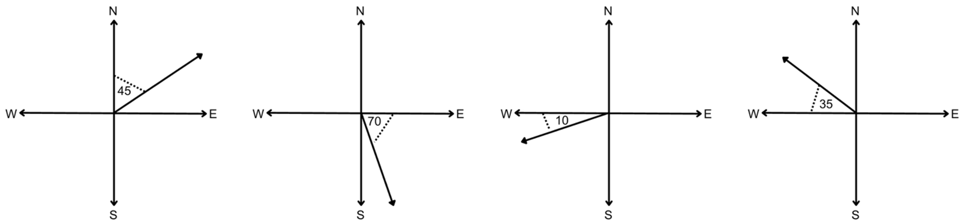
Workbook
page
BEARINGS
52
With your teacher.
1. Write the reduced bearings for the following diagrams.

Slide 39
Workbook
page
BEARINGS
52
With your teacher.
2. A hiker leaves a campsite and walks 4 km on a bearing of N 60° E.
She then turns and walks 9 km on a bearing of S 30° E.
Draw a sketch of the hiker’s journey and use trigonometric ratios or Pythagoras’ theorem to calculate how far she is from the campsite.

Slide 40
Workbook
page
BEARINGS
53
Try it yourself.
Complete the ‘try it yourself’ questions on page 53 of your workbook.

Slide 41
Workbook
page
TRIGONOMETRY CHALLENGE
54
Try it yourself.
Complete the ‘try it yourself’ questions on page 54 and 55 of your workbook.

