Slide 1

This PowerPoint has been designed for use with the workbook:
GM2 ALGEBRA
Workbooks, resources and PowerPoints are available at BertramEducation.com

Slide 2

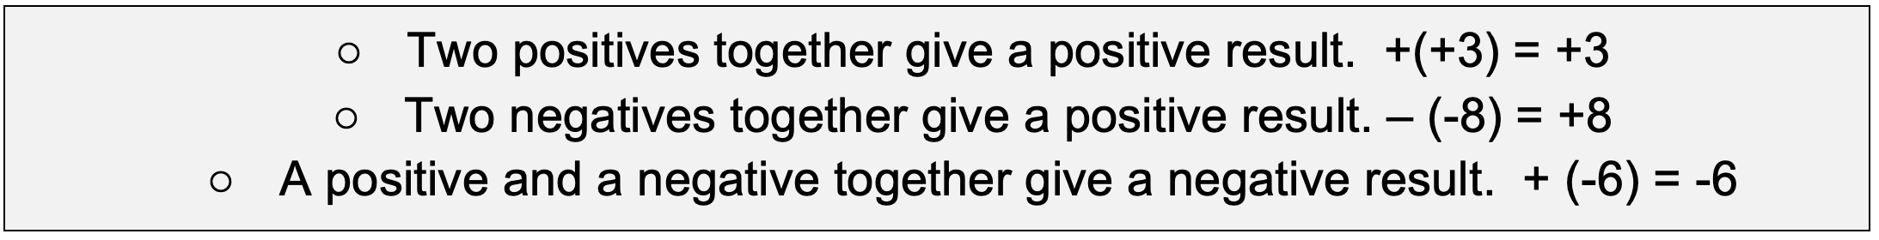
Workbook
page
1
DIRECTED NUMBERS
When working with positive and negative numbers (called directed numbers), signs can sometimes appear next to each other, such as +(-4) or -(-6).
You can simplify these combinations using some basic rules:

Slide 3


Workbook
page
DIRECTED NUMBERS
1
With your teacher.
Simplify the following:
a. $−\left(+38\right)=$ b. $+−21=$
c. $−(−17)=$ d. $−−9=$

Slide 4

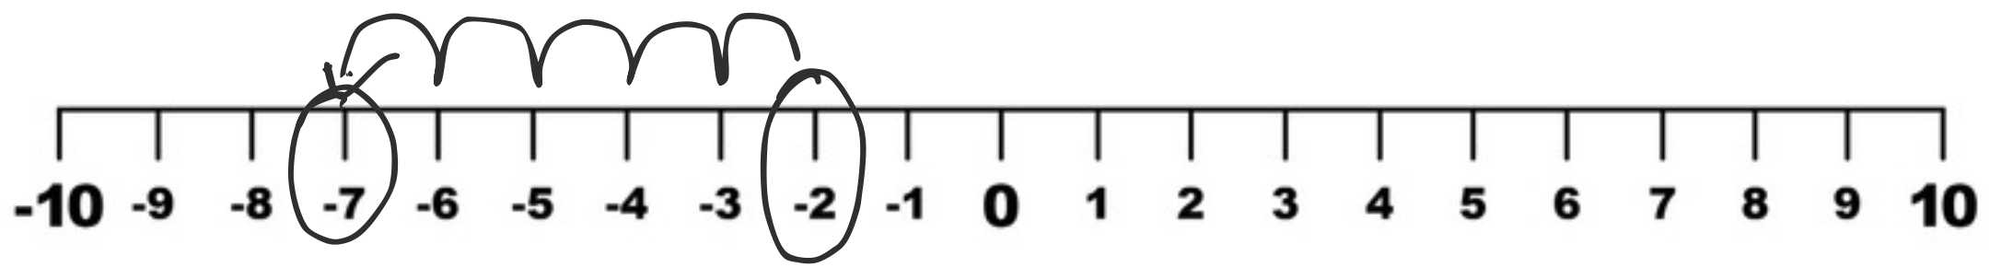

Workbook
page
DIRECTED NUMBERS
1
Adding and subtracting negative numbers
There are two sets of rules when dealing with directed numbers,
1. Addition and subtraction
2. Multiplication and division
When adding or subtracting directed numbers, you can imagine a number line.
Worked example.
Simplify: $−2−5$

Slide 5

Workbook
page
DIRECTED NUMBERS
1
Adding and subtracting negative numbers
With your teacher.
a. $5−9=$ b. $−4+6=$
c. $11+\left(−3\right)=$ d. $18+−22=$

Slide 6
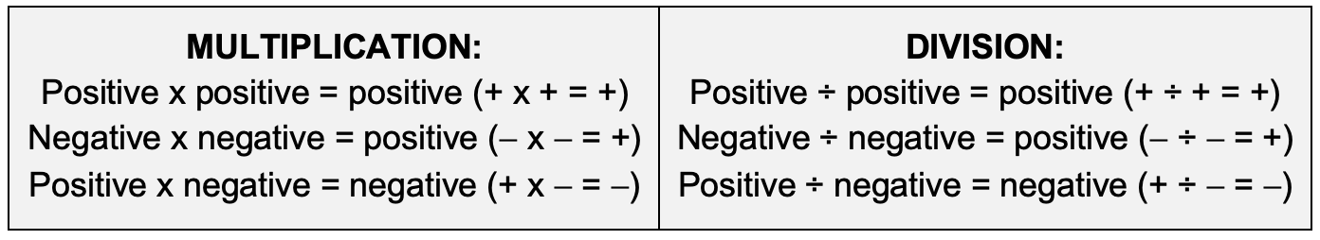
Workbook
page
DIRECTED NUMBERS
1
Multiplying and dividing negative numbers
When multiplying or dividing the rules are different.
To multiply or divide directed numbers follow these steps:
1. Ignore the signs and complete the calculation first
2. Then apply these sign rules:

Slide 7
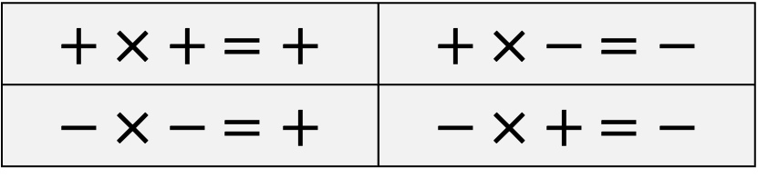
Workbook
page
DIRECTED NUMBERS
$$+ × + =+$$ | $$+ × − =−$$
$$− × − =+$$ | $$− × + =−$$
2
Multiplying and dividing negative numbers
Worked examples.
(a) –3 x 2 | (b) 25 ÷ –5 | (c) 3 x (1 + – 4 )
3 x 2 = 6 | 25 ÷ 5 = 5 | 3 x (–3)
– x + = – | + ÷ – = – | 3 x 3 = 9
∴ = –6 | ∴ = –5 | + x – = –
 |  | ∴ = –9
(d) +4 – (–3 + (–12 ÷ 2(–2)))
+ 4 – (–3 + (–12 ÷ – 4))
+ 4 – (–3 + (3))
+ 4 – (0)
∴ = 4

Slide 8

Workbook
page
DIRECTED NUMBERS
$$+ × + =+$$ | $$+ × − =−$$
$$− × − =+$$ | $$− × + =−$$
2
Multiplying and dividing negative numbers
With your teacher.
(a) $−7×6$ (b) $−2×−5$ (c) $15+−3$ (d) $−18+−3$
(e) $4×3+−5$ (f) $8×(2+−6)$ (g) $5×−3+\left(−4×−2\right)$

Slide 9

Workbook
page
DIRECTED NUMBERS
3
Try it yourself.
Complete the ‘try it yourself’ questions on page 3 of your workbook.

Slide 10
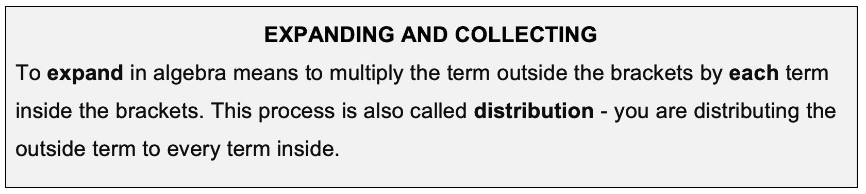
Workbook
page
EXPANDING AND COLLECTING
4
Worked examples.
a. 2(a + 5) | b. 3(f – 4) | c. 5(2 + r)
= 2 x a + 2 x 5 | = 3 x f + 3 x – 4 | = 5 x 2 + 5 x r
= 2a + 10 | = 3f – 12 | =10 + 5r

Slide 11
Workbook
page
EXPANDING AND COLLECTING
4
With your teacher.
a. 4(x – 2) ​​ | b. (3a + 1) | c. –2(5 – y)

Slide 12
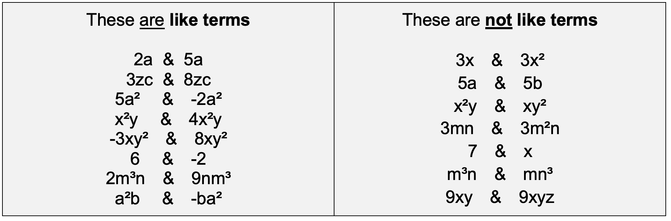
Workbook
page
EXPANDING AND COLLECTING
4
Only ‘like terms’ can be added or subtracted.
‘Like terms’ have the same combination of letters, to the same power. The order of letters is not important.

Slide 13
Workbook
page
EXPANDING AND COLLECTING
4
Steps to adding or subtracting algebraic terms:
  Identify like terms (same combination of letters, to the same powers)
  Rewrite expression so the like terms are grouped together.
  Add or subtract the coefficients (keep the variables the same)
  Write the simplified result.
  Repeat if there are more like terms. Keep grouping and simplifying until there are no more like terms to combine.

Slide 14
Workbook
page
EXPANDING AND COLLECTING
5
Worked examples.
(a) 7p + 4y – 3 – 2p + 6 | (b) 3(2a + 5) + 2(a – 4)
= 7p – 2p + 4y – 3 + 6 | = 3 x 2a + 3 x 5 + 2 x a + 2 x – 4
= 5p + 4y + 3 | = 6a + 15 + 2a – 8
 | = 6a + 2a + 15 – 8
 | = 8a + 7

Slide 15
Workbook
page
EXPANDING AND COLLECTING
5
With your teacher.
(a) 6t + 2 – 2t – 5 | (b) 5a – 3a + 4
(c) 4k + 7y – 1 – 6k + 2 | (d) 2(p + 4) – 3​​​​

Slide 16
Workbook
page
EXPANDING AND COLLECTING
5
With your teacher.
(e) 4(a – 1) + 2(3a + 2)​​​ | (f) 3(2s + 5) – 2(–s + 3)

Slide 17
Workbook
page
EXPANDING AND COLLECTING
5
With your teacher.
(g) 4(2d² – 3d + 1) - 3(d² – 4d – 2) | (h) ½ a + 4(¾ a – ¼ a) – a

Slide 18
Workbook
page
EXPANDING AND COLLECTING
6
Try it yourself.
Complete the ‘try it yourself’ questions on page 6 of your workbook.

Slide 19

Workbook
page
SOLVING LINEAR EQUATIONS
7
An equation shows that two expressions are equal,
just like the two sides of a balanced scale.
When the left side has the same value as the right side, the equation is balanced.
When solving an equation, the goal is to isolate the variable by performing the same operation on both sides.

Slide 20
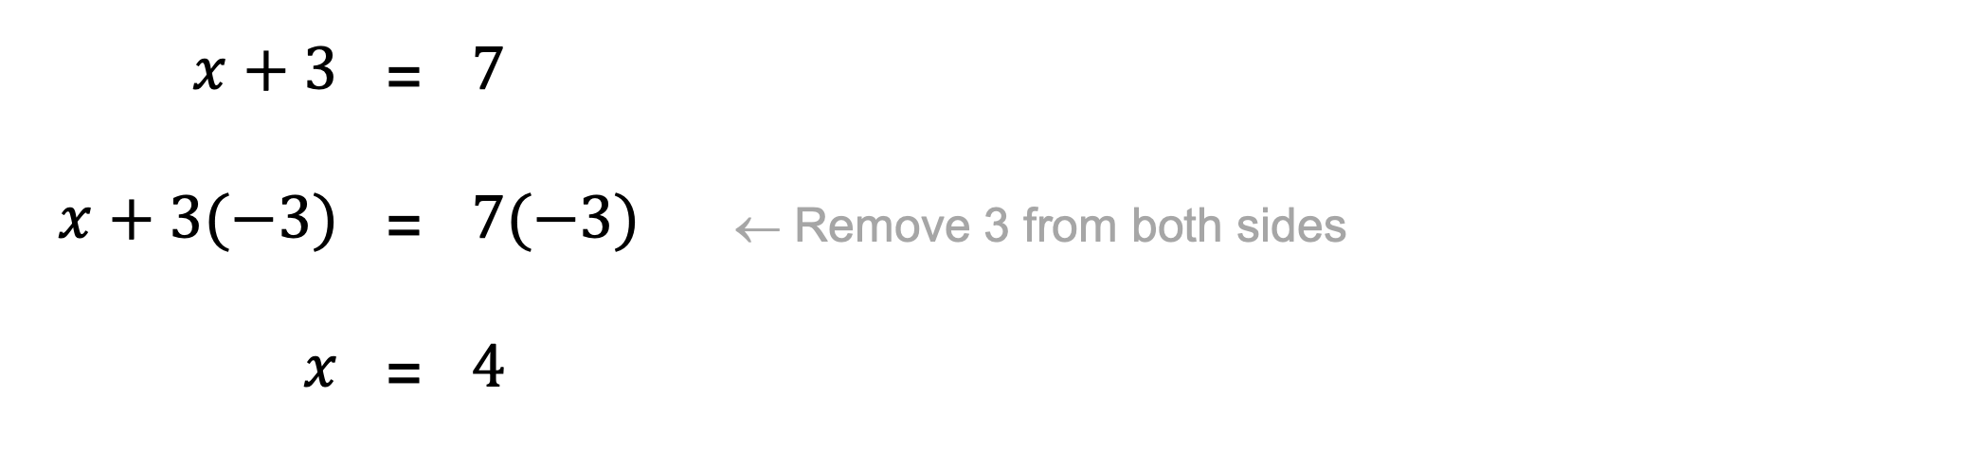
Workbook
page
SOLVING LINEAR EQUATIONS
7
Worked example.
Imagine you have two small buckets hanging from a scale.
One bucket has x coins plus 3 more (x + 3), and the other bucket has exactly 7 coins ( 7 ).
If the scale is balanced, then both sides weigh the same: x + 3 = 7
To find out how many are in the first bucket (x), remove 3 from both sides:
$$x+3$$ | = | $$7$$
$$x+3(−3)$$ | = | $$7(−3)$$ | ← Remove 3 from both sides
$$x$$ | = | $$4$$

Slide 21
Workbook
page
SOLVING LINEAR EQUATIONS
7
To isolate the variable, you need to remove everything on that side that isn’t the variable you are trying to isolate.
We remove terms by doing the opposite operation.
Opposite operations
Addition (+) and subtraction (-) are opposites
Multiplication (×) and division (÷) are opposites

Slide 22
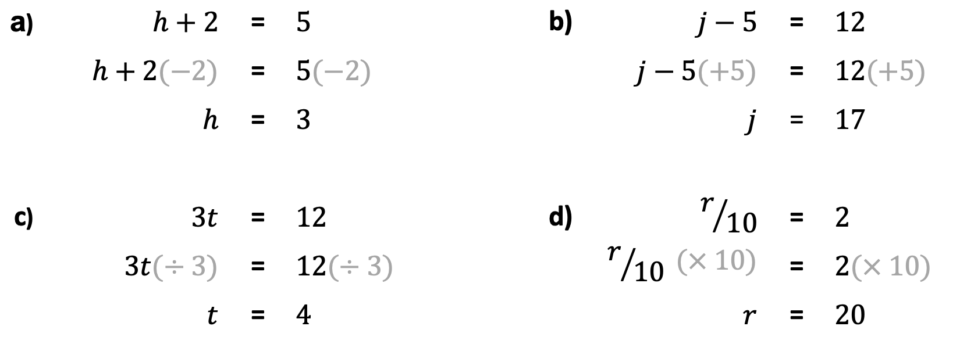
Workbook
page
SOLVING LINEAR EQUATIONS
7
Worked examples.

Slide 23
Workbook
page
SOLVING LINEAR EQUATIONS
8
With your teacher.
x + 4 = 9 | x + 5 = 12 | x - 2 = 7

Slide 24
Workbook
page
SOLVING LINEAR EQUATIONS
8
With your teacher.
x - 9 = -1 | 3x = 21 | -2x = -10

Slide 25
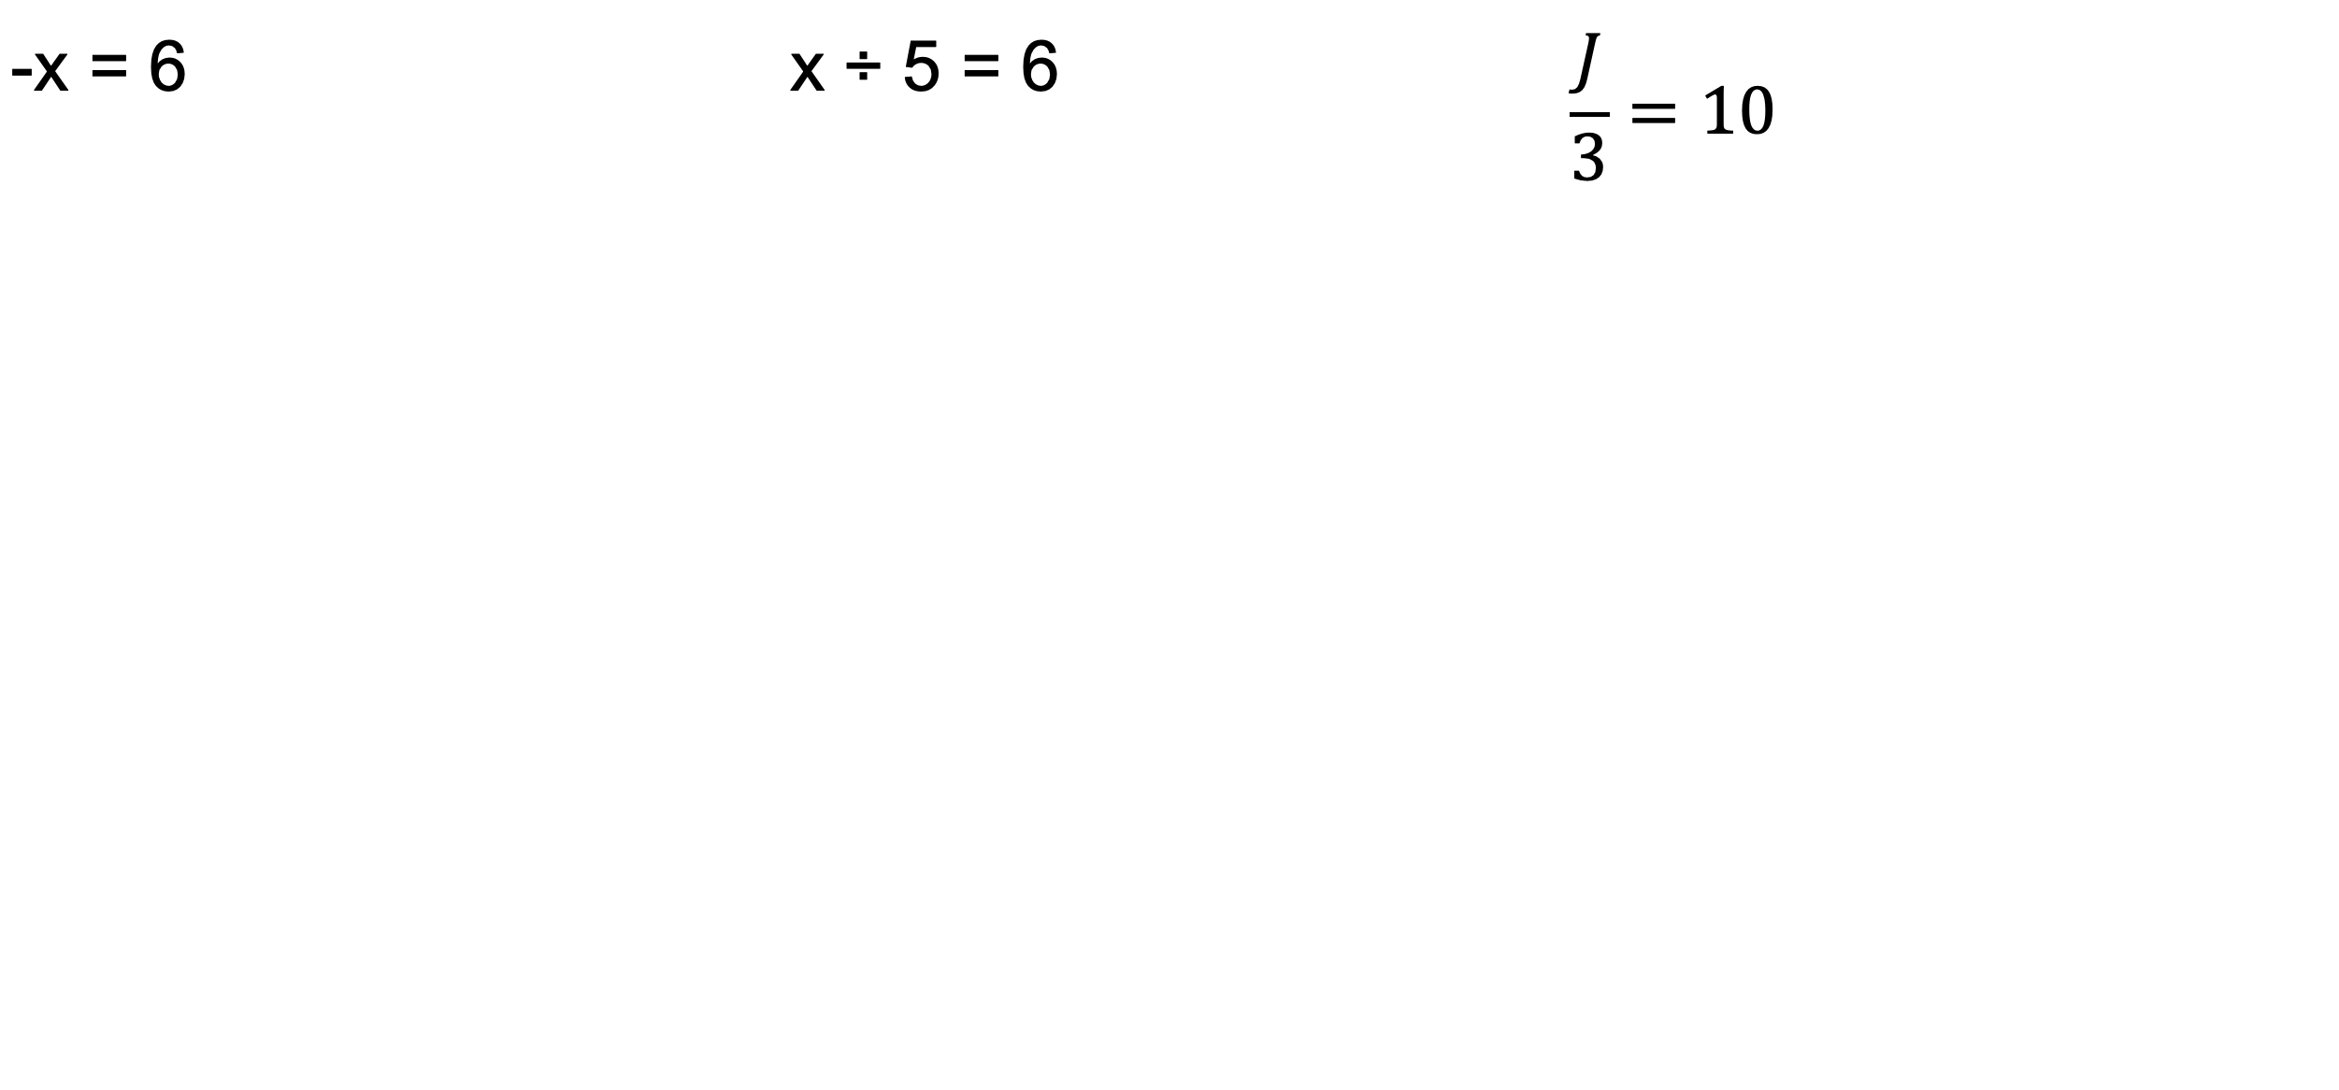
Workbook
page
SOLVING LINEAR EQUATIONS
8
With your teacher.
-x = 6 | x ÷ 5 = 6 | $$\frac{J}{3}=10$$

Slide 26
Workbook
page
SOLVING LINEAR EQUATIONS
8
Solving equations often require more than one step. In this situation, you need to do the reverse of BODMAS.
Sometimes it helps to write down what order you would normally complete the steps, and then do them backwards.

Slide 27
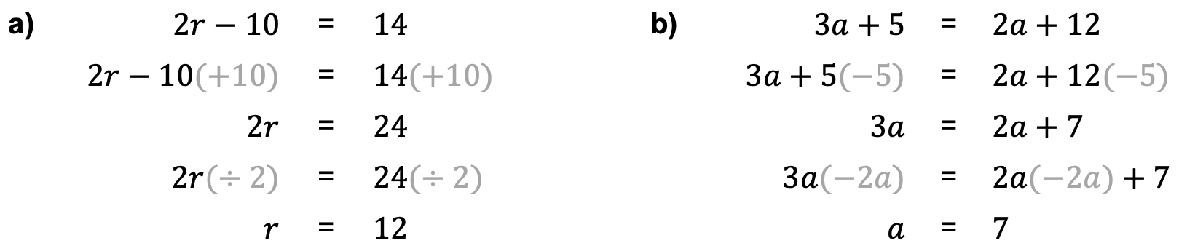
Workbook
page
SOLVING LINEAR EQUATIONS
8
Worked examples.

Slide 28
Workbook
page
SOLVING LINEAR EQUATIONS
8
With your teacher.
2y + 3 = 11 | 5e – 4 = 16

Slide 29
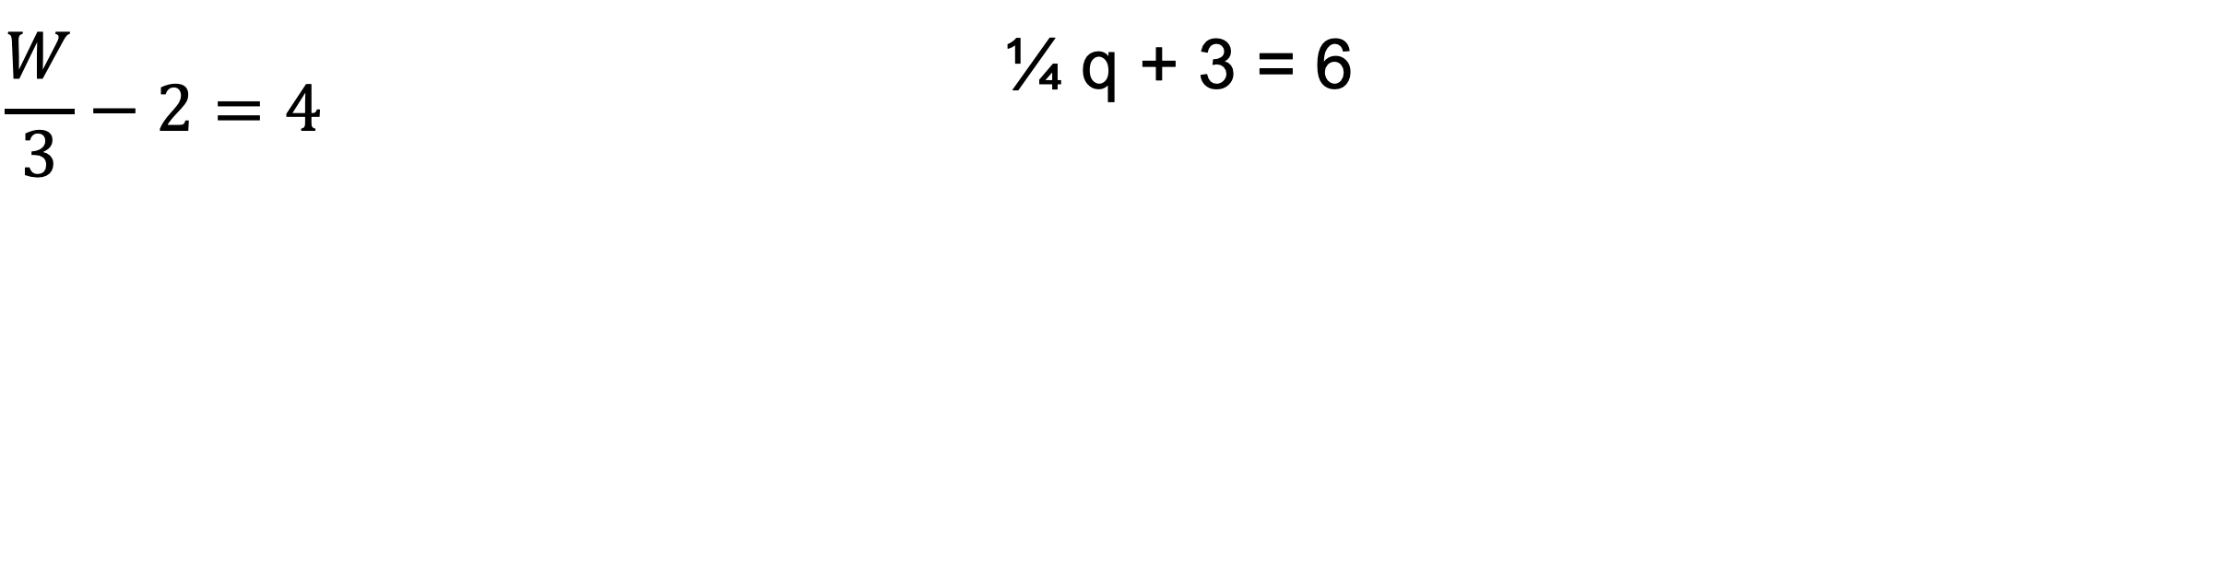
Workbook
page
SOLVING LINEAR EQUATIONS
8
With your teacher.
$$\frac{W}{3}−2=4$$ | ¼ q + 3 = 6

Slide 30
Workbook
page
SOLVING LINEAR EQUATIONS
9
With your teacher.
2(w - 4) = w + 3 | 5u – 2 = 3(u + 1)

Slide 31
Workbook
page
SOLVING LINEAR EQUATIONS
9
With your teacher.
½(j + 4) = 3j - 2 | 6n – (2n + 1) = 3n + 7

Slide 32
Workbook
page
SOLVING LINEAR EQUATIONS
9
Try it yourself.
Complete the ‘try it yourself’ questions on page 9 and 10 of your workbook.

Slide 33

Workbook
page
SUBSTITUTION
11
Substitution
Substitution means replacing variables with known values and then calculating the result.
It is a way of finding the value of an expression when all variables are given.

Slide 34
Workbook
page
SUBSTITUTION
11
Worked examples.
1.
C = 3m + 12
Find C if m = 4
C = 3(4) + 12
C = 12 + 12
∴ C = 24
2.
A = πr²
Find A if π = 3.14, r = 6
A = (3.14) x (6)²
A = 3.14 x 36
∴ A = 113.04

Slide 35
Workbook
page
SUBSTITUTION
11
Worked examples (continued).
3.
D = st
Find D if s = 60, t = 2.5
D = (60) x (2.5)
∴ D = 150

Slide 36
Workbook
page
SUBSTITUTION
11
With your teacher
1.
If T = bh + 4, Find T when b = 7, h = 5

Slide 37
Workbook
page
SUBSTITUTION
11
With your teacher
2.
If S = ½ at² Find S when a = 6, t = 3

Slide 38
Workbook
page
SUBSTITUTION
11
With your teacher
3.
If I = PRT ÷ 100 Find I when P = 1200, R = 5, T = 3

Slide 39
Workbook
page
SUBSTITUTION
12
Try it yourself.
Complete the ‘try it yourself’ questions on page 12 of your workbook.

Slide 40
Workbook
page
TRANSPOSITION
13
Transposition is the process of rearranging an equation to make a different variable the subject.
It’s similar to solving an equation — you perform operations on both sides to isolate the subject variable.
Remember: whatever you do to one side of the equation, you must do to the other.

Slide 41
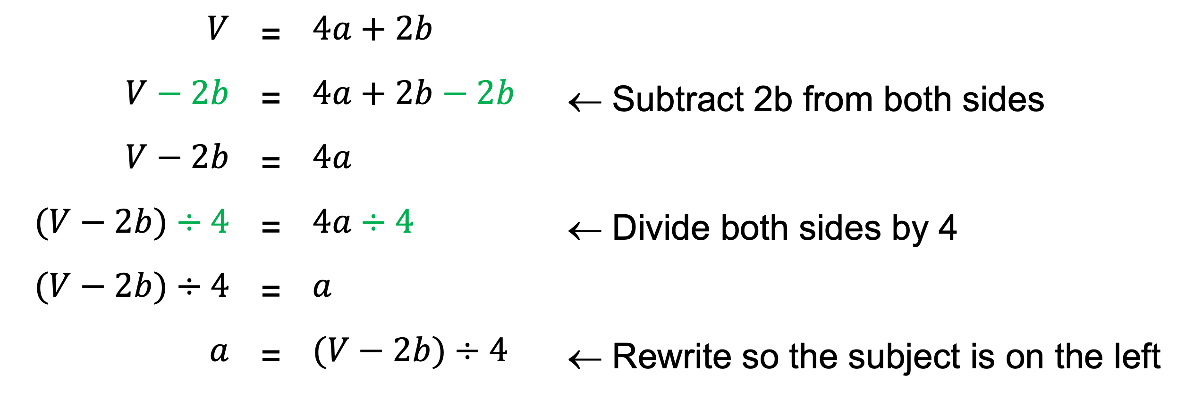
Workbook
page
TRANSPOSITION
13
Worked examples.
Transpose V = 4a + 2b to make ‘a’ the subject
$$V$$ | = | $$4a+2b$$
$$V−2b$$ | = | $$4a+2b−2b$$ | ← Subtract 2b from both sides
$$V−2b$$ | = | $$4a$$
$$(V−2b)÷4$$ | = | $$4a÷4$$ | ← Divide both sides by 4
$$(V−2b)÷4$$ | = | $$a$$
$$a$$ | = | $$(V−2b)÷4$$ | ← Rewrite so the subject is on the left

Slide 42
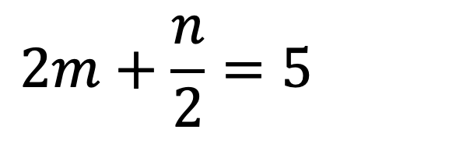
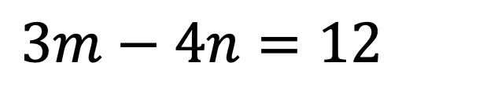

Workbook
page
TRANSPOSITION
13
With your teacher.
Transpose the following to make m the subject:
$$m+2n=7$$
$$2m+\frac{n}{2}=5$$
$$3m−4n=12$$

Slide 43
Workbook
page
TRANSPOSITION
13
Try it yourself.
Complete the ‘try it yourself’ questions on page 13 of your workbook.

Slide 44

Workbook
page
13
Please use the workbook as a guide through the spreadsheet section (part 2).
Use Excel to display progress on the screen.

