Slide 1

This PowerPoint has been designed for use with the workbook:
GM3 SEQUENCES
Workbooks, resources and PowerPoints are available at BertramEducation.com

Slide 2

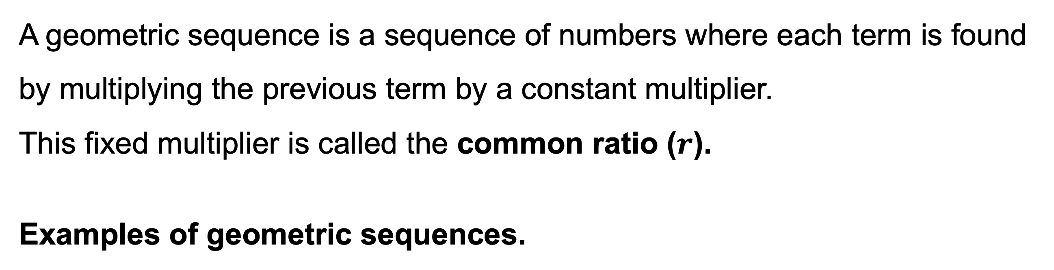
Workbook
page
28
A geometric sequence is a sequence of numbers where each term is found by multiplying the previous term by a constant multiplier.
This fixed multiplier is called the common ratio ($r$).
Examples of geometric sequences.
2, 4, 8, 16, 32, … | ← × 2 each time (common ratio = 2)
100, 50, 25, 12.5, … | ← ÷ 2 each time (common ratio = ½)
81, 27, 9, 3, 1, … | ← ÷ 3 each time (common ratio = ⅓)
5, 5, 5, 5, 5, … | ← ×1 each time (common ratio = 1)

Slide 3

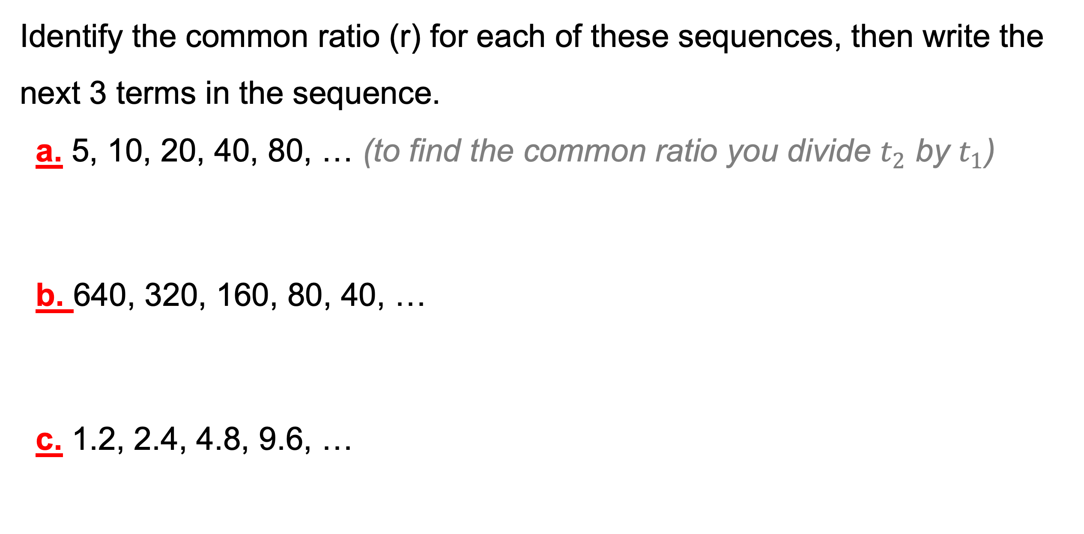
Workbook
page
GEOMETRIC SEQUENCES
28
Intro to geometric sequences
With your teacher.
Identify the common ratio (r) for each of these sequences, then write the next 3 terms in the sequence.
a. 5, 10, 20, 40, 80, … (to find the common ratio you divide $t_{2}$ by $t_{1}$)
b. 640, 320, 160, 80, 40, …
c. 1.2, 2.4, 4.8, 9.6, …

Slide 4
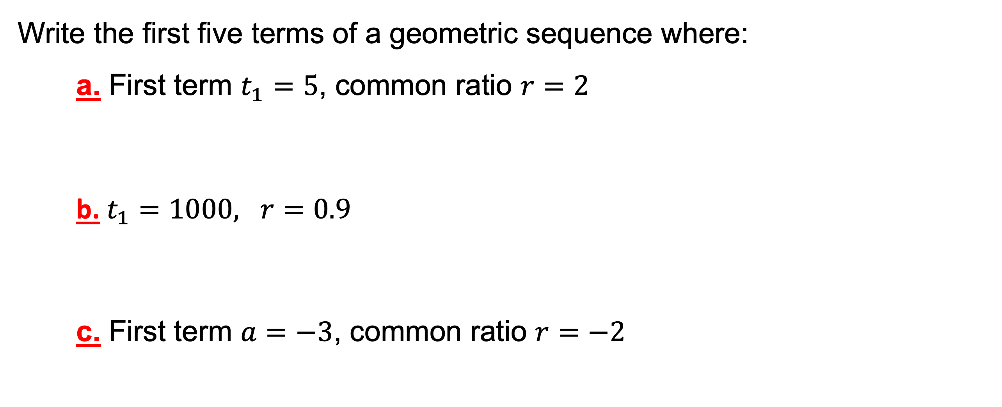
Workbook
page
GEOMETRIC SEQUENCES
29
Intro to geometric sequences
With your teacher.
Write the first five terms of a geometric sequence where:
a. First term $t_{1}=5$, common ratio $r=2$
    b. $t_{1}=1000, r=0.9$
    c. First term $a=−3$, common ratio $r=−2$

Slide 5
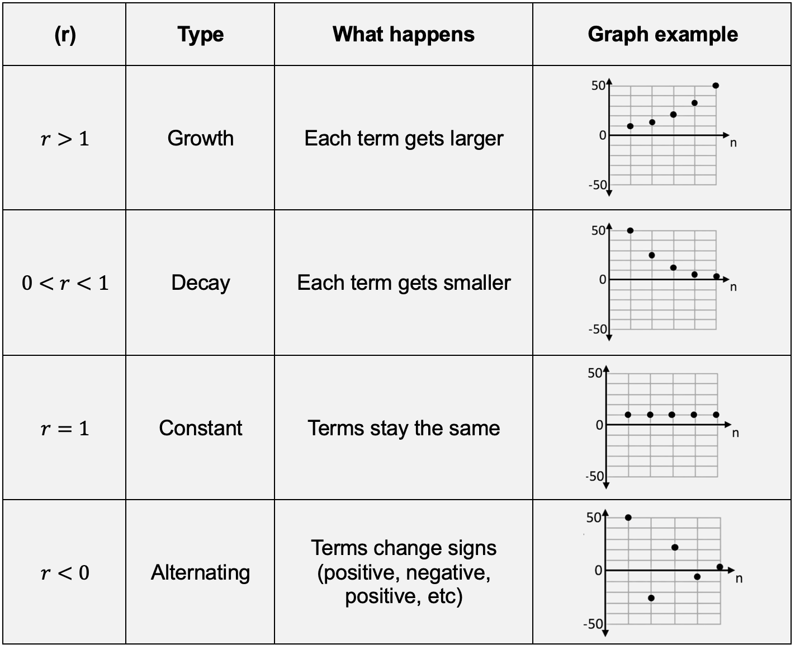
Workbook
page
GEOMETRIC SEQUENCES
29
Intro to geometric sequences

Slide 6
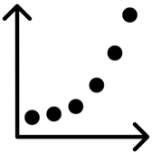
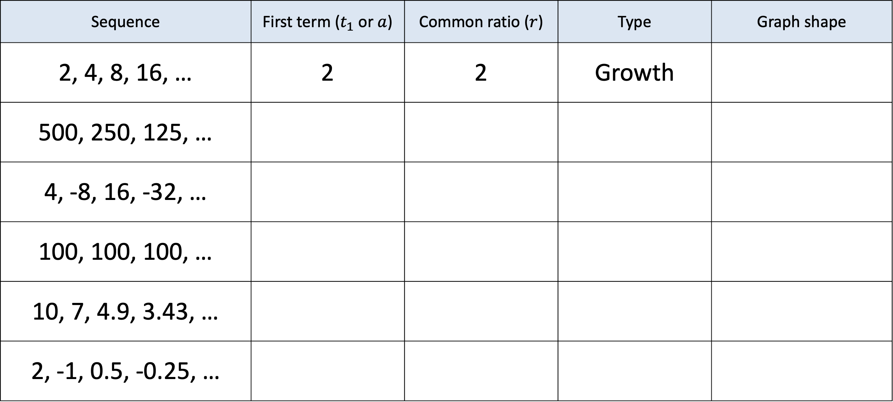
Workbook
page
GEOMETRIC SEQUENCES
30
Intro to geometric sequences
With your teacher.
Sequence | First term ($t_{1}$ or $a$) | Common ratio ($r$) | Type | Graph shape
2, 4, 8, 16, … | 2 | 2 | Growth
500, 250, 125, …
4, -8, 16, -32, …
100, 100, 100, …
10, 7, 4.9, 3.43, …
2, -1, 0.5, -0.25, …

Slide 7

Workbook
page
GEOMETRIC SEQUENCES
30
Intro to geometric sequences
Try it yourself.
Complete the ‘try it yourself’ questions on page 30 and 31 of your workbook.

Slide 8


Workbook
page
GEOMETRIC SEQUENCES
32
Tables and graphs
Worked example.
Dr Nguyen is studying the growth of E. coli bacteria in a controlled laboratory experiment. They place a small sample of bacteria into a nutrient dish at 9 am. Under perfect conditions, E. coli bacteria double in number every hour. Dr Nguyen checks and records the number of bacteria each hour to see how quickly the population increases.
The number of bacteria after each hour forms a geometric sequence.
100, 200, 400, 800, 1600, 3200, 6400, …

Slide 9
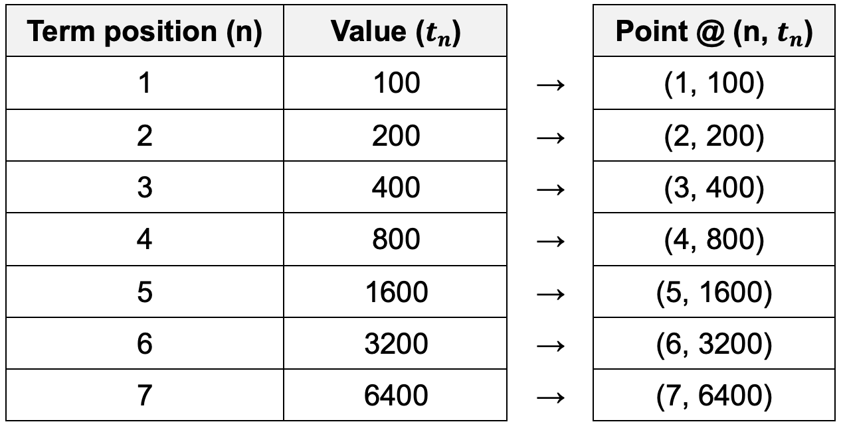
Workbook
page
GEOMETRIC SEQUENCES
32
Tables and graphs
Worked example.
Step 1: Create a table showing term position (n) and the value of the term ($t_{n}$):

Slide 10
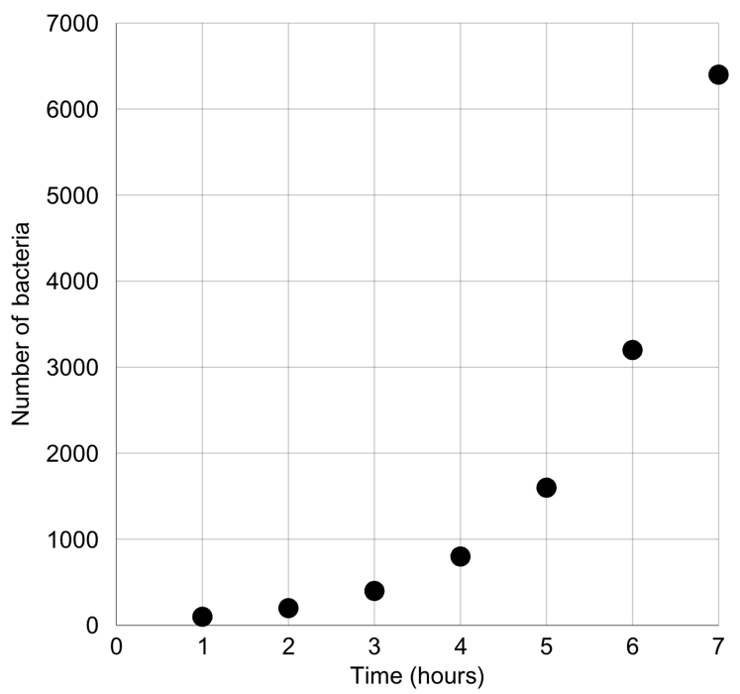
Workbook
page
GEOMETRIC SEQUENCES
32
Tables and graphs
Worked example.
Step 2: Plot each point on a graph. Do not use a line to connect.
Note – The shape of this graph is different to the arithmetic sequence graphs.
This graph shows exponential growth. It grows slowly at first, then very quickly.
All geometric sequence graphs are exponential.

Slide 11

Workbook
page
GEOMETRIC SEQUENCES
33
Tables and graphs
With your teacher.
Dr. Singh is studying the decay of a radioactive isotope used in medical imaging. At the start of the experiment, there are 2000 atoms of the isotope. Every hour, only 70% of the atoms remain (the rest decay).
Write the first 7 terms of the sequence, showing how many atoms remain each hour.

Slide 12
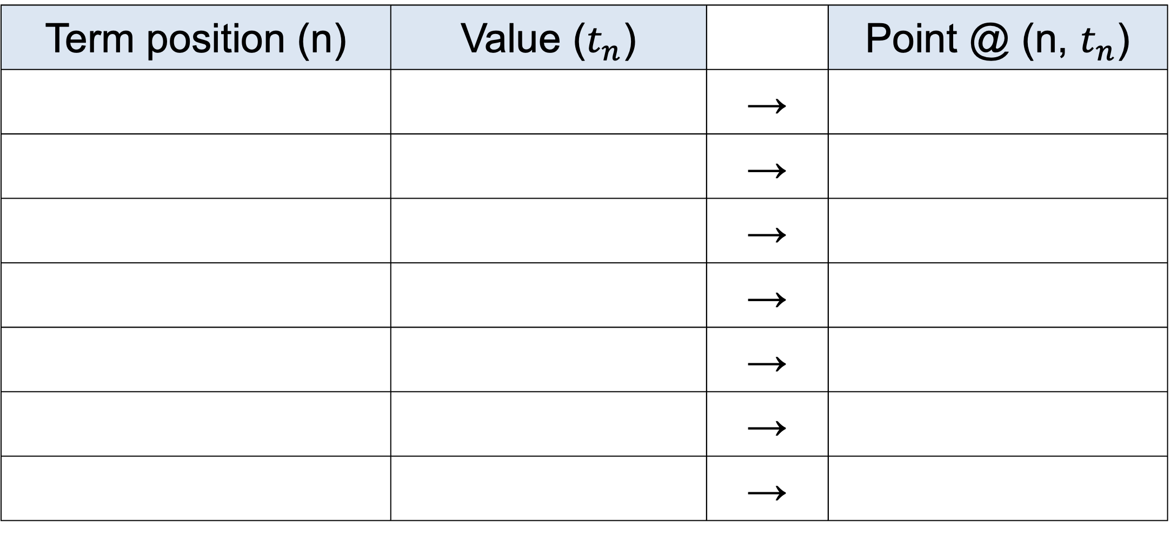
Workbook
page
GEOMETRIC SEQUENCES
33
Tables and graphs
With your teacher.
Complete the below table showing the decay of the atoms over time.
Term position (n) | Value ($t_{n}$) |  | Point @ (n, $t_{n}$)
 |  | →
 |  | →
 |  | →
 |  | →
 |  | →
 |  | →
 |  | →

Slide 13
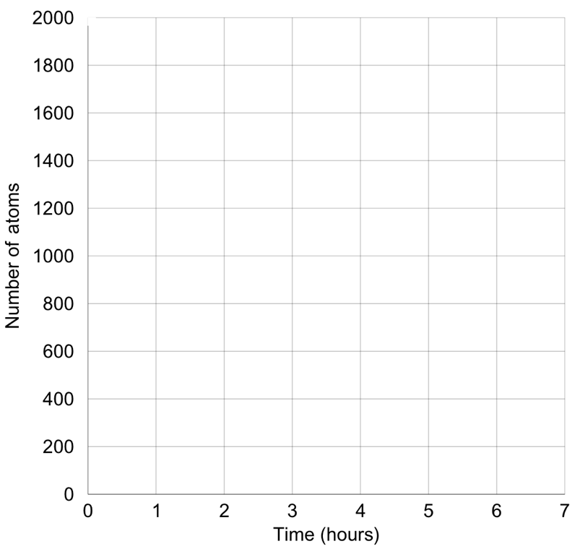
Workbook
page
GEOMETRIC SEQUENCES
33
Tables and graphs
With your teacher.
Graph the geometric sequence showing the decay of atoms over time.

Slide 14

Workbook
page
GEOMETRIC SEQUENCES
33
Tables and graphs
With your teacher.
Identify the first term ($a$) and common ratio ($r$).

Slide 15
Workbook
page
GEOMETRIC SEQUENCES
34
Tables and graphs
Try it yourself.
Complete the ‘try it yourself’ questions on page 34, 35 and 36 of your workbook.

Slide 16
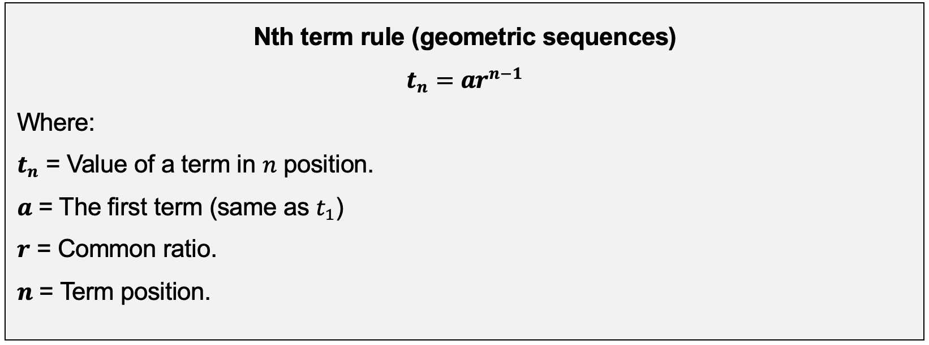
Workbook
page
GEOMETRIC SEQUENCES
37
Nth term rule

Slide 17

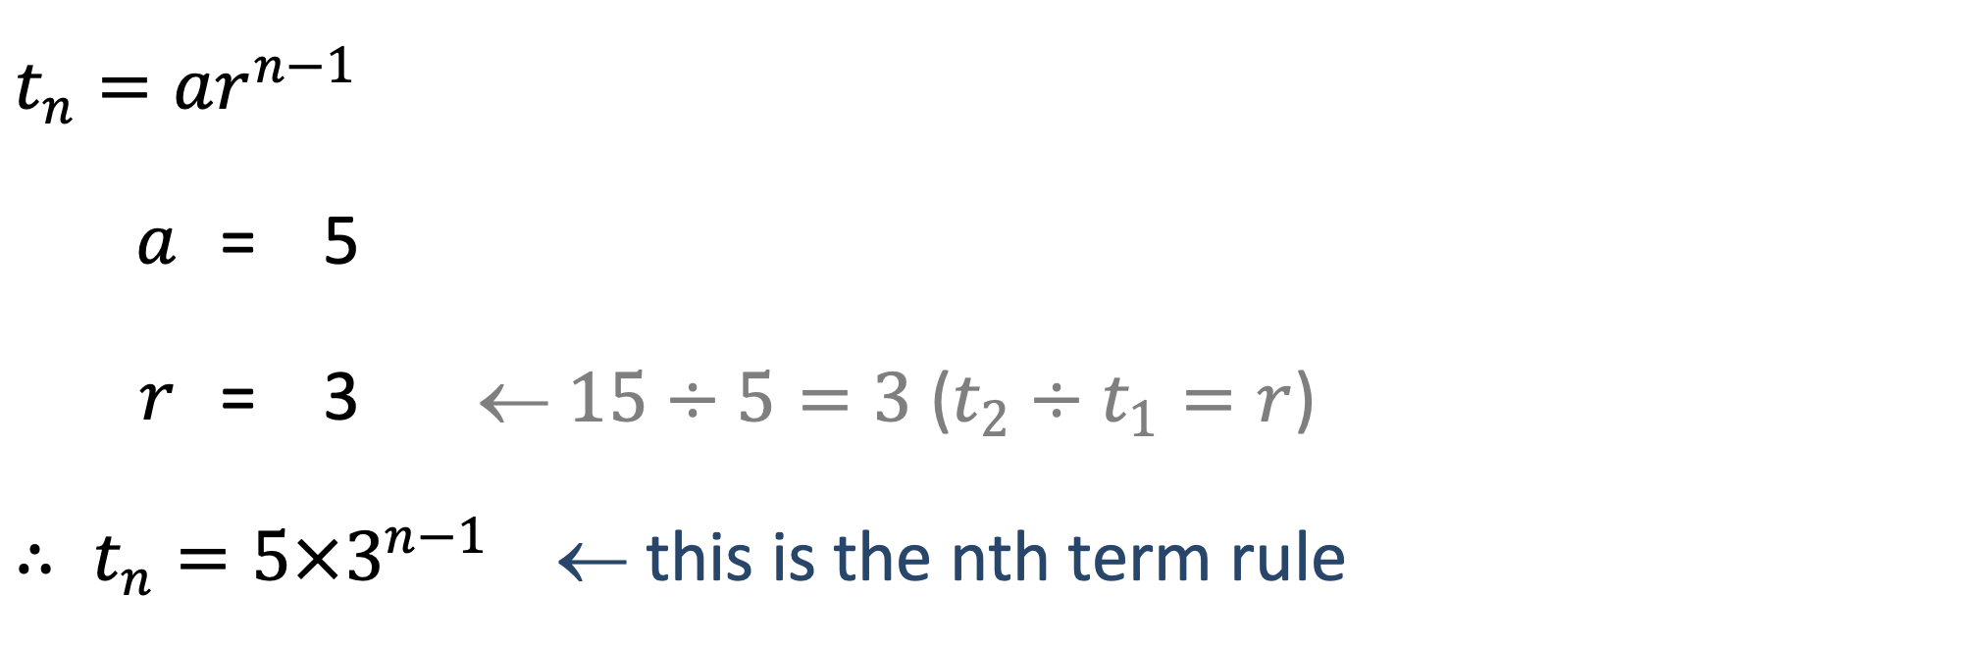
Workbook
page
GEOMETRIC SEQUENCES
37
Nth term rule
Worked example.
Find a rule for the sequence 5, 15, 45, 135, …
$$t_{n}=ar^{n−1}$$
 | $$a$$ | = | 5
 | $$r$$ | = | 3 | ← $15÷5=3$ ($t_{2}÷t_{1}=r$)
$∴ t_{n}=5×3^{n−1}$ ← this is the nth term rule

Slide 18
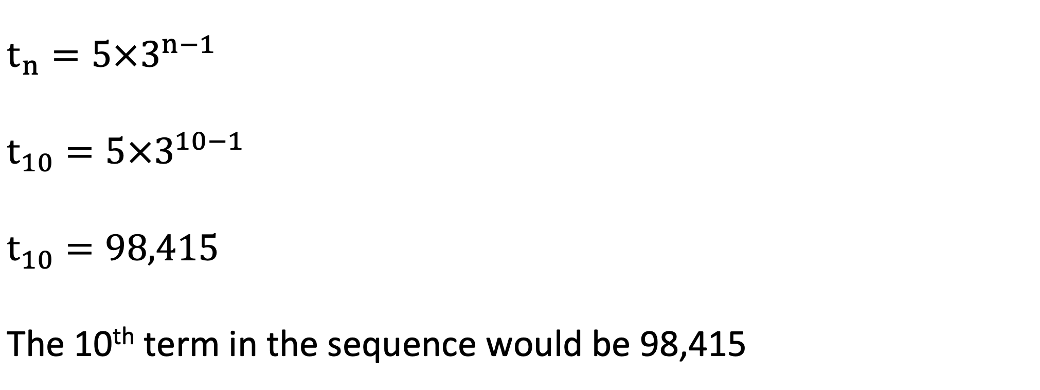
Workbook
page
GEOMETRIC SEQUENCES
37
Nth term rule
Worked example.
Use the nth term rule to find the 10th term of the sequence.
$$t_{n}=5×3^{n−1}$$
$$t_{10}=5×3^{10−1}$$
$$t_{10}=98,415$$
The 10th term in the sequence would be 98,415

Slide 19
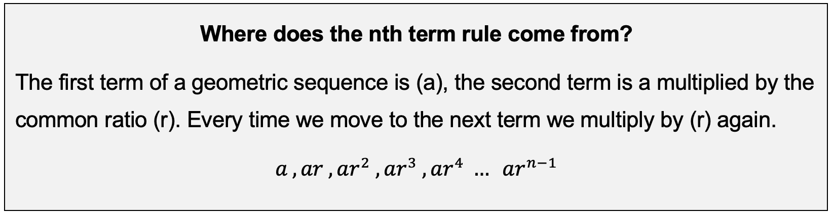
Workbook
page
GEOMETRIC SEQUENCES
37
Nth term rule

Slide 20
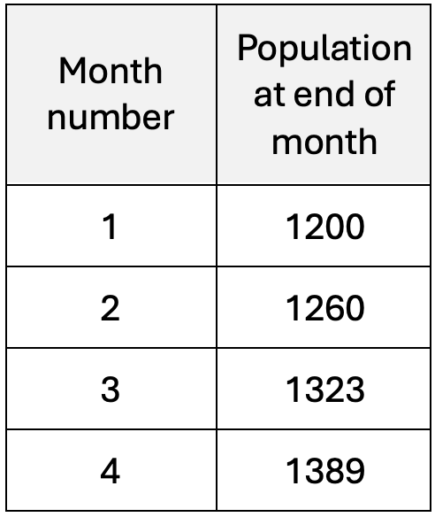

Workbook
page
GEOMETRIC SEQUENCES
38
Nth term rule
With your teacher.
1. A population of tadpoles is increasing according to the table.
a. Show that the data forms a geometric sequence.
(Divide each term by the previous term, if the ratio is
the same each time, it’s a geometric sequence)

Slide 21
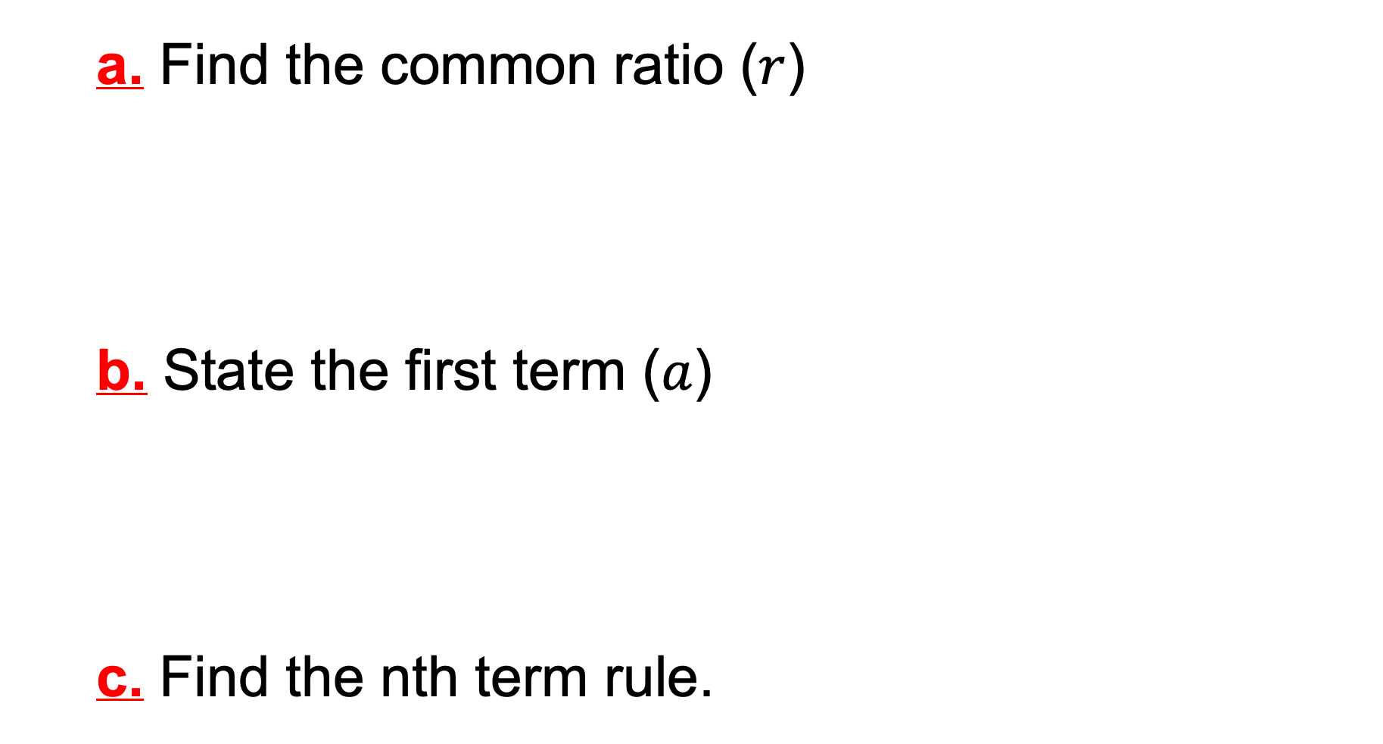
Workbook
page
GEOMETRIC SEQUENCES
38
Nth term rule
With your teacher.
a. Find the common ratio ($r$)
b. State the first term ($a$)
c. Find the nth term rule.

Slide 22
Workbook
page
GEOMETRIC SEQUENCES
38
Nth term rule
With your teacher.
  d. Find the expected number of tadpoles after 12 months.
  e. Use the term from the second month (2, 1260) to verify the sequence.
(sub the n = 2 into the sequence rule you made, it should = 1260)

Slide 23
Workbook
page
GEOMETRIC SEQUENCES
38
Nth term rule
With your teacher.
2. Find the rule and the 10th term of the sequence: 6400, 3200, 1600, 800, …

Slide 24
Workbook
page
GEOMETRIC SEQUENCES
39
Nth term rule
Try it yourself.
Complete the ‘try it yourself’ questions on page 39, 40, 41 and 42 of your workbook.

Slide 25
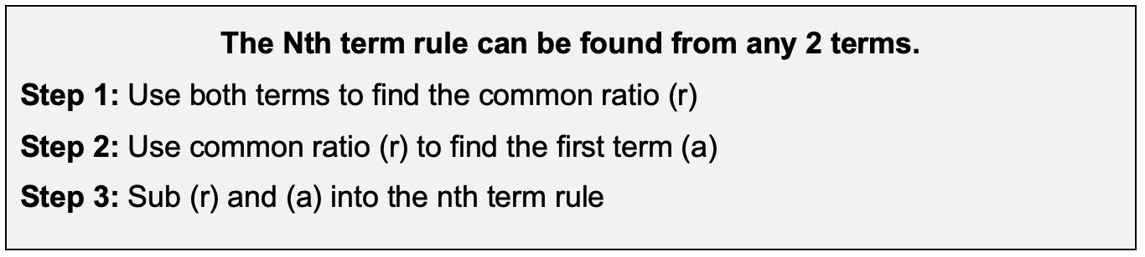
Workbook
page
GEOMETRIC SEQUENCES
43
Nth term rule

Slide 26

Workbook
page
GEOMETRIC SEQUENCES
43
Nth term rule
Worked example.
The fourth term of a geometric sequence is 192. The 8th term is 49,152. Find:
  a. The common ratio (r)
  b. The first term (a).
  c. The rule for the sequence.
  d. The 10th term.

Slide 27
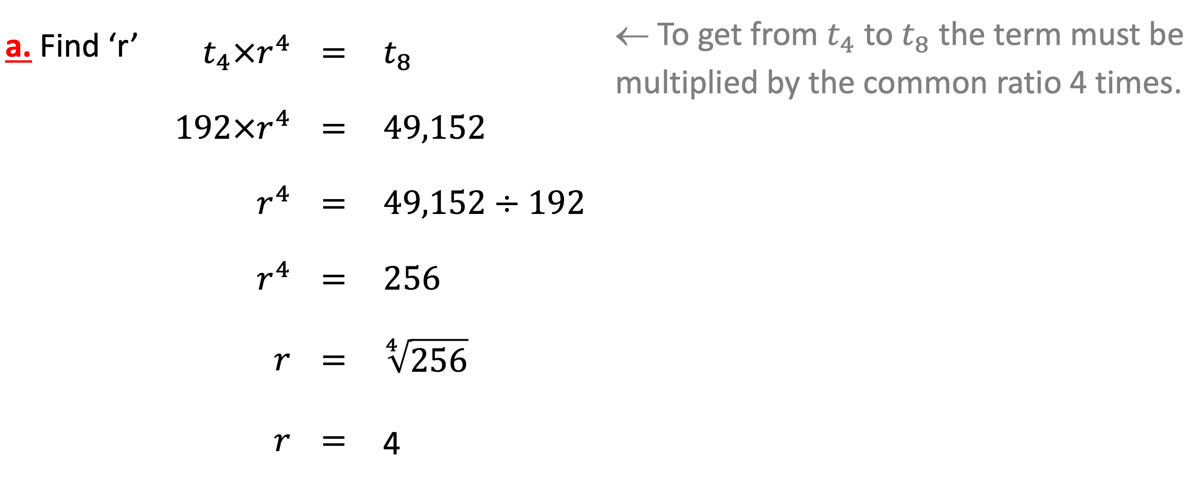
Workbook
page
GEOMETRIC SEQUENCES
43
Nth term rule
Worked example.
a. Find ‘r’ | $$t_{4}×r^{4}$$ | $$=$$ | $$t_{8}$$ | ← To get from $t_{4}$ to $t_{8}$ the term must be multiplied by the common ratio 4 times.
 | $$192×r^{4}$$ | $$=$$ | $$49,152$$
 | $$r^{4}$$ | $$=$$ | $$49,152÷192$$
 | $$r^{4}$$ | $$=$$ | $$256$$
 | $$r$$ | $$=$$ | $$\sqrt[4]{256}$$
 | $$r$$ | $$=$$ | 4

Slide 28
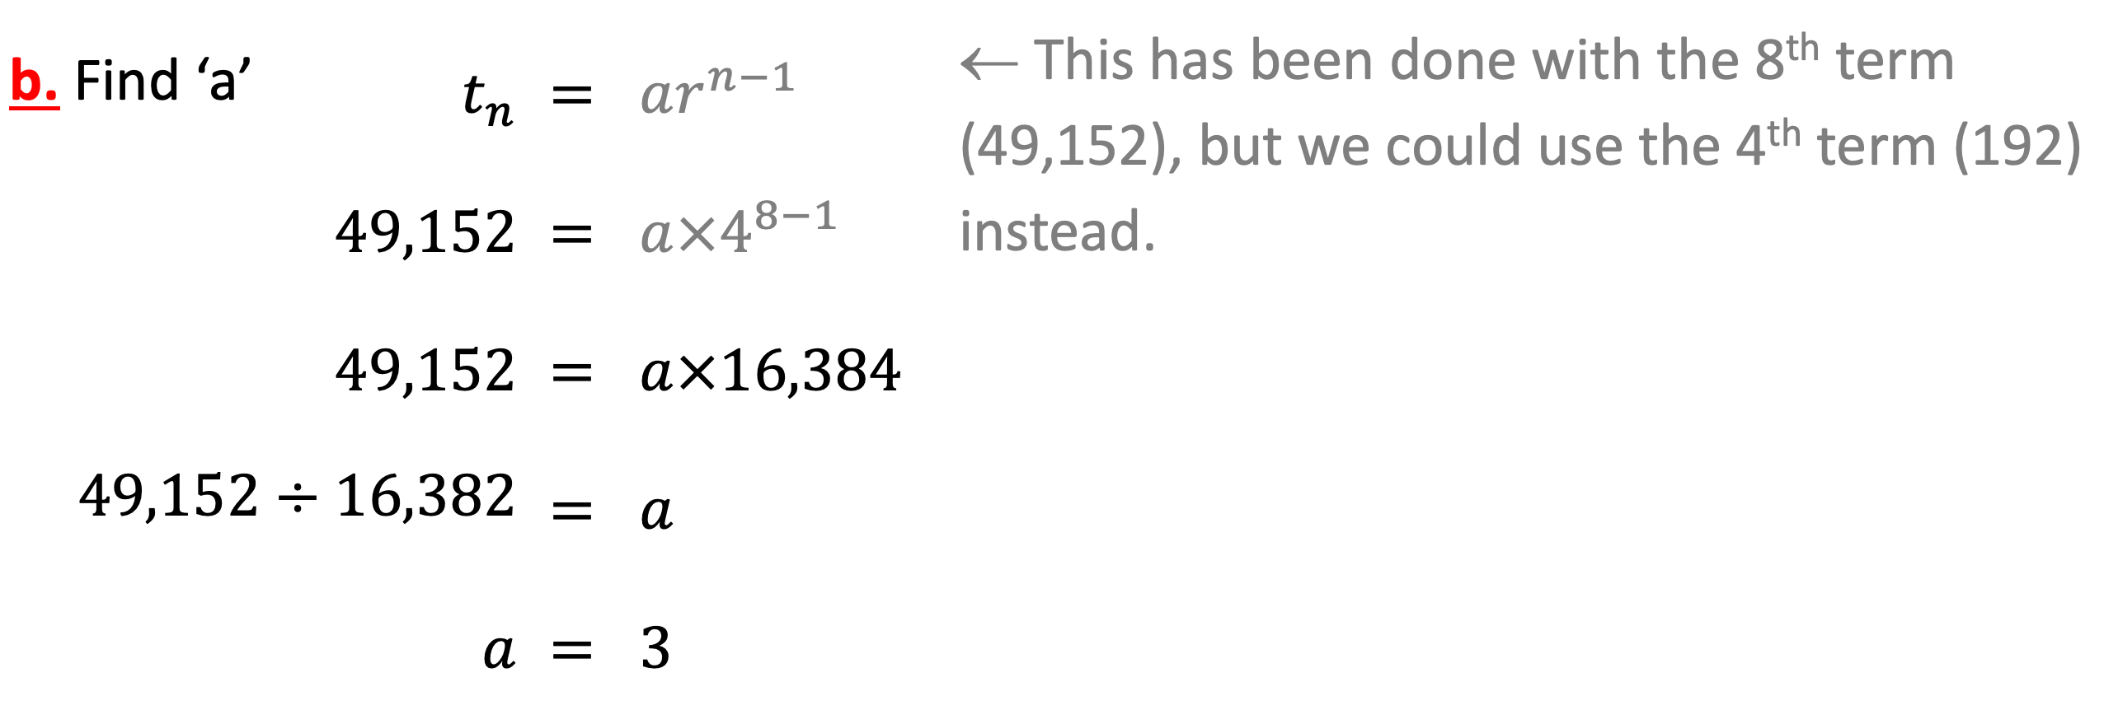
Workbook
page
GEOMETRIC SEQUENCES
43
Nth term rule
Worked example.
b. Find ‘a’ | $$t_{n}$$ | $$=$$ | $$ar^{n−1}$$ | ← This has been done with the 8th term (49,152), but we could use the 4th term (192) instead.
 | $$49,152$$ | $$=$$ | $$a{×4}^{8−1}$$
 | $$49,152$$ | $$=$$ | $$a×16,384$$
$$49,152÷16,382$$ |  | $$=$$ | $$a$$
 | $$a$$ | $$=$$ | $$3$$

Slide 29
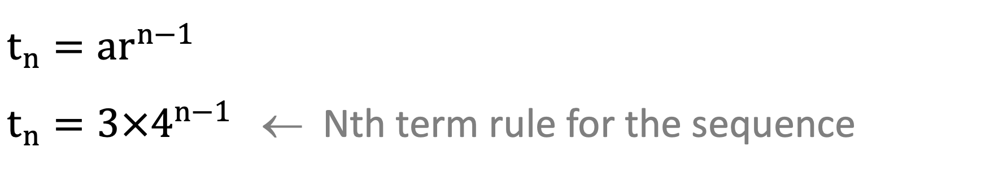
Workbook
page
GEOMETRIC SEQUENCES
43
Nth term rule
Worked example.
c. Find the rule for the sequence.
$$t_{n}=ar^{n−1}$$
$t_{n}=3{×4}^{n−1}$ ← Nth term rule for the sequence

Slide 30
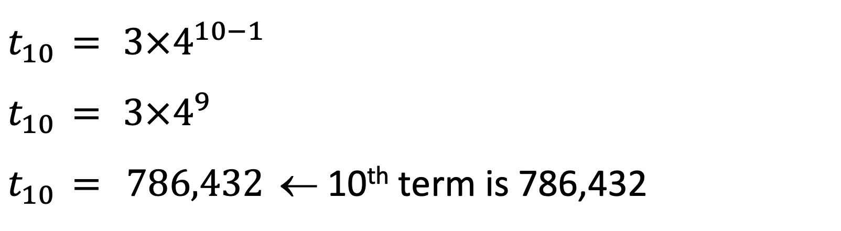
Workbook
page
GEOMETRIC SEQUENCES
43
Nth term rule
Worked example.
d. Find the 10th term.
$$t_{10}$$ | $$=$$ | $3{×4}^{10−1}$
$$t_{10}$$ | $$=$$ | $3{×4}^{9}$
$$t_{10}$$ | $$=$$ | $$786,432$$ | ← 10th term is 786,432

Slide 31
Workbook
page
GEOMETRIC SEQUENCES
44
Nth term rule
With your teacher.
1. The second term of a geometric sequence is 20. The 6th term is 320. Find;
  a. The common ratio ‘r’ and first term ‘a’
  b. The rule for the sequence.

Slide 32

Workbook
page
GEOMETRIC SEQUENCES
45
Nth term rule
With your teacher.
2. The fourth term of a geometric sequence is 24. The 7th term is 3. Find:
  a. The common ratio ‘r’ and first term ‘a’.
  b. The rule for the sequence.

Slide 33
Workbook
page
GEOMETRIC SEQUENCES
45
Nth term rule
With your teacher.
2. The fourth term of a geometric sequence is 24. The 7th term is 3. Find:
  c. The 11th term.
  d. The position of the term 0.75 (hint: use your calculator to find ‘n’)

Slide 34
Workbook
page
GEOMETRIC SEQUENCES
46
Nth term rule
Try it yourself.
Complete the ‘try it yourself’ questions on page 46 and 47 of your workbook.

Slide 35
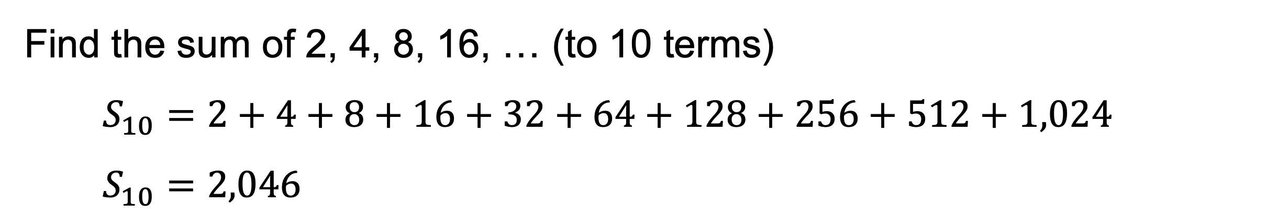
Workbook
page
GEOMETRIC SEQUENCES
48
Sum of term (series)
Worked example.
Find the sum of 2, 4, 8, 16, … (to 10 terms)
$$S_{10}=2+4+8+16+32+64+128+256+512+1,024$$
$S_{10}=2,046$

Slide 36
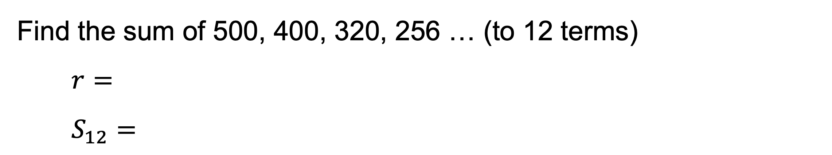
Workbook
page
GEOMETRIC SEQUENCES
48
Sum of term (series)
With your teacher.
Find the sum of 500, 400, 320, 256 … (to 12 terms)
$r=$
$S_{12}=$

Slide 37
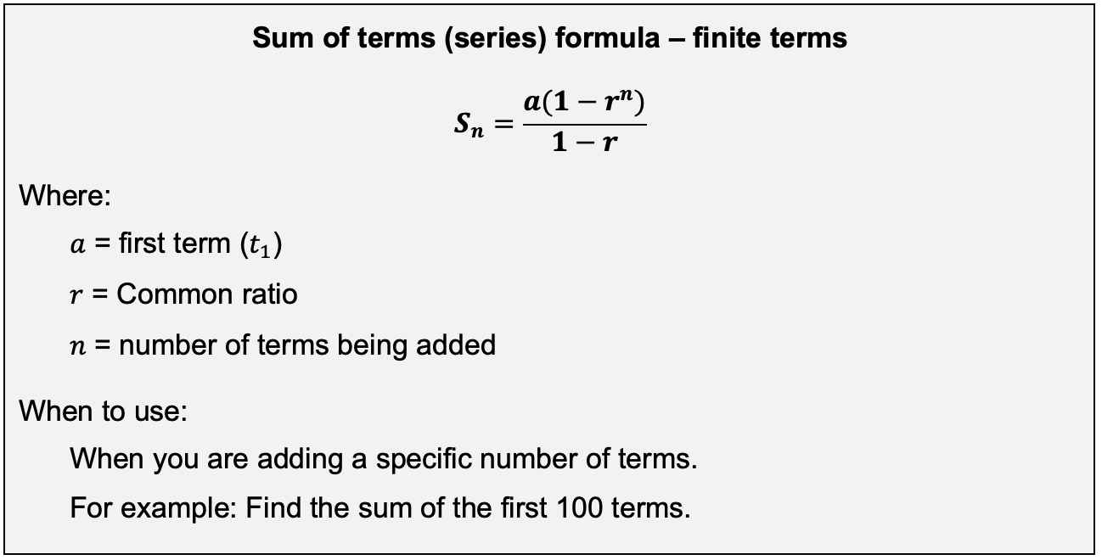
Workbook
page
GEOMETRIC SEQUENCES
49
Sum of term (series)

Slide 38
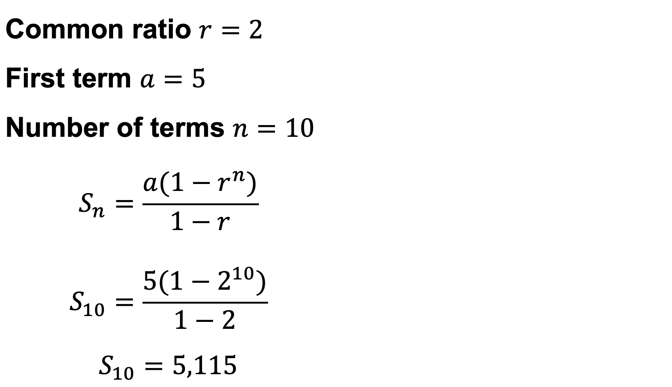
Workbook
page
GEOMETRIC SEQUENCES
49
Sum of term (series)
Worked example.
Find the sum of the sequence: 5, 10, 20, 40, … to ten terms
Common ratio $r=2$ First term $a=5$ Number of terms $n=10$
$$S_{n}=\frac{a(1−r^{n})}{1−r}$$
$$S_{10}=\frac{5(1−2^{10})}{1−2}$$
$$S_{10}=5,115$$

Slide 39
Workbook
page
GEOMETRIC SEQUENCES
49
Sum of term (series)
With your teacher
1. Find the sum of the sequence: 3, 6, 12, 24, … to ten terms.

Slide 40
Workbook
page
GEOMETRIC SEQUENCES
50
Sum of term (series)
With your teacher
2. Find the sum of the sequence: 2000, 1000, 500, 250, … to eight terms.

Slide 41

Workbook
page
GEOMETRIC SEQUENCES
50
Sum of term (series)
With your teacher
3. Vashti has a coffee cart. On her first day of business she sells 100 cups of coffee. On her second day she sells 120 cups of coffee. She hopes that this is the start of a geometric sequence! If Vashti ‘s hopes are right find:
  a. The first 5 terms of the sequence. (Round to the nearest whole cup)

Slide 42
Workbook
page
GEOMETRIC SEQUENCES
50
Sum of term (series)
With your teacher
  b. Find the total sold over the first 10 days.

Slide 43
Workbook
page
GEOMETRIC SEQUENCES
50
Sum of term (series)
With your teacher
  c. If this pattern continues, how many days will it be before Vashti sells 743 cups of coffee? (Hint: Find the sequence rule, then use your calculator to solve for n).

Slide 44
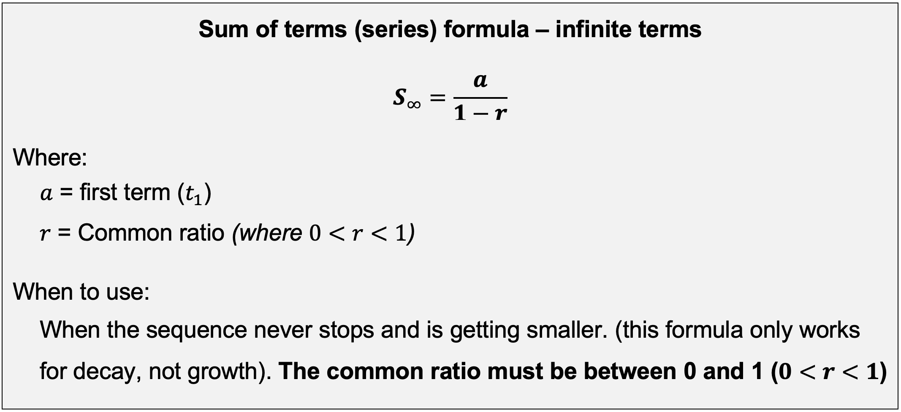
Workbook
page
GEOMETRIC SEQUENCES
51
Sum of term (series)

Slide 45
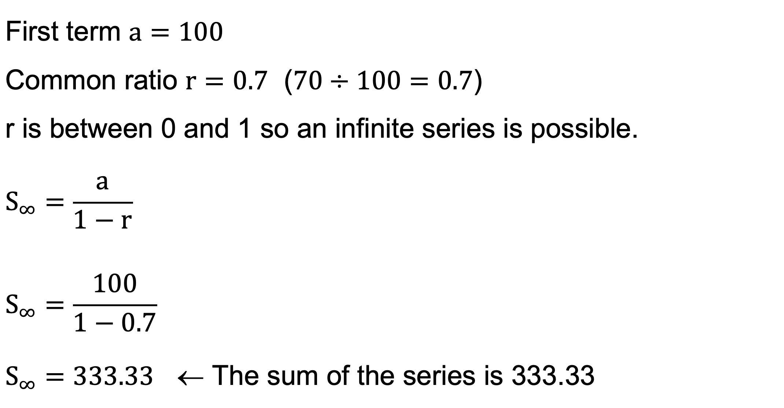
Workbook
page
GEOMETRIC SEQUENCES
51
Sum of term (series)
Worked example.
Find the sum to infinity of the following sequence: 100, 70, 49, 34.3, …
First term $a=100$
Common ratio $r=0.7$ ($70÷100=0.7$)
r is between 0 and 1 so an infinite series is possible.
$$S_{∞}=\frac{a}{1−r}$$
$$S_{∞}=\frac{100}{1−0.7}$$
$S_{∞}=333.33$ ← The sum of the series is 333.33

Slide 46
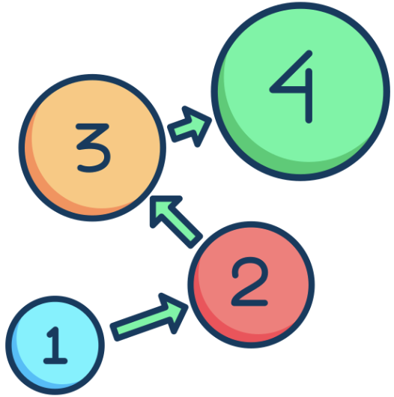
Workbook
page
GEOMETRIC SEQUENCES
51
Sum of term (series)
With your teacher
1. Consider the sequence: 10, 5, 2.5, …
  a. Find the first term (a) and the common ratio (r).
  b. Find the 5th term and the sum to 5 terms.

Slide 47
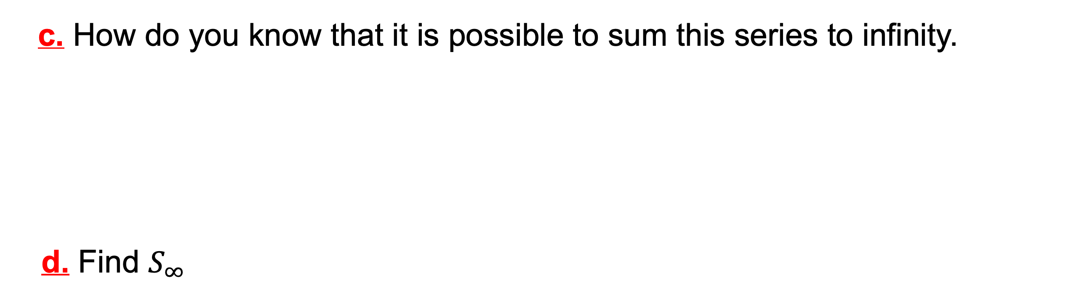
Workbook
page
GEOMETRIC SEQUENCES
51
Sum of term (series)
With your teacher
  c. How do you know that it is possible to sum this series to infinity.
d. Find $S_{∞}$

Slide 48

Workbook
page
GEOMETRIC SEQUENCES
52
Sum of term (series)
With your teacher
2. Max promises to do two hours of piano practice each day and on his first day he does 120 minutes of practice. But on his second day he does 15% less practice. On each successive day the trend of 15% less continues.
  a. Detail the sequence involved expressing each of the practice times in minutes. (List the first few terms, and state what ‘a’ and ‘r’ are)

Slide 49
Workbook
page
GEOMETRIC SEQUENCES
52
Sum of term (series)
With your teacher
b. Find the amount of practice done on the 10th day.
c. Find the total amount of practice done up to the 10th day.

Slide 50
Workbook
page
GEOMETRIC SEQUENCES
52
Sum of term (series)
With your teacher
d. Find the amount of practice Max will end up doing in total given his current habit even if he practices each day forever.

Slide 51
Workbook
page
GEOMETRIC SEQUENCES
53
Sum of term (series)
Try it yourself.
Complete the ‘try it yourself’ questions on page 53, 54, 55, and 56 of your workbook.

