Slide 1

This PowerPoint has been designed for use with the workbook:
GM3 BIVARIATE DATA
Workbooks, resources and PowerPoints are available at BertramEducation.com

Slide 2

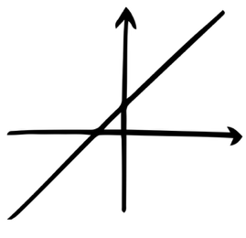
Workbook
page
21
Statistics doesn’t just stop at finding out whether
two variables are associated. Once we’ve identified an association,
the next step is to see if we can model the relationship with a mathematical equation.
In this part of the unit, we focus on linear relationships.
These are situations where the data can be modelled by a straight line (linear regression).

Slide 3
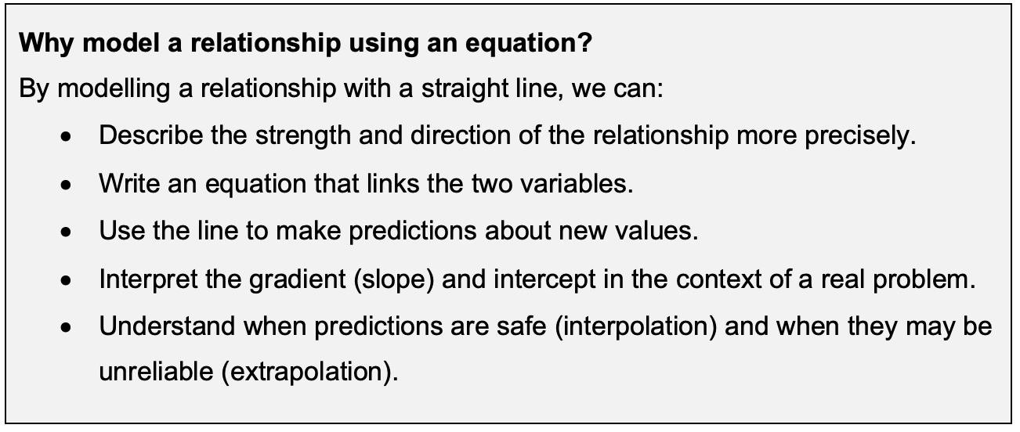
Workbook
page
LINEAR RELATIONSHIPS
21

Slide 4

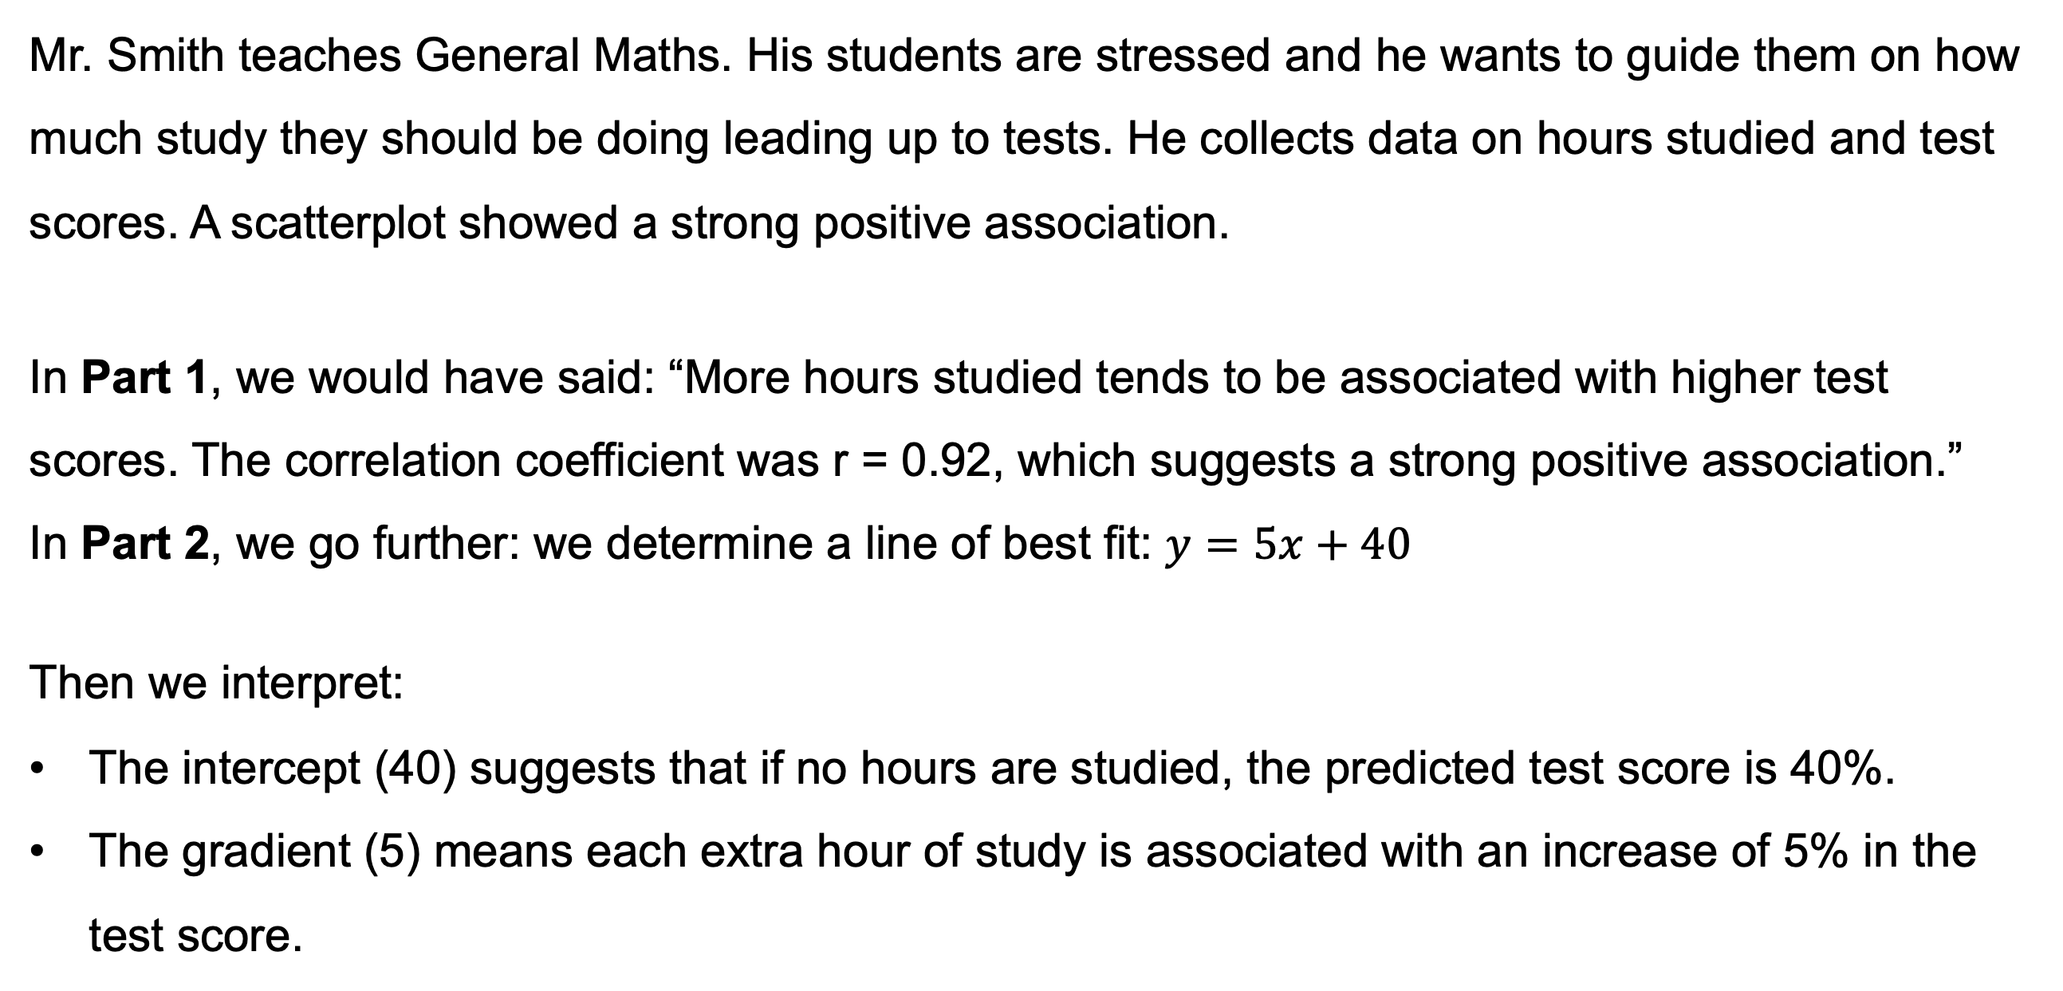
Workbook
page
LINEAR RELATIONSHIPS
21
Worked example.
Mr. Smith teaches General Maths. His students are stressed and he wants to guide them on how much study they should be doing leading up to tests. He collects data on hours studied and test scores. A scatterplot showed a strong positive association.
In Part 1, we would have said: “More hours studied tends to be associated with higher test scores. The correlation coefficient was r = 0.92, which suggests a strong positive association.”
In Part 2, we go further: we determine a line of best fit: $y=5x+40$
Then we interpret:
The intercept (40) suggests that if no hours are studied, the predicted test score is 40%.
The gradient (5) means each extra hour of study is associated with an increase of 5% in the test score.

Slide 5

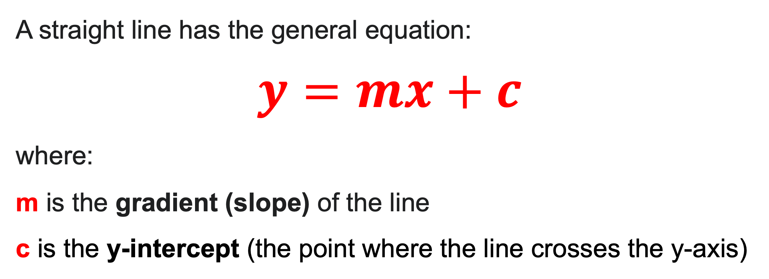
Workbook
page
STRAIGHT LINE EQUATION INTRODUCTION
22
A straight line has the general equation:
$y=mx+c$
where:
m is the gradient (slope) of the line
c is the y-intercept (the point where the line crosses the y-axis)
$y=mx+c$can also be written as $y=ax+b.$
They both work the same. Your CAS calculator uses $y=ax+b$

Slide 6
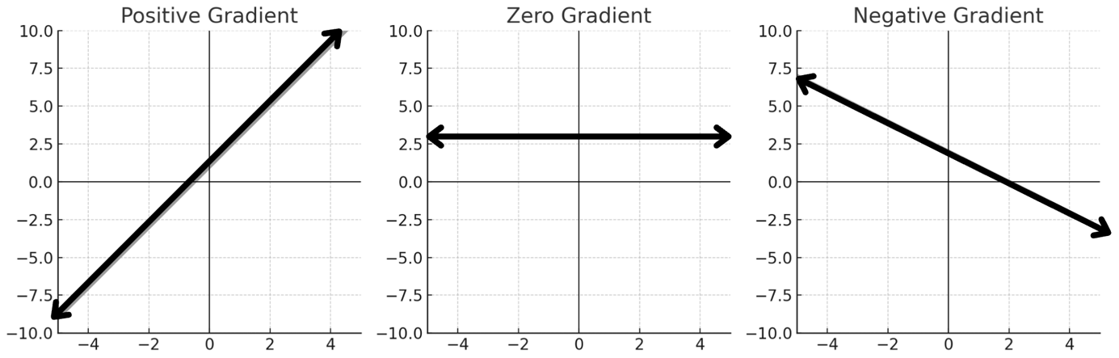
Workbook
page
STRAIGHT LINE EQUATION INTRODUCTION
22
GRADIENT (SLOPE)
The gradient tells us how steep the line is.
The gradient can be positive, zero, or negative.
The larger the number, the steeper the graph.

Slide 7
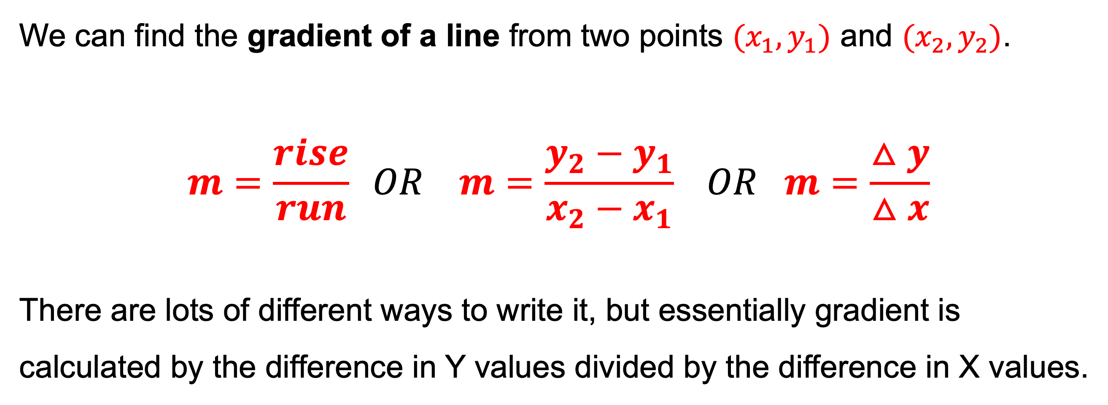
Workbook
page
STRAIGHT LINE EQUATION INTRODUCTION
22
We can find the gradient of a line from two points ${(x}_{1}, y_{1})$ and ${(x}_{2},y_{2})$.
$$m=\frac{rise}{run} OR m=\frac{y_{2}−y_{1}}{x_{2}−x_{1}} OR m=\frac{△y}{△x}$$
There are lots of different ways to write it, but essentially gradient is calculated by the difference in Y values divided by the difference in X values.

Slide 8
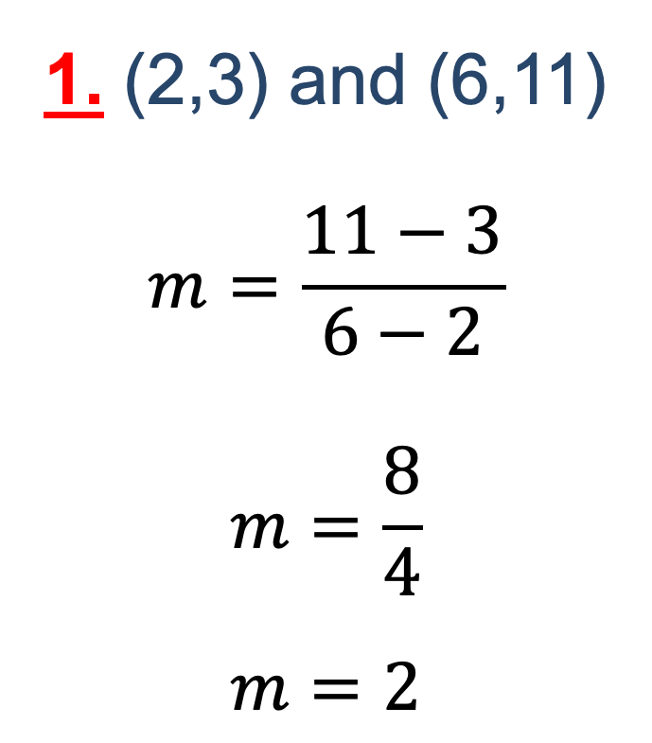
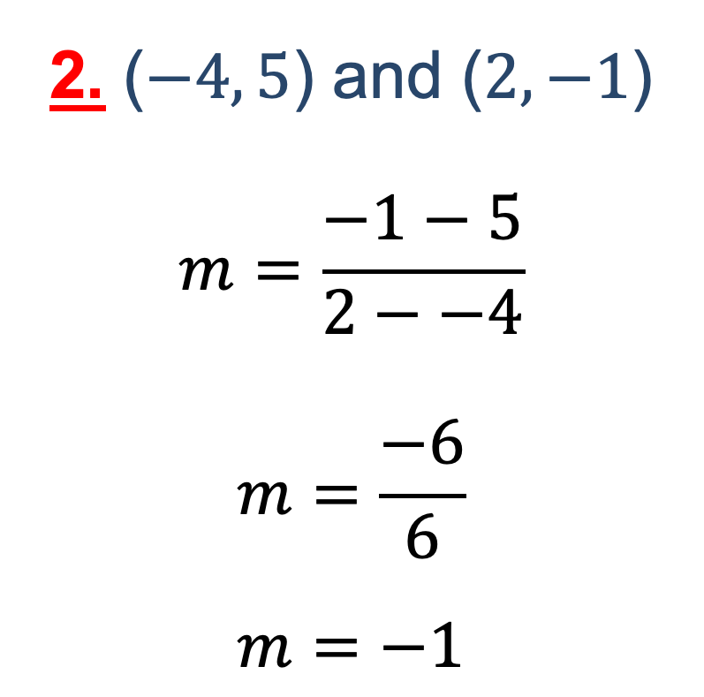
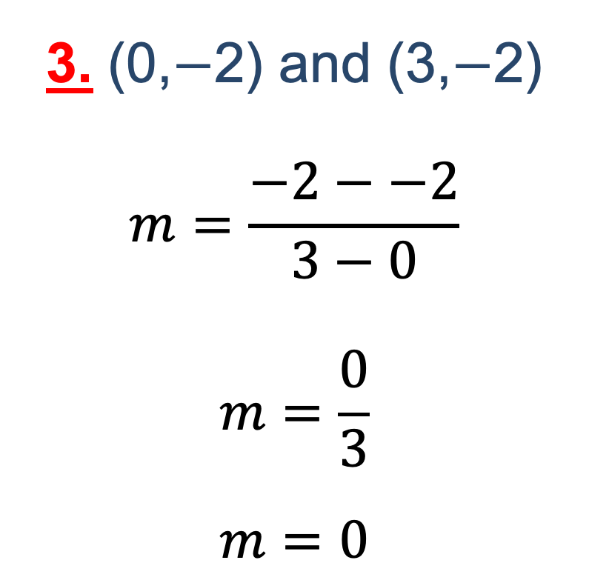
Workbook
page
STRAIGHT LINE EQUATION INTRODUCTION
22
Worked example.
Find the gradient of the line between each pair of points.
1. (2,3) and (6,11)
$$m=\frac{11−3}{6−2}$$
$$m=\frac{8}{4}$$
$m=2$
2. ($−4, 5$) and ($2,−1$)
$$m=\frac{−1−5}{2−−4}$$
$$m=\frac{−6}{6}$$
$m=−1$
3. (0,$−$2) and (3,$−$2)
$$m=\frac{−2−−2}{3−0}$$
$$m=\frac{0}{3}$$
$m=0$

Slide 9

Workbook
page
STRAIGHT LINE EQUATION INTRODUCTION
23
With your teacher.
Find the gradient between the following pairs of points.
1. (1, 2) & (5, 6) 2. (1, 5) & (4, -1)

Slide 10
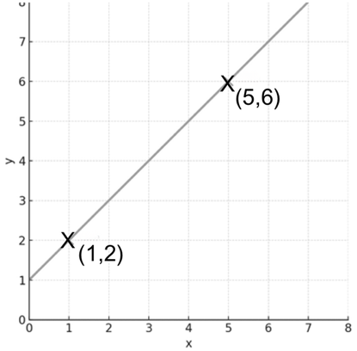
Workbook
page
STRAIGHT LINE EQUATION INTRODUCTION
23
With your teacher.
Find the gradient between the following pairs of points.
3. (1, 2) & (5, 3) 4.

Slide 11
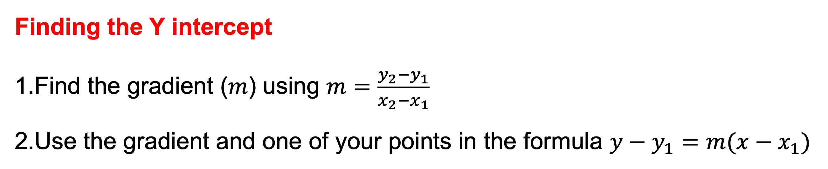
Workbook
page
STRAIGHT LINE EQUATION INTRODUCTION
23
Y INTERCEPT
Finding the Y intercept
Find the gradient ($m$) using $m=\frac{y_{2}−y_{1}}{x_{2}−x_{1}}$
Use the gradient and one of your points in the formula ${y−y}_{1}=m(x−x_{1})$

Slide 12
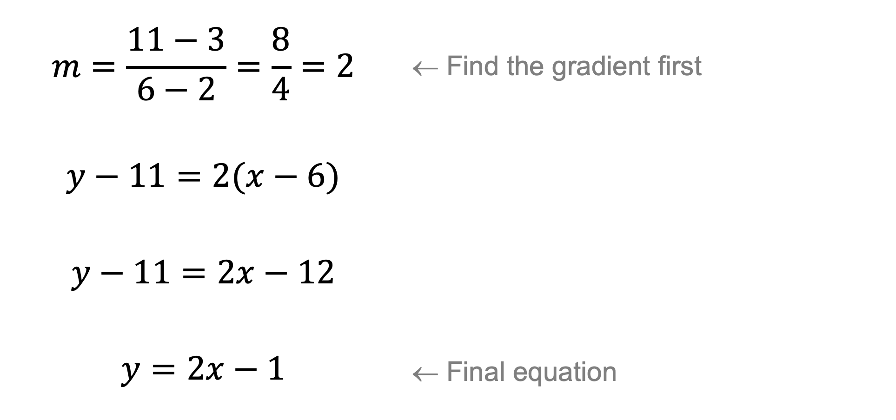
Workbook
page
STRAIGHT LINE EQUATION INTRODUCTION
23
Y INTERCEPT
Worked example 1.
Find the equation of the line through the points (2, 3) and (6, 11).
$$m=\frac{11−3}{6−2}=\frac{8}{4}=2$$ | ← Find the gradient first
$$y−11=2(x−6)$$
$$y−11=2x−12$$
$$y=2x−1$$ | ← Final equation

Slide 13
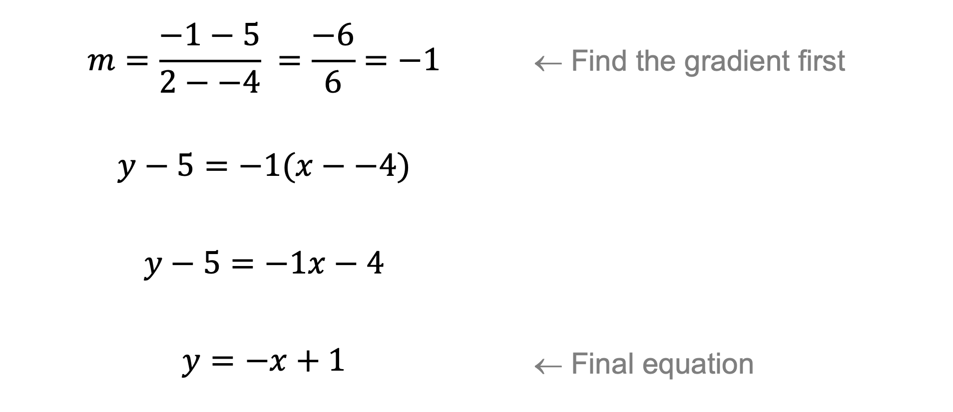
Workbook
page
STRAIGHT LINE EQUATION INTRODUCTION
23
Y INTERCEPT
Worked example 2.
Find the equation of the line through (-4, 5) and (2, -1).
$$m=\frac{−1−5}{2−−4} =\frac{−6}{6}=−1$$ | ← Find the gradient first
$$y−5=−1(x−−4)$$
$$y−5=−1x−4$$
$$y=−x+1$$ | ← Final equation

Slide 14
Workbook
page
STRAIGHT LINE EQUATION INTRODUCTION
24
With your teacher 1.
Find the equation of the line that passes through the points (1,4) and (5,8)

Slide 15
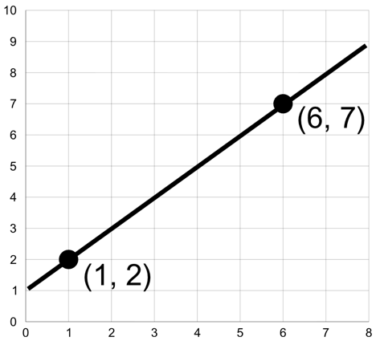
Workbook
page
STRAIGHT LINE EQUATION INTRODUCTION
24
With your teacher 2.
Find the equation of the line below.

Slide 16

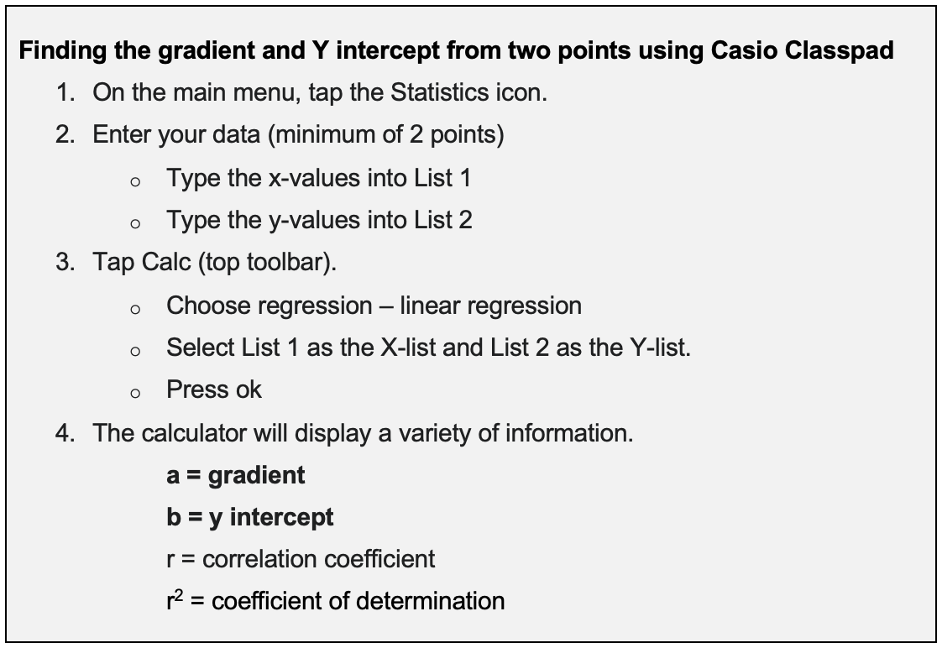
Workbook
page
STRAIGHT LINE EQUATION INTRODUCTION
24

Slide 17

Workbook
page
STRAIGHT LINE EQUATION INTRODUCTION
25
Try it yourself.
Complete the ‘try it yourself’ questions on page 25 of your workbook.

Slide 18
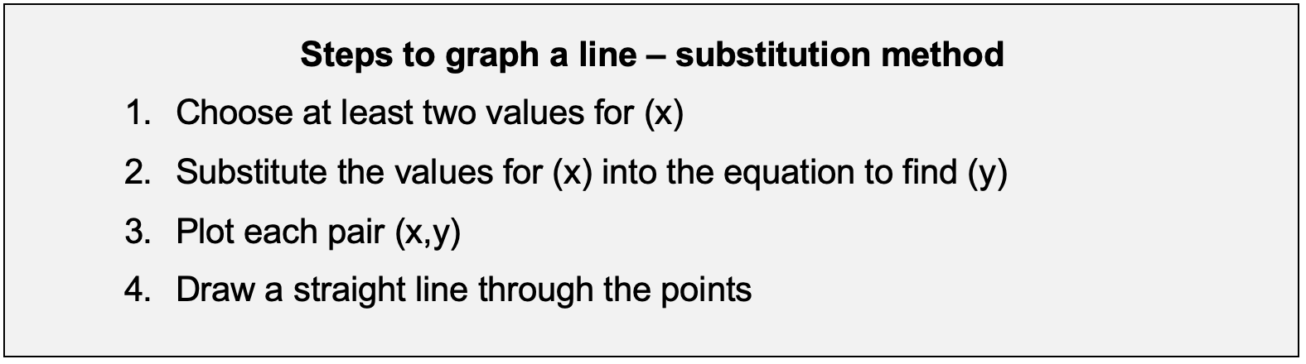
Workbook
page
CONSTRUCTING GRAPHS - SUBSTITUTION
26
There are multiple ways to draw a graph from a given equation.
In this workbook we will focus on the substitution method.
You may use a different method if you prefer.

Slide 19
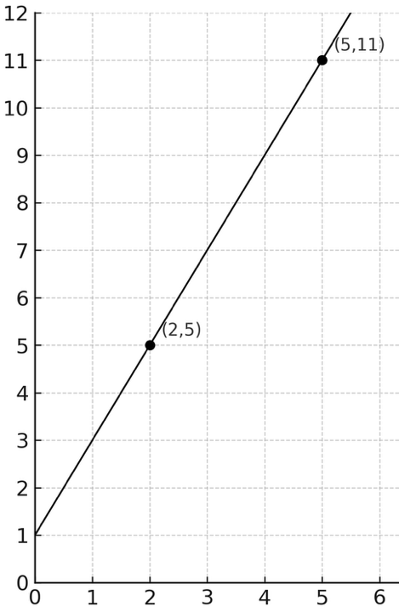
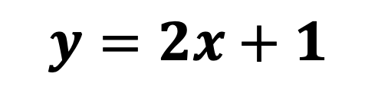
Workbook
page
CONSTRUCTING GRAPHS - SUBSTITUTION
26
Worked example.
$$y=2x+1$$
Graph the equation
Step 1 – Choose 2 values for (x)
X = 2 and X = 5
Step 2 – Substitute each X into the equation.
(X = 2) Y = 2(2) + 1 Y = 5 Point @ (2,5) | (X = 5) Y = 2(5) + 1 Y = 11 Point @ (5,11)
Step 3 – Plot each pair
Step 4 – Draw a straight line through the points

Slide 20
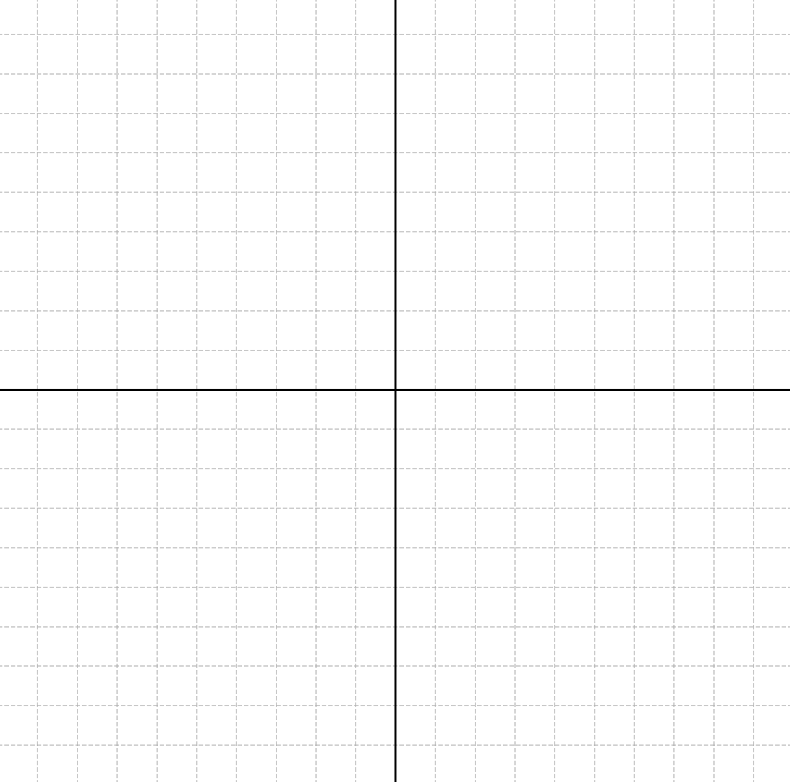
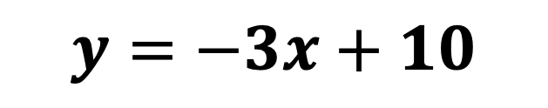
Workbook
page
CONSTRUCTING GRAPHS - SUBSTITUTION
26
With your teacher.
$$y=−3x+10$$
Graph the equation

Slide 21
Workbook
page
CONSTRUCTING GRAPHS - SUBSTITUTION
27
Worked example.
Katy runs a small business. She has found that her profit (y, in $) can be modelled by the equation y = 15x – 50, where x is the number of items she sells.
She wants to know what her profit will be if she sells 20 items.
Substitute x = 20:
y = 15(20) - 50
y = 300 - 50
y = 250
If Katy sells 20 items, she can expect to make a profit of $250.

Slide 22
Workbook
page
CONSTRUCTING GRAPHS - SUBSTITUTION
27
With your teacher.
Using the previous example, find Katy’s profit when she sells 10 items, 50 items, and 100 items (y = 15x – 50).

Slide 23
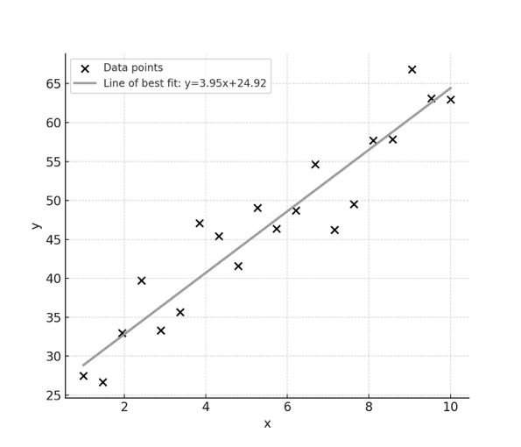
Workbook
page
LINE OF BEST FIT
28
Line of best fit.
When we have a scatterplot showing
an association between two variables,
we can summarise the relationship
using a line of best fit.
This line is not drawn through all the points - it is placed so that it best represents the overall trend of the data.
Fitting a line can be done by hand or by calculator.

Slide 24
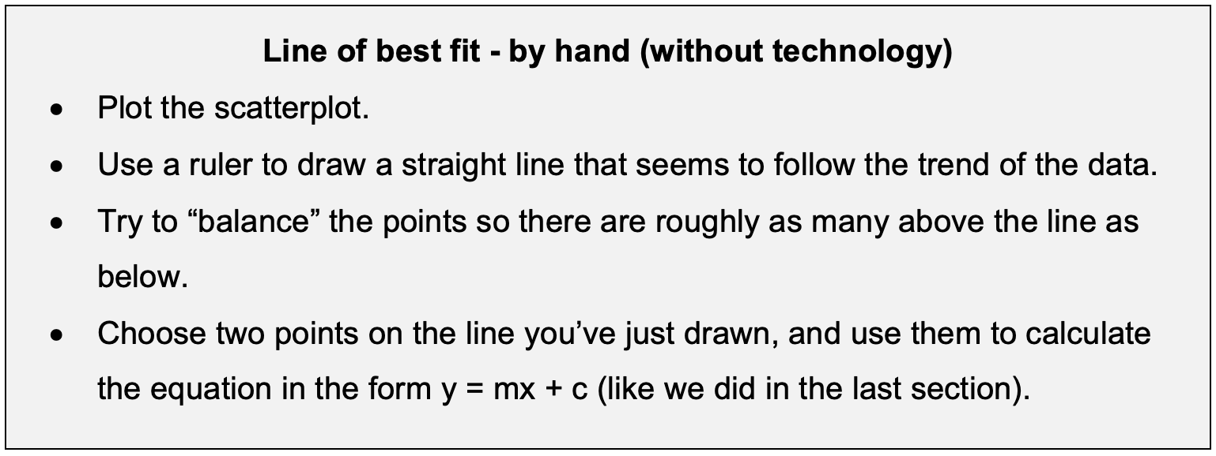
Workbook
page
LINE OF BEST FIT
28

Slide 25
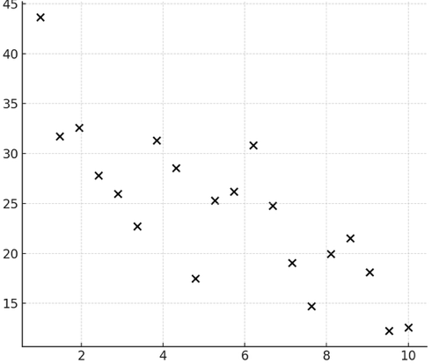
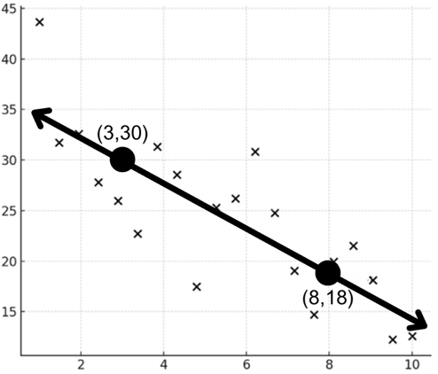
Workbook
page
LINE OF BEST FIT
28
Worked example.
Step 1: Plot the scatterplot
Step 2: Fit the line

Slide 26
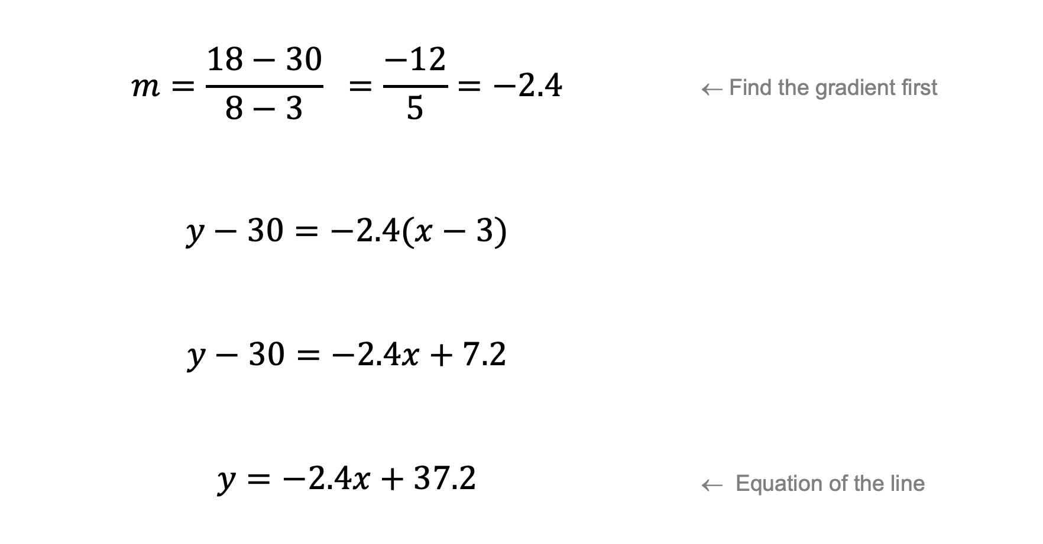
Workbook
page
LINE OF BEST FIT
28
Worked example (continued).
Step 3: Use two points [(3,30) and (8,18)] to calculate the equation of the line.
$$m=\frac{18−30}{8−3} =\frac{−12}{5}=−2.4$$ | ← Find the gradient first
$$y−30=−2.4(x−3)$$
$$y−30=−2.4x+7.2$$
$$y=−2.4x+37.2$$ | ← Equation of the line

Slide 27
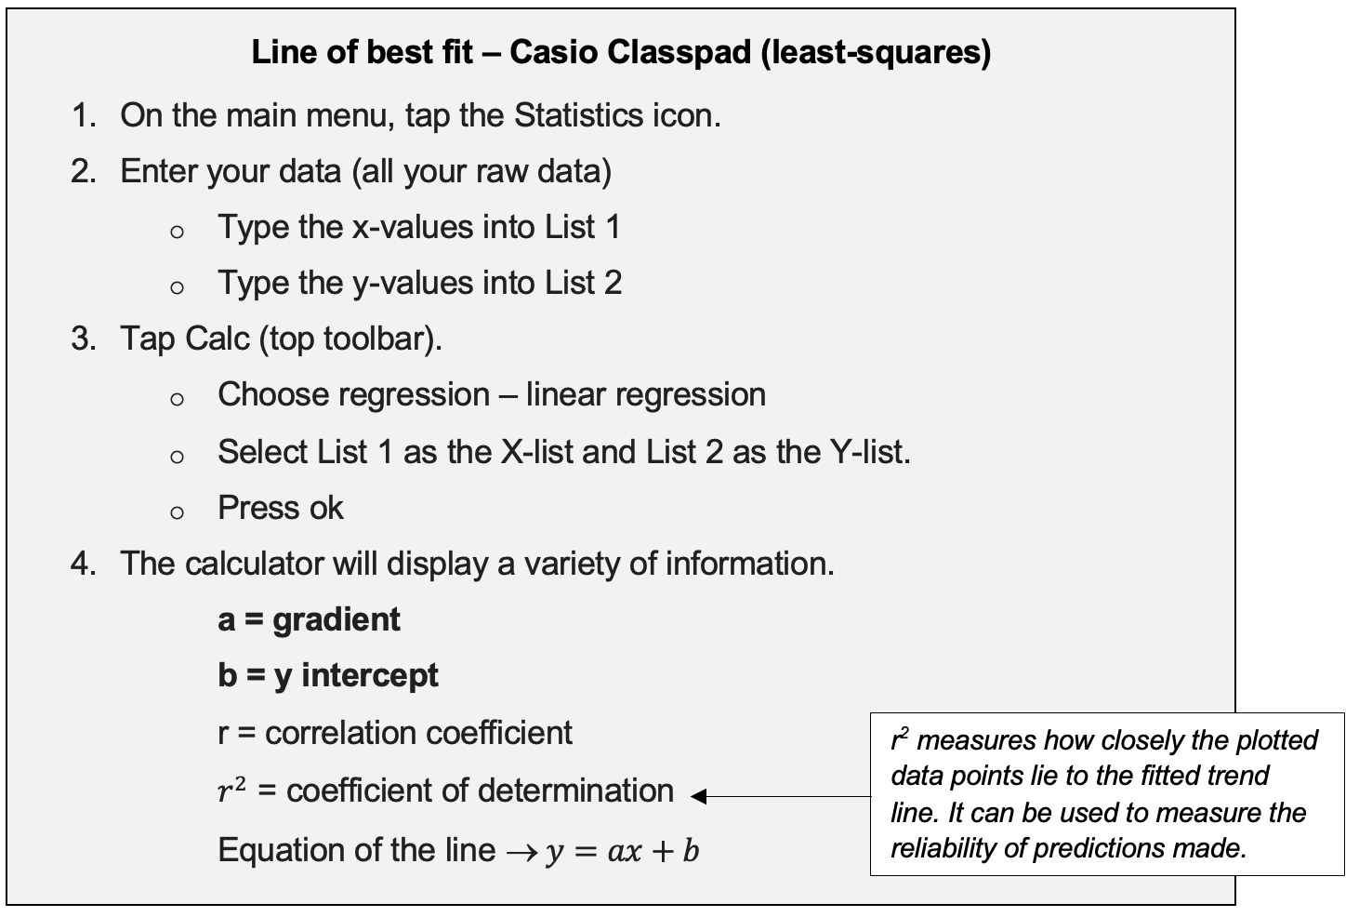
Workbook
page
LINE OF BEST FIT
29
A calculator or spreadsheet can calculate the line of best fit more precisely.
This is called the least-squares line because it minimises the total squared vertical distances between the data points and the line.

Slide 28
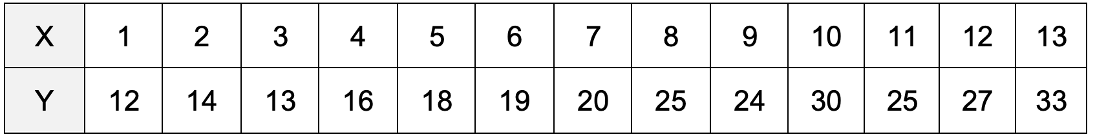
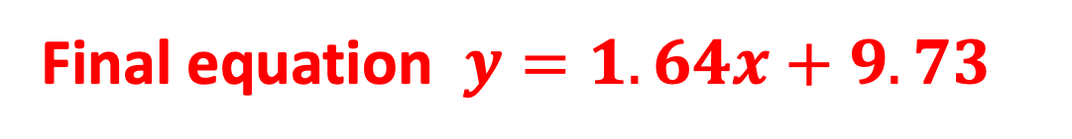
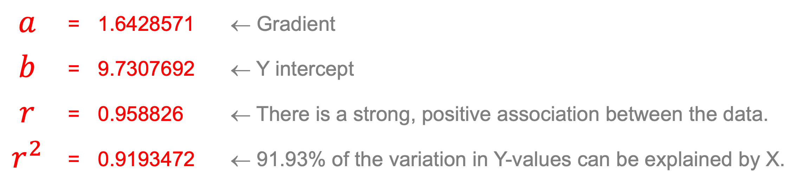
Workbook
page
LINE OF BEST FIT
29
Worked example.
Find the equation of the line of best fit for the following data.
Following the steps on the previous slide – the screen should show the following:
$$a$$ | = | 1.6428571 | ← Gradient
$$b$$ | = | 9.7307692 | ← Y intercept
$$r$$ | = | 0.958826 | ← There is a strong, positive association between the data.
$$r^{2}$$ | = | 0.9193472 | ← 91.93% of the variation in Y-values can be explained by X.
Final equation $y=1.64x+9.73$
Once you’ve written down the information, hit ‘ok’ and the calculator will show you the scatterplot with line of best fit drawn on it.

Slide 29
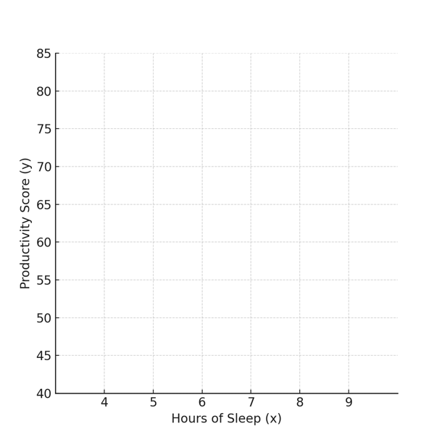
Workbook
page
LINE OF BEST FIT
30
With your teacher.
Find the equation of the line of best fit for
the below data by hand.

Slide 30
Workbook
page
LINE OF BEST FIT
30
With your teacher.
Find the equation of the line of best fit for the below data
using a CAS calculator.
Interpret, in context, the values of a, b, r and r² found by your calculator.

Slide 31
Workbook
page
LINE OF BEST FIT
31
Try it yourself.
Complete the ‘try it yourself’ questions on page 31 and 32 of your workbook.

Slide 32
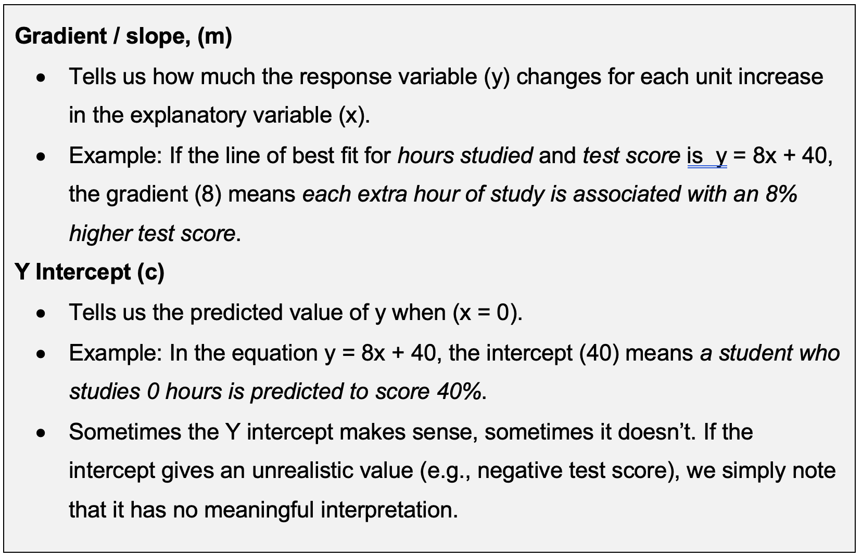
Workbook
page
INTERPRETING AND PREDICTING
33
Interpreting the gradient and Y intercept.

Slide 33

Workbook
page
INTERPRETING AND PREDICTING
33
Worked example.
A group of students record their study hours and test scores.
The CAS calculator gives the line of best fit: y = 7.9x + 42.3, with a correlation coefficient (r) of 0.95 and a coefficient of determination (r²) of 0.90.

Slide 34
Workbook
page
INTERPRETING AND PREDICTING
34
Worked example.
A group of students record their study hours and test scores. The CAS calculator gives the line of best fit: y = 7.9x + 42.3, with a correlation coefficient (r) of 0.95 and a coefficient of determination (r²) of 0.90.
The data is interpreted as follows:
  Gradient (7.9): For every extra hour of study, test scores increase by 7.9%.
  Y Intercept (42.3): A student who does no study is predicted to score 42%.
  Correlation coefficient (r = 0.95): There is a strong positive linear association between study hours and test scores.
  Coefficient of determination (r² = 0.90): 90% of the variation in test scores is explained by hours studied. The remaining 10% of the variation is due to other factors (natural ability, quality of sleep, distractions, etc.).
  Context: The line fits the data strongly (r = 0.95), so we can confidently use it to describe and predict scores from study time.

Slide 35
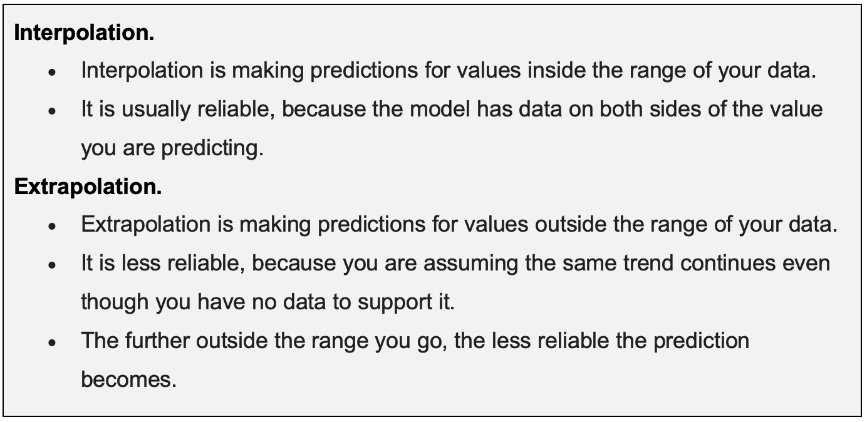
Workbook
page
INTERPRETING AND PREDICTING
35
Making predictions using a line of best fit.
Once we have a regression line, we can use it to predict values of x and y. These predictions can be helpful — but their reliability depends on where the value of x sits.

Slide 36

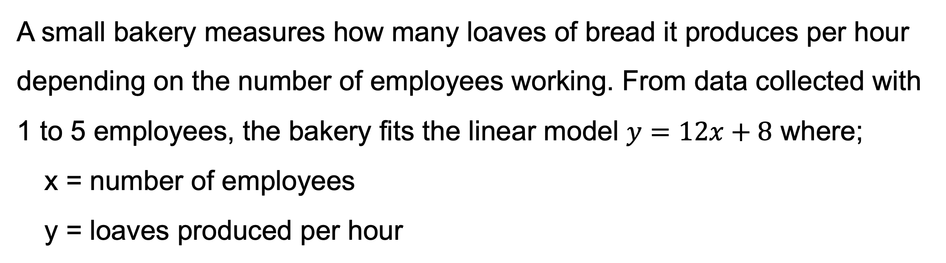
Workbook
page
INTERPRETING AND PREDICTING
34
Worked example.
A small bakery measures how many loaves of bread it produces per hour depending on the number of employees working. From data collected with 1 to 5 employees, the bakery fits the linear model $y=12x+8$ where;
x = number of employees
y = loaves produced per hour

Slide 37
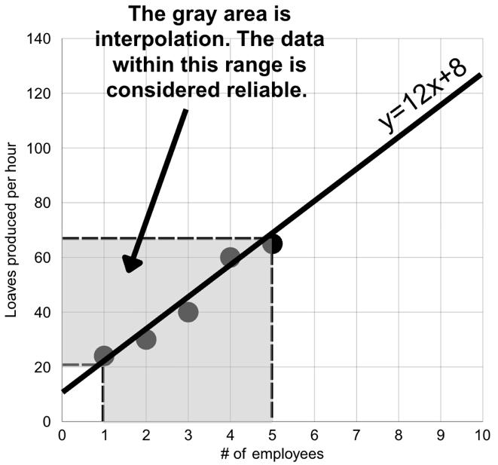
Workbook
page
INTERPRETING AND PREDICTING
34
Worked example (continued).
Predict the output for 4 employees:
y = 12(4) + 8 = 56 loaves per hour.
This is within the collected data range (1–5 employees) so it is interpolation.
It is considered a reliable prediction.

Slide 38
Workbook
page
INTERPRETING AND PREDICTING
34
Worked example (continued).
Predict the output for 1,000 employees:
y = 12(1000) + 8 = 12,008 loaves per hour
This is far outside the data range and is considered extrapolation.
This prediction is not reliable. This makes sense in context because:
A small bakery could not comfortably fit 1,000 workers.
They would be crowded, unable to move, and productivity would drop.

Slide 39
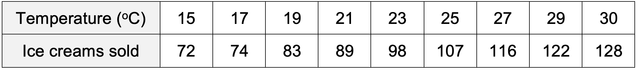

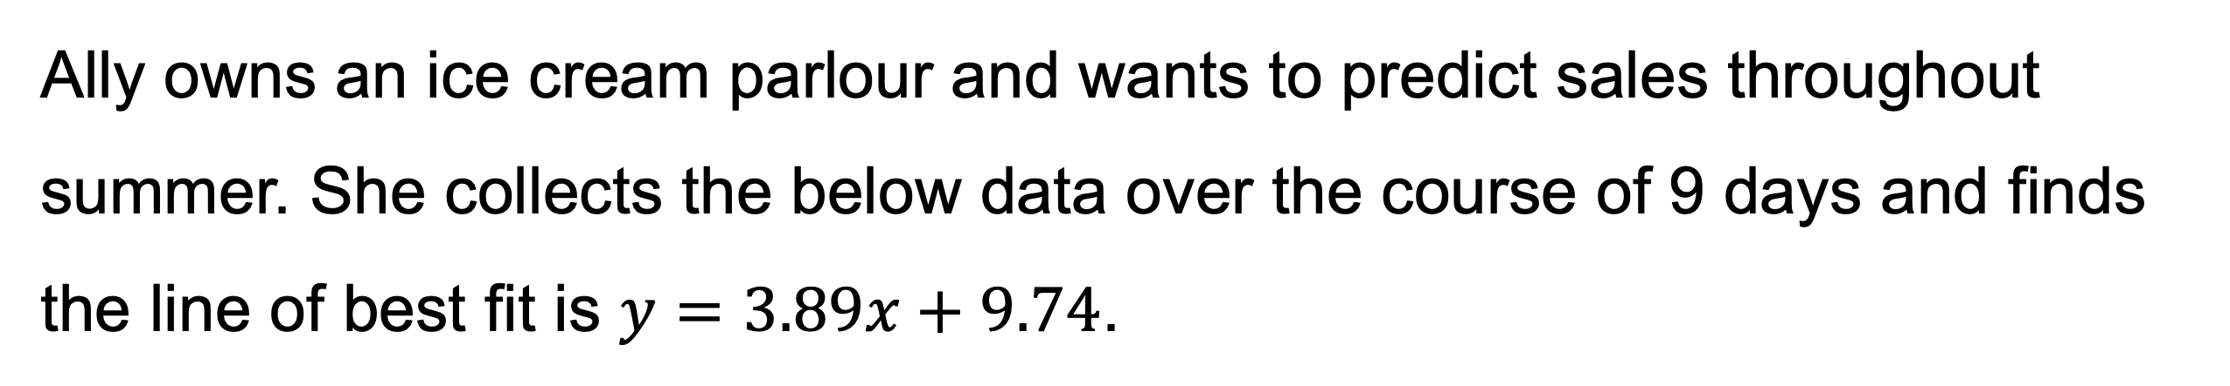
Workbook
page
INTERPRETING AND PREDICTING
35
With your teacher.
Ally owns an ice cream parlour and wants to predict sales throughout summer. She collects the below data over the course of 9 days and finds the line of best fit is $y=3.89x+9.74$.

Slide 40
Workbook
page
INTERPRETING AND PREDICTING
35
With your teacher (continued).
Ally owns an ice cream parlour and wants to predict sales throughout summer. She collects the below data over the course of 9 days and finds the line of best fit is $y=3.89x+9.74$.
1. What is the Y intercept and what does this represent?
2. What is the gradient and what does it represent?
3. What does it mean if (r) is 0.996 and (r²) is 0.991?

Slide 41
Workbook
page
INTERPRETING AND PREDICTING
35
With your teacher (continued).
Ally owns an ice cream parlour and wants to predict sales throughout summer. She collects the below data over the course of 9 days and finds the line of best fit is $y=3.89x+9.74$.
4. Ally wants to predict the number of ice-creams sold if the temperature was 24 degrees.
  a. Is this considered interpolation or extrapolation?
  b. How many ice-creams would be sold?
  c. Is this a reliable estimate?

Slide 42
Workbook
page
INTERPRETING AND PREDICTING
35
With your teacher (continued).
Ally owns an ice cream parlour and wants to predict sales throughout summer. She collects the below data over the course of 9 days and finds the line of best fit is $y=3.89x+9.74$.
5. Ally wants to predict the number of ice-creams sold if the temperature was 100 degrees.
a. Is this considered interpolation or extrapolation?
b. How many ice-creams would be sold?
c. Is this a reliable estimate?

Slide 43
Workbook
page
INTERPRETING AND PREDICTING
36
Try it yourself.
Complete the ‘try it yourself’ questions on page 36 of your workbook.

Slide 44
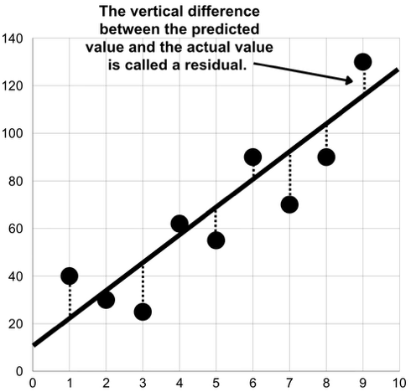
Workbook
page
RESIDUAL PLOTS
37
When we fit a line to data, the line is usually not a perfect fit. Each point is often a little above or below the line.
The difference between the raw data and the line of best fit is called a residual.

Slide 45
Workbook
page
RESIDUAL PLOTS
37
If a raw data point lies above the line,
the residual is positive (+).
If a raw data point lies below the line,
the residual is negative (-).
Small residual → the raw data point is close to the line → good fit.
Large residual → the raw data point is far from the line → poor fit.

Slide 46
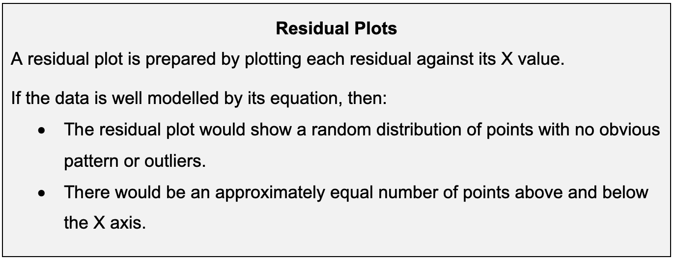
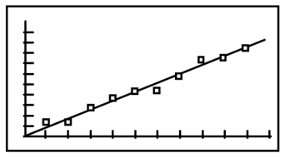
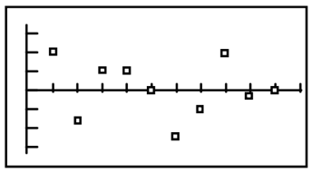
Workbook
page
RESIDUAL PLOTS
37
Original graph
Residual plot

Slide 47
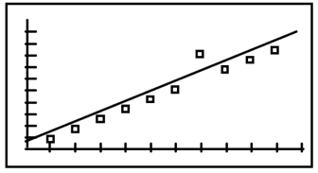
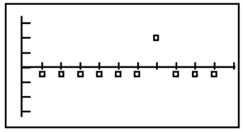
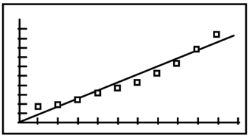
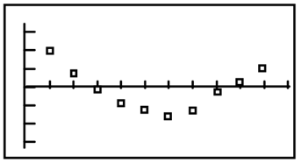
Workbook
page
RESIDUAL PLOTS
37
Original graph
Residual plot
The residual plot shows a random distribution with both positive and negative residuals.
The data is well modelled by its equation.
One data point on the residual plot shows a large deviation.
This pattern indicates an outlier in the data.
The residual plot shows a distinct pattern.
There may be a better model for the data than the linear one chosen.

Slide 48
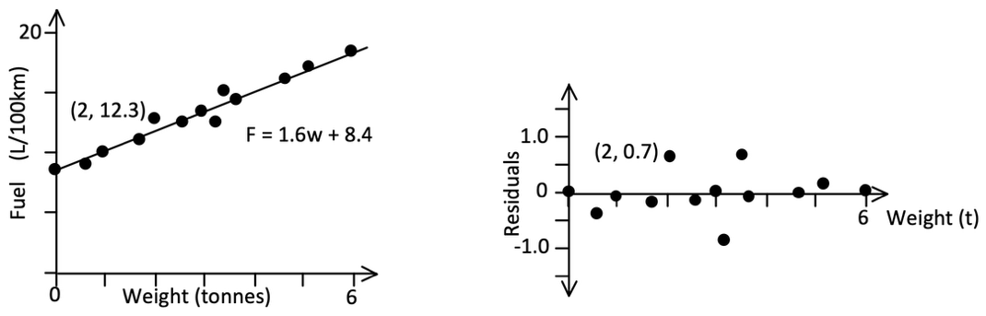

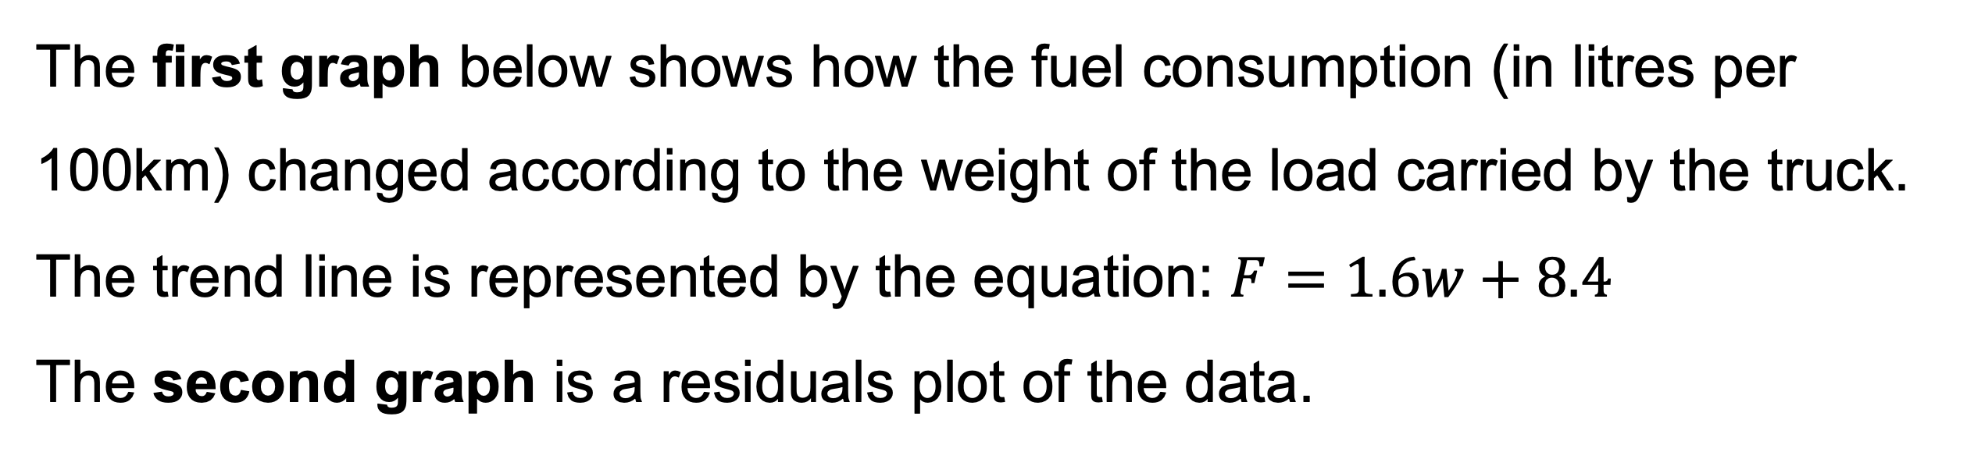
Workbook
page
RESIDUAL PLOTS
38
With your teacher.
The first graph below shows how the fuel consumption (in litres per 100km) changed according to the weight of the load carried by the truck.
The trend line is represented by the equation: $F=1.6w+8.4$
The second graph is a residuals plot of the data.

Slide 49
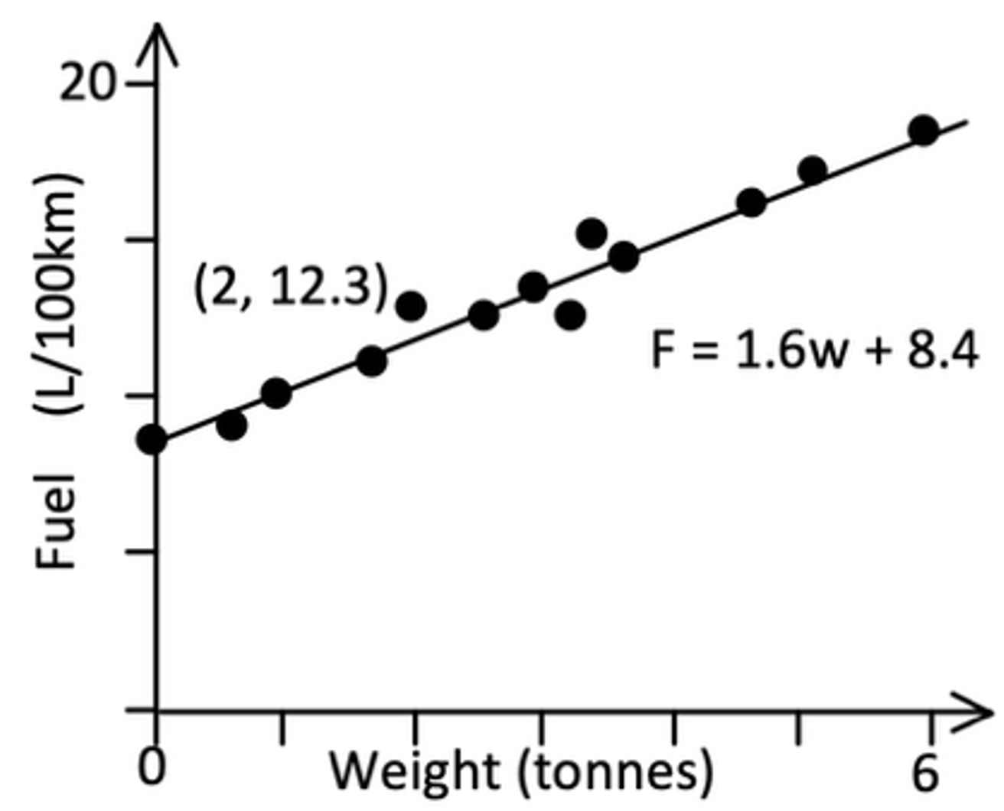
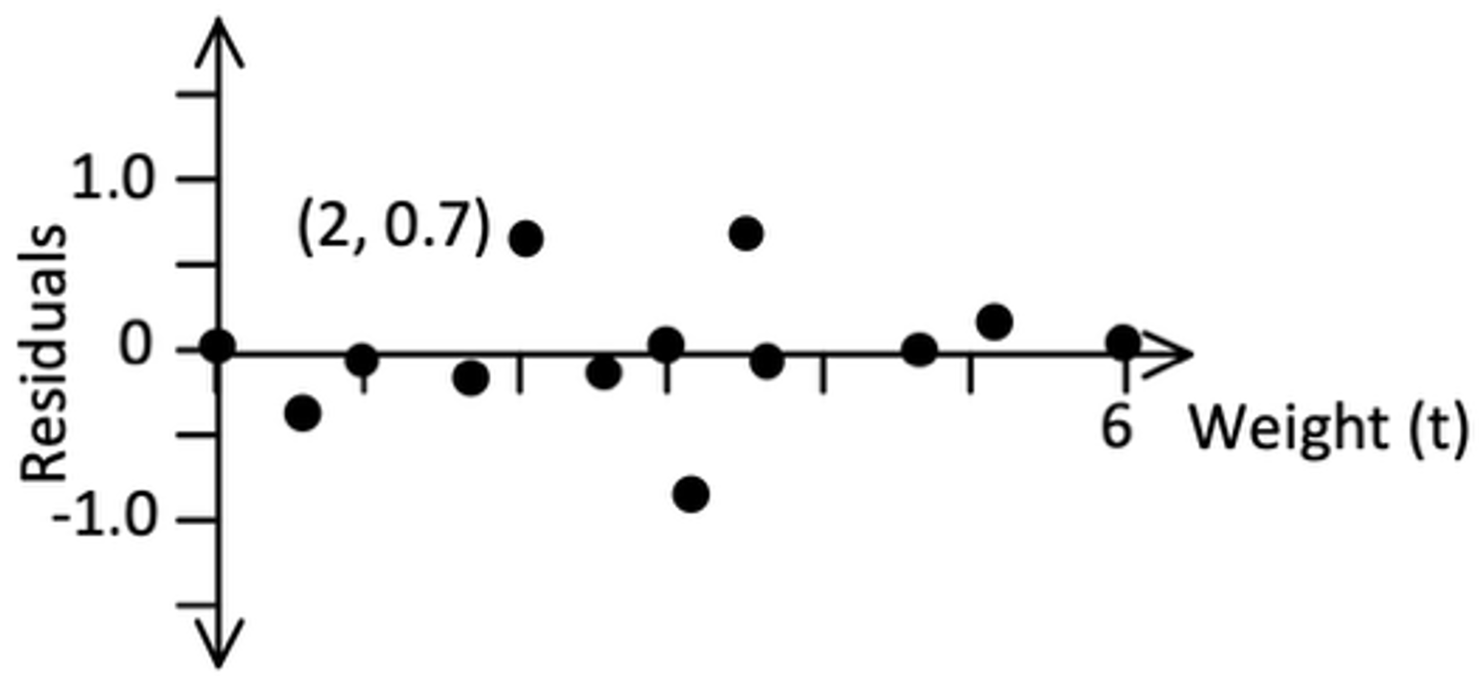
Workbook
page
RESIDUAL PLOTS
38
With your teacher (continued).
a. What features of the residuals plot show that the data is well modelled by the linear equation?
b. The point (2, 12.3) is on the original data plot. Interpret this point in words.

Slide 50
Workbook
page
RESIDUAL PLOTS
38
With your teacher (continued).
c. What fuel consumption would the equation predict for a load of this size (2 tonnes)?
d. Find the residual value for this point (2, 12.3)
(Residual = actual value - predicted value)

Slide 51
Workbook
page
RESIDUAL PLOTS
38
With your teacher (continued).
e. The point (2, 0.7) is on the residuals graph. Interpret this point in words.

Slide 52
Workbook
page
RESIDUAL PLOTS
39
Try it yourself.
Complete the ‘try it yourself’ questions on page 39, 40, and 41 of your workbook.

