Slide 1

This PowerPoint has been designed for use with the workbook:
GM2 MEASUREMENT
Workbooks, resources and PowerPoints are available at BertramEducation.com

Slide 2

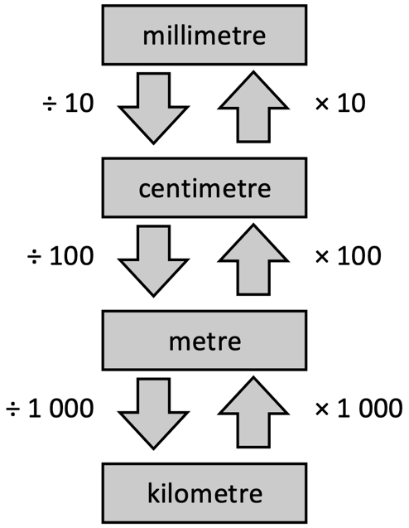
Workbook
page
INTRO TO MEASUREMENT
1
With your teacher.
1. Convert the following units.
Original | Convert to
100mm | cm
3,506mm | cm
200cm | m
1,346cm | m
2,000m | km
3,506mm | m
210km | m
35m | cm
22.5cm | mm
2.5km | mm

Slide 3
Workbook
page
INTRO TO MEASUREMENT
1
With your teacher.
2. Add together the following: 125mm + 35.6cm +1050mm + 1.5m + 27.4cm

Slide 4
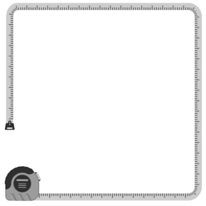
Workbook
page
PERIMETER
2
Perimeter is the distance around the outside of a two-dimensional shape. It is a linear measurement, usually measured in millimetres (mm), centimetres (cm), metres (m) or kilometres (km).
To calculate perimeter, we add together the
lengths of all the sides of the shape.

Slide 5

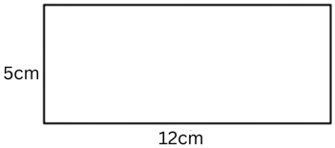
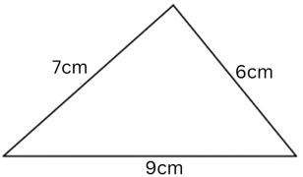
Workbook
page
PERIMETER
2
Worked examples.
1. A rectangle has a length of 12 cm and a width of 5 cm.
Perimeter = 5 + 5 + 12 + 12 = 34 cm.
2. A triangle has sides of 6 cm, 7 cm, and 9 cm.
Perimeter = 6 + 7 + 9 = 22 cm.

Slide 6
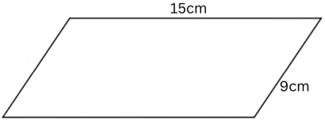
Workbook
page
PERIMETER
2
Worked examples.
3. A parallelogram has a base of 15 cm and a side length of 9 cm.
Perimeter = 15 + 9 + 15 + 9 = 48 cm.

Slide 7
Workbook
page
PERIMETER
2
With your teacher.
Find the perimeter of the following shapes.
1. Rectangle with length 8 cm and width 3 cm.
2. Triangle with side lengths 5 cm, 12 cm, and 13 cm.

Slide 8
Workbook
page
PERIMETER
3
With your teacher.
1. A rectangle has a perimeter of 50 cm and a width of 10 cm. What is its length?

Slide 9
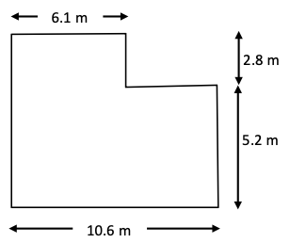
Workbook
page
PERIMETER
3
With your teacher.
2. Find the perimeter of the following shape:

Slide 10

Workbook
page
PERIMETER
3
Try it yourself.
Complete the ‘try it yourself’ questions on page 3 of your workbook.

Slide 11
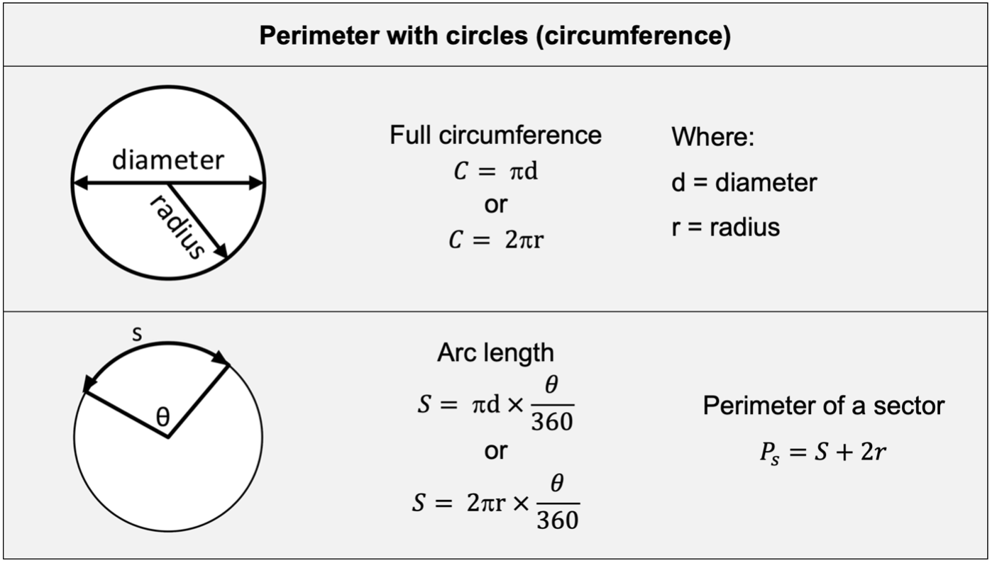
Workbook
page
PERIMETER
4

Slide 12
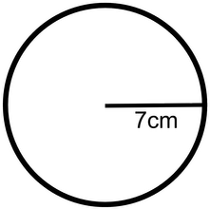
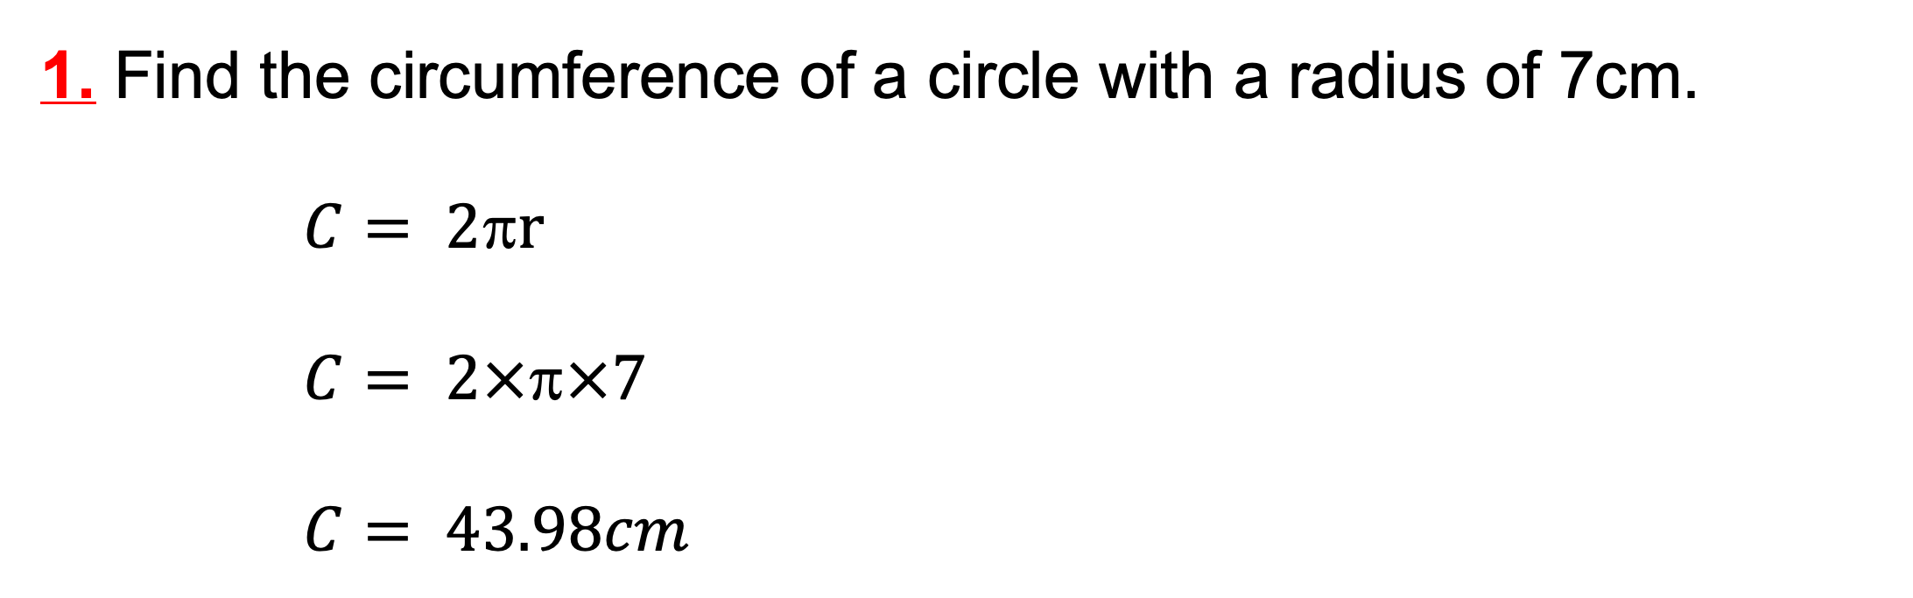
Workbook
page
PERIMETER
4
Worked examples.
1. Find the circumference of a circle with a radius of 7cm.
$C= 2r$
$C= 2××7$
$C= 43.98cm$

Slide 13
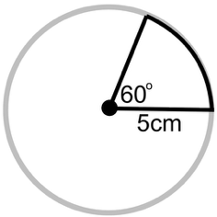
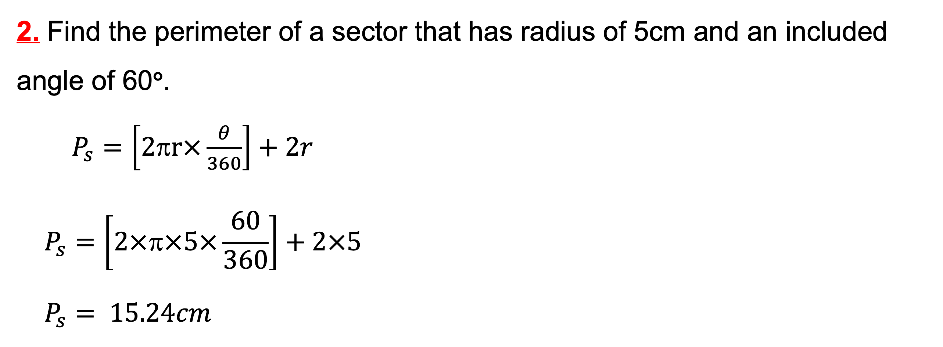
Workbook
page
PERIMETER
4
Worked examples.
2. Find the perimeter of a sector that has radius of 5cm and an included angle of 60°.
$P_{s}=\left[2πr×\frac{θ}{360}\right]+2r$
$$P_{s}=\left[2×π×5×\frac{60}{360}\right]+2×5$$
$$P_{s}= 15.24cm$$

Slide 14
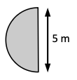
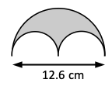
Workbook
page
PERIMETER
4
With your teacher.
Find the perimeter of the following shapes.

Slide 15
Workbook
page
PERIMETER
5
Try it yourself.
Complete the ‘try it yourself’ questions on page 5 of your workbook.

Slide 16
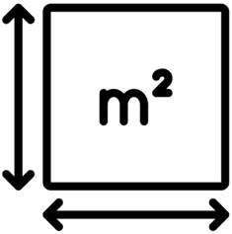
Workbook
page
AREA
6
Area is the amount of space inside a two-dimensional shape.
It is measured in square units such as mm², cm², m² and km².
*Make sure all dimensions are in the same unit before you start.*

Slide 17
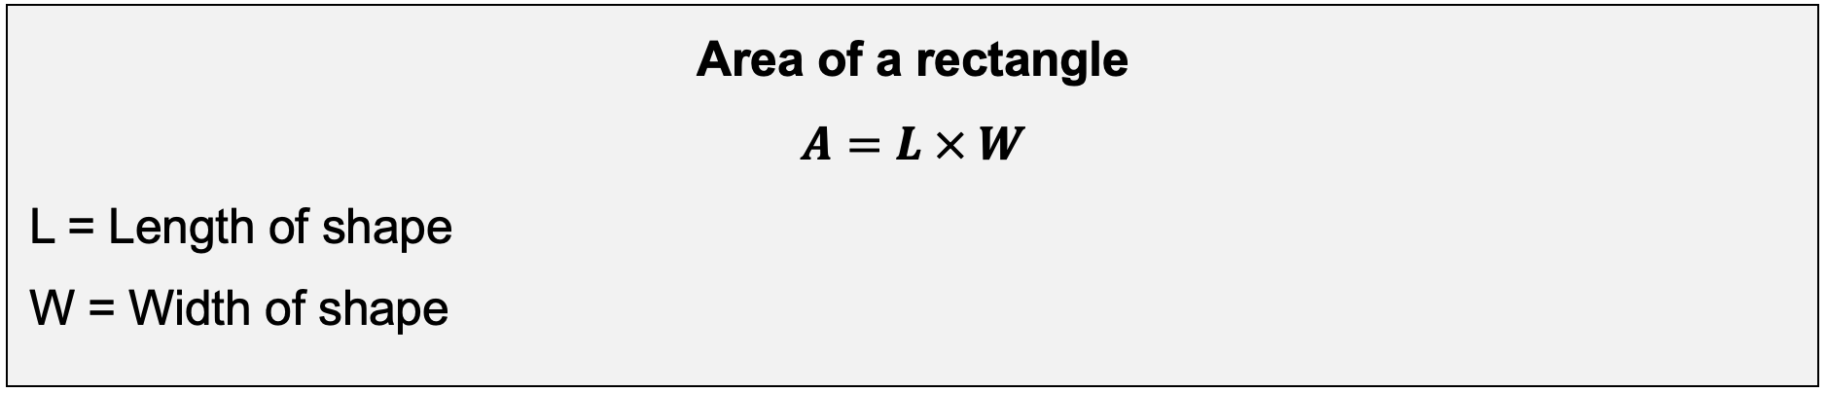
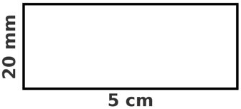
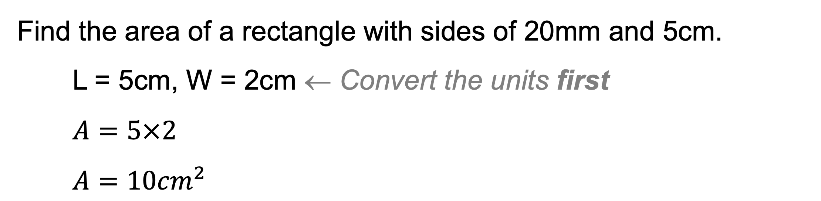
Workbook
page
AREA
6
Worked example.
Find the area of a rectangle with sides of 20mm and 5cm.
L = 5cm, W = 2cm ← Convert the units first
$$A=5×2$$
$A=10{cm}^{2}$

Slide 18
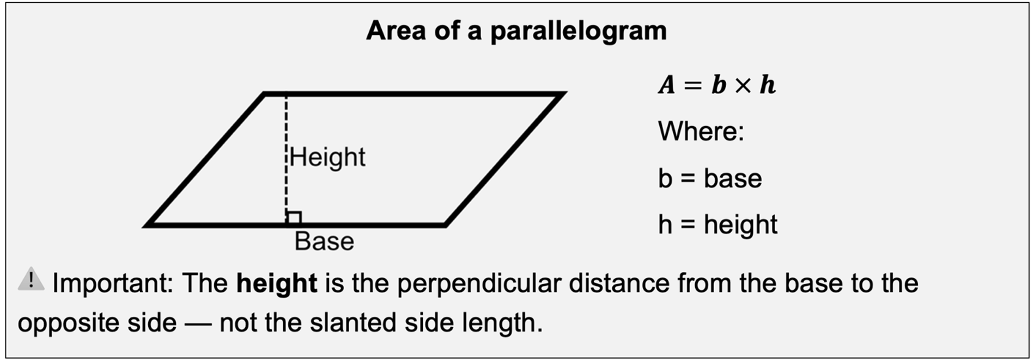
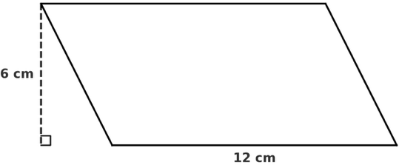
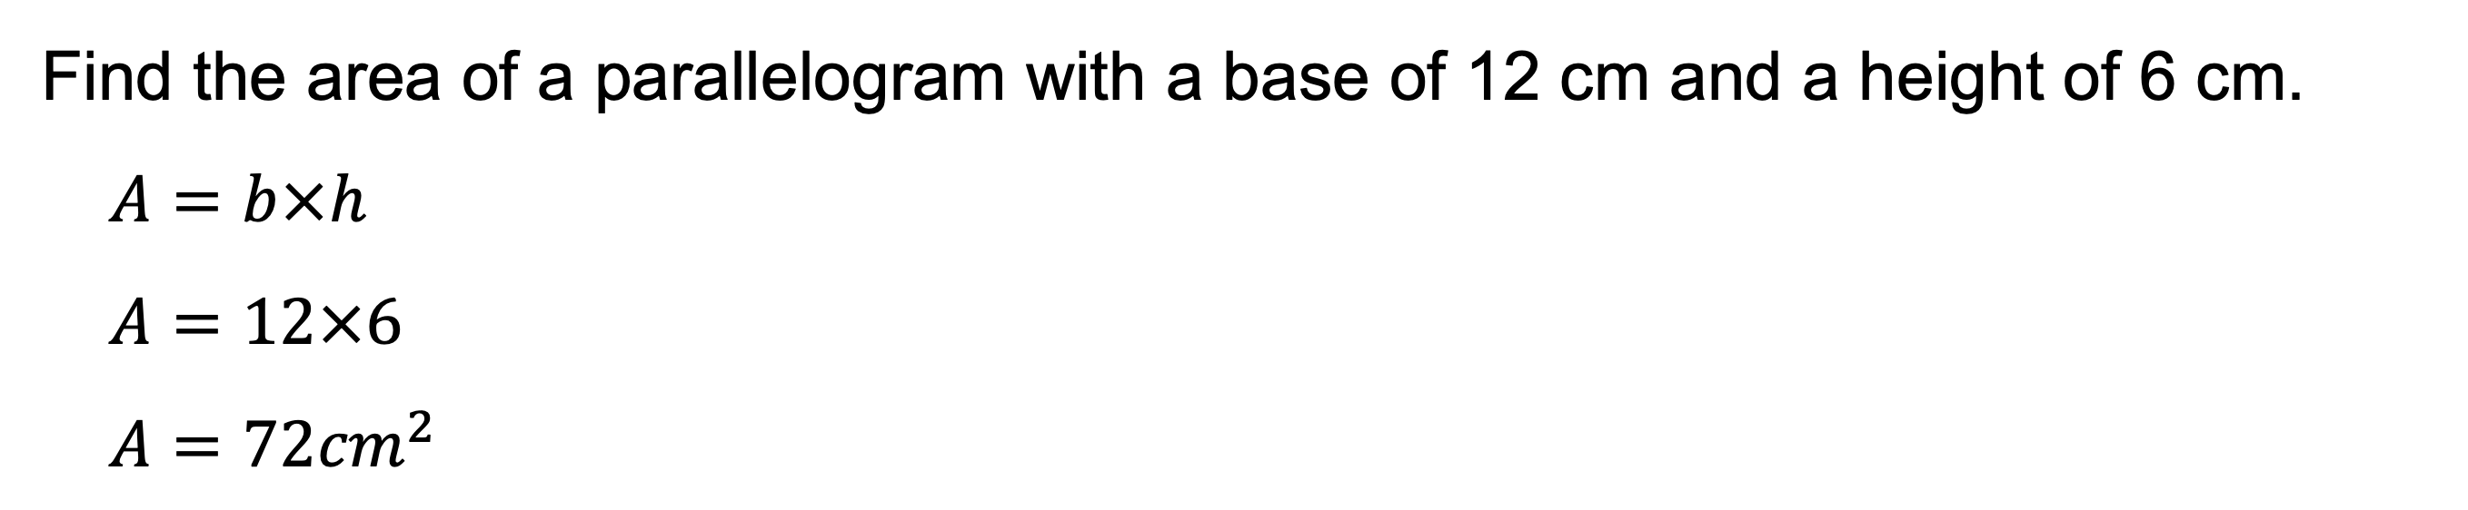
Workbook
page
AREA
6
Worked example.
Find the area of a parallelogram with a base of 12 cm and a height of 6 cm.
$$A=b×h$$
$$A=12×6$$
$$A=72{cm}^{2}$$

Slide 19
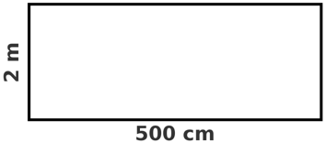
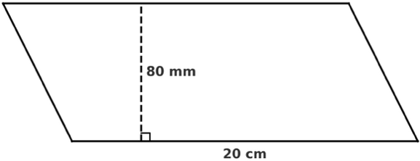
Workbook
page
AREA
6
With your teacher.
Find the area of the following shapes.

Slide 20
Workbook
page
AREA
7
Try it yourself.
Complete the ‘try it yourself’ questions on page 7 of your workbook.

Slide 21
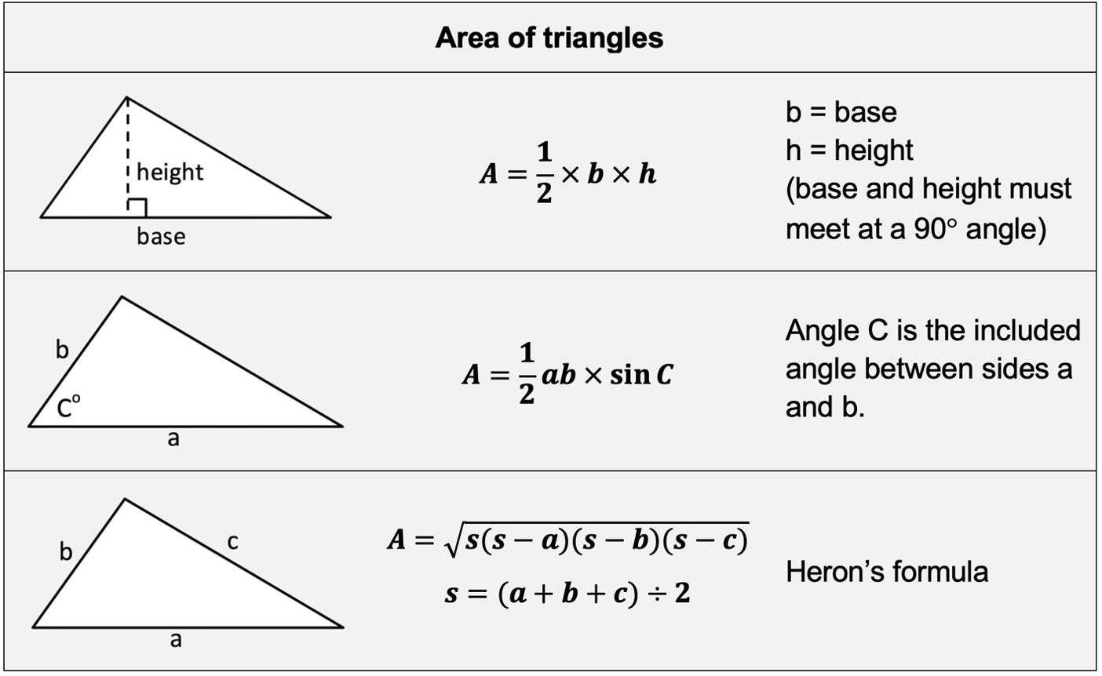
Workbook
page
AREA
7

Slide 22
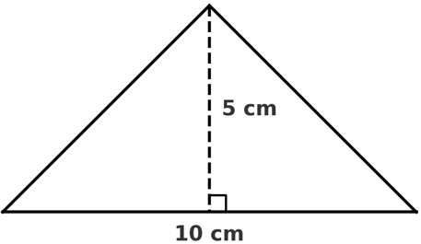

Workbook
page
AREA
7
Worked examples.
Use an appropriate formula to find the areas of the triangles.
$$A=\frac{1}{2}×b×h$$
$$A=\frac{1}{2}×10×5$$
$A=25{cm}^{2}$
1.

Slide 23
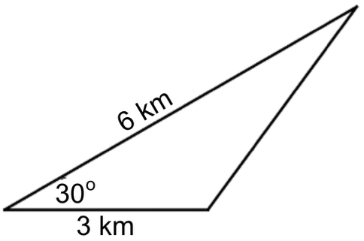
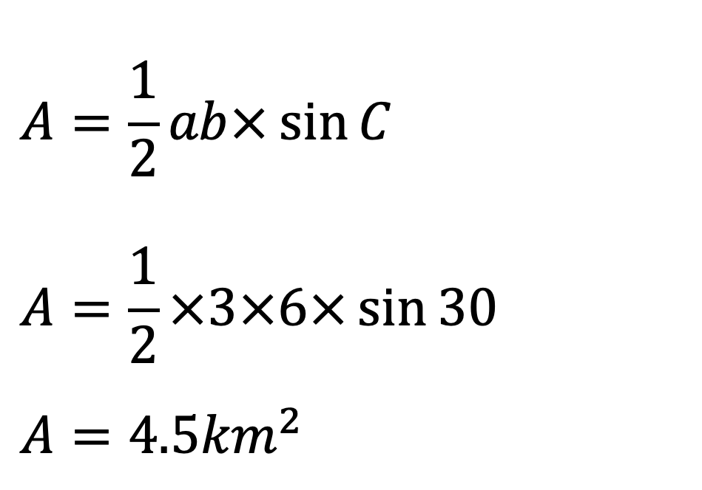
Workbook
page
AREA
8
Worked examples.
Use an appropriate formula to find the areas of the triangles.
2.
$$A=\frac{1}{2}ab×\sin{C}$$
$$A=\frac{1}{2}×3×6×\sin{30}$$
$$A=4.5{km}^{2}$$
*Make sure your calculator is in degrees mode for this course*

Slide 24
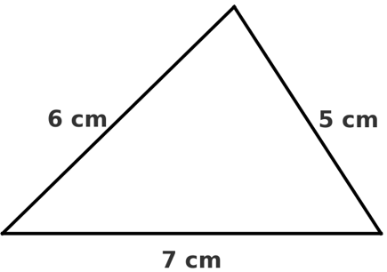
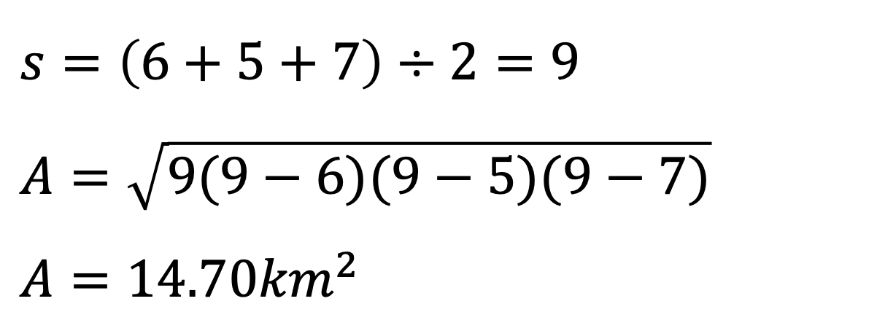
Workbook
page
AREA
8
Worked examples.
Use an appropriate formula to find the areas of the triangles.
3.
$$s=\left(6+5+7\right)÷2=9$$
$$A=\sqrt{9(9−6)(9−5)(9−7)}$$
$A=14.70{km}^{2}$

Slide 25
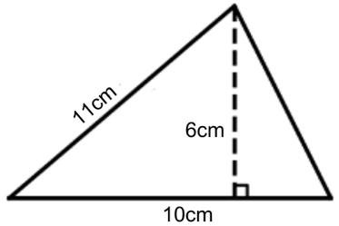
Workbook
page
AREA
8
With your teacher.
Use an appropriate formula to find the areas of the triangles.
1.

Slide 26
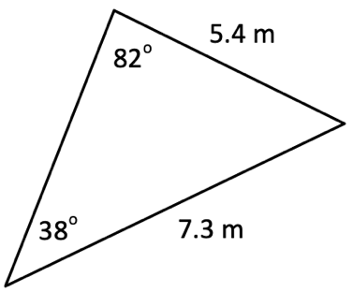
Workbook
page
AREA
8
With your teacher.
Use an appropriate formula to find the areas of the triangles.
2.

Slide 27
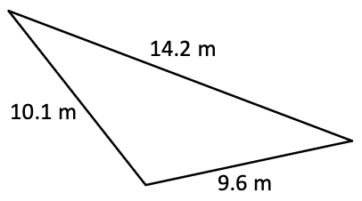
Workbook
page
AREA
8
With your teacher.
Use an appropriate formula to find the areas of the triangles.
3.

Slide 28
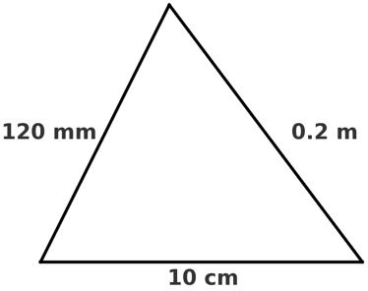
Workbook
page
AREA
8
With your teacher.
Use an appropriate formula to find the areas of the triangles.
4.

Slide 29
Workbook
page
AREA
9
Try it yourself.
Complete the ‘try it yourself’ questions on page 9 of your workbook.

Slide 30
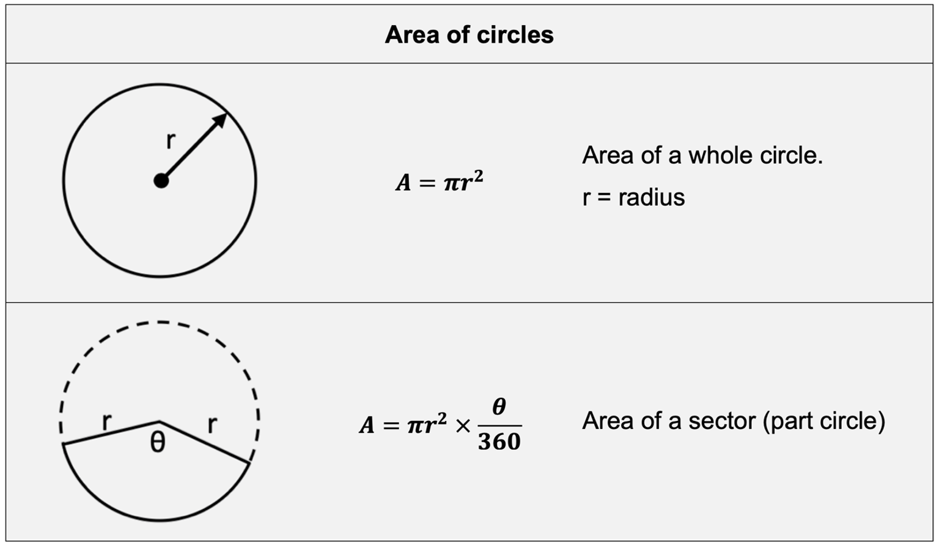
Workbook
page
AREA
10

Slide 31
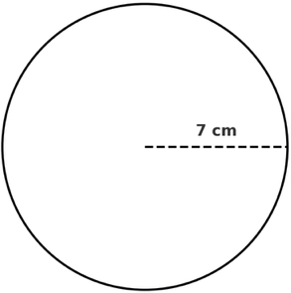
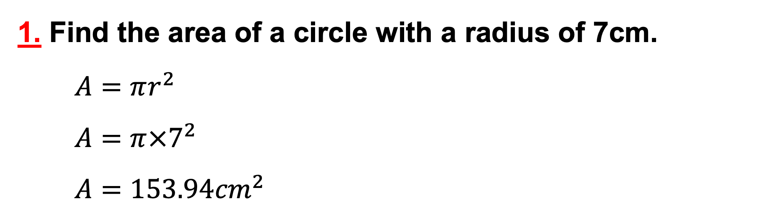
Workbook
page
AREA
10
Worked examples.
1. Find the area of a circle with a radius of 7cm.
$$A=πr^{2}$$
$$A=π×7^{2}$$
$$A=153.94{cm}^{2}$$

Slide 32
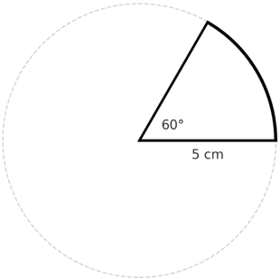

Workbook
page
AREA
10
Worked examples.
2. Find the area of a 60° sector with a radius of 5cm.
$$A=πr^{2}×\frac{θ}{360}$$
$$A=π×5^{2}×\frac{60}{360}$$
$$A=13.09{cm}^{2}$$

Slide 33
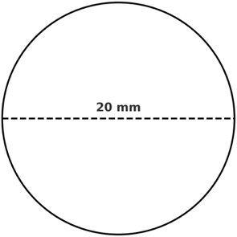
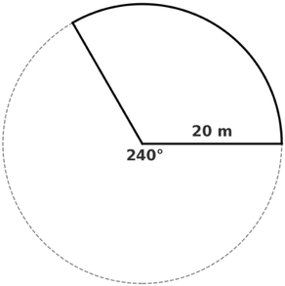
Workbook
page
AREA
10
With your teacher.
1. Find the area of this circle.
2. Find the area of this sector.

Slide 34
Workbook
page
AREA
11
Try it yourself.
Complete the ‘try it yourself’ questions on page 11 of your workbook.

Slide 35
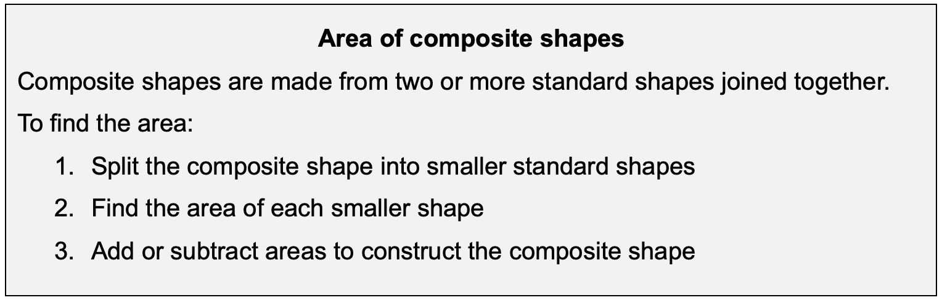
Workbook
page
AREA
12

Slide 36
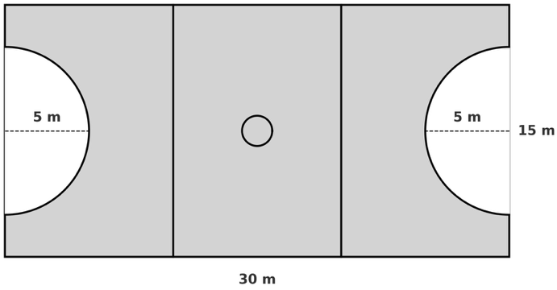
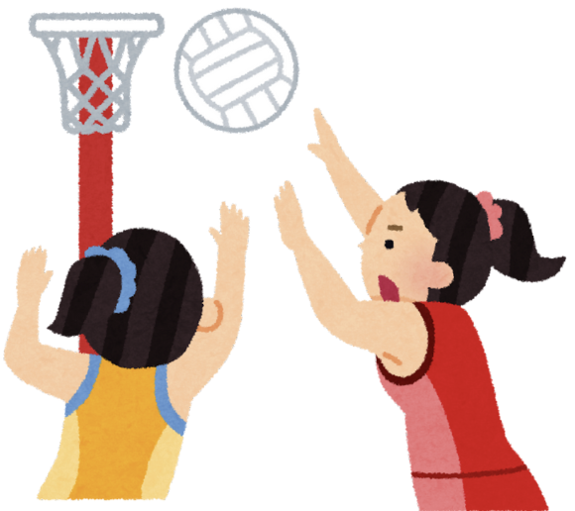
Workbook
page
AREA
12
Worked example.
Liz Watson accidentally stepped in paint before starting a game of netball. She plays the position of centre the whole game, getting paint all over the court except for in the shooting semi-circles at each end.

Slide 37
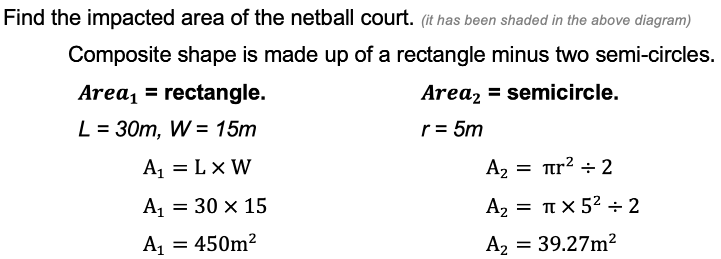
Workbook
page
AREA
12
Worked example.
a.

Slide 38
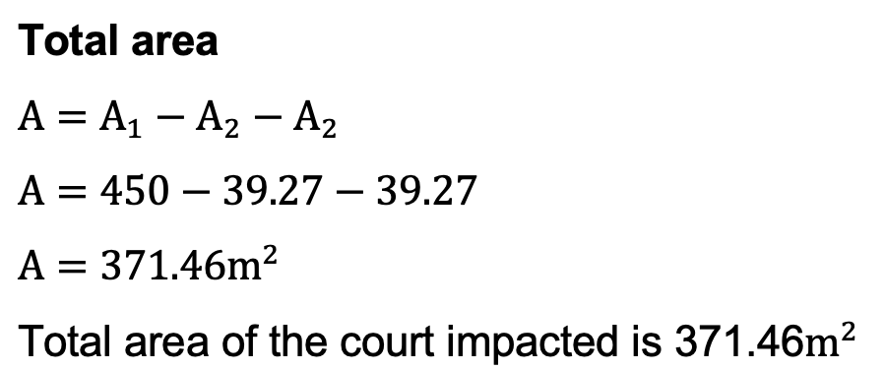
Workbook
page
AREA
12
Worked example.
a.

Slide 39
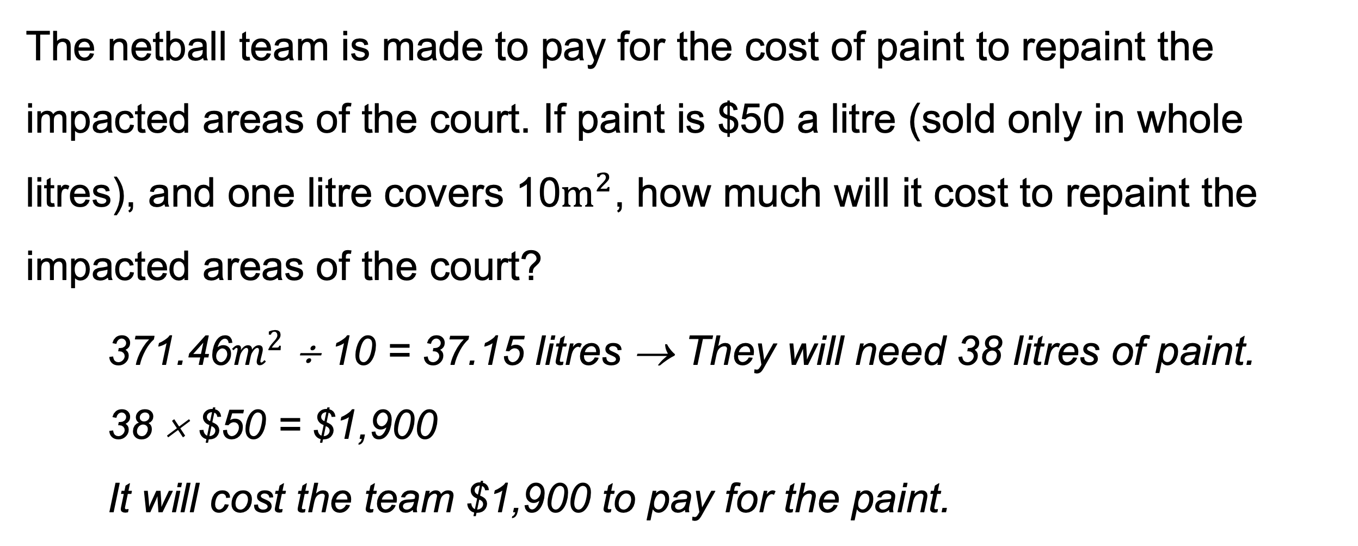
Workbook
page
AREA
12
Worked example.
b.
The netball team is made to pay for the cost of paint to repaint the impacted areas of the court. If paint is $50 a litre (sold only in whole litres), and one litre covers 10$m^{2}$, how much will it cost to repaint the impacted areas of the court?
371.46$m^{2}$ ÷ 10 = 37.15 litres → They will need 38 litres of paint.
38 × $50 = $1,900
It will cost the team $1,900 to pay for the paint.

Slide 40
Workbook
page
AREA
13
Try it yourself.
Complete the ‘try it yourself’ questions on page 13 of your workbook.

Slide 41
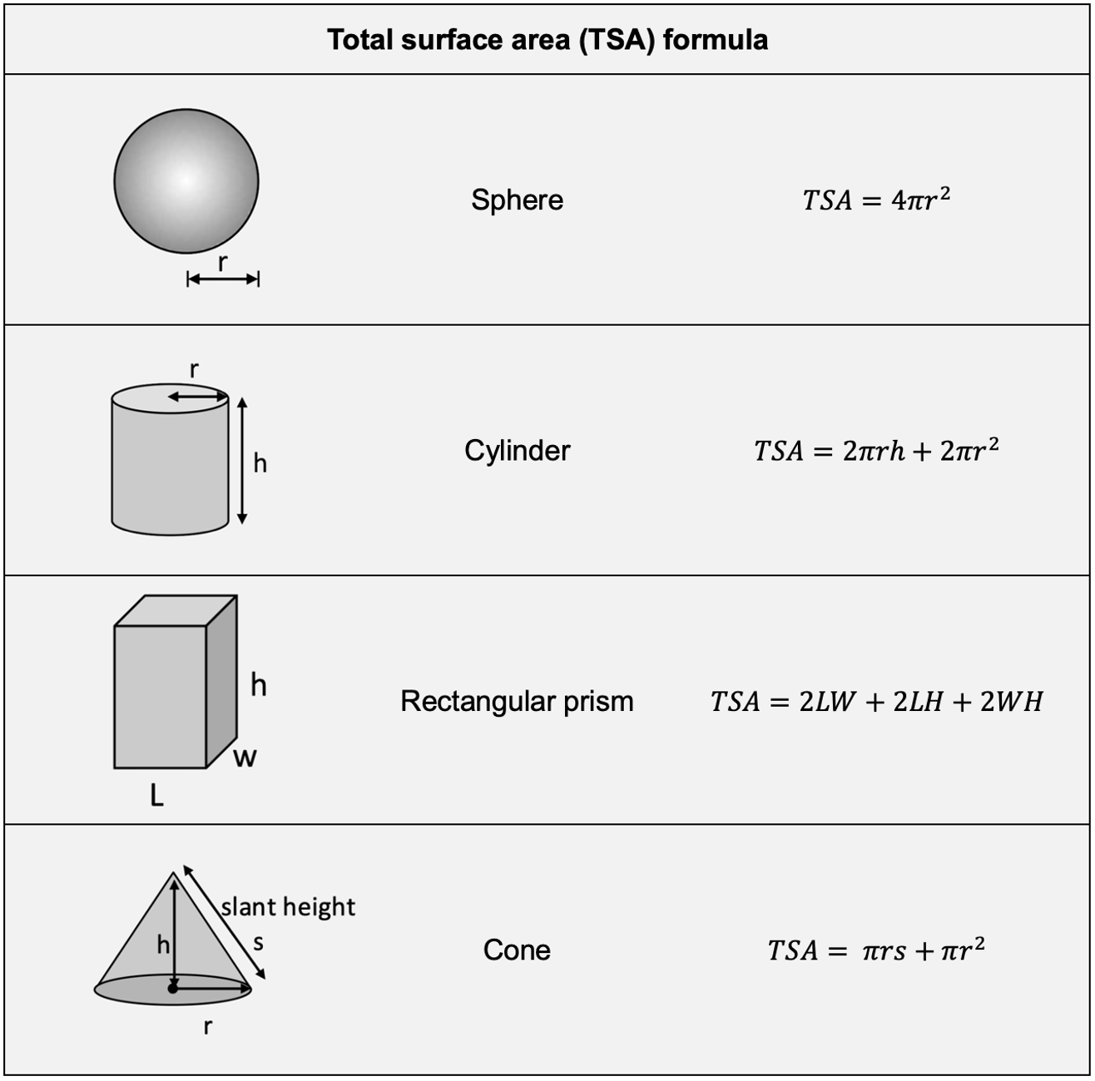
Workbook
page
TOTAL SURFACE AREA (TSA)
14

Slide 42
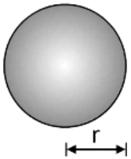
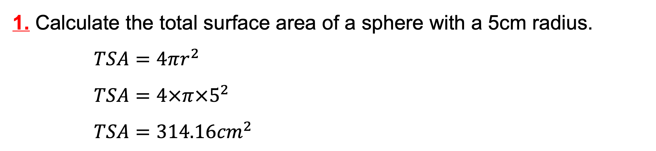
Workbook
page
TOTAL SURFACE AREA (TSA)
15
Worked examples.
1. Calculate the total surface area of a sphere with a 5cm radius.
$TSA=4πr^{2}$
$TSA=4×π×5^{2}$
$TSA=314.16{cm}^{2}$

Slide 43
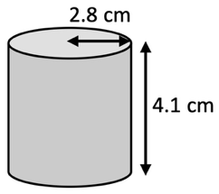
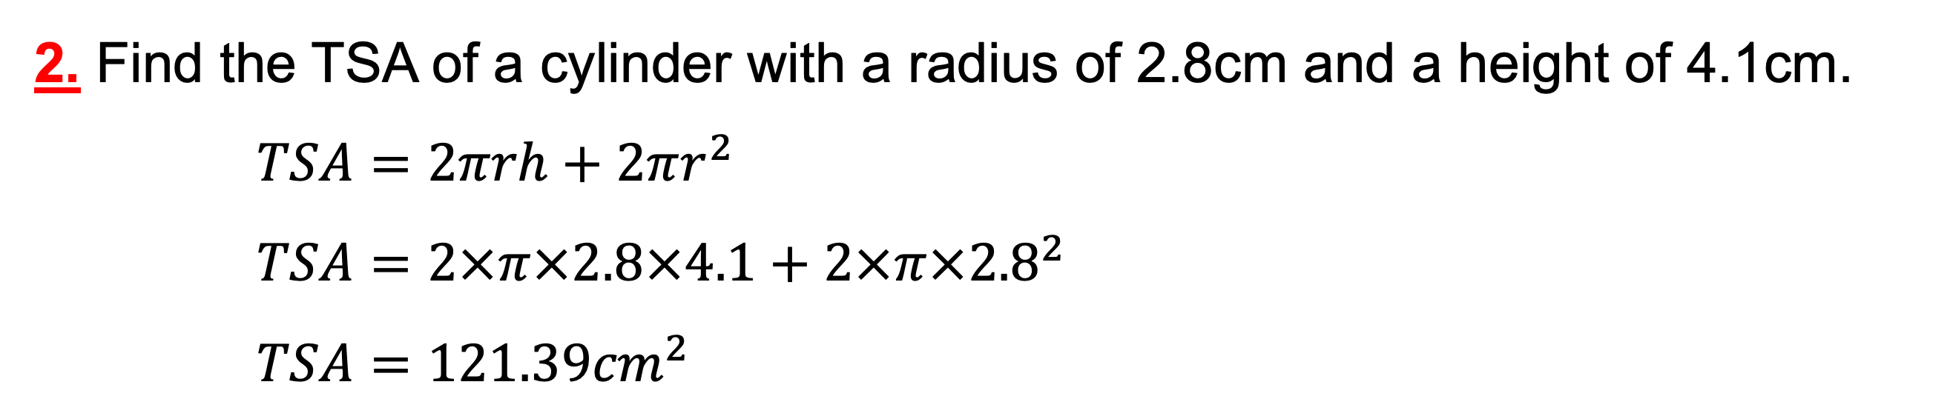
Workbook
page
TOTAL SURFACE AREA (TSA)
15
Worked examples.
2. Find the TSA of a cylinder with a radius of 2.8cm and a height of 4.1cm.
$TSA=2πrh+2πr^{2}$
$TSA=2×π×2.8×4.1+2×π{×2.8}^{2}$
$TSA=121.39{cm}^{2}$

Slide 44

Workbook
page
TOTAL SURFACE AREA (TSA)
15
With your teacher.
1. Find the TSA of a rectangular prism with sides of 7cm, 3cm and 5cm.

Slide 45

Workbook
page
TOTAL SURFACE AREA (TSA)
15
With your teacher.
2. Find the TSA of a cone with a radius of 5cm and a slant height of 8cm.

Slide 46

Workbook
page
TOTAL SURFACE AREA (TSA)
15

Slide 47



Workbook
page
TOTAL SURFACE AREA (TSA)
16
Worked example.
Break the 3D shape up into separate surfaces (faces).
This shape has 2 triangle faces and 3 rectangle faces.
$A_{1}$ = 2 x triangles (height of 4.8cm, base of 6.4cm)
$A_{2}$ = Base rectangle (length of 8.2cm, width of 6.4cm)
$A_{3}$ = 2 x side rectangles (length of 8.2cm, width of 5.8cm)

Slide 48


Workbook
page
TOTAL SURFACE AREA (TSA)
16
Worked example.
The total surface area would be:
$TSA= A_{1}+A_{1}+A_{2}+A_{3}+A_{3}$
$TSA= 15.36+15.36+52.48+47.56+47.56$
$TSA= 178.32{cm}^{2}$

Slide 49

Workbook
page
TOTAL SURFACE AREA (TSA)
16
With your teacher.
A cube with side lengths of 10cm has a square hole cut out of it. The square hole has sides of 5cm. Find the total surface area of the shape (including inside the hole!)

Slide 50
Workbook
page
TOTAL SURFACE AREA (TSA)
17
Try it yourself.
Complete the ‘try it yourself’ questions on page 17 of your workbook.

Slide 51

Workbook
page
VOLUME OF A PRISM
18

Slide 52


Workbook
page
VOLUME OF A PRISM
18
Worked example.
Find the volume of the prism in the diagram.
$$V=Ah$$
$V=0.45×2.1$ ← The area of the base is given in this shape
$$V=0.945m^{3}$$

Slide 53


Workbook
page
VOLUME OF A PRISM
19
Worked example.
Find the volume of a cylinder with a radius of 3.2cm and a height of 7.8cm
$V=Ah$← “A” represents the area of the base shape.
$V=\left(πr^{2}\right)×h$ ← Replace the “A” with the formula for area of a circle.
$$V=\left(π{×3.2}^{2}\right)×7.8$$
$$V=250.93{cm}^{3}$$

Slide 54

Workbook
page
VOLUME OF A PRISM
19
With your teacher.
1. Find the volume of the triangular prism in the diagram.

Slide 55


Workbook
page
VOLUME OF A PRISM
19
With your teacher.
2. Ariarne Titmus has used her Olympic prize money to install a pool in her backyard. The pool is 10 metres long and 4 metres wide. The deep end is 3m deep, and the shallow end is 1m deep. Calculate the volume of water needed to fill the swimming pool ($1m^{3}=1,000L$)

Slide 56
Workbook
page
VOLUME OF A PRISM
20
Try it yourself.
Complete the ‘try it yourself’ questions on page 20 of your workbook.

Slide 57

Workbook
page
VOLUME USING FORMULAS
21

Slide 58


Workbook
page
VOLUME USING FORMULAS
21
Worked example.
Find the volume of a sphere with a radius of 3.2 metres.
$V= \frac{4}{3}πr^{3}$
$V= \frac{4}{3}×π{×3.2}^{3}$
$V=137.26m^{3}$

Slide 59


Workbook
page
VOLUME USING FORMULAS
21
With your teacher.
Billy is making a model set of pyramids for his school project on Egypt.
He has made a mould for the pyramid with a square base of 20cm x 20cm, and a height of 30cm
He wants to build the pyramids out of plaster. Plaster is sold in 500mL bags. How many bags would he need? ($1{cm}^{3}=1mL$)

Slide 60

Workbook
page
VOLUME USING FORMULAS
22

Slide 61


Workbook
page
VOLUME USING FORMULAS
22
Worked example.
Students in Mrs Thorp’s science class are learning about rainfall.
On a particularly rainy day, they measure the rainfall on the school basketball court and attached seating area.
The rectangular basketball court measures 28m x 15m.
The viewing area is a semi-circle with a radius of 7.5m.
The students measure 20mm of rain evenly over the entire area.
Find the total amount of rainfall.

Slide 62


Workbook
page
VOLUME USING FORMULAS
22
Worked example.
Find the volume of both shapes.
$V_{1}$ = volume of rectangular prism
$V_{2}$ = volume of semi-circle prism
$$V_{1}=Ah$$
$$V_{1}=(L×W)×h$$
$V_{1}=(15×28)×0.02$ ← Convert the 20mm to 0.02m
$V_{1}=8.4m^{3}$

Slide 63

Workbook
page
VOLUME USING FORMULAS
22
Worked example.
Find the volume of both shapes.
$V_{1}$ = volume of rectangular prism
$V_{2}$ = volume of semi-circle prism
$$V_{2}=Ah$$
$$V_{2}=(\frac{1}{2}πr^{2})×h$$
$$V_{2}=(\frac{1}{2}×π×{7.5}^{2})×0.02$$
$$V_{2}=1.77m^{3}$$

Slide 64

Workbook
page
VOLUME USING FORMULAS
22
Worked example.
Find the volume of both shapes.
$V_{1}$ = volume of rectangular prism
$V_{2}$ = volume of semi-circle prism
$$V_{1}+V_{2}=10.17m^{3}$$
Total amount of rainfall is 10.17$m^{3}$ or 10,170 litres of rain ($1m^{3}=1,000L$)

Slide 65

Workbook
page
VOLUME USING FORMULAS
23
With your teacher.
1. A basketball signed by Michael Jordan is being shipped to Australia.
The ball has a diameter of 25cm. The ball is packed tightly into a box and the remaining space in the box is filled with packing peanuts.
What volume of the box would need to be filled with packing peanuts?

Slide 66
Workbook
page
VOLUME USING FORMULAS
23
With your teacher.
2. Billy is still working on his model set for his Egypt school project.
He decided that his plaster pyramid was too simple, he now wants to make it fancier. He decides he will make 3 pyramids and mount them on a rectangular block; all made of plaster. The pyramids still have a square base of 20cm x 20cm, and a height of 30cm. The rectangular base will have a surface area of 1m x 1m and a height of 20cm. Calculate the volume of plaster needed to make his vision.

Slide 67
Workbook
page
VOLUME
24
Try it yourself.
Complete the ‘try it yourself’ questions on page 24 of your workbook.

