Slide 1

This PowerPoint has been designed for use with the workbook:
GM3 BIVARIATE DATA
Workbooks, resources and PowerPoints are available at BertramEducation.com

Slide 2

Workbook
page
42
CONSTRUCTING TIME SERIES PLOTS
What is a Time Series Plot?
A time series plot shows how one variable changes over time.
The x-axis always represents time (days, months, years, etc.).
The y-axis represents the variable being measured (e.g., rainfall, sales)
Data points are plotted and then joined with straight lines to show how the variable moves through time.

Slide 3
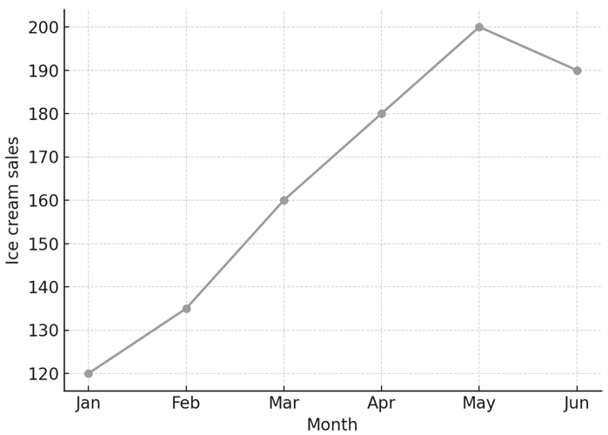
Workbook
page
CONSTRUCTING TIME SERIES PLOTS
42
Example of a time series plot:
Monthly sales of ice cream at a
beach shop.
How is this different from a scatterplot?
Scatterplot: compares two variables (e.g., hours studied vs exam mark).
Time series plot: shows how one variable changes over time

Slide 4

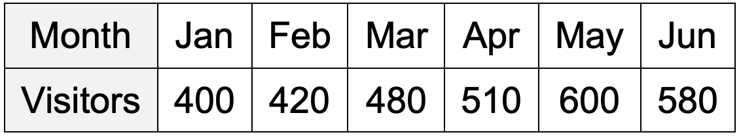
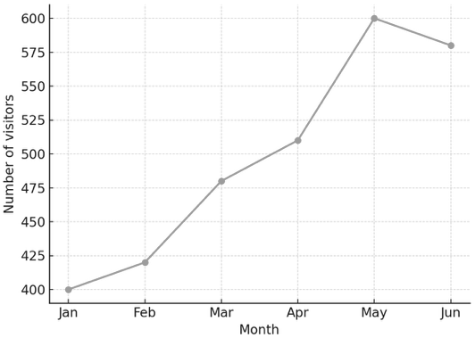
Workbook
page
CONSTRUCTING TIME SERIES PLOTS
42
Worked example.
The table shows the number of visitors to a swimming pool over 6 months.
Step 1: Put months on the x-axis (time).
Step 2: Put number of visitors on the y-axis.
Step 3: Plot the points and join them with
straight lines.
Interpretation: The number of visitors increased steadily from January to May, then dropped slightly in June.

Slide 5

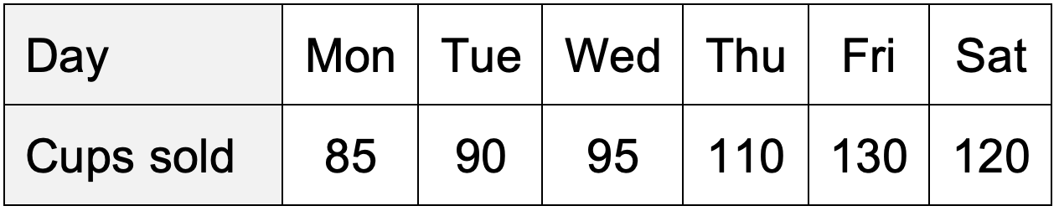
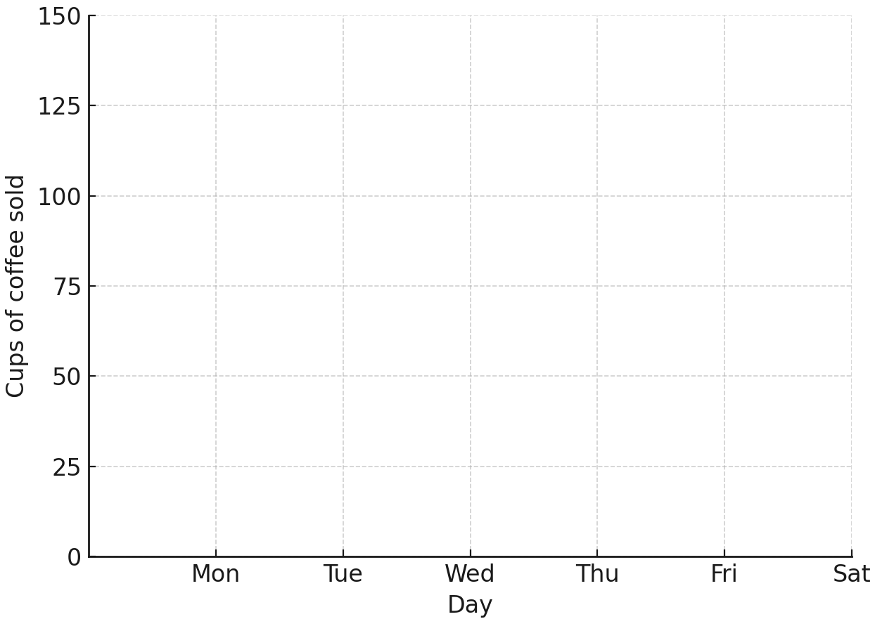
Workbook
page
CONSTRUCTING TIME SERIES PLOTS
43
With your teacher.
The table below shows the number of cups of coffee sold in a café over six days. Plot a time series graph of the data, joining the points with lines.

Slide 6
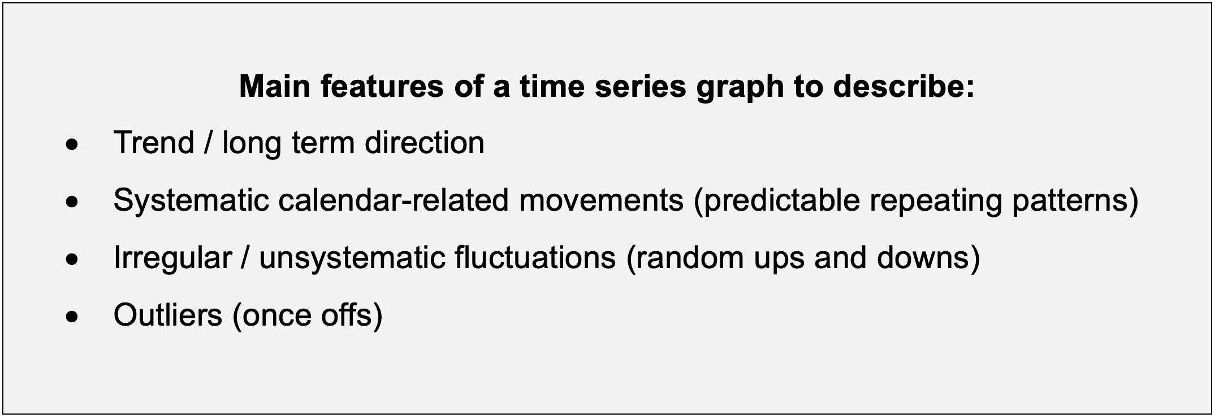
Workbook
page
DESCRIBING TIME SERIES PLOTS
43
In this course you will construct time series plots, but there is a bigger focus on describing, interpreting, and analysing time series graphs.
When describing time series data, we look for important features and patterns. These help us describe what the data is doing and make predictions.

Slide 7
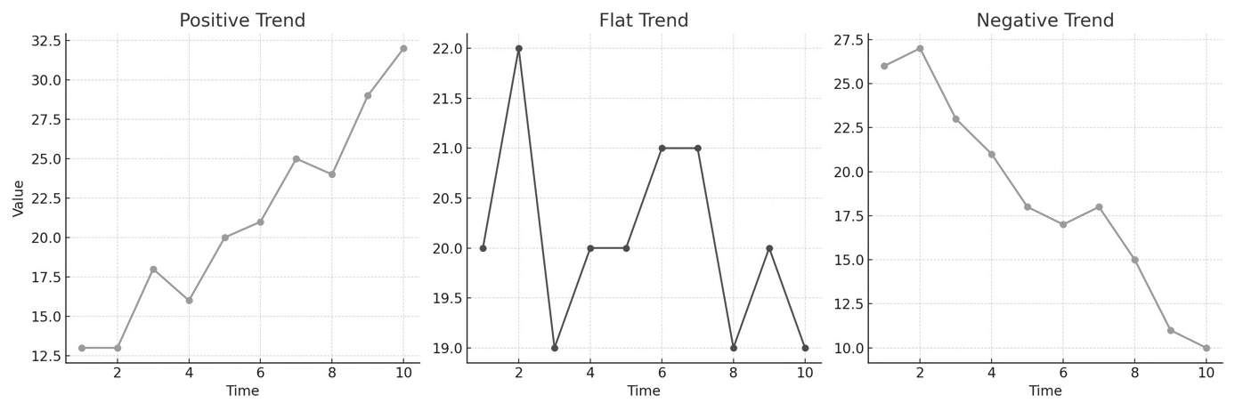
Workbook
page
DESCRIBING TIME SERIES PLOTS
44
Trend / long term direction
  The overall movement of the data over time.
  It may be upward (positive), downward (negative), or relatively flat.
Example. The number of people using smartphones has increased steadily over the past 10 years. (positive trend)

Slide 8
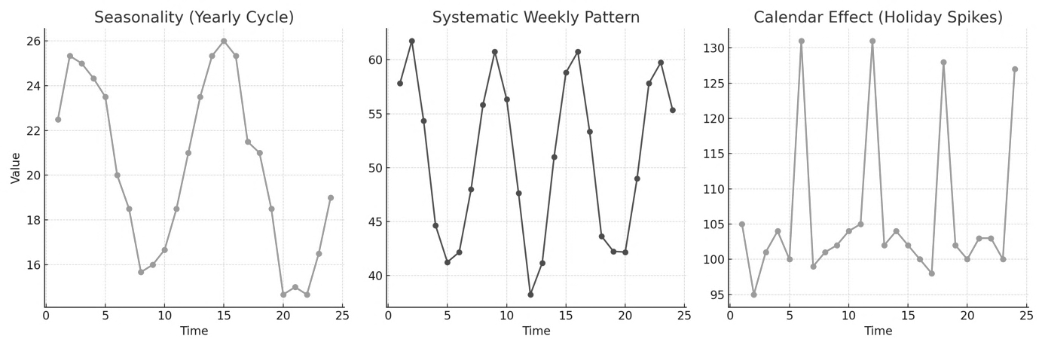
Workbook
page
DESCRIBING TIME SERIES PLOTS
44
Systematic calendar-related movements
Regular repeating patterns linked to the calendar.
Movements may be seasonal (weekly / monthly / yearly, or literal seasons like summer and winter). For example, Ice cream sales increase every summer and decrease every winter.
Patterns may also be caused by specific calendar-related events that aren’t strictly seasonal, e.g. hotel use during school term times, long weekends, or holidays.

Slide 9
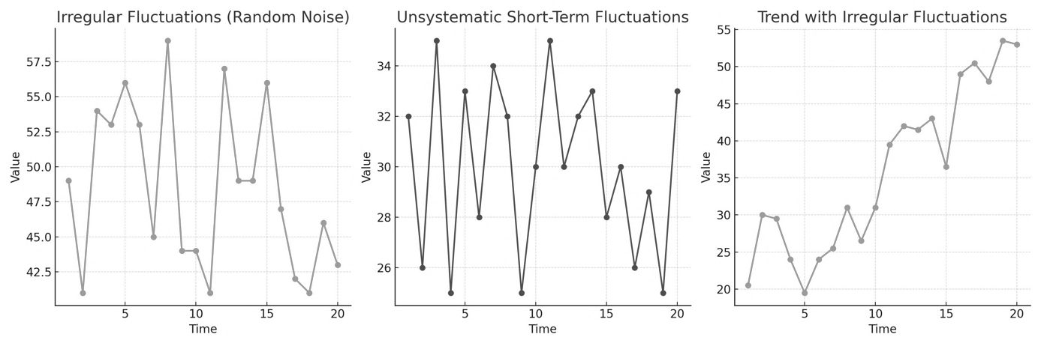
Workbook
page
DESCRIBING TIME SERIES PLOTS
45
Irregular / unsystematic fluctuations
Random ups and downs that do not follow a regular cycle.
Example: A council records how many car accidents happen daily over the course of a month. The numbers fluctuate, especially one rainy weekend, but not in any regular pattern.
Often referred to as “noise” in the data.

Slide 10
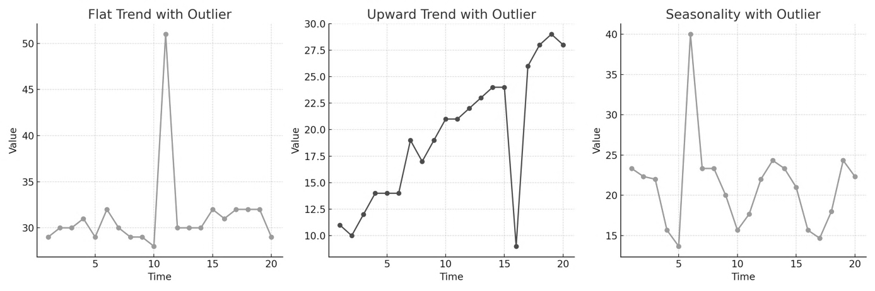
Workbook
page
DESCRIBING TIME SERIES PLOTS
45
Outliers
One-off unusual results that stand out from the rest of the pattern.
In some cases, an outlier may be dropped from the data, so it doesn’t interfere with calculations.

Slide 11
Workbook
page
DESCRIBING TIME SERIES PLOTS
45
Features to Look For.
When describing a time series, always check:
Trend - is there an overall upward or downward movement?
Seasonal pattern - are there regular ups and downs repeating by time (e.g., each year or each week)?
Irregular fluctuations – are there short-term random jumps or drops?
Outliers – any unusual results that don’t fit the pattern?

Slide 12
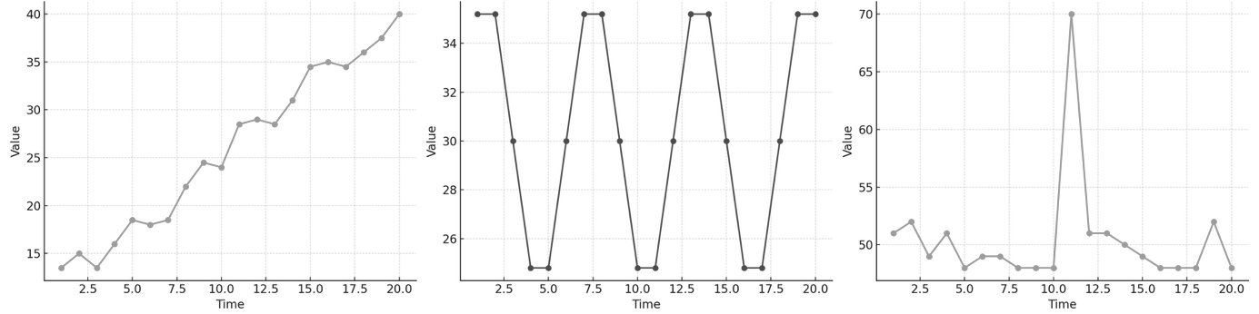
Workbook
page
DESCRIBING TIME SERIES PLOTS
46
With your teacher.
Describe each of the following graphs.

Slide 13
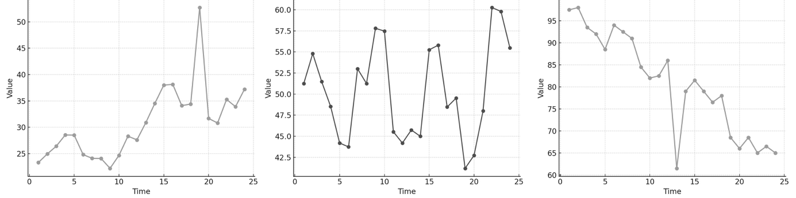
Workbook
page
DESCRIBING TIME SERIES PLOTS
46
With your teacher.
Describe each of the following graphs.

Slide 14
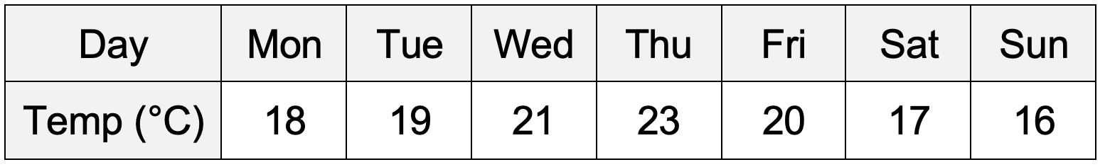
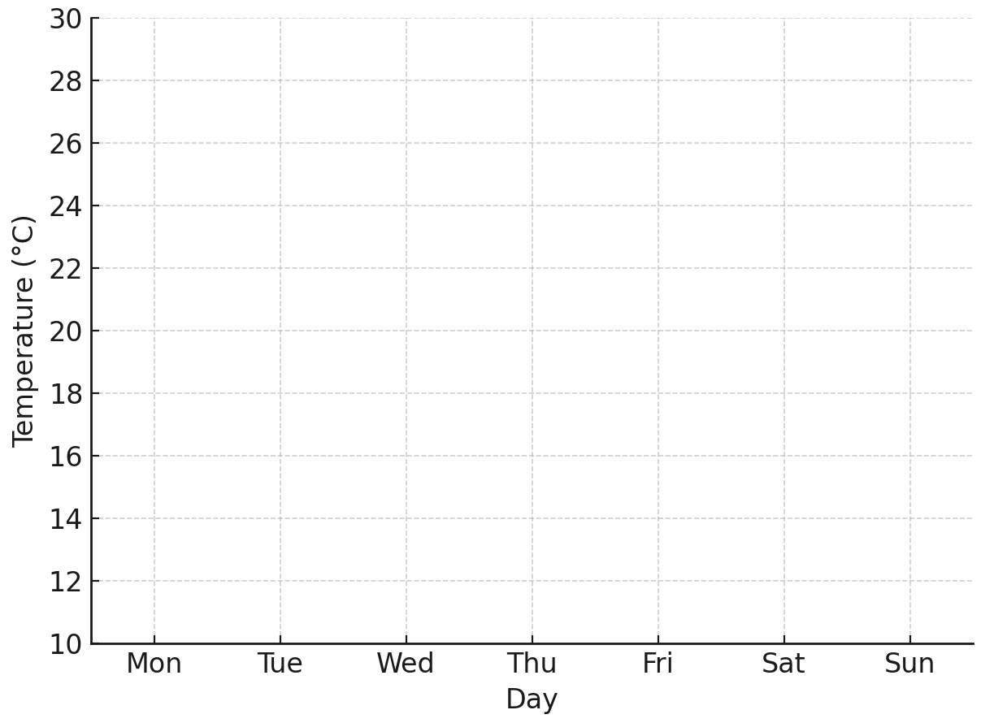

Workbook
page
DESCRIBING TIME SERIES PLOTS
46
With your teacher.
The table shows the average daily temperature in Hobart for one week.
a. Plot the time series graph

Slide 15
Workbook
page
DESCRIBING TIME SERIES PLOTS
46
With your teacher.
The table shows the average daily temperature in Hobart for one week.
a. Plot the time series graph
b. Can you see any kind of trends or patterns over the week? Describe them.
c. Was there an unusual result or outlier?

Slide 16

Workbook
page
DESCRIBING TIME SERIES PLOTS
47
Try it yourself.
Complete the ‘try it yourself’ questions on page 47 of your workbook.

Slide 17

Workbook
page
ANALYSING TIME SERIES DATA
48
So far, we have learned how to describe the main features of a time series plot such as trend, seasonality, irregular fluctuations, and outliers.
But often, time series data can be messy - with lots of ups and downs that make it difficult to see the big picture.
There are 4 techniques this course uses to help analyse time series data. We will go through them one by one.

Slide 18
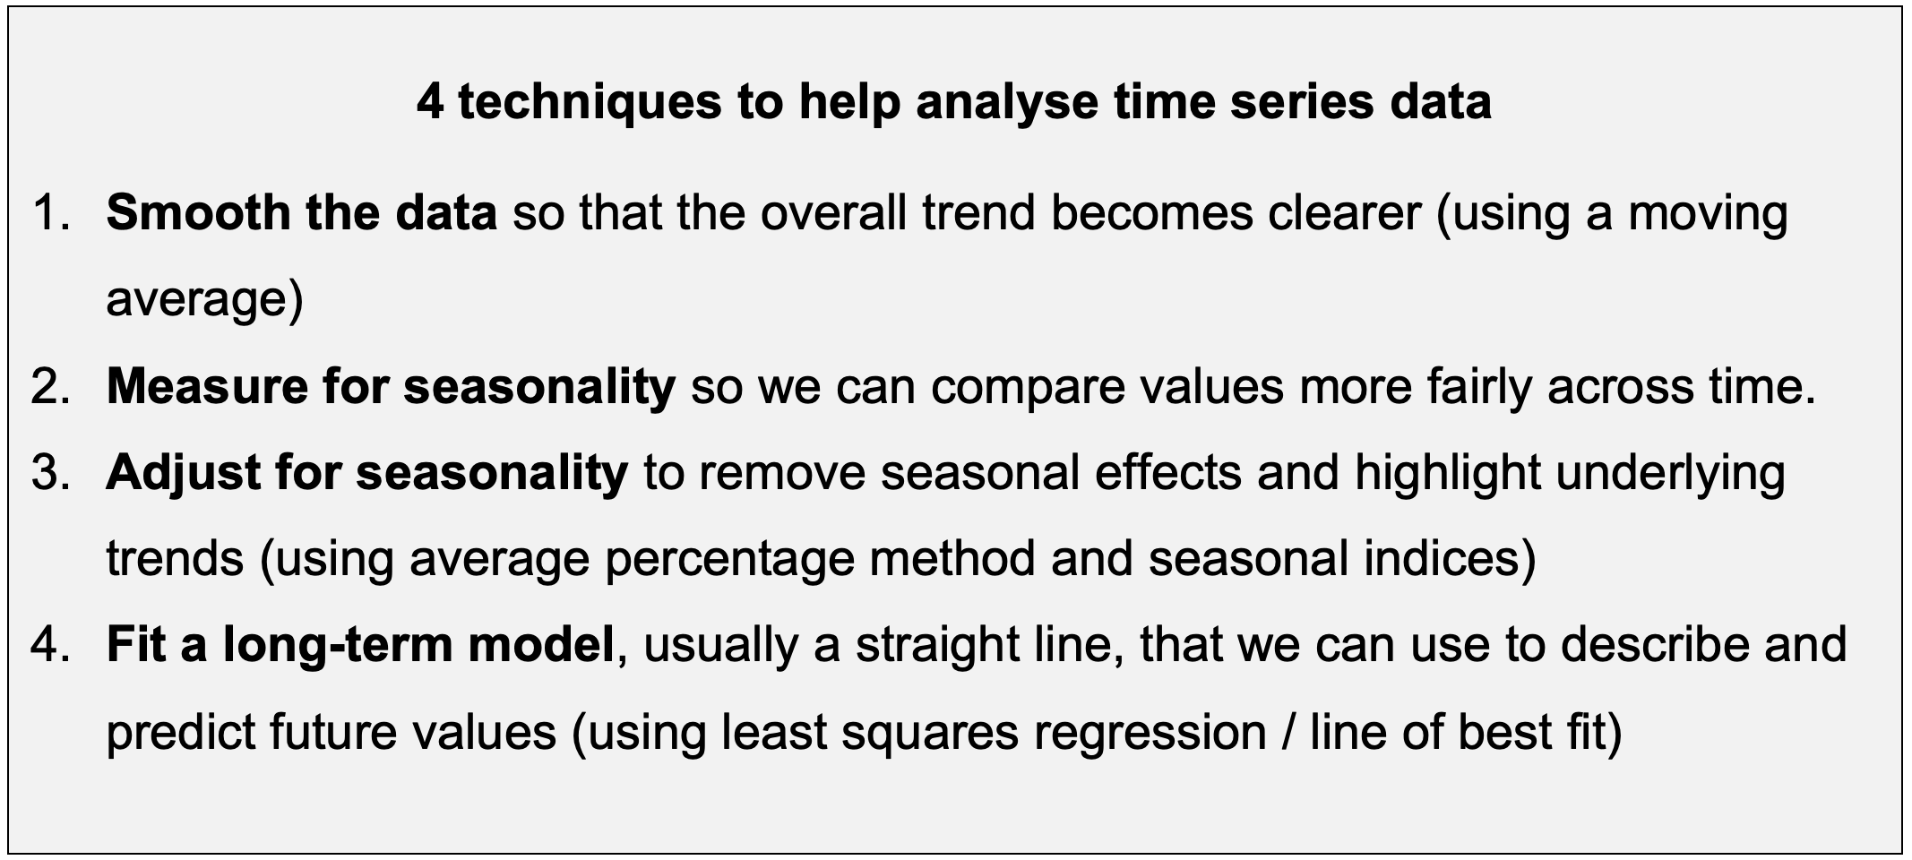
Workbook
page
ANALYSING TIME SERIES DATA
48

Slide 19
Workbook
page
ANALYSING TIME SERIES DATA
48
1. SMOOTHING DATA USING A MOVING AVERAGE.
Problem: Raw data is often noisy (lots of irregular ups and downs). It can be hard to see the overall pattern.
Solution: A moving average smooths the data by replacing each point with the average of it and its neighbours. This can help make the underlying trend clearer.

Slide 20
Workbook
page
ANALYSING TIME SERIES DATA
48
1. SMOOTHING DATA USING A MOVING AVERAGE.
A 3-point moving average takes the average of 3 points
(e.g. day before, current day, day after).
A 5-point moving average take the average of 5 consecutive points,
(e.g. two months before, current month, two months after)
Spreadsheets are commonly used to automate moving averages.

Slide 21
Workbook
page
ANALYSING TIME SERIES DATA
49
1. SMOOTHING DATA USING A MOVING AVERAGE.
A 3-point moving average takes the average of 3 points
(e.g. day before, current day, day after).
A 5-point moving average take the average of 5 consecutive points,
(e.g. two months before, current month, two months after)
Spreadsheets are commonly used to automate moving averages.

Slide 22
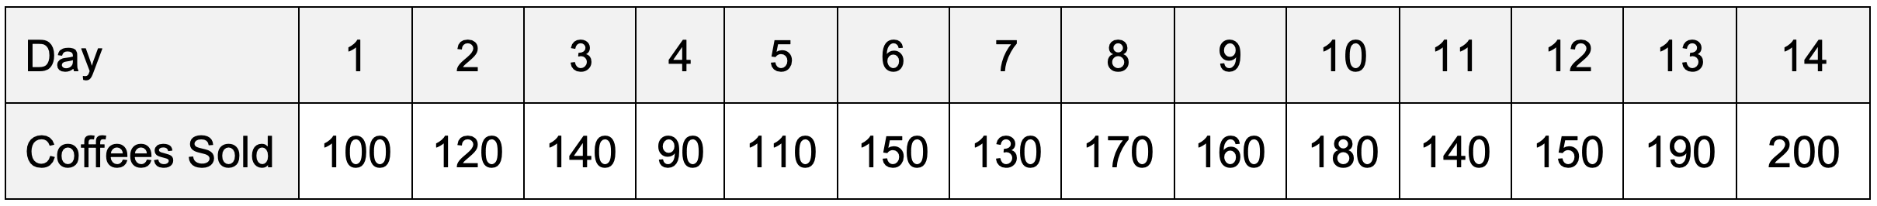

Workbook
page
ANALYSING TIME SERIES DATA
49
1. SMOOTHING DATA USING A MOVING AVERAGE.
Worked example.
A café manager wants to know whether coffee sales are growing overall, because they’re thinking about hiring an extra barista.
It’s hard to tell if sales are improving because the numbers jump around a lot: Mondays are often quiet, Fridays and Saturdays are busy, and some days are affected by the weather.
They record the number of coffees sold each day for two weeks.

Slide 23
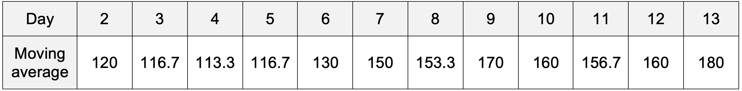
Workbook
page
ANALYSING TIME SERIES DATA
49
1. SMOOTHING DATA USING A MOVING AVERAGE.
Worked example (continued).
To see the overall trend, the manager calculates a 3-day moving average. This means that instead of looking at each day on its own, they take the average of three days at a time.

Slide 24
Workbook
page
ANALYSING TIME SERIES DATA
49
1. SMOOTHING DATA USING A MOVING AVERAGE.
Worked example (continued).
For Tuesday (day 2) the moving average would be 120. It is found by averaging 3 days,
which consist of the day before (Monday day 1), the current day (Tuesday day 2) and the day after (Wednesday day 3) [(100+120+140)÷3]
For Wednesday (day 3) the moving average is 116.7 [(120+140+90)÷3]
And so on…

Slide 25
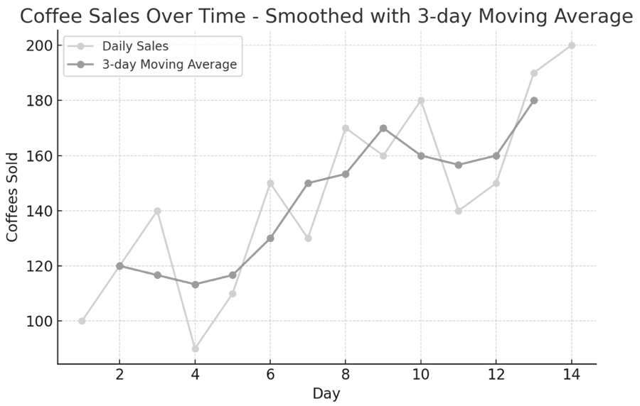
Workbook
page
ANALYSING TIME SERIES DATA
49
1. SMOOTHING DATA USING A MOVING AVERAGE.
Worked example (continued).
By plotting these moving averages, the “jagged” daily sales line is smoothed out, making it easier
to see whether coffee sales are generally increasing, decreasing, or staying stable.
The higher number of points averaged (e.g. 5 points, 7 points) the smoother the data.

Slide 26
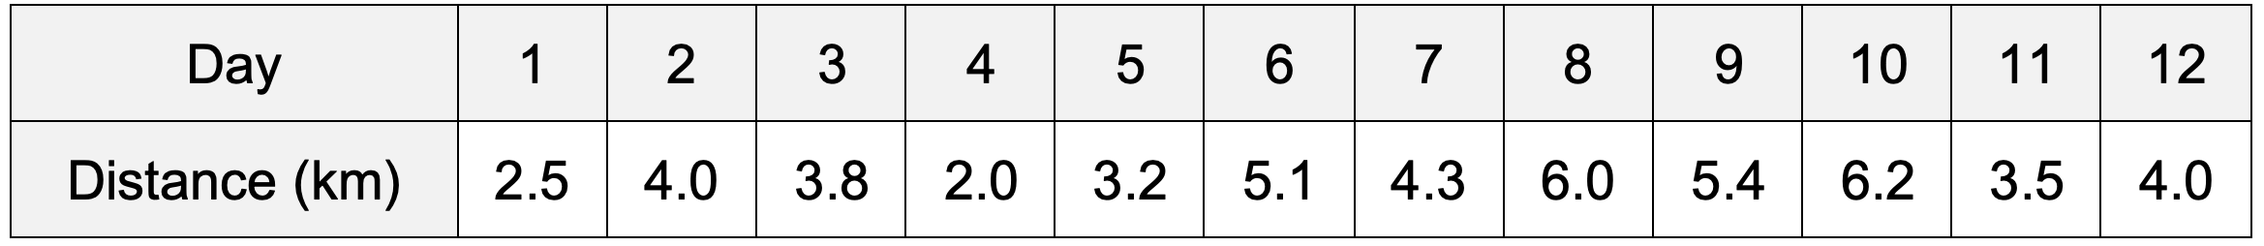

Workbook
page
ANALYSING TIME SERIES DATA
50
1. SMOOTHING DATA USING A MOVING AVERAGE.
With your teacher.
A student is training for a marathon and records their daily running distance (km) over 12 days. Some days are longer runs, some are short recovery runs, and sometimes they skip a bit if they’re tired. The distances jump around, making it hard to tell if their endurance is building up over time.

Slide 27
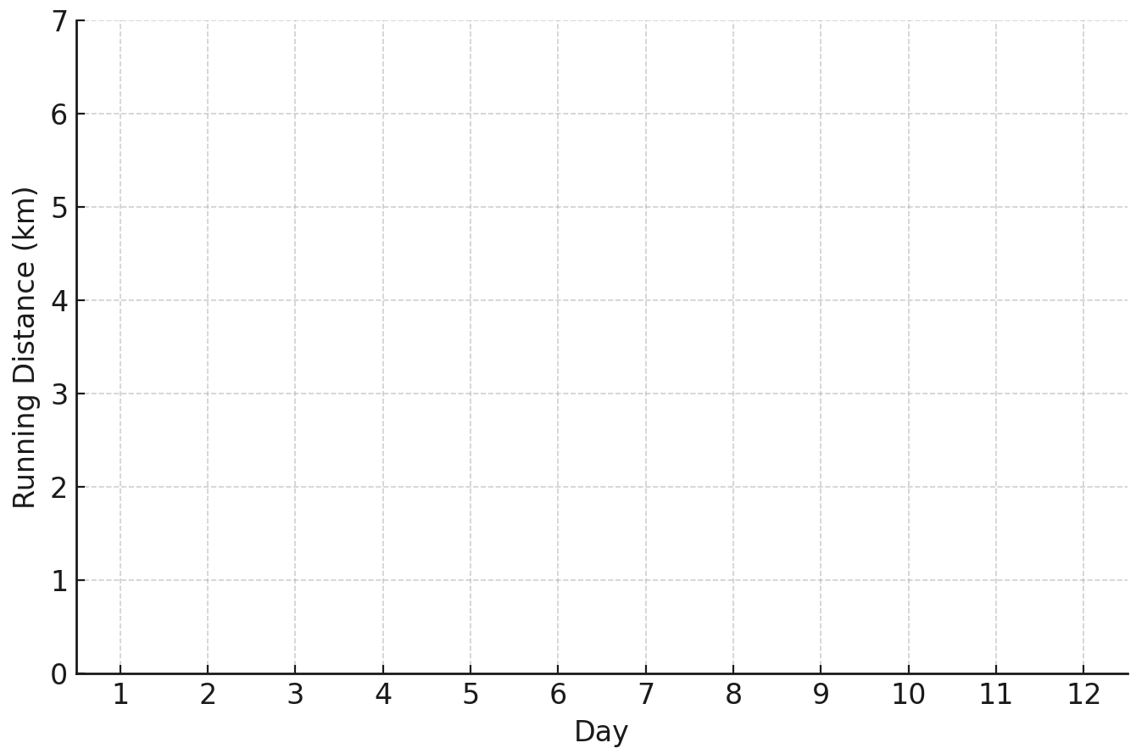
Workbook
page
ANALYSING TIME SERIES DATA
50
1. SMOOTHING DATA USING A MOVING AVERAGE.
1. Plot the raw time series on the graph below. Join your points with lines.

Slide 28
Workbook
page
ANALYSING TIME SERIES DATA
50
1. SMOOTHING DATA USING A MOVING AVERAGE.
2. Calculate the 3-day centred moving average for Days 2–11.
Day | 1 | 2 | 3 | 4 | 5 | 6 | 7 | 8 | 9 | 10 | 11 | 12
MA distance | - | 3.43
  Example: MA(2) = (2.5 + 4.0 + 3.8) ÷ 3 = 3.43 km

Slide 29
Workbook
page
ANALYSING TIME SERIES DATA
50
1. SMOOTHING DATA USING A MOVING AVERAGE.
3. Add the moving average line to the graph. (day 2-11)
4. Write an interpretation in context.

Slide 30
Workbook
page
ANALYSING TIME SERIES DATA
51
1. SMOOTHING DATA USING A MOVING AVERAGE.
Spreadsheets are often used to quickly and accurately calculate moving averages.
Many bookkeeping software programs (like XERO or MYOB) allow you to download data (like sales or profits) as a spreadsheet, so you don’t even need to enter the data, just the formulas.

Slide 31
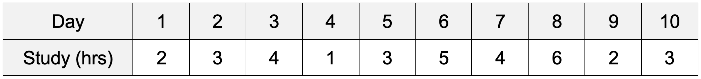

Workbook
page
ANALYSING TIME SERIES DATA
51
1. SMOOTHING DATA USING A MOVING AVERAGE.
Worked example.
A student records how many hours they study each day over 10 days. The numbers go up and down depending on homework, sport, or work.
We are going to prepare a time series plot using a 5-day moving average to see if study time is increasing overall.
*Students might like to follow along on their computer and try and make this example*

Slide 32
Workbook
page
ANALYSING TIME SERIES DATA
51
1. SMOOTHING DATA USING A MOVING AVERAGE.
Worked example (continued).
Step 1 - Enter the data. put days in row 1, study hours in row 2.

Slide 33
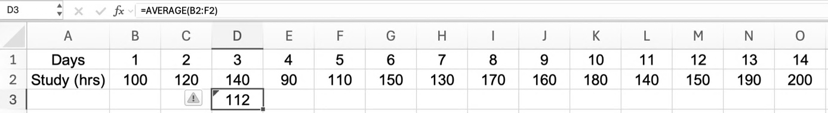
Workbook
page
ANALYSING TIME SERIES DATA
51
1. SMOOTHING DATA USING A MOVING AVERAGE.
Worked example (continued).
Step 2 - Create a formula.
Use the average formula to calculate the average over the 5 days.

Slide 34
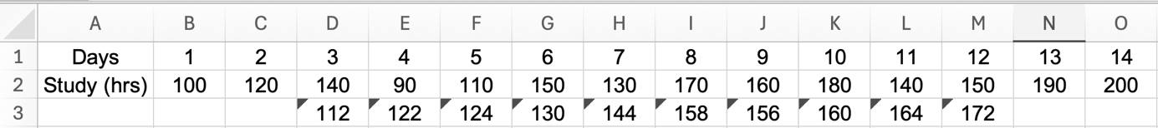
Workbook
page
ANALYSING TIME SERIES DATA
51
1. SMOOTHING DATA USING A MOVING AVERAGE.
Worked example (continued).
Step 3 – Fill the formula to other cells.

Slide 35
Workbook
page
ANALYSING TIME SERIES DATA
52
1. SMOOTHING DATA USING A MOVING AVERAGE.
Worked example (continued).
Excel automatically uses relative referencing, meaning it automatically changes the formula so it always refers to the cells in the same position relative to the formula’s new location. It recognises the pattern and applies it to the rest of the cells.
If you click on cell E3, you can see the formula has changed to =AVERAGE(C2:G2).
In F3 the formula has changed to =AVERAGE(D2:H2), and so on.

Slide 36
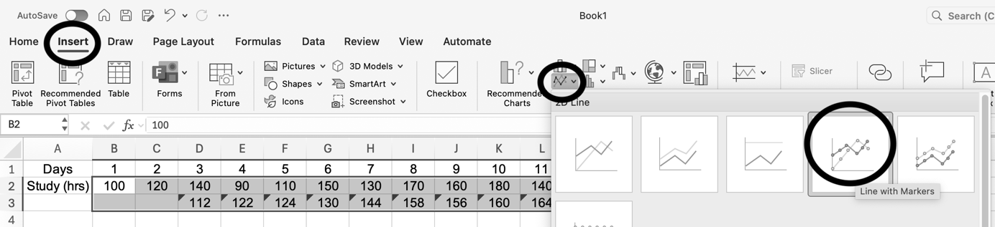
Workbook
page
ANALYSING TIME SERIES DATA
52
1. SMOOTHING DATA USING A MOVING AVERAGE.
Worked example (continued).
Step 4 – create a time series plot.

Slide 37
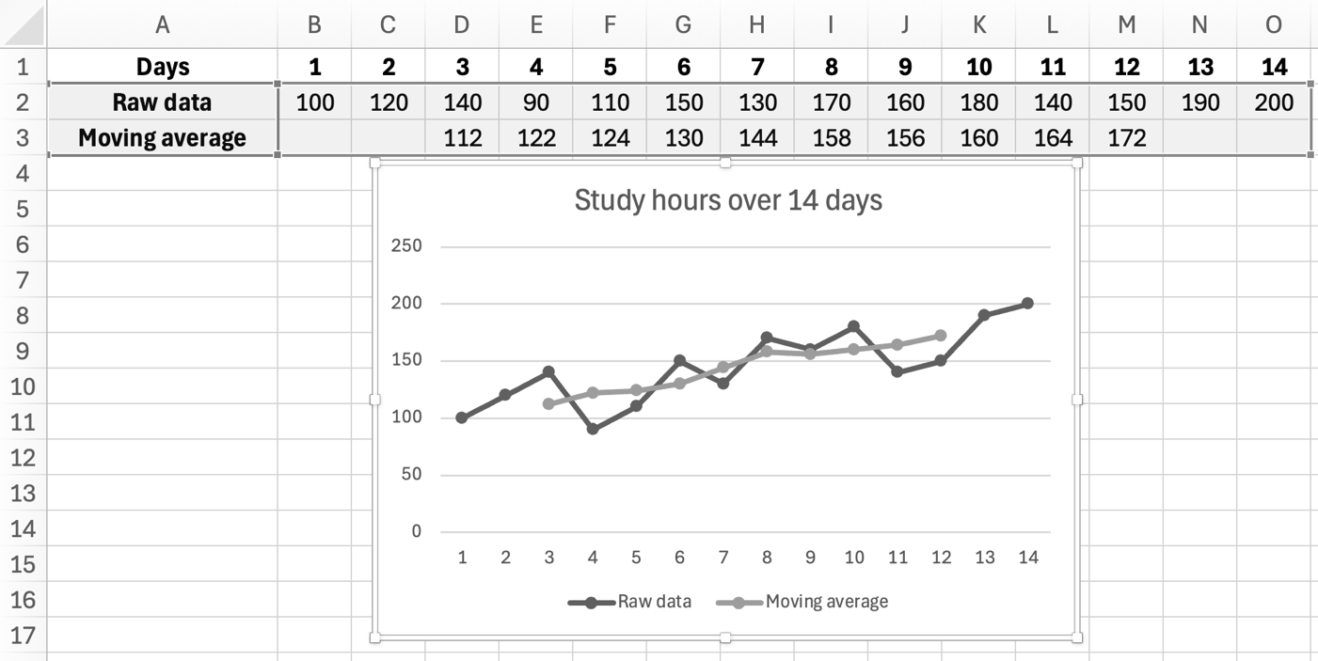
Workbook
page
ANALYSING TIME SERIES DATA
52
1. SMOOTHING DATA USING A MOVING AVERAGE.
Worked example (continued).
The graph will show your raw data (study hours) and the moving average.

Slide 38
Workbook
page
ANALYSING TIME SERIES DATA
53
1. SMOOTHING DATA USING A MOVING AVERAGE.
Try it yourself.
Complete the ‘try it yourself’ questions on page 53, 54, and 55 of your workbook.

Slide 39

Workbook
page
ANALYSING TIME SERIES DATA
56
2. MEASURE SEASONALITY (USING SEASONAL INDICES)
Problem: Some time series show seasonality (a repeating pattern e.g., sales higher every December, lower every February).
Solution: A seasonal index measures how much a particular period differs from the average.
Seasonal indices allow us to compare across periods without the “noise” of trend.

Slide 40
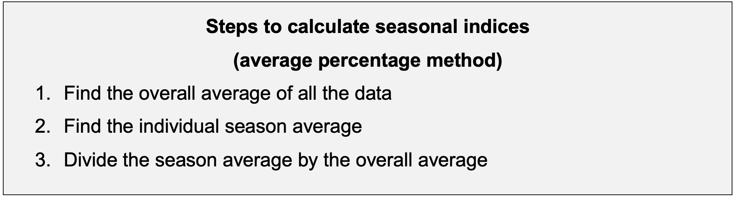
Workbook
page
ANALYSING TIME SERIES DATA
56
2. MEASURE SEASONALITY (USING SEASONAL INDICES)

Slide 41
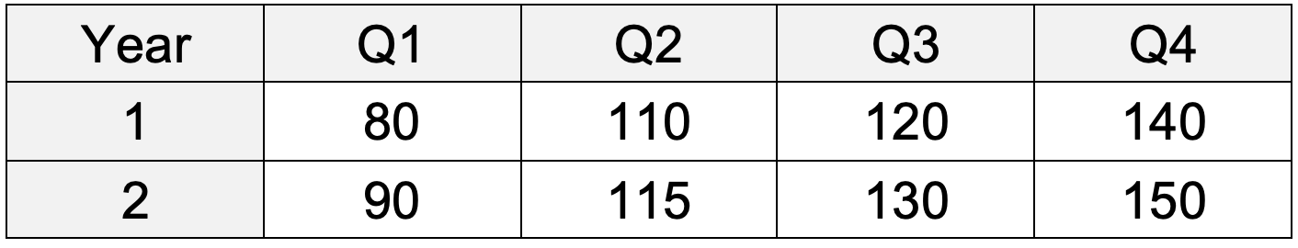

Workbook
page
ANALYSING TIME SERIES DATA
56
2. MEASURE SEASONALITY (USING SEASONAL INDICES)
Worked example.
A business records its sales each quarter for 2 years.
Step 1 – find the overall average.
(80 + 110 + 120 + 140 + 90 + 115 + 130 + 150) ÷ 8 = 116.88
Step 2 – Find the season average (average for each season)

Slide 42
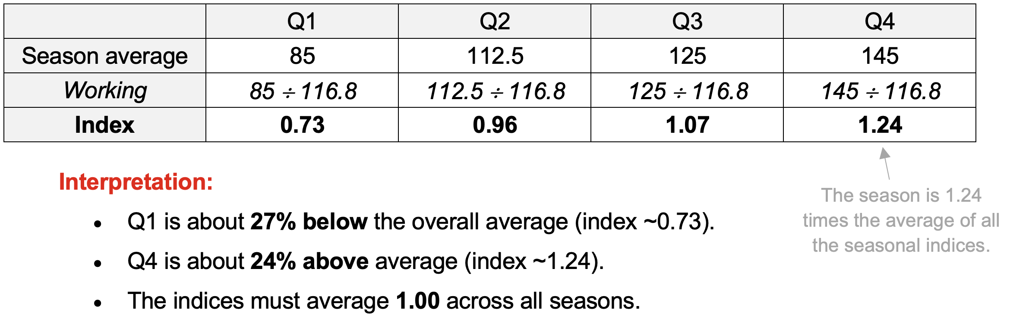
Workbook
page
ANALYSING TIME SERIES DATA
56
2. MEASURE SEASONALITY (USING SEASONAL INDICES)
Worked example (continued).
Step 3 – Divide the season average by the overall average.

Slide 43
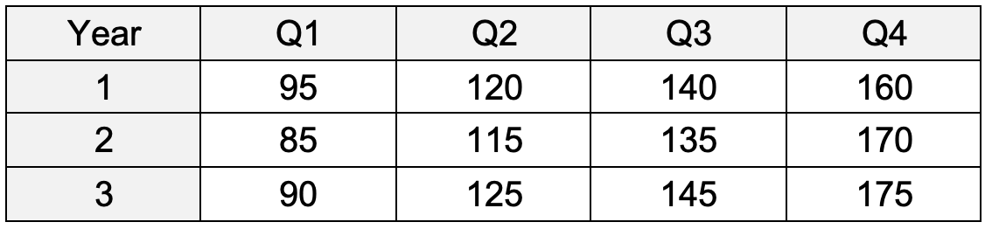

Workbook
page
ANALYSING TIME SERIES DATA
57
2. MEASURE SEASONALITY (USING SEASONAL INDICES)
With your teacher.
A clothing store records its sales each quarter for 3 years.
Step 1: Find the overall average of all sales across the 3 years.

Slide 44
Workbook
page
ANALYSING TIME SERIES DATA
57
2. MEASURE SEASONALITY (USING SEASONAL INDICES)
With your teacher.
Step 2: Calculate the season average for each quarter (average of Q1s, Q2s, etc.).
Q1 | Q2 | Q3 | Q4

Slide 45
Workbook
page
ANALYSING TIME SERIES DATA
57
2. MEASURE SEASONALITY (USING SEASONAL INDICES)
With your teacher.
Step 3: Divide each season average by the overall average to calculate the seasonal indices. Express the indices as decimals and percentages.
 | Q1 | Q2 | Q3 | Q4
Season average
Working
Index

Slide 46
Workbook
page
ANALYSING TIME SERIES DATA
57
2. MEASURE SEASONALITY (USING SEASONAL INDICES)
With your teacher.
Step 4: Interpret your results:
  Which quarters are above average?
  Which quarters are below average?
  Do the indices average to ~1.0 (100%)?

Slide 47
Workbook
page
ANALYSING TIME SERIES DATA
58
2. MEASURE SEASONALITY (USING SEASONAL INDICES)
Try it yourself.
Complete the ‘try it yourself’ questions on page 58 of your workbook.

Slide 48
Workbook
page
ANALYSING TIME SERIES DATA
59
3. DE-SEASONALISE A TIME SERIES
When data is affected by seasonal patterns (e.g., sales always peak in December, or electricity use rises every winter) we can remove the seasonal effects to see the underlying trend. This is known as de-seasonalising.
To deseasonalise data:
Step 1: | Find average for each cycle.
Step 2: | Divide actual data by cycle averages
Step 3: | Calculate seasonal indices
Step 4: | Deseasonalise the data by dividing the actual data by its seasonal index.

Slide 49
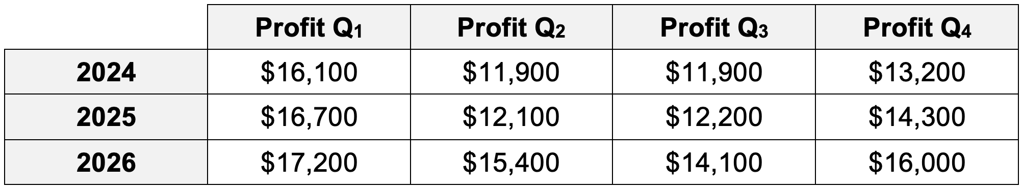

Workbook
page
ANALYSING TIME SERIES DATA
59
3. DE-SEASONALISE A TIME SERIES
Worked example.
The manager of The Rosella café keeps quarterly profit records for tax purposes. We want to deseasonalise the data to remove seasonal affects.

Slide 50
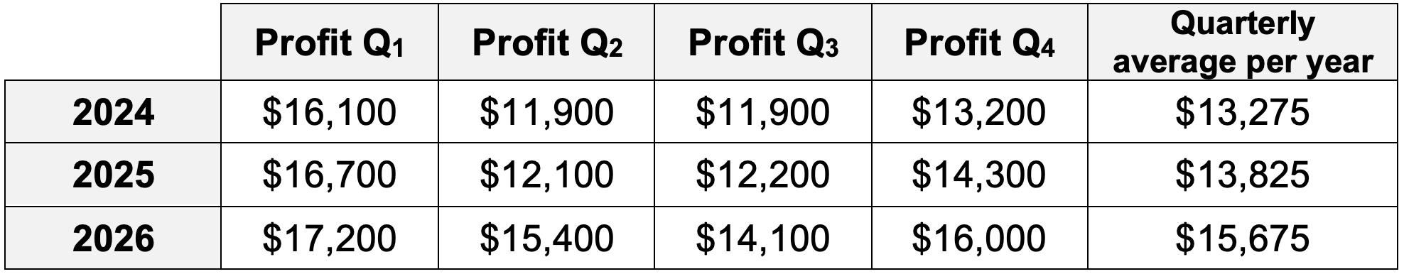
Workbook
page
ANALYSING TIME SERIES DATA
59
3. DE-SEASONALISE A TIME SERIES
Worked example (continued).
Step 1 – Find the average of the data for each cycle (year).

Slide 51
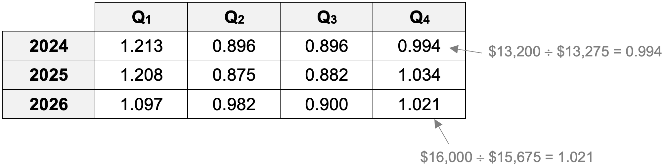
Workbook
page
ANALYSING TIME SERIES DATA
59
3. DE-SEASONALISE A TIME SERIES
Worked example (continued).
Step 2 – Divide each of the initial (actual) data by the cycle average.

Slide 52
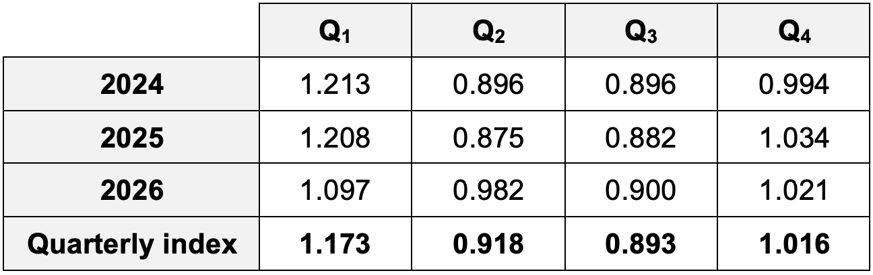
Workbook
page
ANALYSING TIME SERIES DATA
60
3. DE-SEASONALISE A TIME SERIES
Worked example (continued).
Step 3 – Calculate the seasonal indices, in this example it will be a quarterly index.

Slide 53
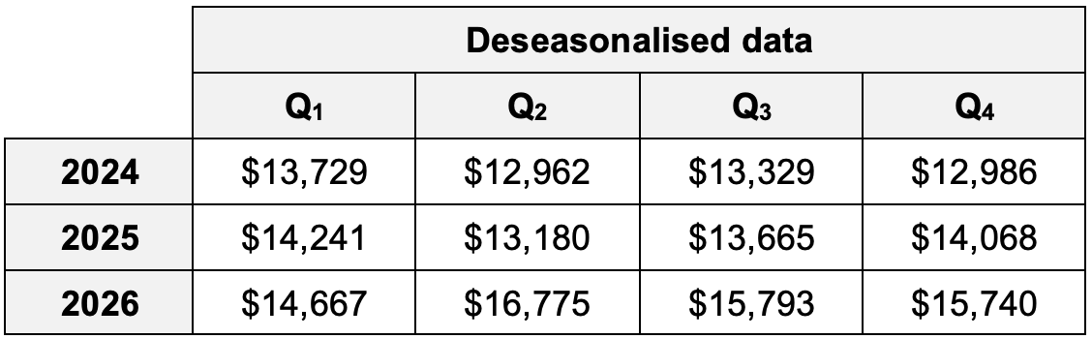
Workbook
page
ANALYSING TIME SERIES DATA
60
3. DE-SEASONALISE A TIME SERIES
Worked example (continued).
Step 4 – Deseasonalise the data.

Slide 54
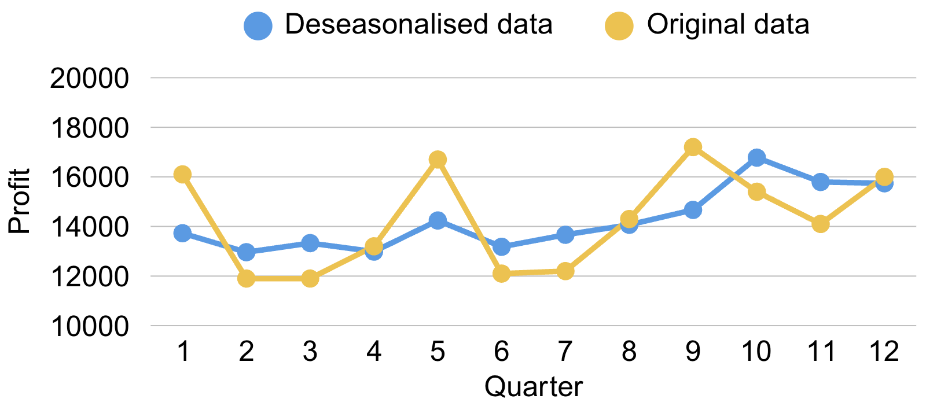
Workbook
page
ANALYSING TIME SERIES DATA
60
3. DE-SEASONALISE A TIME SERIES
Worked example (continued).
The deseasonalised data can be presented on the same axis as the original data for comparison purposes.

Slide 55

Workbook
page
ANALYSING TIME SERIES DATA
61
3. DE-SEASONALISE A TIME SERIES
With your teacher (1).
Deseasonalise the pizza shop data and then graph the deseasonalised data.
 | M | T | W | T | F | S | S
Week 1 | 42 | 72 | 38 | 44 | 75 | 98 | 95
Week 2 | 38 | 66 | 38 | 31 | 68 | 89 | 81
Week 3 | 32 | 62 | 31 | 28 | 61 | 82 | 80

Slide 56
Workbook
page
ANALYSING TIME SERIES DATA
61
3. DE-SEASONALISE A TIME SERIES
With your teacher (1).
Step 1: Find the average of the data for each cycle (weekly).
 | M | T | W | T | F | S | S | Weekly average
Week 1 | 42 | 72 | 38 | 44 | 75 | 98 | 95
Week 2 | 38 | 66 | 38 | 31 | 68 | 89 | 81
Week 3 | 32 | 62 | 31 | 28 | 61 | 82 | 80

Slide 57
Workbook
page
ANALYSING TIME SERIES DATA
61
3. DE-SEASONALISE A TIME SERIES
With your teacher (1).
Step 2: Divide each of the initial data by the weekly average.
Step 3: Calculate the seasonal (daily) indices.
 | M | T | W | T | F | S | S
Week 1
Week 2
Week 3
Daily Index

Slide 58
Workbook
page
ANALYSING TIME SERIES DATA
61
3. DE-SEASONALISE A TIME SERIES
With your teacher (1).
Step 4: Deseasonalise the data.
 | Deseasonalised data
 | M | T | W | T | F | S | S
Week 1
Week 2
Week 3

Slide 59
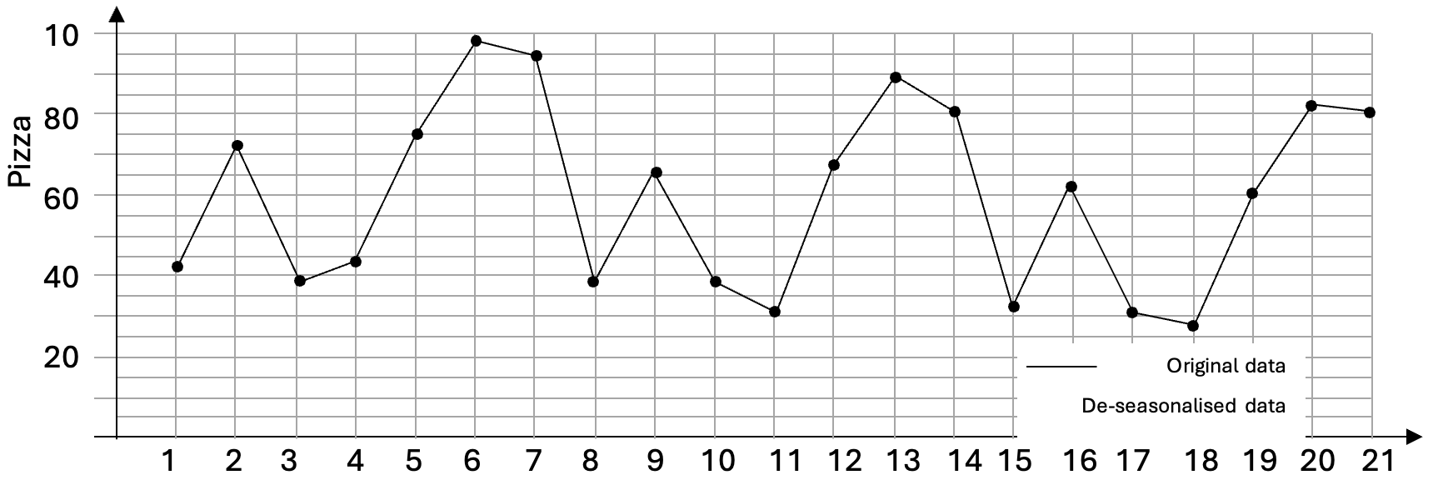
Workbook
page
ANALYSING TIME SERIES DATA
61
3. DE-SEASONALISE A TIME SERIES
With your teacher (1).
Graph the deseasonalised data against the original data (below).
Discuss: What long term overall trend does the data show? Which was the most outstanding day and why?

Slide 60

Workbook
page
ANALYSING TIME SERIES DATA
62
3. DE-SEASONALISE A TIME SERIES
With your teacher (2).
A gardening store records its quarterly sales for 2 years. Seasonal indices have already been calculated and are provided in the table.
Year | Q1 | Q2 | Q3 | Q4
1 | 60,000 | 90,000 | 140,000 | 80,000
2 | 70,000 | 95,000 | 150,000 | 85,000
Index | 0.80 | 1.00 | 1.25 | 0.95

Slide 61
Workbook
page
ANALYSING TIME SERIES DATA
62
3. DE-SEASONALISE A TIME SERIES
With your teacher (2).
a. Deseasonalise the data by dividing each sales value by the seasonal index.
Year | Q1 (÷0.80) | Q2 (÷1.00) | Q3 (÷1.25) | Q4 (÷0.95)
1
2

Slide 62
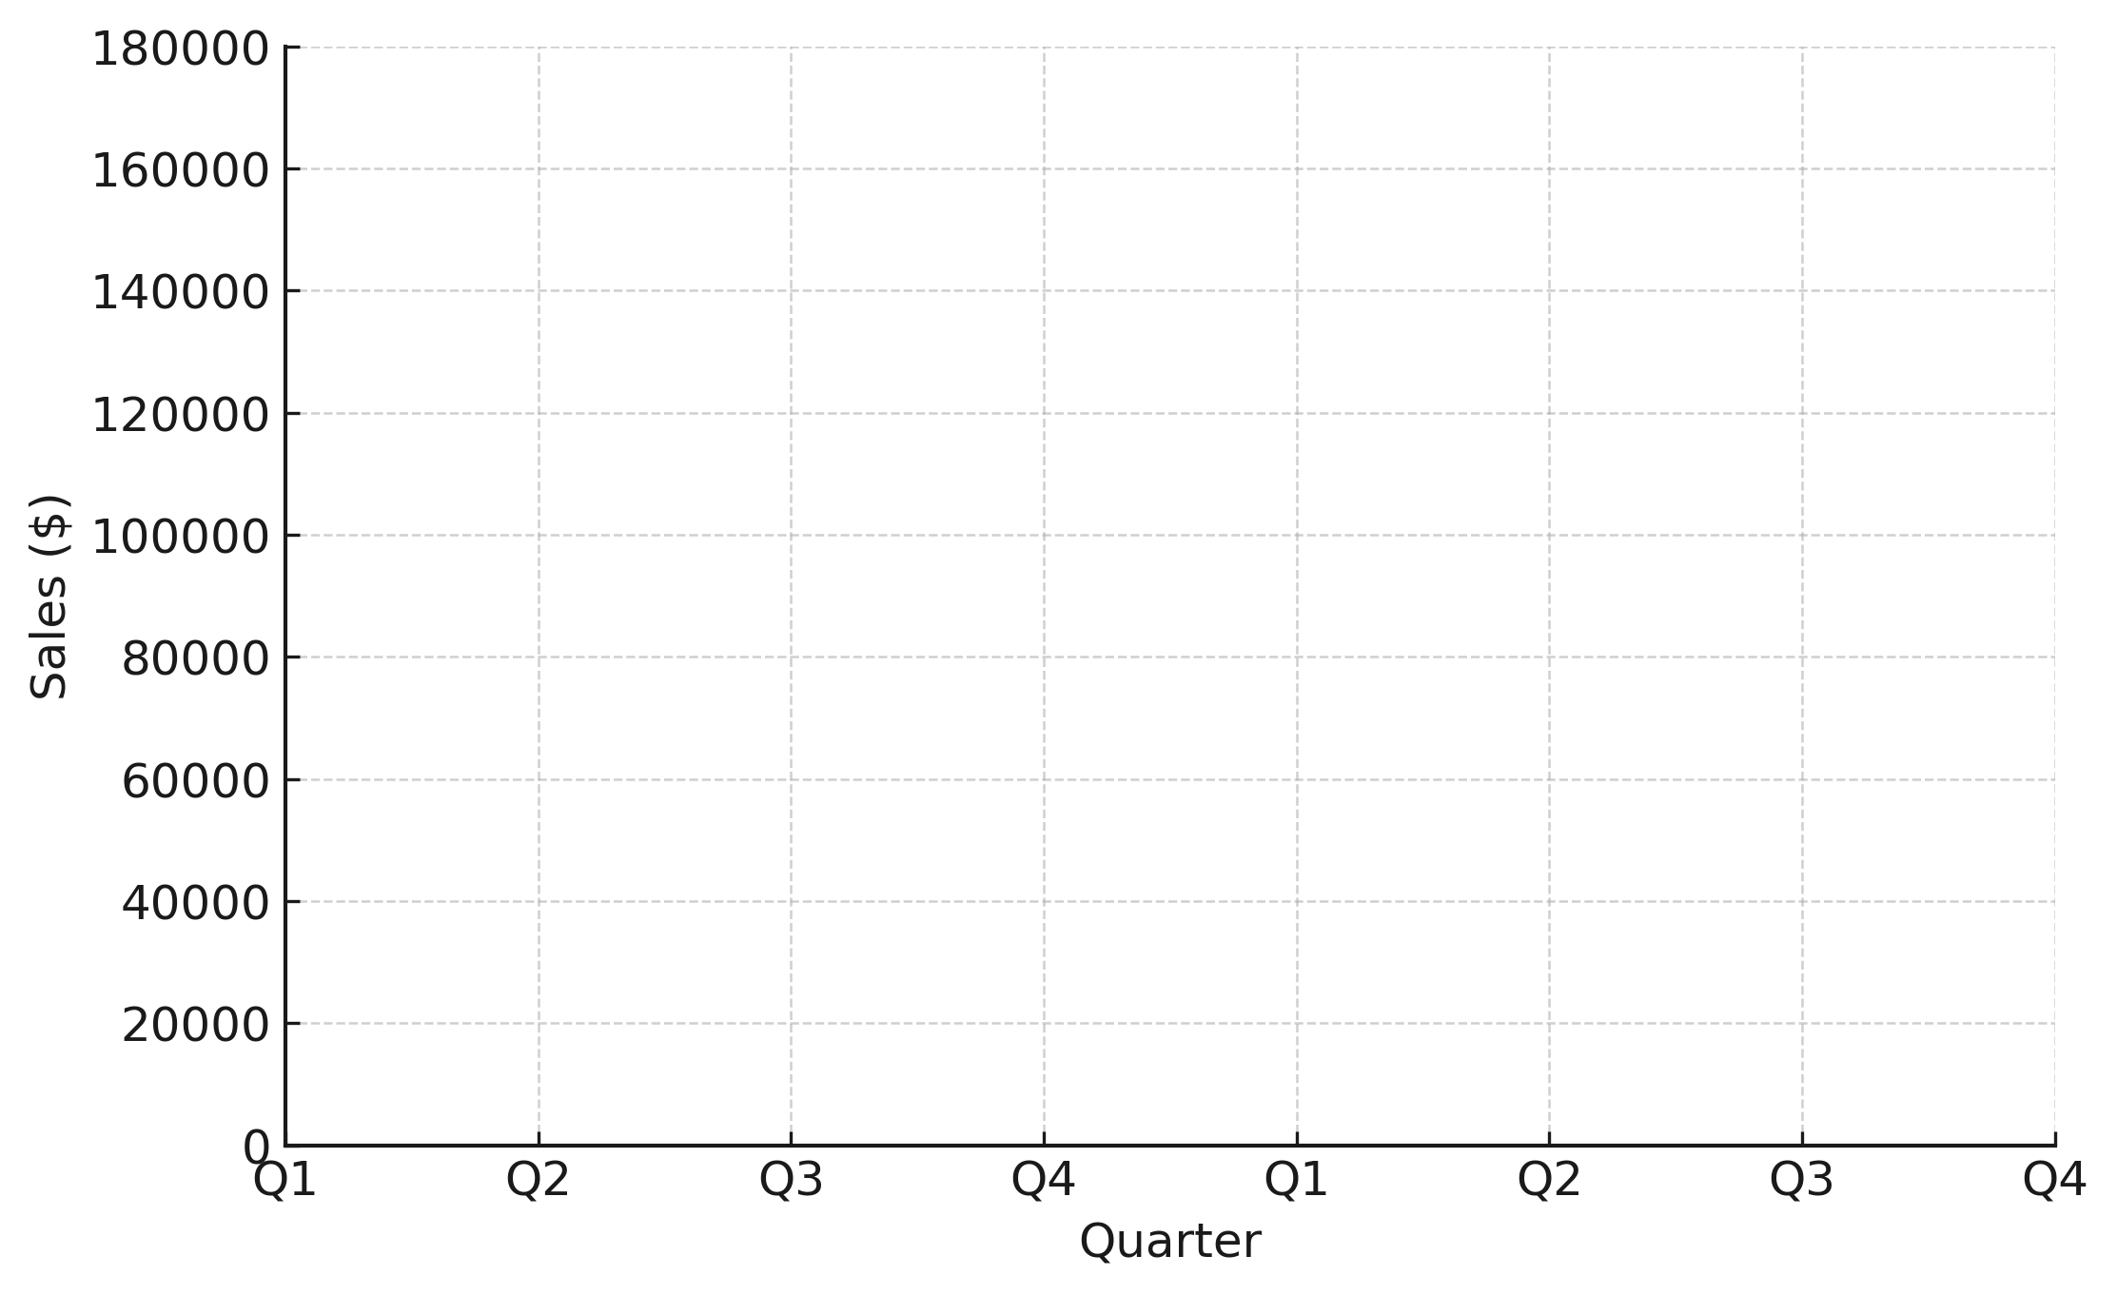
Workbook
page
ANALYSING TIME SERIES DATA
62
3. DE-SEASONALISE A TIME SERIES
With your teacher (2).
b. Plot both the original sales and the deseasonalised sales on the same time series graph.

Slide 63
Workbook
page
ANALYSING TIME SERIES DATA
62
3. DE-SEASONALISE A TIME SERIES
With your teacher (2).
c. Write an interpretation:
  What trend does the deseasonalised data show? How is it different from the raw seasonal data?
  Why is this useful for the business?

Slide 64
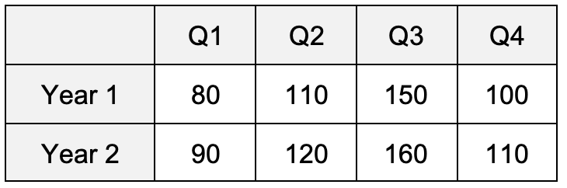

Workbook
page
ANALYSING TIME SERIES DATA
63
3. DE-SEASONALISE A TIME SERIES
Worked example (using Excel).
A sports shop records its quarterly sales (in $’000s) for 2 years. You will calculate the seasonal indices and then deseasonalise the data using excel.
*It is recommended students complete this example on Excel as they go*

Slide 65
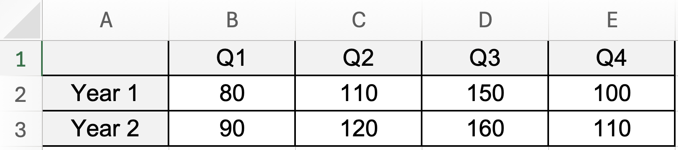
Workbook
page
ANALYSING TIME SERIES DATA
63
3. DE-SEASONALISE A TIME SERIES
Worked example (using Excel).
Enter the data shown in the table into Excel

Slide 66
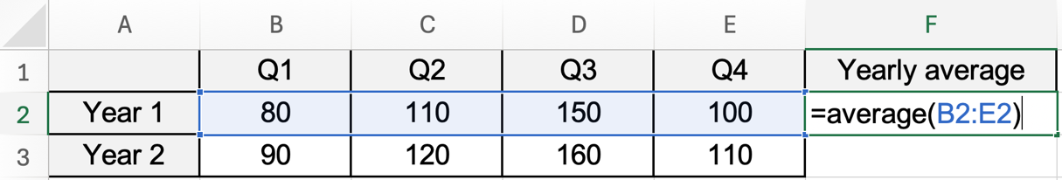
Workbook
page
ANALYSING TIME SERIES DATA
63
3. DE-SEASONALISE A TIME SERIES
Worked example (using Excel).
Step 1 – Find average for each cycle.

Slide 67
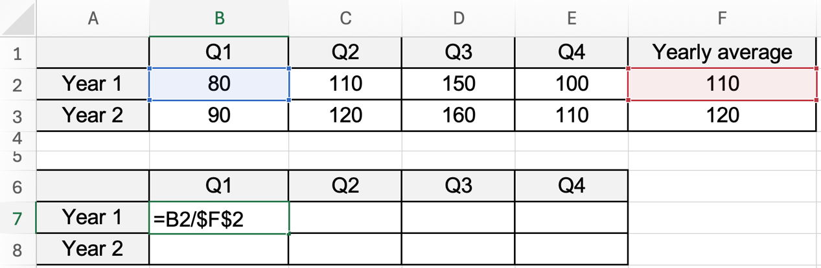
Workbook
page
ANALYSING TIME SERIES DATA
63
3. DE-SEASONALISE A TIME SERIES
Worked example (using Excel).
Step 2 – Divide actual data by cycle averages.

Slide 68
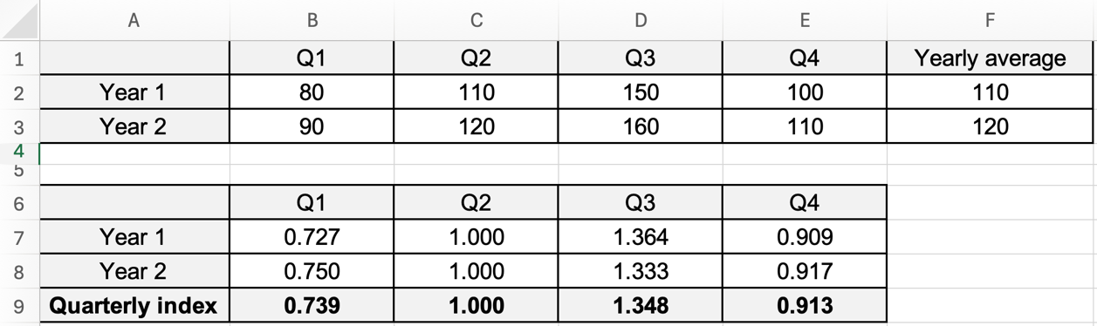
Workbook
page
ANALYSING TIME SERIES DATA
64
3. DE-SEASONALISE A TIME SERIES
Worked example (using Excel).
Step 3 – Calculate the seasonal indices

Slide 69
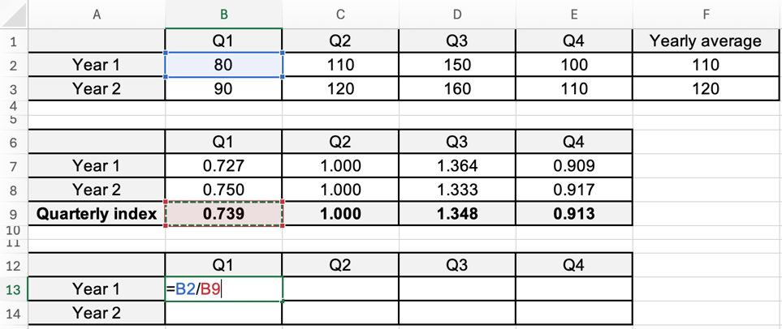
Workbook
page
ANALYSING TIME SERIES DATA
64
3. DE-SEASONALISE A TIME SERIES
Worked example (using Excel).
Step 5 – Deseasonalise the data

Slide 70
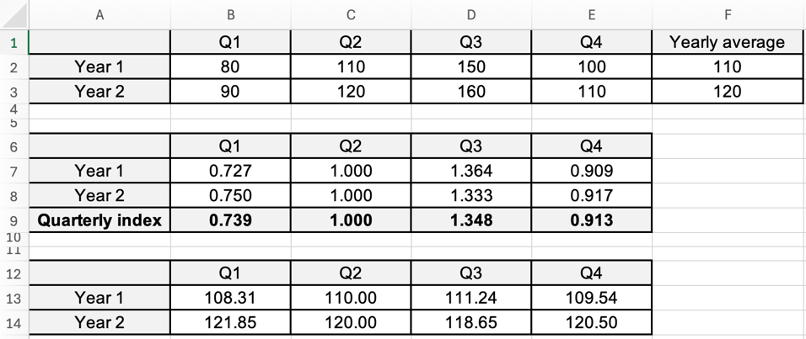
Workbook
page
ANALYSING TIME SERIES DATA
64
3. DE-SEASONALISE A TIME SERIES
Worked example (using Excel).
Step 5 – Deseasonalise the data

Slide 71
Workbook
page
ANALYSING TIME SERIES DATA
65
3. DE-SEASONALISE A TIME SERIES
Try it yourself.
Complete the ‘try it yourself’ questions on page 65, 66, and 67 of your workbook.

Slide 72
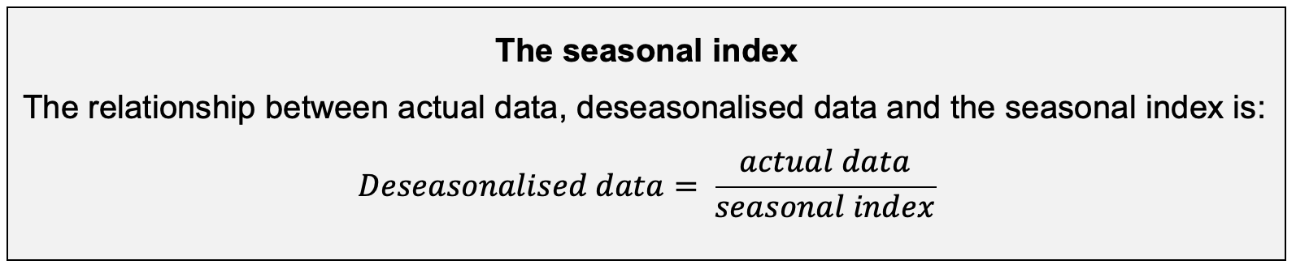
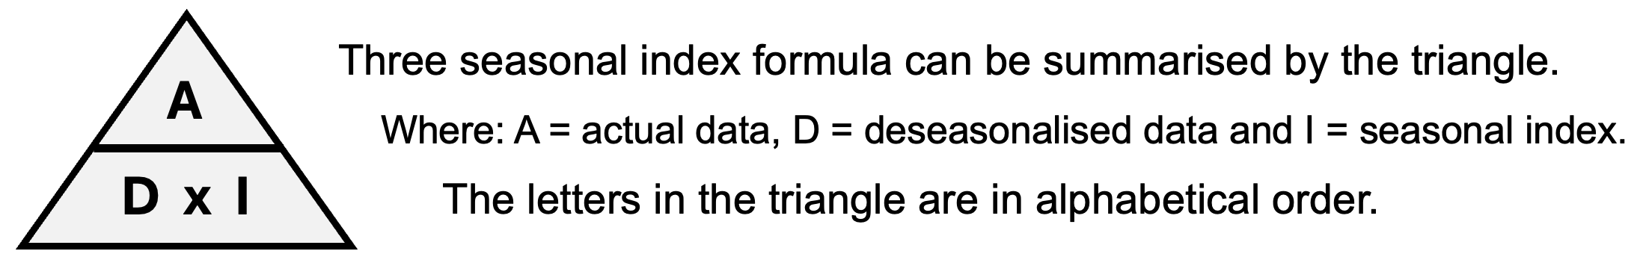
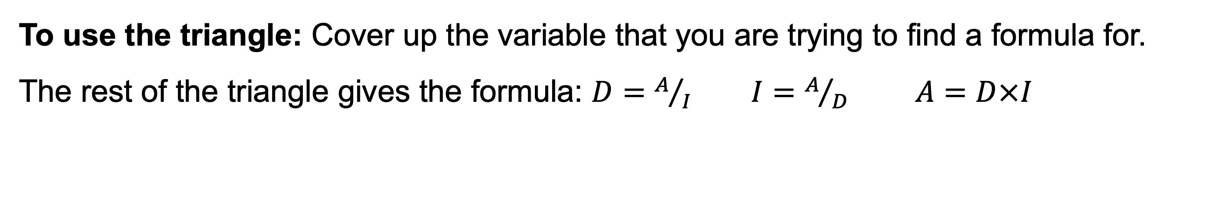
Workbook
page
ANALYSING TIME SERIES DATA
68
The seasonal index gives the expected performance for each season relative to the average season.
To use the triangle: Cover up the variable that you are trying to find a formula for.
The rest of the triangle gives the formula: $D=A/I I=A/D A=D×I$

Slide 73
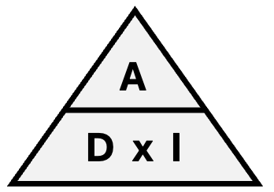
Workbook
page
ANALYSING TIME SERIES DATA
68
With your teacher.
1. Find the deseasonalised sales figure if the actual sales were $13,750 and the seasonal index was 1.35

Slide 74
Workbook
page
ANALYSING TIME SERIES DATA
68
With your teacher.
2. Find the actual quarterly profit if the deseasonalised figure was $25,630 and the quarterly index was 0.93

Slide 75
Workbook
page
ANALYSING TIME SERIES DATA
68
With your teacher.
3. Find the quarterly unemployment index if the actual number of unemployed was 1.25 million but the seasonally adjusted number of unemployed was 1.1 million.

Slide 76
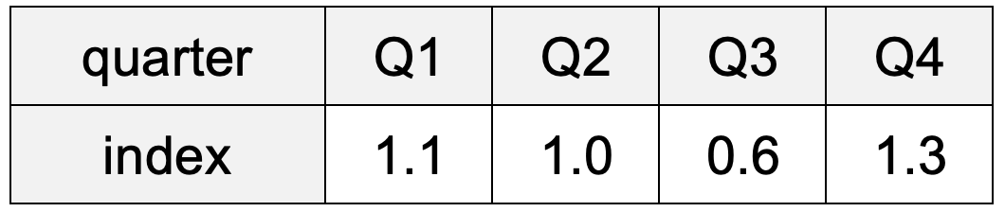

Workbook
page
ANALYSING TIME SERIES DATA
69
With your teacher.
4. The seasonal indices for the sales of a department store are:
a. Find the deseasonalised sales figure for quarter 4 if the store actually made $25,200 of sales.

Slide 77
Workbook
page
ANALYSING TIME SERIES DATA
69
With your teacher.
4. The seasonal indices for the sales of a department store are:
b. Find the actual sales for quarter 3 if the deseasonalised figure is $12,500.

Slide 78
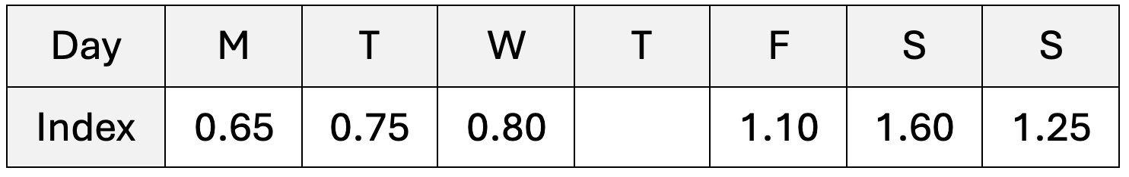

Workbook
page
ANALYSING TIME SERIES DATA
69
With your teacher.
5. The daily indices for the sales of a take-away shop are:
a. Deseasonalise Tuesday’s sales if the actual sales on Tuesday were $750

Slide 79
Workbook
page
ANALYSING TIME SERIES DATA
69
With your teacher.
5. The daily indices for the sales of a take-away shop are:
b. Find the seasonal index for Thursday.

Slide 80
Workbook
page
ANALYSING TIME SERIES DATA
69
With your teacher.
5. The daily indices for the sales of a take-away shop are:
c. Find the actual sales for Thursday if the deseasonalised figure was $620

Slide 81
Workbook
page
ANALYSING TIME SERIES DATA
69
With your teacher.
5. The daily indices for the sales of a take-away shop are:
d. Saturday has the highest index. What does this mean?
Interpret Saturday’s index in words.

Slide 82
Workbook
page
ANALYSING TIME SERIES DATA
69
With your teacher.
5. The daily indices for the sales of a take-away shop are:
d. Saturday has the highest index. What does this mean?
Interpret Saturday’s index in words.

Slide 83



Workbook
page
ANALYSING TIME SERIES DATA
70
With your teacher.
6. The following table and graph gives information about apple prices.

Slide 84
Workbook
page
ANALYSING TIME SERIES DATA
70
With your teacher.
a. What features of the graph of actual data indicate that this is seasonal data?

Slide 85
Workbook
page
ANALYSING TIME SERIES DATA
70
With your teacher.
b. Some seasonal indices are given in the table below. Complete the table.
 | Quarter
 | Summer | Autumn | Winter | Spring
Index | 1.32 | 0.76 | 0.84
c. Confirm your answer to part (b) by using quarter 4 data from the first table.

Slide 86
Workbook
page
ANALYSING TIME SERIES DATA
70
With your teacher.
d. Use the seasonal indices to complete the first table.
 | Summer | Autumn | Winter | Spring | Summer | Autumn | Winter | Spring | Summer | Autumn | Winter | Spring
Quarter | 1 | 2 | 3 | 4 | 5 | 6 | 7 | 8 | 9 | 10 | 11 | 12
Apple price ($ per kg) | 3.00 | 1.80 | 2.00 | 2.50 | 2.90 | 1.60 | 1.80 | 2.30 | 2.80 | 1.60 | 1.70 | 2.30
De-seasonalised apple price | 2.27 | 2.36 | 2.38 | 2.31 | 2.19 | 2.10 | 2.14 | 2.13

Slide 87
Workbook
page
ANALYSING TIME SERIES DATA
70
With your teacher.
e. Complete the graph of de-seasonalised data.

Slide 88
Workbook
page
ANALYSING TIME SERIES DATA
70
With your teacher.
f. Which season has the highest index? Explain what this means.
g. Which of the quarters (1 - 12) had the highest apple price in de-seasonalised terms. Explain what this means.

Slide 89
Workbook
page
ANALYSING TIME SERIES DATA
71
4. FIT A LEAST-SQUARES LINE TO MODEL LONG TERM TRENDS
Once the data is smoothed or de-seasonalised, you can apply linear regression (like we did in Part 2 of the book).
This gives a line of best fit that models the long-term trend.
E.g., even with seasonality, sales are rising by about +2% each year.
This helps with making predictions.
(e.g., “In 2027, we expect average monthly sales to be about 1200 units”) and planning (e.g. we need to hire more staff).

Slide 90
Workbook
page
ANALYSING TIME SERIES DATA
71
4. FIT A LEAST-SQUARES LINE TO MODEL LONG TERM TRENDS
Once the data is smoothed or de-seasonalised, you can apply linear regression (like we did in Part 2 of the book).
This gives a line of best fit that models the long-term trend.
E.g., even with seasonality, sales are rising by about +2% each year.
This helps with making predictions. E.g. “In 2027, we expect average monthly sales to be about 1200 units” and planning “we need to hire more staff”
When seasonal effects are removed (the data is deseasonalised), what remains reflects the long‑term trend. We can model that trend with a line of best fit.

Slide 91


Workbook
page
ANALYSING TIME SERIES DATA
71
4. FIT A LEAST-SQUARES LINE TO MODEL LONG TERM TRENDS
Worked example.
The table below shows the deseasonalised quarterly sales over 8 quarters.

Slide 92

Workbook
page
ANALYSING TIME SERIES DATA
71
4. FIT A LEAST-SQUARES LINE TO MODEL LONG TERM TRENDS

Slide 93


Workbook
page
ANALYSING TIME SERIES DATA
72
4. FIT A LEAST-SQUARES LINE TO MODEL LONG TERM TRENDS
With your teacher.
The table below shows the deseasonalised monthly electricity usage (in 1000 kWh) for a business over 12 months.

Slide 94
Workbook
page
ANALYSING TIME SERIES DATA
72
4. FIT A LEAST-SQUARES LINE TO MODEL LONG TERM TRENDS
With your teacher.
Enter the data into your CAS calculator in the ‘statistics’ section.
  List 1 = months (x), List 2 = electricity usage (y)
Find the least-squares line of best fit.
  Calc → Regression → Linear Regression
  Select List 1 (months) as x and List 2 (usage) as y

Slide 95
Workbook
page
ANALYSING TIME SERIES DATA
72
4. FIT A LEAST-SQUARES LINE TO MODEL LONG TERM TRENDS
With your teacher.
Record the calculator output:
  Gradient (a) =
  Y-intercept (b) =
  Correlation coefficient (r) =
  Coefficient of determination (r²) =
  Linear regression equation ( y = ax + b ) =

Slide 96
Workbook
page
ANALYSING TIME SERIES DATA
72
4. FIT A LEAST-SQUARES LINE TO MODEL LONG TERM TRENDS
With your teacher.
Interpret your results.
  What does the gradient tell us about electricity usage each month?
  What does the intercept represent in this context?
  How strong is the association (based on r and r²)?

Slide 97


Workbook
page
ANALYSING TIME SERIES DATA
73
(BRINGING ALL OF TIME-SERIES TOGETHER)
With your teacher.
A supermarket records its quarterly sales revenue ($’000s) over 3 years.

Slide 98
Workbook
page
ANALYSING TIME SERIES DATA
73
(BRINGING ALL OF TIME-SERIES TOGETHER)
With your teacher.
Step 1 – Calculate seasonal indices
a. Find the overall average of all 12 quarters.
b. Find the average for each quarter (Q1s, Q2s, Q3s, Q4s).
c. Calculate the seasonal indices (quarter average ÷ overall average).
 | Q1 | Q2 | Q3 | Q4
Seasonal average
Seasonal index

Slide 99
Workbook
page
ANALYSING TIME SERIES DATA
73
(BRINGING ALL OF TIME-SERIES TOGETHER)
With your teacher.
Step 2 – Deseasonalise the data
a. Divide each actual quarterly value by its seasonal index.
b. Prepare a new table of deseasonalised values.
 | Q1 | Q2 | Q3 | Q4
Deseasonalised year 1
Deseasonalised year 2
Deseasonalised year 3

Slide 100
Workbook
page
ANALYSING TIME SERIES DATA
73
(BRINGING ALL OF TIME-SERIES TOGETHER)
With your teacher.
Step 3 – Use your CAS calculator to fit a least-squares line model.
Step 4 – Interpret the model
    What does the gradient mean in the context of supermarket sales?
    What does the intercept mean? Is it meaningful in this context?
    How strong is the linear fit?

Slide 101
Workbook
page
ANALYSING TIME SERIES DATA
74
(BRINGING ALL OF TIME-SERIES TOGETHER)
Try it yourself.
Complete the ‘try it yourself’ questions on page 74 of your workbook.

