Slide 1

This PowerPoint has been designed for use with the workbook:
GM2 MEASUREMENT
Workbooks, resources and PowerPoints are available at BertramEducation.com

Slide 2
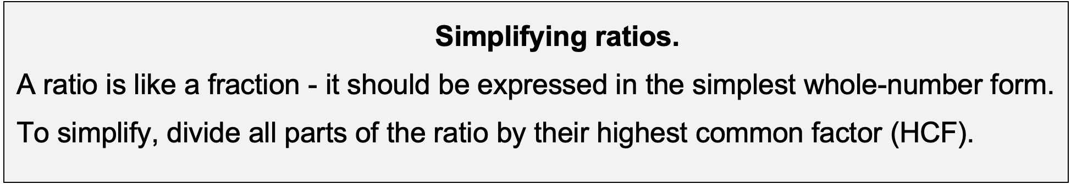
Workbook
page
INTRODUCTION TO RATIOS
25
Worked examples. Simplify the following ratios.
a. | 12:3 (÷ both sides by 3) = 4:1 | b. | 12:18 (÷ by 3) = 2:3 |  | c. | 45:60 (÷ by 15) = 3:4

Slide 3

Workbook
page
INTRODUCTION TO RATIOS
25
With your teacher.
Simplify the following ratios.
a. | 16:24 | b. | 81:108 | c. | 150:225
d. Karen is baking cookies. Her recipe uses 180 g of chocolate chips and 300 g of flour. Write the ratio of chocolate chips to flour in simplest form.
e. A basket has 15 apples and 25 oranges. What is the ratio of apples to oranges?

Slide 4
Workbook
page
INTRODUCTION TO RATIOS
26
Dividing quantities in given ratios
Dividing a quantity in a given ratio means splitting an amount into parts that are proportional to the numbers in the ratio.
To divide an amount in a ratio, follow these steps:
1. Add the parts of the ratio.
2. Divide the total amount by the number of parts.
3. Multiply by each part of the ratio.

Slide 5

Workbook
page
INTRODUCTION TO RATIOS
26
Worked example.
$84 is to be shared in the ratio 2:5.
How much does each person get?
Step 1: Add the parts of the ratio → 2 + 5 = 7
Step 2: Divide the total by number of parts → 84 ÷ 7 = 12
Step 3: First share → 2 × 12 = 24, Second share → 5 × 12 = 60
Answer: the money is shared $24:$60

Slide 6
Workbook
page
INTRODUCTION TO RATIOS
26
With your teacher.
A builder mixes cement and sand in the ratio 3:2. If she makes 20kg of the mixture, how much cement and how much sand are used?

Slide 7

Workbook
page
INTRODUCTION TO RATIOS
26
Try it yourself.
Complete the ‘try it yourself’ questions on page 26 of your workbook.

Slide 8
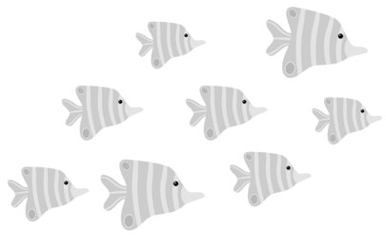
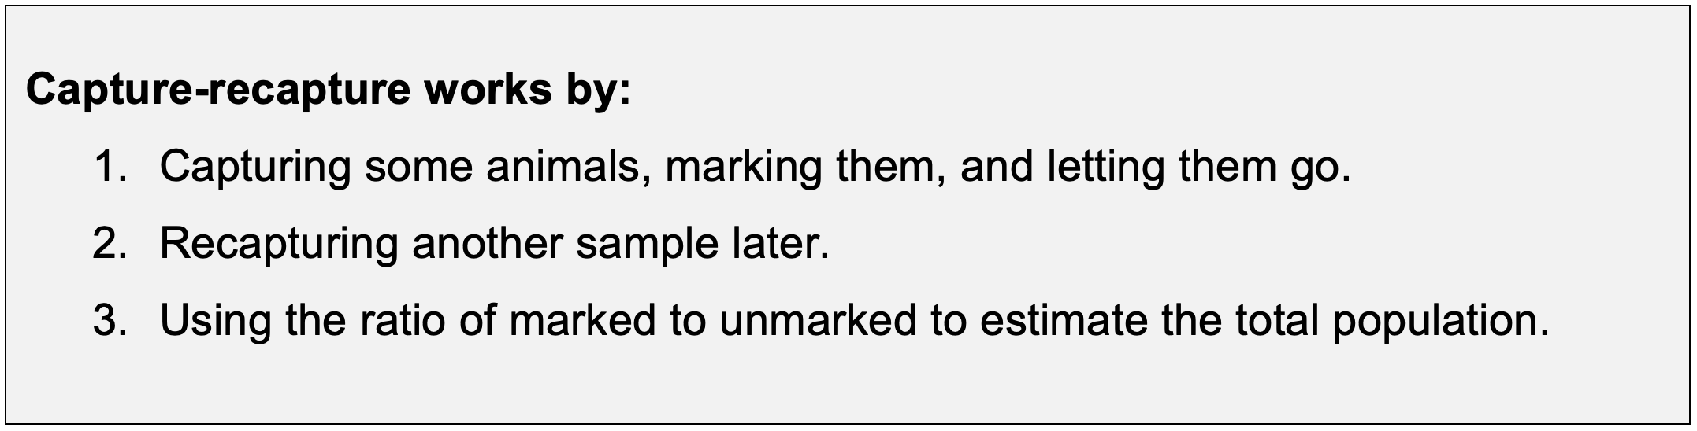
Workbook
page
CAPTURE RECAPTURE
27
Capture–recapture is a way of estimating the size of a population (like fish, animals, or insects) when it’s too hard or impractical to count them all.

Slide 9
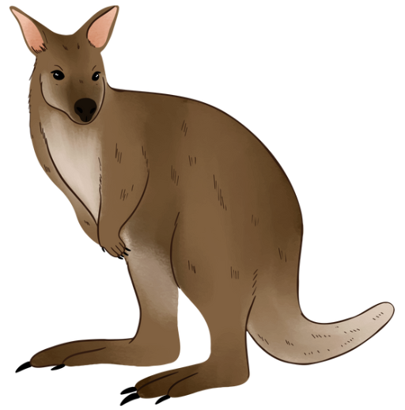
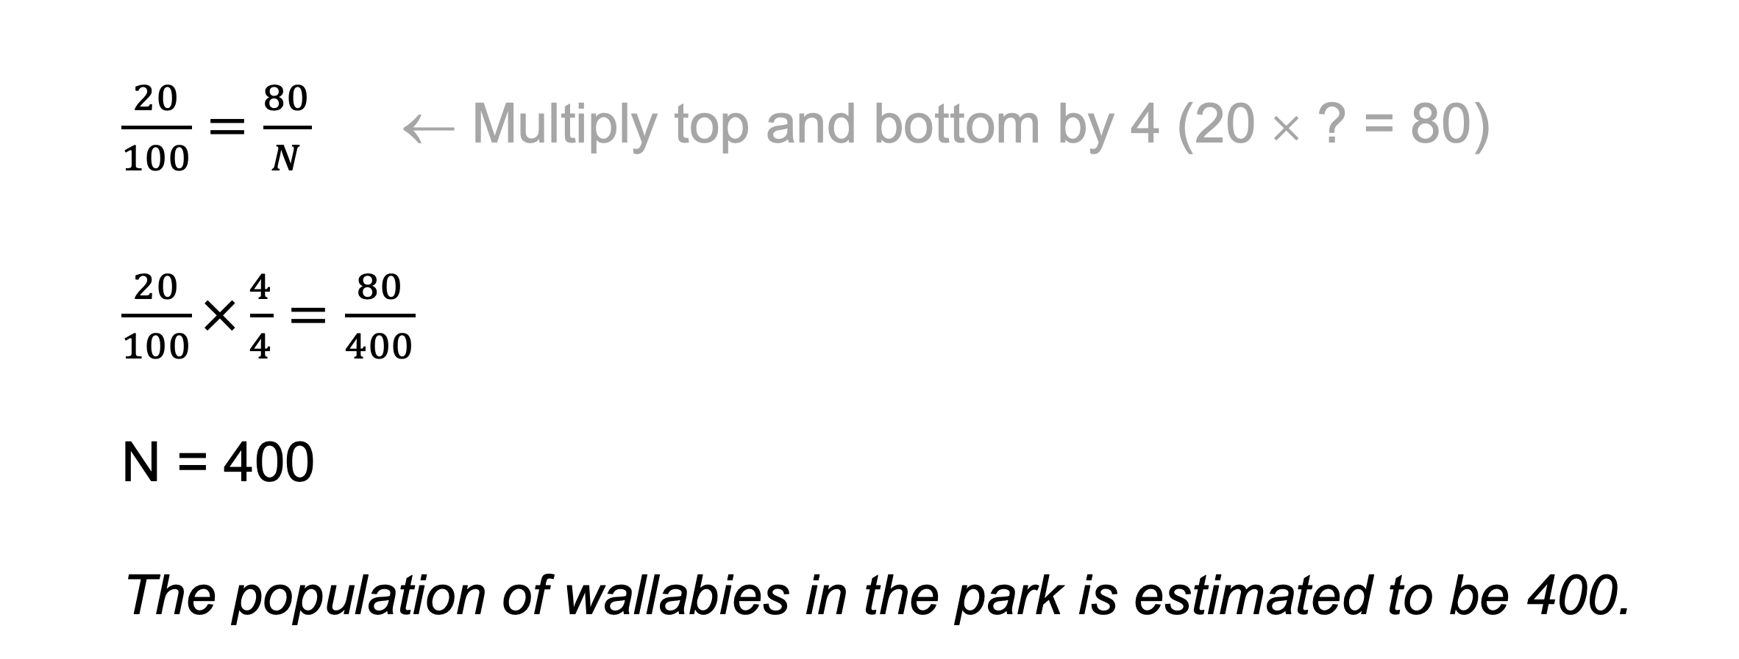
Workbook
page
CAPTURE RECAPTURE
27
Worked example.
Wildlife rangers catch and tag 80 wallabies in a park. A week later, they catch 100 wallabies and see that 20 of them are tagged.
Estimate the population of Wallabies in the park.
$\frac{20}{100}=\frac{80}{N}$ ← Multiply top and bottom by 4 (20 × ? = 80)
$\frac{20}{100}×\frac{4}{4}=\frac{80}{400}$
N = 400
The population of wallabies in the park is estimated to be 400.

Slide 10
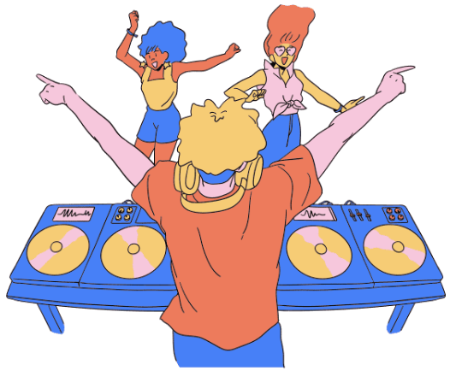
Workbook
page
CAPTURE RECAPTURE
27
With your teacher.
Festival organisers want to know how many underage teenagers are sneaking into Party in the Paddock.
On day one of the festival, security capture 600 underage teenagers, stamp their foreheads with an invisible UV symbol, and release them back into the crowd.
On day two they capture 500 underage teens, and 120 of them have the UV stamp from day 1.
Estimate the number of underage teenagers who attended the festival.

Slide 11
Workbook
page
CAPTURE RECAPTURE
28
Try it yourself.
Complete the ‘try it yourself’ questions on page 28 of your workbook.

Slide 12
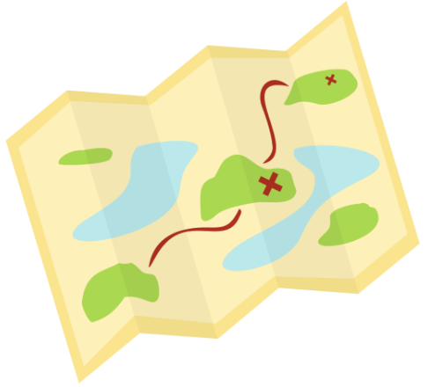
Workbook
page
SCALE DRAWINGS
28
Worked example.
A map shows a scale of 1:50,000. On the map, two towns are 4cm apart. How far apart are they in real life?
1:50,000 means 1cm on the map = 50,000cm in real life.
4cm on the map → 4 × 50,000cm = 200,000cm
200,000cm = 2km (200,000cm ÷ 100 = 2,000m → 2,000m ÷ 1,000 = 2km)
The towns are 2km apart.

Slide 13
Workbook
page
SCALE DRAWINGS
29
With your teacher.
1. A house plan has a scale of 1:100. On the plan, the living room measures 6cm by 4cm.
Find the actual dimensions and area of the living room.

Slide 14
Workbook
page
SCALE DRAWINGS
29
With your teacher.
2. A culture mapping project shows part of the NW Tasmanian coast, including Preminghana, an important site for the Palawa people. The scale is 1:50,000. The distance between Preminghana and a nearby marked campsite measures 6 cm on the map.
Calculate the distance between these sites in kms.

Slide 15
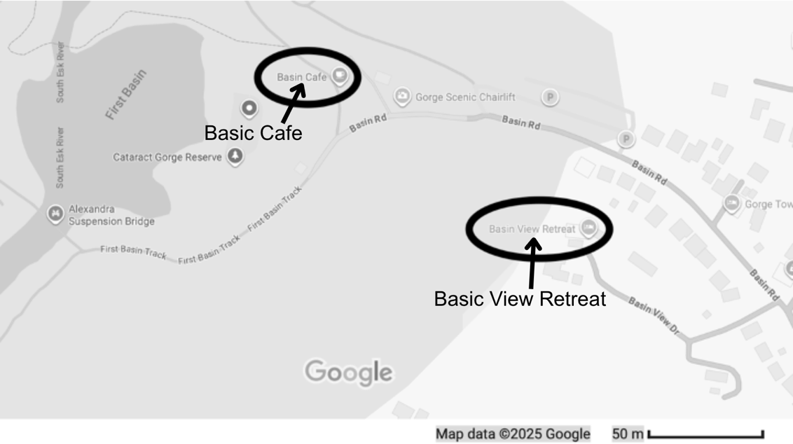
Workbook
page
SCALE DRAWINGS
29
With your teacher.
3. Daniel is a marketing guru who has been tasked with advertising for the Basin View Retreat accommodation near the Cataract Gorge in Launceston. As part of his marketing campaign, he wants to include how close the retreat is to the Basin Café at the Gorge.
He looks at the map on Google
Maps, the scale is in the bottom
corner.

Slide 16
Workbook
page
SCALE DRAWINGS
29
With your teacher.
How far is the Basin View Retreat from the Basin Café directly?
How far are they apart if visitors
need to stay on the road?

Slide 17
Workbook
page
SCALE DRAWINGS
30
Try it yourself.
Complete the ‘try it yourself’ questions on page 30 of your workbook.

Slide 18
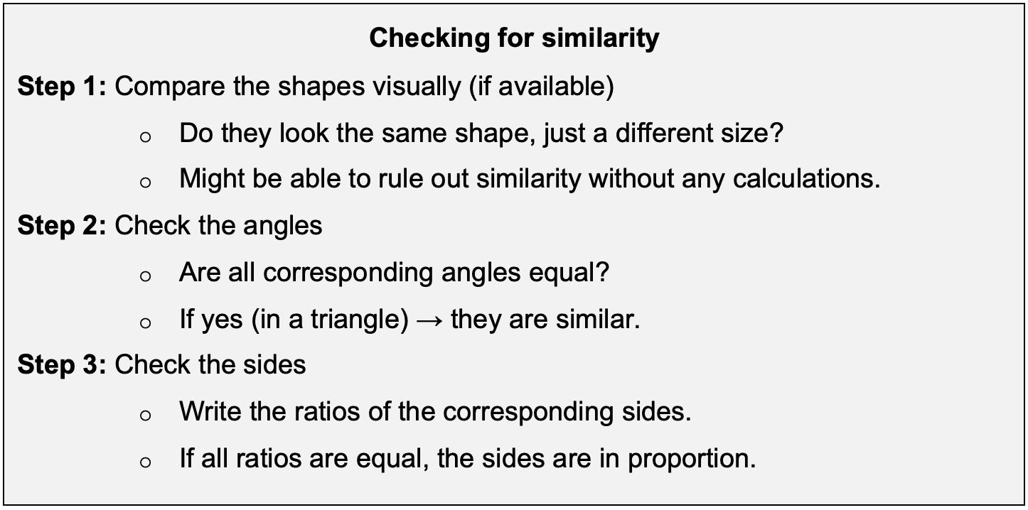
Workbook
page
SIMILARITY
31

Slide 19
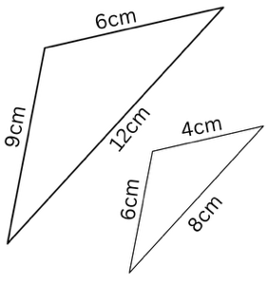
Workbook
page
SIMILARITY
31
Worked example.
Triangle A has sides of 4cm, 6cm, and 8cm.
Triangle B has sides 6cm, 9cm, and 12cm.
Are the triangles similar?
Step 1: Compare the shapes visually.
They look possibly similar.
Step 2: Check the angles
Not available for this question. Does not confirm nor rule out similarity.

Slide 20
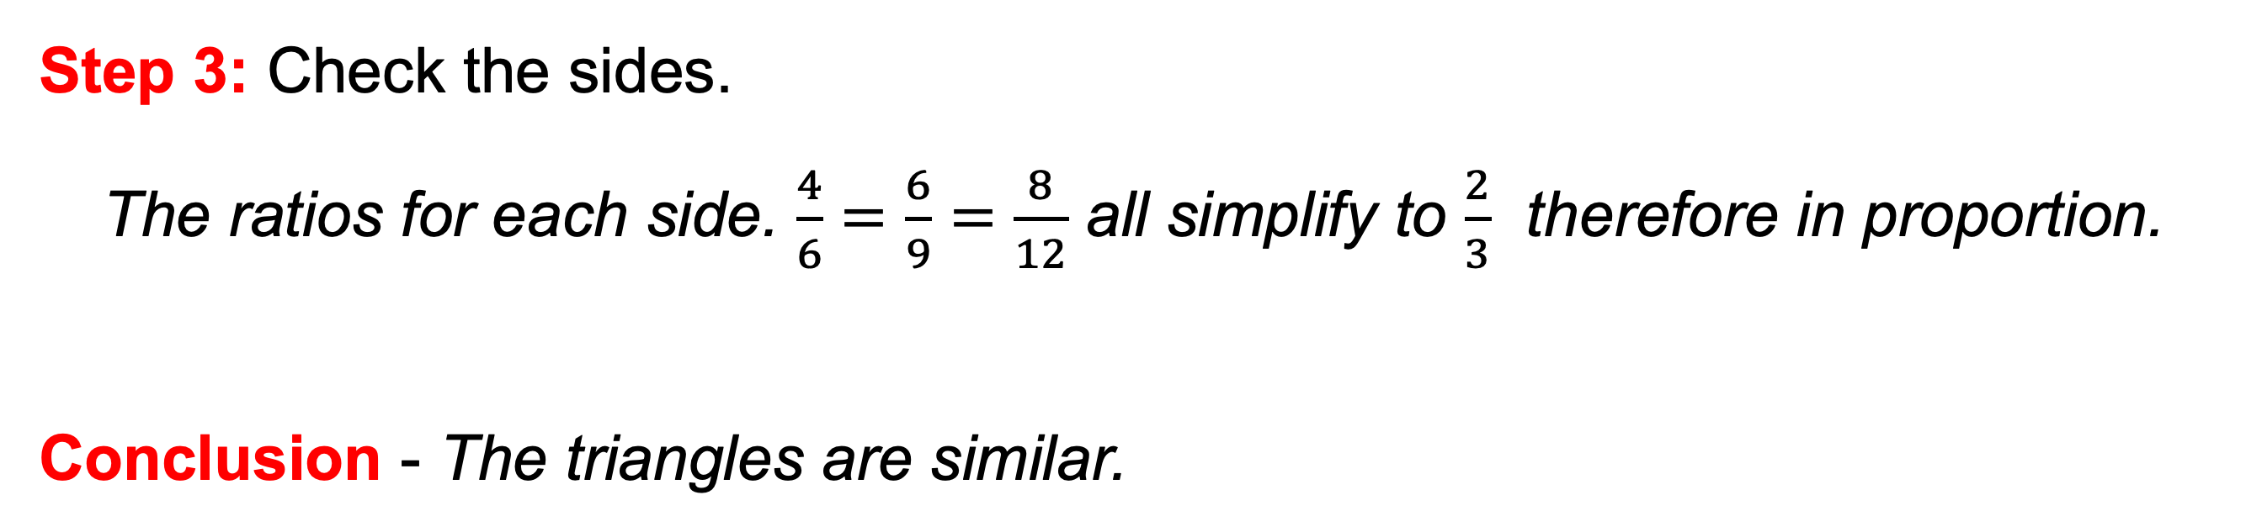
Workbook
page
SIMILARITY
31
Worked example.
Triangle A has sides of 4cm, 6cm, and 8cm.
Triangle B has sides 6cm, 9cm, and 12cm.
Are the triangles similar?
Step 3: Check the sides.
The ratios for each side. $\frac{4}{6}=\frac{6}{9}=\frac{8}{12}$ all simplify to $\frac{2}{3}$ therefore in proportion.
Conclusion - The triangles are similar.

Slide 21
Workbook
page
SIMILARITY
32
With your teacher.
1. Triangle P has angles 40°, 70°, 70°. Triangle Q has angles 40°, 70°, 70°, but different side lengths. Are the triangles similar?

Slide 22
Workbook
page
SIMILARITY
32
With your teacher.
2. Two similar triangles have sides in the ratio 2:3. In the smaller triangle, a side is 10 cm. Find the corresponding side in the larger triangle.

Slide 23
Workbook
page
SIMILARITY
32
With your teacher.
3. On a photo of a building, the height measures 8cm. In real life, the building is 20m tall. A tree next to the building measures 6 cm on the photo. How tall is the tree in real life?

Slide 24
Workbook
page
SIMILARITY
32
Try it yourself.
Complete the ‘try it yourself’ questions on page 32 of your workbook.

Slide 25
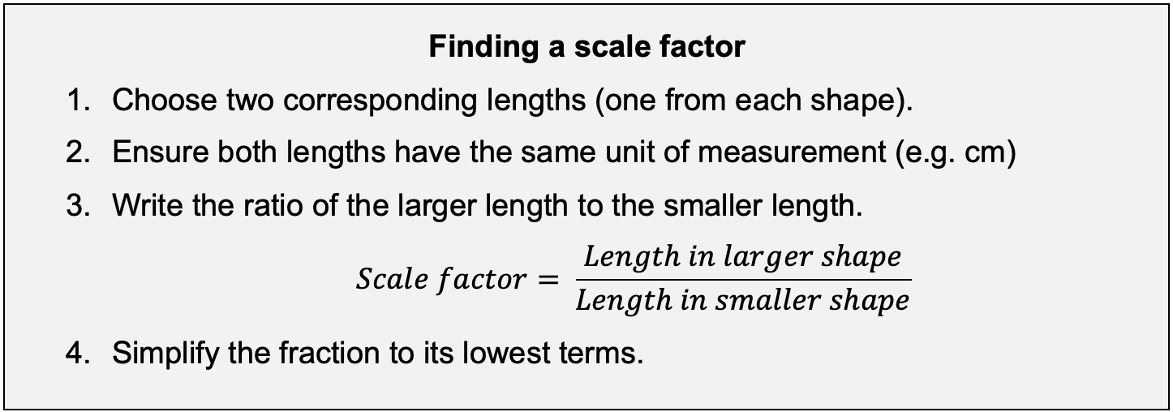
Workbook
page
SCALE FACTOR
33

Slide 26
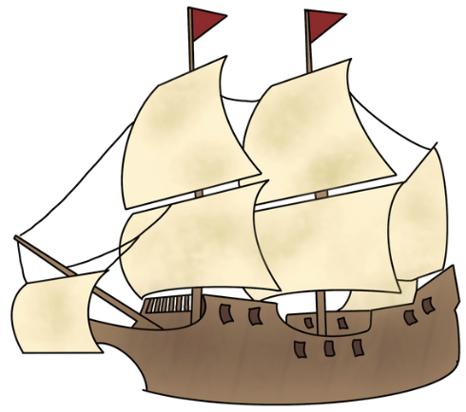
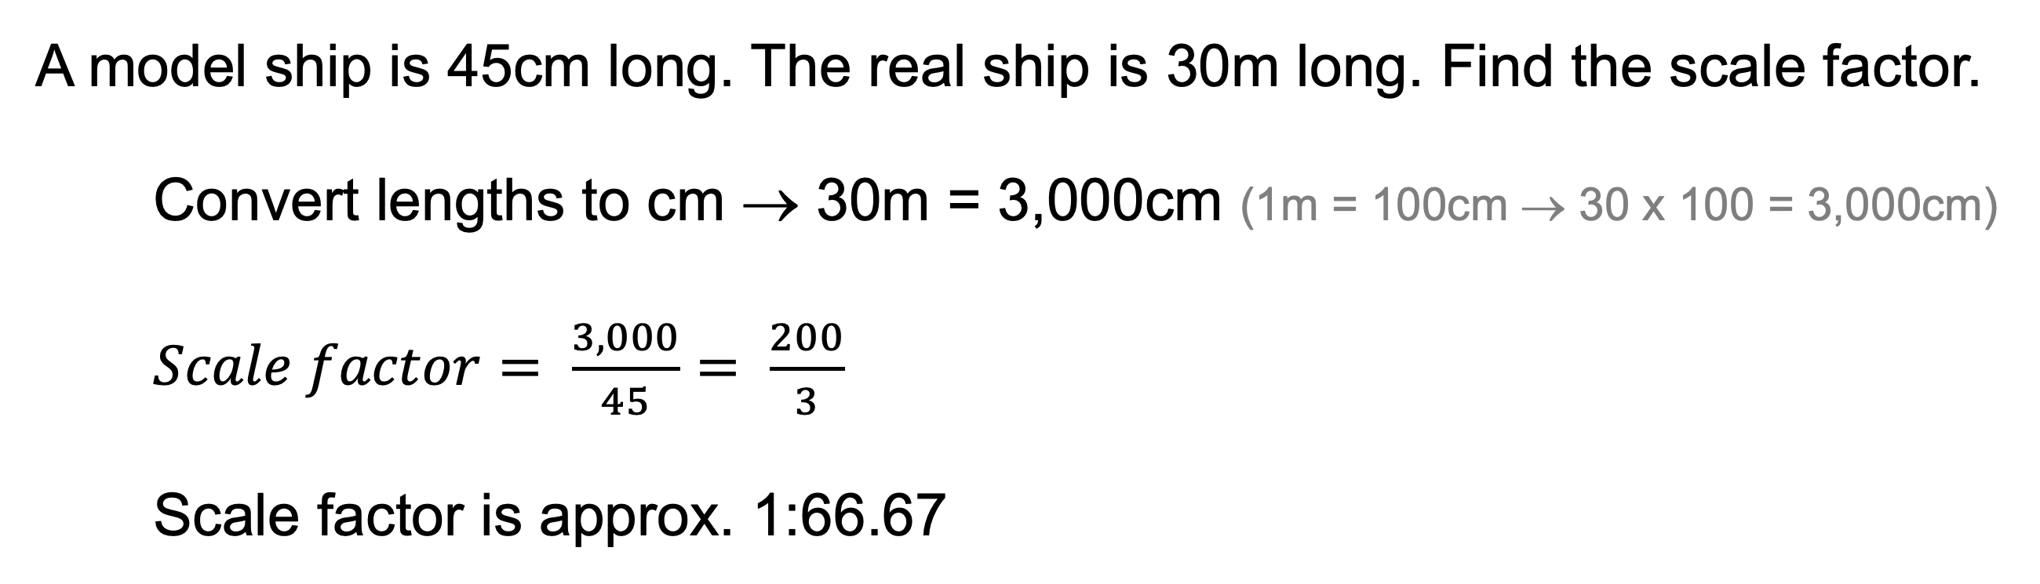
Workbook
page
SCALE FACTOR
33
Worked example.
A model ship is 45cm long. The real ship is 30m long. Find the scale factor.
Convert lengths to cm → 30m = 3,000cm (1m = 100cm → 30 x 100 = 3,000cm)
$Scale factor= \frac{3,000}{45}= \frac{200}{3}$
Scale factor is approx. 1:66.67

Slide 27
Workbook
page
SCALE FACTOR
33
With your teacher.
1. A photo is 12cm wide, it is enlarged to 30cm wide. Find the scale factor.
2. A model house is 25cm tall. The real house is 5m tall. Find the scale factor.

Slide 28
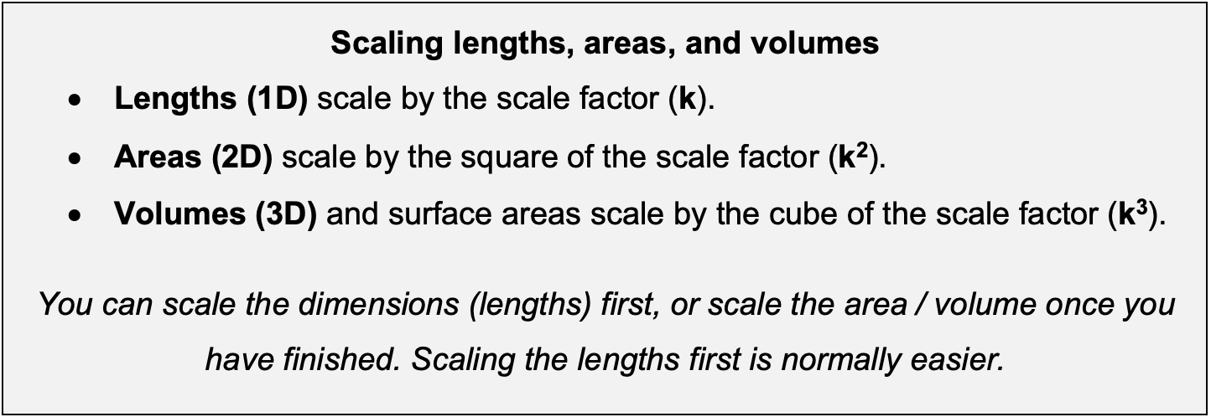
Workbook
page
SCALE FACTOR
34
Scaling lengths, areas, and volumes

Slide 29

Workbook
page
SCALE FACTOR
34
Worked example.
On a map, a rectangular park measures 3cm by 5cm. The map is drawn to a scale of 1:2000. What is the real area of the park?
Option 1 – Scale the dimensions
Map dimensions = 3cm x 5cm
Scale by multiplying by 2,000
Dimensions = 6,000cm x 10,000cm
Convert from cm to m
Dimensions = 60m x 100m
Find the area
Area = L x W
Area = 60m x 100m
Area = 6,000m²

Slide 30
Workbook
page
SCALE FACTOR
34
Worked example.
On a map, a rectangular park measures 3cm by 5cm. The map is drawn to a scale of 1:2000. What is the real area of the park?
Option 2 – Scale the area
Find the area
Area = L x W
Area = 3cm x 5cm
Area = 15cm²
Scale by multiplying by 2,000²
15 x 2,000² = 60,000,000cm²
Convert to m² (divide by 100²)
60,000,000cm² ÷ 100² = 6,000m²
Area = 6,000m²

Slide 31
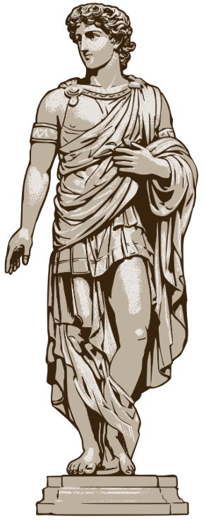
Workbook
page
SCALE FACTOR
34
With your teacher.
A small souvenir model of a statue is built at 1:20 scale. The surface area of the model is 200 cm². Estimate the surface area of the full-sized statue.

Slide 32

Workbook
page
SCALE FACTOR
35
With your teacher.
A manufacturer makes a prototype cylindrical water tank with a volume
of 50 litres. The full-size tank is built at 4 times the size in every dimension.
Find the volume of the full-size tank.

Slide 33
Workbook
page
SCALE FACTOR
35
Try it yourself.
Complete the ‘try it yourself’ questions on page 35 and 36 of your workbook.

